Slide 1
FIELD OPERATIONS MANAGEMENT SYSTEM
Supervisor Location Monitoring &
Bike Conveyance Management System
Complete Visual Walkthrough: User Login, Duty Workflow & Full Admin Access Control (A to Z)
📍 Live GPS Tracking
Anti-drift breadcrumbs & speed sanity filtering
📸 AI Odometer OCR
Live camera dial scan with auto numeric extraction
🛡️ Hardware Security
Developer options block & mock location rejection
📊 1-Click Conveyance
Day-wise attendance & Excel payroll automation
GeoConvey • Supervisor Location Monitoring & Bike Conveyance System | Confidential | Slide 1 of 16

Slide 2
EXECUTIVE SUMMARY & OPERATIONAL ROI
The Business Problem vs. The GeoConvey Solution
❌ Legacy Field Operations Pain Points
• Inflated Odometer Claims: Supervisors manually write inflated mileage with zero visual proof.
• Ghost Site Visits: Supervisors claim presence on sites they never visited or arrive hours late.
• Mock Location Apps: Staff use Fake GPS joysticks to simulate movement from home.
• Manual Billing Arguments: Accounts spends days debating handwritten logbooks and receipts.
• Zero Field Visibility: Management has zero real-time map tracking during active duty hours.
✅ The GeoConvey Solution
• AI Odometer Dial OCR: Camera-only snap of bike dial; auto-extracts digits with supervisor confirmation.
• Live Geo-Tagged Selfies: Mandatory start/end front camera photos embedded with GPS & timestamps.
• Developer Mode Lockdown: Automated hardware detection kills duty if Developer Options are enabled.
• Smart Variance Engine: Cross-checks GPS vs Odometer; flags discrepancies over 15% for audit.
• Supervisor In-App Calendar: Supervisors see their own approved KM & conveyance ₹ daily on mobile.
GeoConvey • Supervisor Location Monitoring & Bike Conveyance System | Confidential | Slide 2 of 16

Slide 3
ROLE-BASED ACCESS CONTROL (RBAC)
System Access Hierarchy: Supervisor vs. Administrator
📱 Supervisor Access Scope (Mobile App)
• Login Authentication: Login via unique Employee ID and secure password/PIN.
• Start Duty Execution: Live selfie capture + Bike odometer OCR scanning + GPS fix.
• Active Duty Tracking: Live distance counter, elapsed time, current conveyance estimate.
• End Duty Submission: Closing selfie + End odometer OCR scan + Duty summary submission.
• Personal Attendance Calendar: View own monthly calendar (P, WO, Today, A) and approved bike run KM.
• Personal History & Profile: View past completed duty sessions and change login password.
• In-App Updates: 1-tap APK downloader and installer without Play Store account.
💻 Administrator Access Scope (Web Portal)
• Real-Time Fleet Map: Full live map tracking of all supervisors with telemetry and status.
• Session Audit & Verification: Side-by-side photo inspection, route playback, and 1-click Approve/Reject.
• Company Attendance Register: Full monthly 1-31 attendance grid (P, WO, A) with 1-click Excel export.
• Conveyance Payroll Register: Day-wise approved KM, per-KM rates, total payouts in Excel (.xlsx).
• Supervisor Management: Create/edit supervisor profiles, assign bike numbers and conveyance rates (₹/KM).
• Security & Audit Trails: Inspect Developer Mode violations, mock GPS attempts, and audit logs.
• App Version Control: Publish new APK updates and configure mandatory update thresholds.
GeoConvey • Supervisor Location Monitoring & Bike Conveyance System | Confidential | Slide 3 of 16

Slide 4
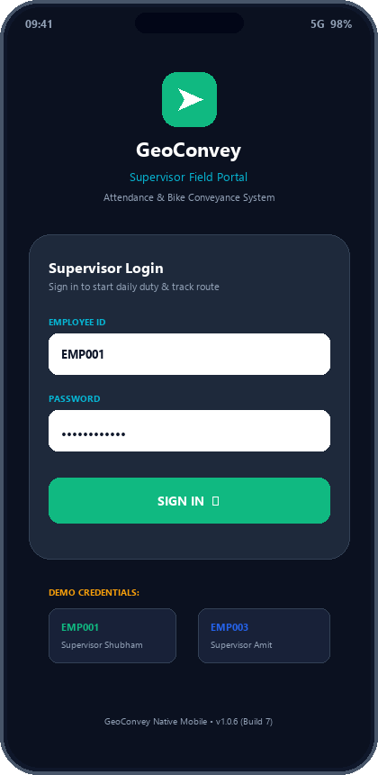
STEP 1: SUPERVISOR AUTHENTICATION
Screen 1: Supervisor Mobile Login & Device Security
📱 What the Supervisor Sees on Mobile
• Employee ID & Password Entry: Supervisors sign in with their unique employee credentials assigned by HR/Admin.
• Cloud Server Discovery: Automatically connects to live production cloud backend (https://supervisor-api-vvba.onrender.com).
• Single-Device Session Binding: Encrypted JWT auth tokens prevent concurrent logins from unauthorized third-party devices.
• Offline Credential Cache: Credentials securely encrypted on device to allow field operation even if network is temporarily down.
🛡️ Behind-the-Scenes Security Pre-Check
• App Version Validation: Checks if installed APK is up-to-date; alerts user if a newer build is required.
• Developer Options Interception: Instant native check ensures Developer Mode is disabled before granting duty access.
GeoConvey • Supervisor Location Monitoring & Bike Conveyance System | Confidential | Slide 4 of 16

Slide 5
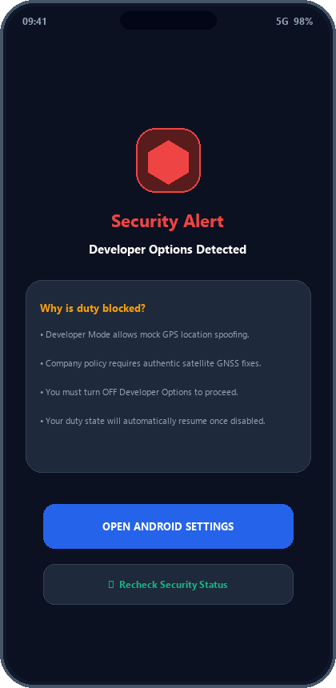
ANTI-SPOOFING & FAKE GPS SHIELD
Screen 2: Hardware-Level Security Wall (Developer Mode Block)
🚫 Zero-Tolerance Mock GPS Policy
• Why Developer Options are Blocked: Developer Options in Android allow apps like 'Fake GPS Joystick' to inject fake coordinates.
• Immediate Duty Killswitch: If a supervisor enables Developer Options while On Duty, tracking halts immediately to protect company records.
• Unbypassable Full-Screen Guard: The app will NOT allow starting duty or accumulating distance until Developer Mode is turned off.
• One-Tap Settings Deep Link: The 'Open Android Settings' button takes the user directly to the toggle switch on their phone.
• Instant Auto-Resume: Tapping 'Recheck Security Status' verifies the toggle is OFF and unlocks the app in 1 second.
💡 Business Value to Management
Guarantees that 100% of recorded conveyance claims originate from real physical travel on the road, completely eliminating digital GPS spoofing fraud.
GeoConvey • Supervisor Location Monitoring & Bike Conveyance System | Confidential | Slide 5 of 16

Slide 6
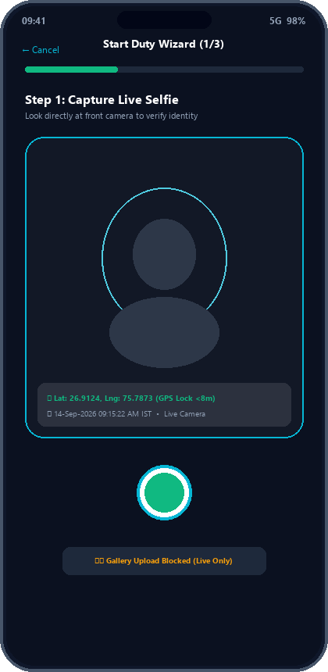
STEP 2: MORNING DUTY KICKOFF (PART 1)
Screen 3: Start Duty Wizard – Mandatory Live Selfie
📸 Live Front Camera Selfie Verification
• Physical Presence Verification: Confirms that the actual assigned supervisor is present at the duty start point.
• Gallery Upload Strictly Prohibited: The app bypasses file managers and album selection. Only live camera captures are accepted.
• Cryptographic Watermark: Latitude, longitude, accuracy radius, and exact timestamp (IST) are stamped into image metadata.
• Face Alignment Guide: An on-screen oval guide helps the supervisor align their face for clear, audit-ready photos.
• Cloudinary Encrypted Upload: Photos are compressed, optimized, and uploaded to secure cloud storage for instant Admin review.
🛡️ Anti-Proxy Guarantee
Supervisors cannot ask a friend or family member to clock in on their behalf. The photo is compared side-by-side in the Admin Audit console.
GeoConvey • Supervisor Location Monitoring & Bike Conveyance System | Confidential | Slide 6 of 16

Slide 7
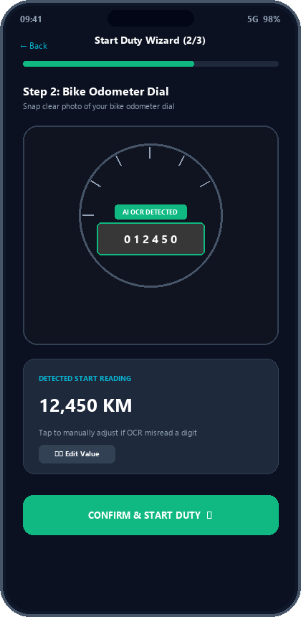
STEP 2: MORNING DUTY KICKOFF (PART 2)
Screen 4: Start Duty Wizard – Bike Odometer AI OCR Scan
🔍 AI OCR Odometer Dial Recognition
• Direct Rear Camera Capture: Supervisors photograph their bike speedometer/odometer meter dial.
• Automated Digit Extraction: Computer vision OCR algorithm scans mechanical drum dials and digital LCDs to read kilometers.
• Instant Confirmation with Edit: Detected reading (e.g. 12,450 KM) is shown with a manual edit option for glare or dirty dials.
• Logical Mileage Consistency: Start odometer must be >= previous session's closing odometer, catching odometer rollbacks.
• High-Precision GNSS Fix: The phone acquires authentic satellite GPS coordinates (<20m threshold) before duty begins.
⚡ What Happens Upon Confirmation
Duty status flips to ON DUTY. Background GPS service starts. Admin Live Map marker immediately turns GREEN and displays the supervisor active in the field.
GeoConvey • Supervisor Location Monitoring & Bike Conveyance System | Confidential | Slide 7 of 16

Slide 8
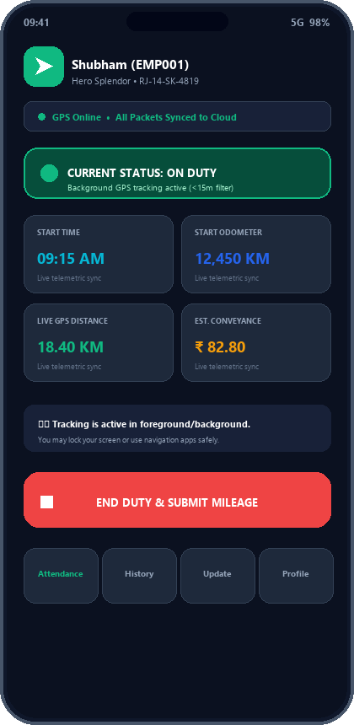
STEP 3: CONTINUOUS FIELD OPERATIONS
Screen 5: Active 'ON DUTY' Live Tracking Dashboard
🟢 Real-Time Field Telemetry Dashboard
• Live Duty Status Beacon: Prominent green pulsing indicator shows tracking is active and operating.
• Running GPS Distance: Live calculation of kilometers traveled today (e.g. 18.40 KM), updating automatically.
• Estimated Conveyance (₹): Real-time earnings counter based on supervisor's per-KM rate (e.g. ₹82.80).
• Android Foreground Service: Persistent notification tray keeps GPS active even if app is minimized or screen locked.
• Smart Battery Optimization: Movement delta (>15m) pauses GPS polling when supervisor is stationary, saving battery.
• Offline Local Buffer: If mobile network drops in basements or rural areas, breadcrumbs buffer locally in SQLite.
🏁 Ending Duty (The Red Button)
When the supervisor finishes work, tapping 'END DUTY' triggers the closing wizard: End Selfie + End Odometer OCR. The system automatically computes total travel distance and submits the session for Admin audit.
GeoConvey • Supervisor Location Monitoring & Bike Conveyance System | Confidential | Slide 8 of 16

Slide 9
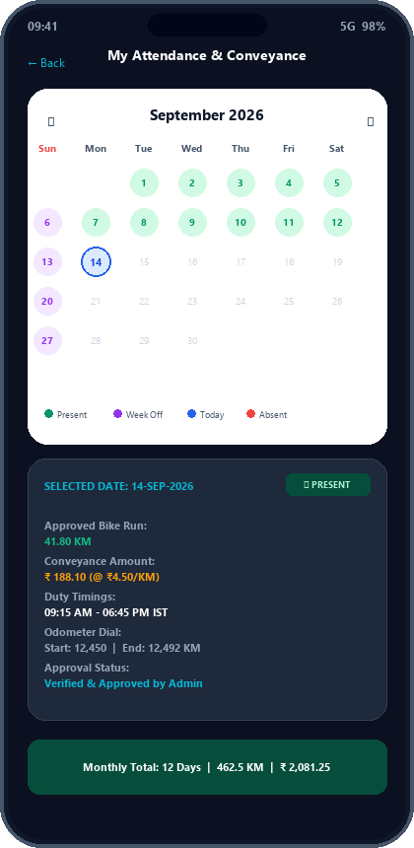
STEP 4: EMPLOYEE SELF-SERVICE & TRANSPARENCY
Screen 6: Supervisor In-App Attendance & Bike Run Calendar
📅 Mobile Attendance Calendar & Day-Wise Bike Run
• Clean Calendar Layout: Follows company HR standard calendar styling with month & year navigation.
• Color-Coded Status Badges: 🟢 Present (Duty logged) | 🟣 Week Off (Sundays) | 🔵 Today | 🔴 Absent.
• Day-Wise Bike Run Drilldown: Tapping any day reveals exact approved kilometers run (e.g. 41.80 KM).
• Conveyance Reimbursement Calculation: Calculates exact daily conveyance earned (e.g. ₹ 188.10 @ ₹4.50/KM).
• Odometer & Duty Time Audit: Shows duty start/end time in IST and odometer start/end numbers for physical proof.
• Monthly Running Total Bar: Total Present Days, Week Offs, Total Approved KM, and Total Conveyance ₹.
• Zero Dispute Guarantee: Supervisors have 100% daily visibility into their approved earnings before payroll cutoff.
⭐ Why Field Supervisors Love This Feature
No more guessing or manual diary entries. Every single kilometer and rupee is transparently verified, building immense trust between field staff and management.
GeoConvey • Supervisor Location Monitoring & Bike Conveyance System | Confidential | Slide 9 of 16

Slide 10
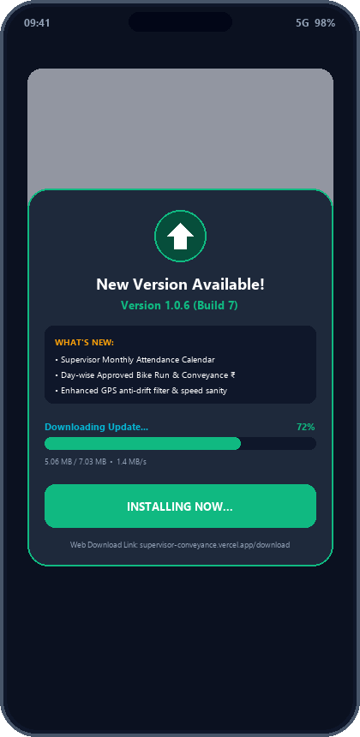
STEP 5: FIELD MAINTENANCE & LIFECYCLE
Screen 7: Zero-Friction In-App APK Auto-Update System
🚀 In-App Direct APK Downloader (No Google Play Needed)
• Automated Version Polling: Client queries cloud API on launch. If a higher versionCode is detected, an update pill illuminates.
• In-App Byte Streaming: Downloads the release APK directly within the app, displaying live percentage and MB progress.
• One-Tap Native Installation: Invokes Android Package Installer with secure FileProvider intents for instant installation.
• Changelog Display: Supervisors read what's new (e.g. Attendance calendar, GPS performance improvements).
• Fallback Web Portal: New supervisors can download the APK anytime from https://supervisor-conveyance.vercel.app/download.
🛠️ IT Overhead Reduced to Zero
No need to manage Google Play Console review delays or collect physical phones. Feature updates deploy seamlessly to 500+ field supervisors simultaneously.
GeoConvey • Supervisor Location Monitoring & Bike Conveyance System | Confidential | Slide 10 of 16

Slide 11
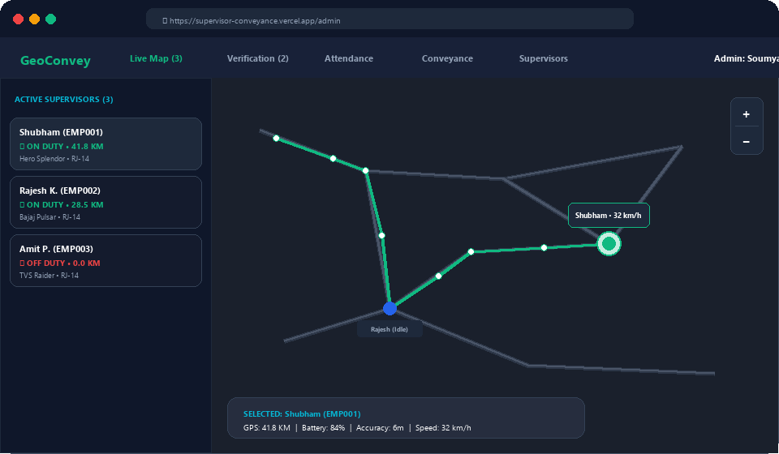
ADMIN ACCESS: REAL-TIME WORKFORCE VISIBILITY
Screen 8: Administrator Live Fleet Monitoring Center
🗺️ Operations Room Capabilities
Interactive GIS Map: OpenStreetMap / Leaflet live view showing real-time markers for all active supervisors.
Status Badges: 🟢 On Duty (Active Tracking)
🔴 Off Duty (Duty Finished)
🟡 Idle / Stationary
Live Breadcrumb Trail: Visual polyline of road route traveled so far with start flag and movement direction.
Telemetry Drawer: Displays supervisor speed (e.g. 32 km/h), battery % (84%), GPS accuracy (6m), and distance.
Branch Filtering: Filter supervisors by city depot, zone, or operational territory with instant search.
GeoConvey • Supervisor Location Monitoring & Bike Conveyance System | Confidential | Slide 11 of 16

Slide 12
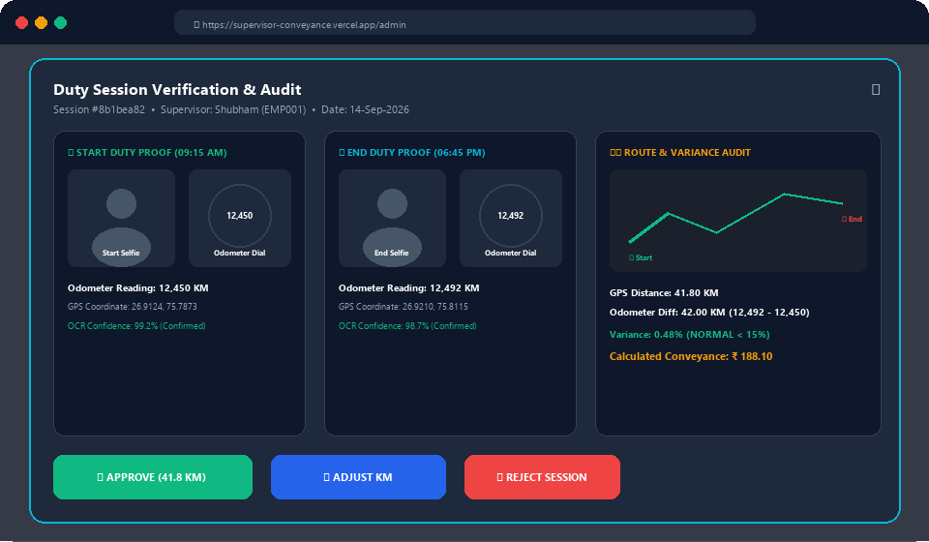
ADMIN ACCESS: 1-CLICK VERIFICATION & FRAUD AUDIT
Screen 9: Duty Session Verification & Audit Modal
🔍 Side-by-Side Audit Evidence
Photographic Proofs: Side-by-side Start & End Selfies to verify driver identity; Start & End Odometer photos to verify meter dial.
AI OCR vs GPS Cross-Check: Odometer Distance: 42.0 KM
GPS Distance: 41.8 KM
Variance: 0.48% (NORMAL < 15%)
Interactive Route Playback: Displays start flag, breadcrumbs along real roads, and finish location.
1-Click Approval: Approve full GPS distance with one click.
Adjust KM or Reject: Allows distance adjustment or session rejection with mandatory audit reason comment.
GeoConvey • Supervisor Location Monitoring & Bike Conveyance System | Confidential | Slide 12 of 16

Slide 13
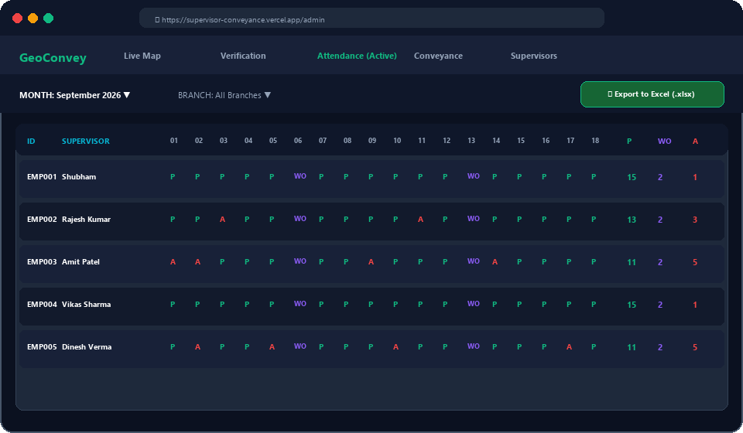
ADMIN ACCESS: HR PAYROLL AUTOMATION
Screen 10: Admin Day-Wise Attendance Register
📋 HR Attendance Automation
Company HR Format: Matches official corporate attendance registers with Day 1 to 31 columns.
Standard Status Codes: 🟢 P = Present (Duty logged)
🟣 WO = Week Off (Sundays)
🔴 A = Absent (No duty)
Automated Summary Counters: Calculates total Present, Week Offs, and Absent days automatically.
Instant Excel Download: One-click 'Export to Excel' generates a pre-formatted .xlsx spreadsheet ready for biometric HR systems.
GeoConvey • Supervisor Location Monitoring & Bike Conveyance System | Confidential | Slide 13 of 16

Slide 14
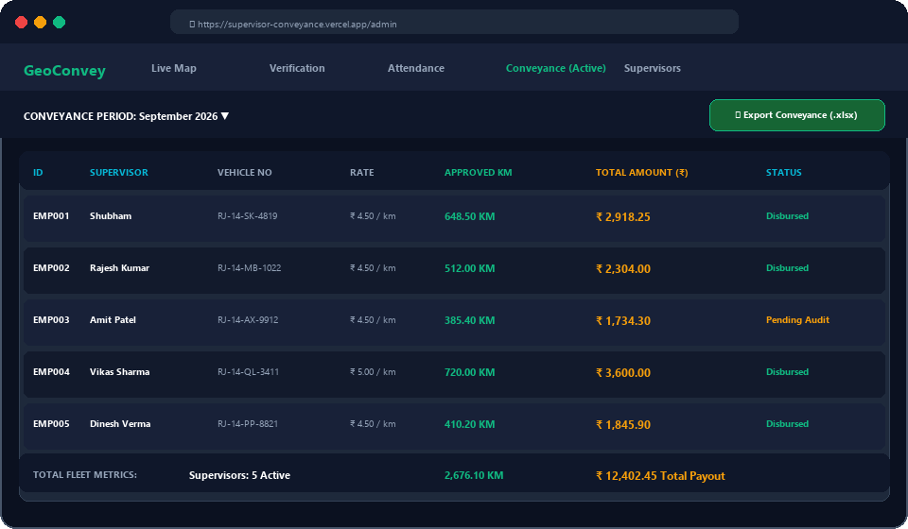
ADMIN ACCESS: FINANCE & EXPENSE DISBURSEMENT
Screen 11: Admin Monthly Conveyance Register
💰 Finance & Reimbursements
Day-by-Day Approved KM: Records daily verified kilometers run by each bike supervisor.
Configurable Rates (₹/KM): Applies individual vehicle conveyance rates (e.g. ₹4.50/KM or ₹5.00/KM).
Total Payout Calculation: Automatically computes exact monthly payout figures (e.g. ₹2,918.25).
Audit-Approved Proofs: Every rupee backed by GPS breadcrumbs and odometer dial photographs.
1-Click Accounts Excel: Exports directly to formatted Excel workbook for bank disbursement.
GeoConvey • Supervisor Location Monitoring & Bike Conveyance System | Confidential | Slide 14 of 16

Slide 15
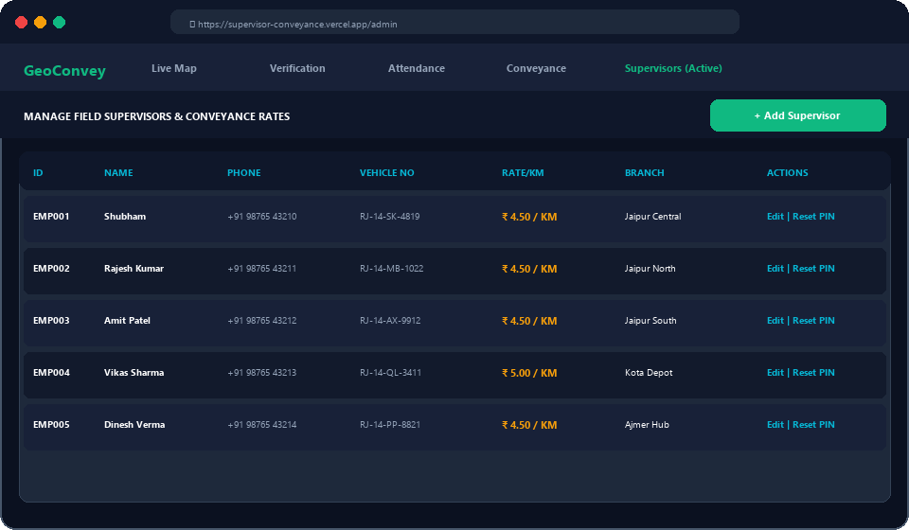
ADMIN ACCESS: WORKFORCE CONFIGURATION
Screen 12: Admin Supervisor Management & Rate Control
⚙️ Workforce Administration
Add New Supervisors: Admin onboards field staff with Employee ID, Full Name, Phone, and Branch.
Vehicle Assignment: Register official bike registration number (e.g. RJ-14-SK-4819).
Per-KM Conveyance Rate: Set individual per-kilometer reimbursement rate (e.g. ₹4.50 / KM).
Password & PIN Reset: Admin can reset supervisor credentials instantly if phone is changed.
Account Deactivation: Instantly revoke login access if an employee leaves the organization.
GeoConvey • Supervisor Location Monitoring & Bike Conveyance System | Confidential | Slide 15 of 16

Slide 16
FINANCIAL ROI & EXECUTIVE SIGN-OFF
Measurable Business Impact & Company Rollout
25% - 35%
Conveyance Cost Savings
Eliminates inflated mileage claims.
90%
Time Saved in Audits
1-click OCR replaces manual logbooks.
100%
Dispute-Free Settlements
Clear daily calendar visibility.
0%
Mock GPS Spoofing
Developer mode hardware blocking.
🗓️ Rapid 3-Week Implementation Roadmap
• Week 1: Pilot cohort (10-15 supervisors) across urban & rural routes.
• Week 2: Full company onboarding via direct APK link & Admin operations training.
• Week 3: Automated monthly Excel export & integration with accounts payroll.
Ready for Immediate Deployment • Live System Demo
Portal: https://supervisor-conveyance.vercel.app • Mobile APK: v1.0.6 (Build 7) Ready for Download
GeoConvey • Supervisor Location Monitoring & Bike Conveyance System | Confidential | Slide 16 of 16

