Slide 1
ENTERPRISE FIELD OPERATIONS PLATFORM
GeoConvey
Intelligent Supervisor Location Monitoring & Bike Conveyance System
Real-Time GPS Tracking • Live Selfie & Odometer Verification • Automated Statutory Audit
🛰️ Native Background GPS
Continuous tracking with screen locked and persistent service
🛡️ Dual-Verification
Prevents fraud by picking lower of GPS route vs Odometer
📊 13-Column Reports
One-click export to Excel & CSV with full statutory compliance
Live Production Deployment | Web Admin Portal + Android Native App (v1.0.3) | Genus Power Operations

Slide 2
● THE BUSINESS CHALLENGE
02 / 12
Operational Challenges in Field Supervision & Conveyance
🚨 Conveyance Claim Inflation
Manual odometer logs frequently inflated by 20–40%. Lack of actual route verification leads to large, unverified conveyance payouts across field operations.
👻 Ghost Attendance & Proxy
Supervisors marking attendance remotely without being on-site. Traditional time-clocks cannot verify physical presence at assigned geographical substations/zones.
📵 GPS Interruption on Screen Lock
Standard web tracking stops as soon as supervisors put phones in pockets or screen turns off. Results in fragmented, incomplete distance logs.
📑 Tedious Manual Report Auditing
Operations and accounts teams spending hundreds of hours every month manually cross-checking handwritten logbooks, calculators, and receipts.

Slide 3
● SYSTEM ARCHITECTURE
03 / 12
3-Tier Modern Cloud Architecture
📱 1. Supervisor Android App
Capacitor 7 + React + Native Java
• Native Android Foreground Location Service
• Partial WakeLock (Zero sleep on screen lock)
• Selfie & Bike Odometer Camera Capture
• Offline-first local tracking queue with auto-sync
• In-App APK Auto-Updater (v1.0.3)
☁️ 2. Cloud REST API & Engine
Node.js + Express + SQLite
• Geodesic Haversine Distance Engine
• Dual-Verification Lower Distance Selector
• JWT Authentication & Session Management
• Static Vercel Proxy & Render Auto-Recovery
• Data persistence & audit log recording
🖥️ 3. Admin Operations Portal
React + Vite + Leaflet OpenStreetMap
• Live Supervisor Map with Real-Time Marker
• Clean Supervisor List (Name, EMP ID, Status)
• Session Inspection (Start/End Selfies & Odo)
• 13-Column Statutory Conveyance Reports
• Single-Click Authenticated Excel & CSV Exports

Slide 4
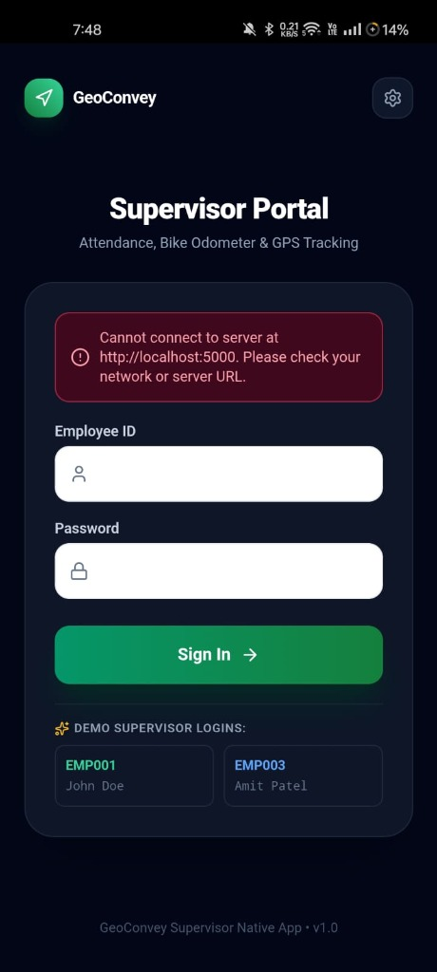
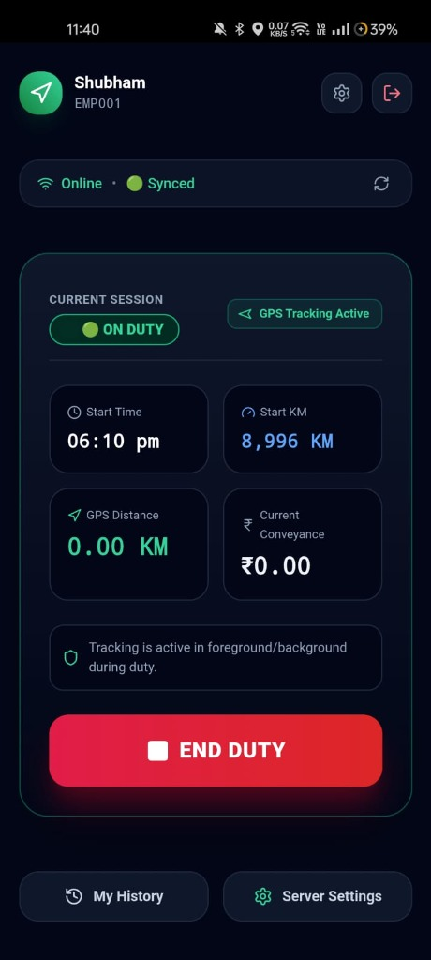
● MOBILE EXPERIENCE
04 / 12
Supervisor Mobile Application: Step-by-Step Field Journey
1. Secure Login & Auth
Supervisors authenticate with unique Employee ID & password. Single-device session protection.
2. Start Duty Wizard
Requires geotagged live attendance selfie + bike odometer capture before GPS tracking begins.
3. Live Telemetry Dashboard
Displays live duty duration, start odometer KM, recorded GPS distance, and current conveyance in ₹.
4. End Duty Verification
End-of-shift selfie and final odometer photo. Computes approved distance and generates instant summary.

Slide 5
● CORE INNOVATION
05 / 12
Continuous Background GPS: Runs With Screen Off & Phone in Pocket
🔔 Android Foreground Service
Runs LocationTrackingService as an official Android Foreground Service with type='location'. Prevents the OS from terminating tracking.
⚡ Partial WakeLock Architecture
Acquires PowerManager.PARTIAL_WAKE_LOCK to ensure the phone's CPU remains active while the phone is locked inside the rider's pocket.
📍 High-Precision Geolocation
Requests updates from GPS_PROVIDER every 5 seconds / 5 meters with speed, bearing, and accuracy validation (< 50m filter).
📶 Offline-First Queue Sync
If the supervisor travels through rural network dead zones, points are queued locally and automatically bulk-synced once back in coverage.
Sticky Android Status Bar Notification Displayed to Supervisor:
🟢 GeoConvey • Duty in Progress — Recording GPS route & bike conveyance in background

Slide 6
● CONVEYANCE LOGIC
06 / 12
Dual-Verification Engine: Fraud-Proof Distance Calculation
The Lower Distance Selection Rule
• 1. GPS Distance Tracked: Calculated via continuous geodesic coordinate path sum with Haversine formula and noise suppression.
• 2. Odometer Distance Tracked: Calculated by subtracting verified Start Odometer KM from End Odometer KM with photo proof.
• 3. Automated Selection: System compares both distances and automatically selects the LOWER of the two valid measurements.
• 4. Fraud Prevention: If odometer is inflated by 10 KM, GPS route limits claim to actual distance. If GPS loses signal, odometer protects supervisor.
• 5. Conveyance Payable: Approved Distance (KM) × Rate per KM (₹4.50/KM). Rounded and formatted to statutory 2 decimal places.
Real Live Audit Case (Example):
Supervisor Name : Shubham (EMP001)
Duty Start Time : 11:40 PM IST
Start Odometer : 8,996 KM (Photo Verified)
End Odometer : 9,024 KM (Photo Verified)
Odometer Delta : 28.00 KM
Recorded GPS Route : 26.40 KM
System Decision : 26.40 KM (Lower Valid Selected)
Approved Rate : ₹4.50 / KM (Bike)
Total Conveyance : ₹118.80 (26.40 × ₹4.50)
Audit Status : ✅ APPROVED (Ready for Payout)

Slide 7
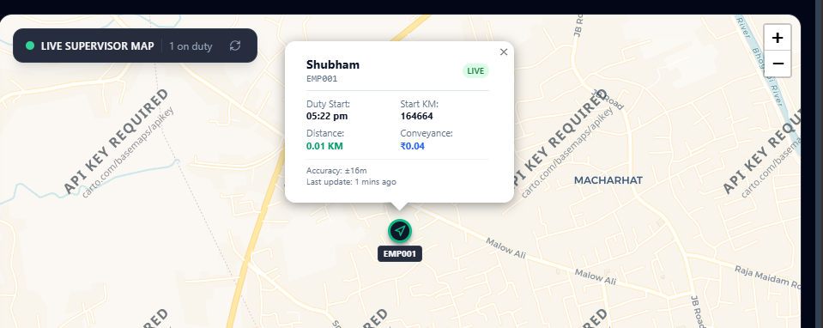
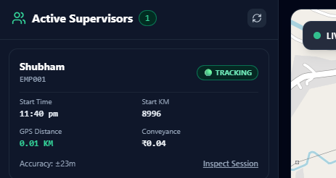
● WEB PORTAL
07 / 12
Admin Operations Portal: Real-Time Live Supervisor Map
Key Live Map Features:
• Clean Active Supervisor List displaying Supervisor Name and Employee ID.
• Real-time GPS marker updating every 8 seconds automatically with Live Auto-Sync.
• Interactive Map Pin with accuracy radius (±16m) and battery/sync status.
• 100% Free OpenStreetMap tile server — Zero API key required, zero recurring cost.
• One-click 'Inspect Session' to open full attendance and odometer modal.

Slide 8
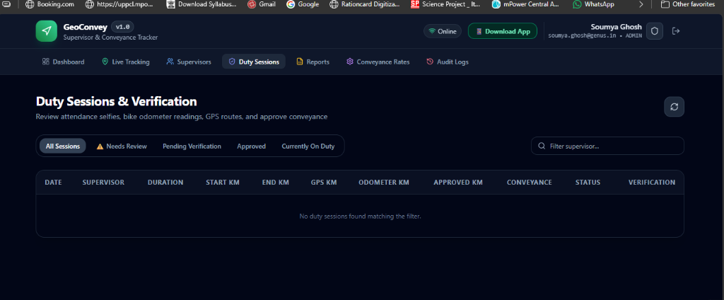
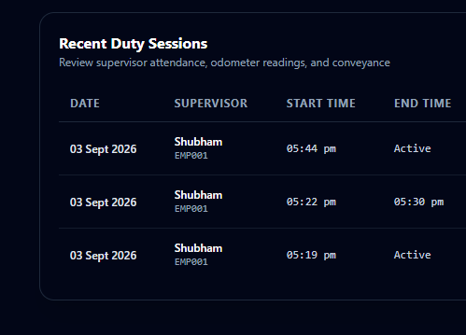
● VERIFICATION ENGINE
08 / 12
Duty Sessions & Verification: Complete Photo Audit Trail
Audit Capabilities:
• Full session table showing Date, Supervisor, Start Time, End Time, and Status.
• Inspect Modal presents Start Attendance Selfie vs End Duty Selfie.
• Odometer Reading Verification: Start Bike Photo vs End Bike Photo.
• Calculated GPS route overlay rendered on playback map.
• Admin actions: Approve Conveyance, Override Rate/KM, or Request Review.

Slide 9
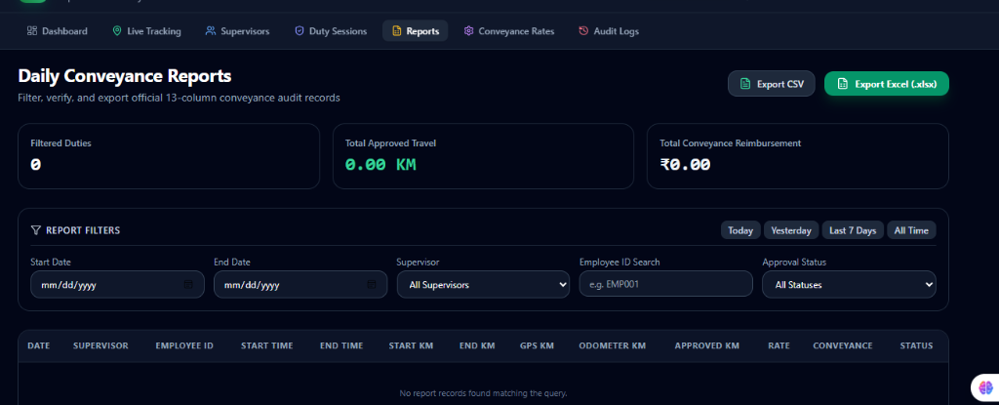
● REPORTS & ANALYTICS
09 / 12
Daily Conveyance Reports: 13-Column Statutory Audit & Export
13 Official Columns Included in Every Report:
1. Record ID • 2. Date • 3. Supervisor Name • 4. Employee ID • 5. Vehicle Type • 6. Start Time • 7. End Time 8. Start Odometer KM • 9. End Odometer KM • 10. Odometer KM • 11. GPS KM • 12. Approved KM • 13. Conveyance Amount (₹)

Slide 10
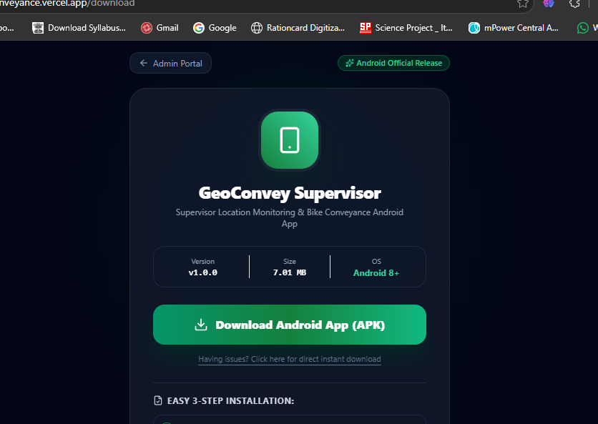
● APP MANAGEMENT
10 / 12
Application Distribution & In-App Auto-Update System
Frictionless App Delivery (v1.0.3):
• Dedicated Download Portal (/download)
Publicly accessible link with animated progress bar showing live download speed, MB transferred, and installation instructions.
• In-App Auto-Update Banner
When a new APK is deployed, active supervisors receive an update banner directly on their dashboard with zero downtime.
• In-App APK Package Downloader
Supervisors tap 'UPDATE' inside the app, watch the 0% -> 100% progress modal, and Android automatically prompts installation.
• Zero Manual File Sharing
No need to send APK files via WhatsApp or email — everything is self-updating via the cloud API.

Slide 11
● BUSINESS VALUE
11 / 12
Quantifiable Business Impact & Operational ROI
100%
Fraud Elimination
Eliminates ghost trips, manipulated odometer logs, and proxy attendance through dual-verification.
90%
Time Saved in Auditing
Operations and finance teams save 90% of processing time with instant automated 13-column reports.
₹0.00
Map Infrastructure Cost
Uses OpenStreetMap with Leaflet instead of expensive proprietary map APIs, saving recurring billing fees.
100%
Field Accountability
Live GPS tracking and breadcrumbs ensure complete visibility of supervisor coverage across substations.
Executive Takeaway:
GeoConvey transforms bike conveyance from an honor-system liability into a transparent, mathematically verified, and automated asset. It protects company financial resources while ensuring supervisors are reimbursed fairly, accurately, and without delay.

Slide 12
● DEPLOYMENT & WRAP-UP
12 / 12
Production Status, Live URLs & Next Steps
Live Production Endpoints:
Admin Operations Portal
https://supervisor-conveyance.vercel.app
Access live dashboard, map, reports & verification
Supervisor App Download
https://supervisor-conveyance.vercel.app/download
Download Android APK (v1.0.3) directly
Cloud Backend API
https://supervisor-api-vvba.onrender.com
High-performance Node.js REST API on Render cloud
Current App Release
v1.0.3 (Build 4)
Native background GPS + IST timezone synchronization
Thank You!
Questions & Demonstration
GeoConvey is live and active in production. Ready for interactive walkthrough and demonstration.

