Slide 1
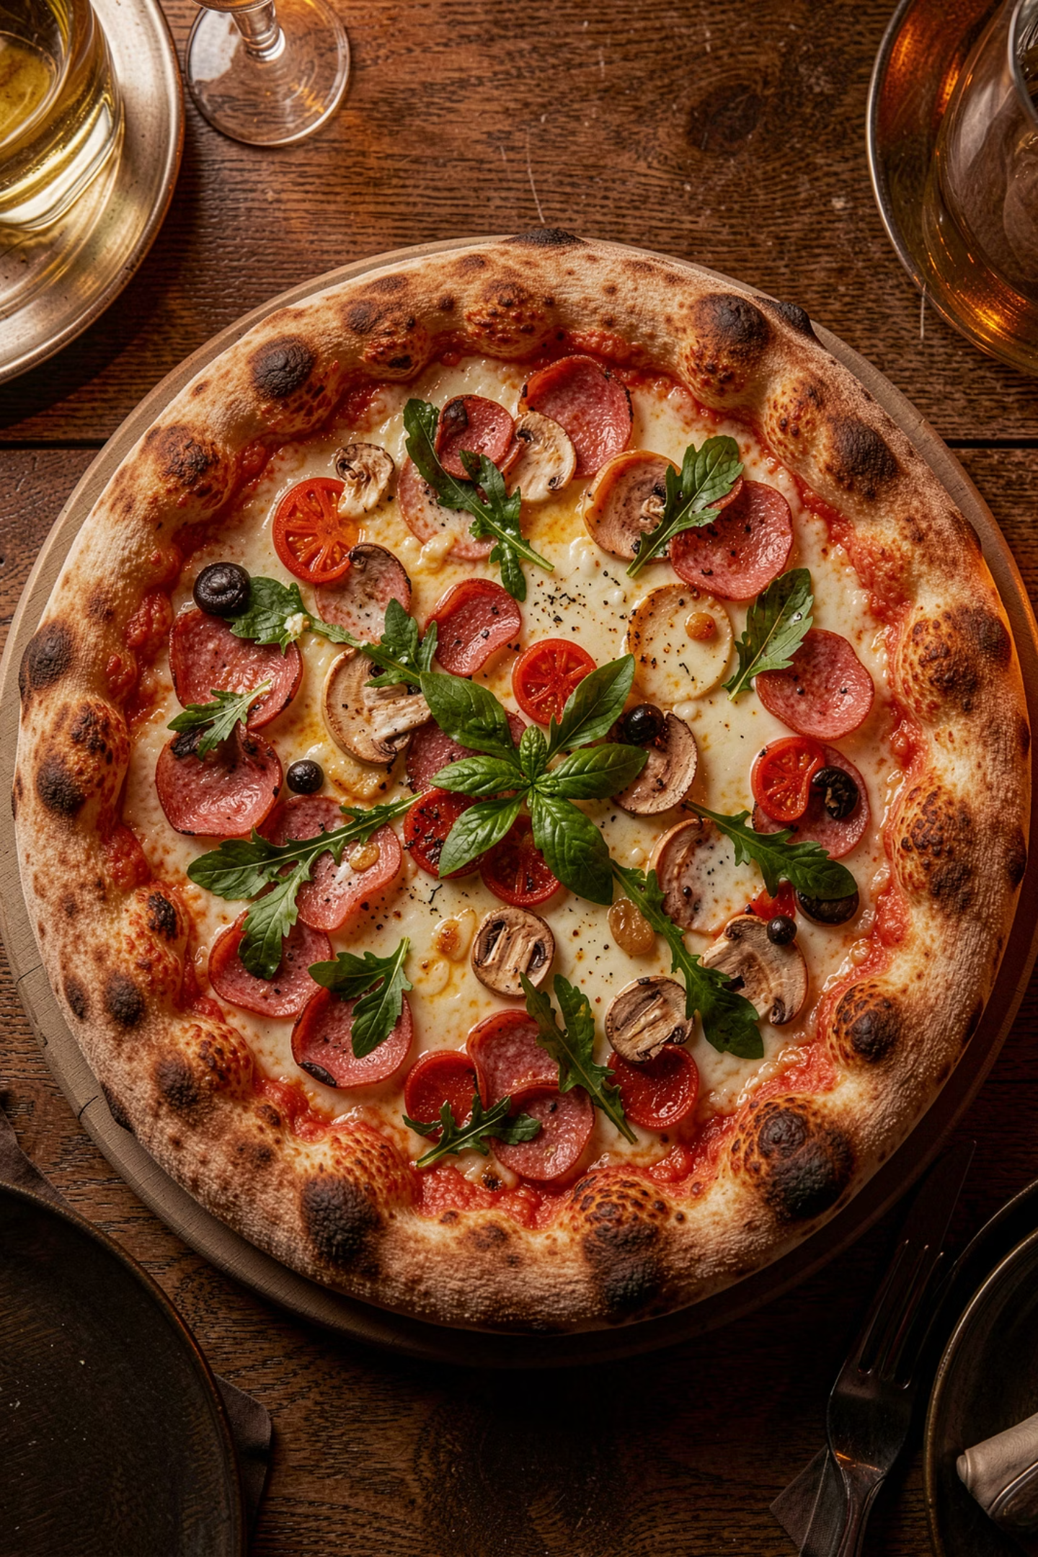
Pizza Sales Analysis Using SQL
Exploring a real-world sales dataset with MySQL to uncover customer behavior and revenue insights.
SQL · MYSQL
PIZZA SALES DATASET

Slide 2

Project Overview
Objective
Dataset Tables
Analyze sales data, generate business insights, understand ordering patterns
Orders · Order_Details · Pizzas · Pizza_Types
Tools
MySQL, JOINs, Window Functions, Aggregations

Slide 3
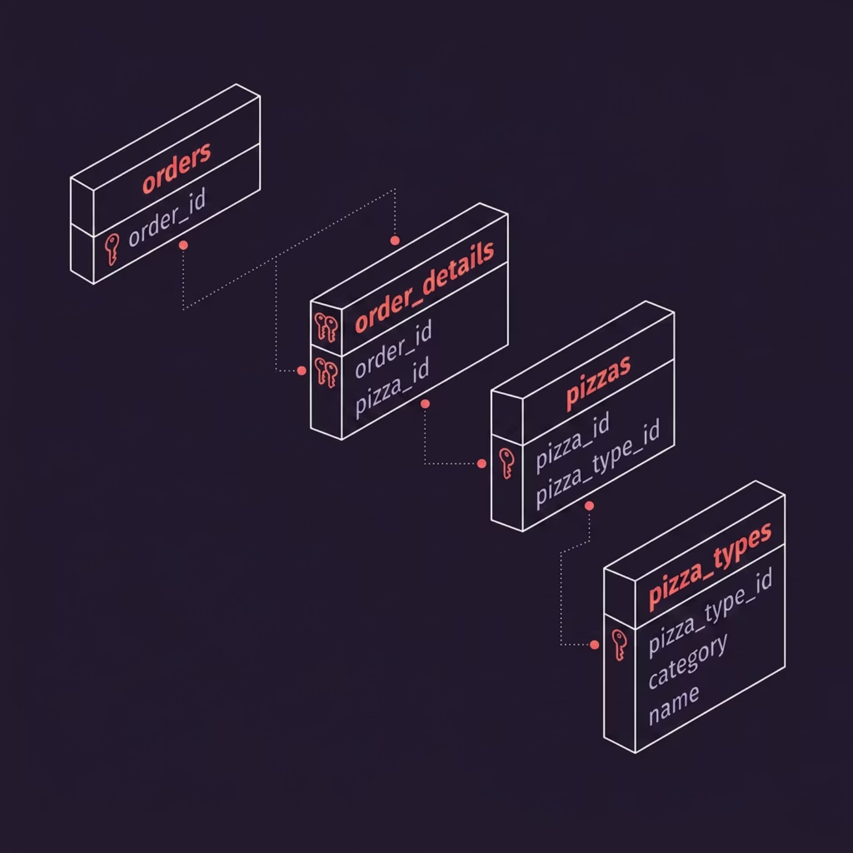
Database Schema
Four tables linked through foreign keys — from orders down to pizza categories.
orders
order_details
order_id, order_date, order_time
order_details_id, order_id, pizza_id, quantity
pizzas
pizza_types
pizza_id, pizza_type_id, size, price
pizza_type_id, category, name

Slide 4
Q1–Q3: Foundational Queries
21,350
$817K
$35.95
Total Orders
Total Revenue
Highest Priced
Q1: COUNT(order_id)
Q2: SUM(quantity × price)
Q3: The Greek Pizza

Slide 5
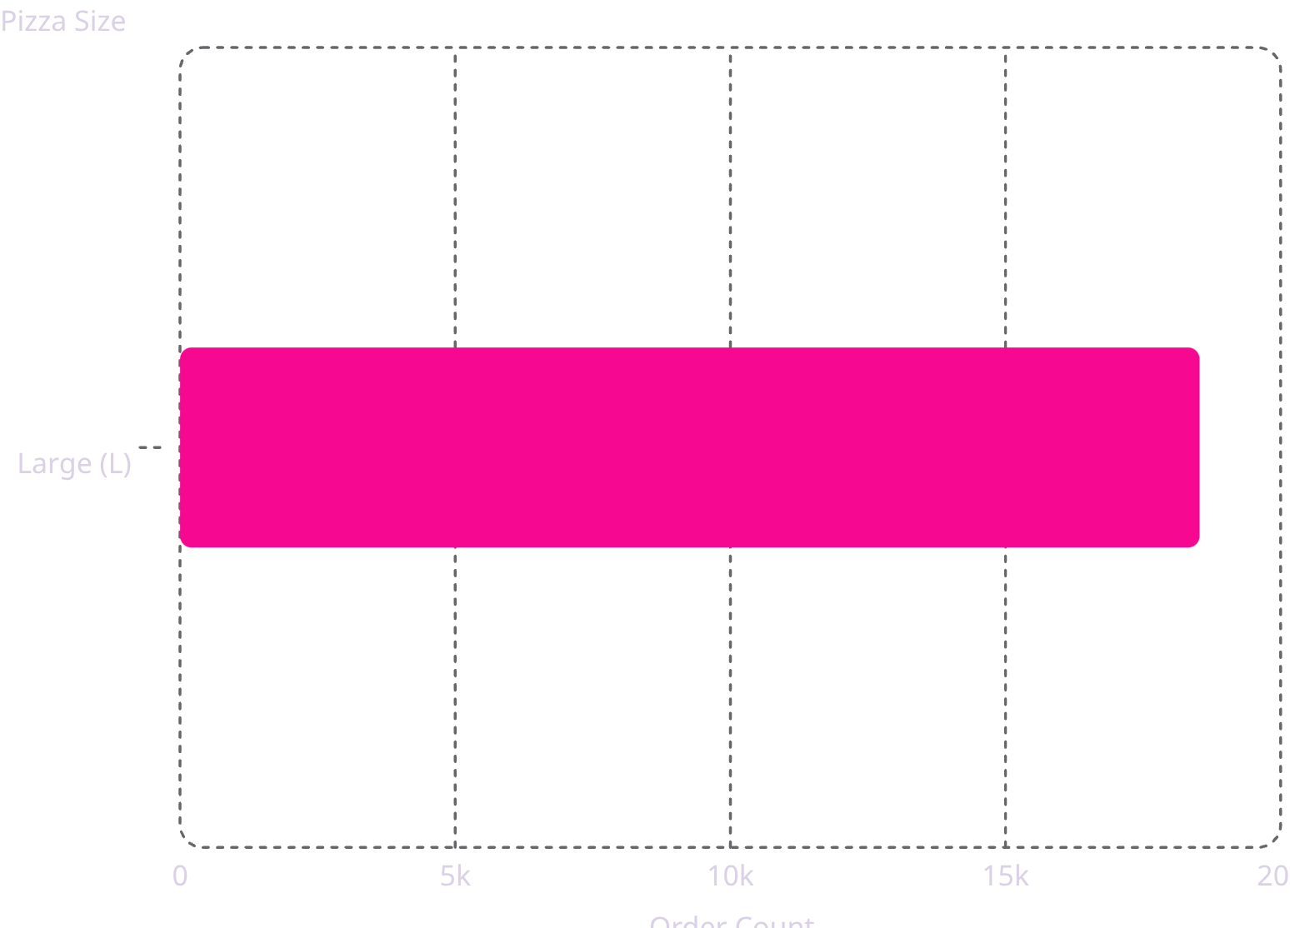
Q4–Q5: Size & Popularity
Most Common Size
Large dominates with 18,526 orders
Top 5 Pizza Types by Quantity
01
Classic Deluxe
02
Barbecue Chicken
03
Hawaiian
04
Pepperoni
05
Thai Chicken

Slide 6
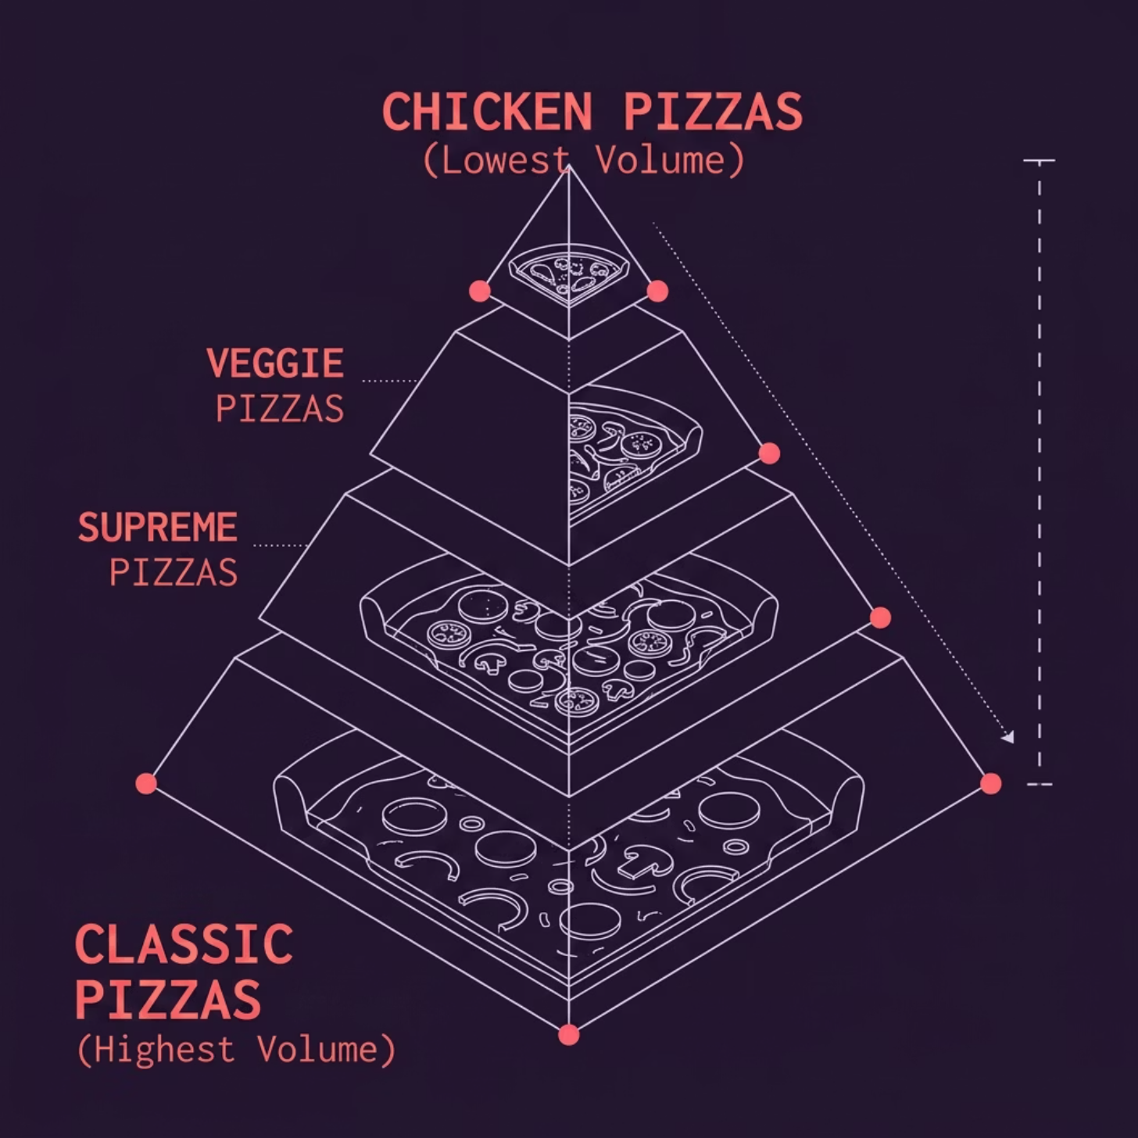

Q6–Q7: Category Volume & Order Timing
Orders by Category
Classic leads in total quantity ordered
Peak Ordering Hours
Orders cluster around lunch (12pm) and evening (6–8pm)
Insight: Staffing and promotions can be timed around these peaks.

Slide 7
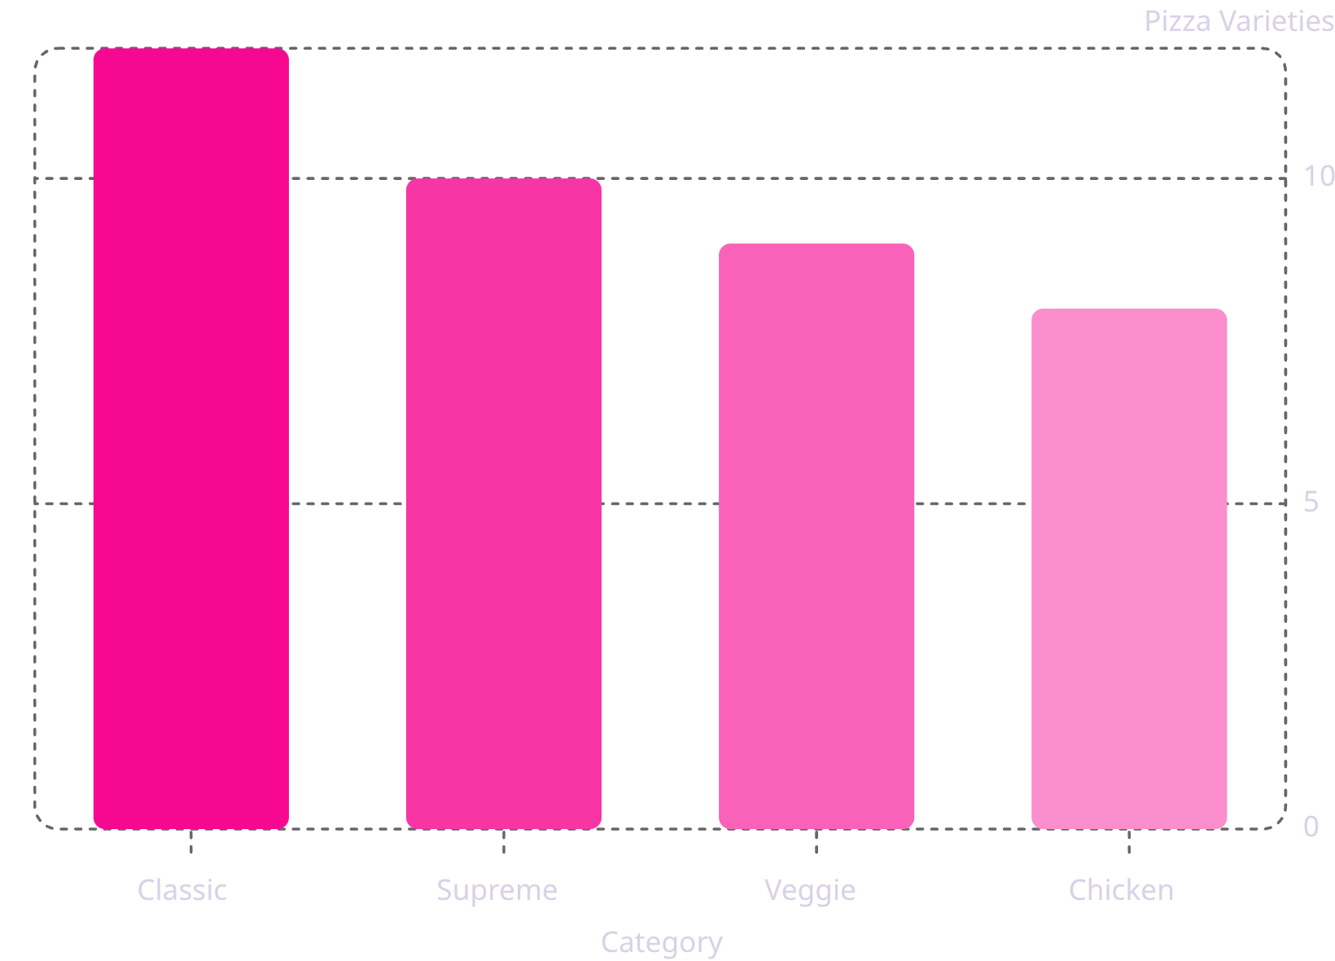

Q8–Q9: Menu Variety & Daily Demand
Pizza Varieties by Category
Average Pizzas Per Day
Subquery aggregates daily quantity, then AVG() estimates typical demand for inventory planning
Technique: Nested subquery + AVG()

Slide 8
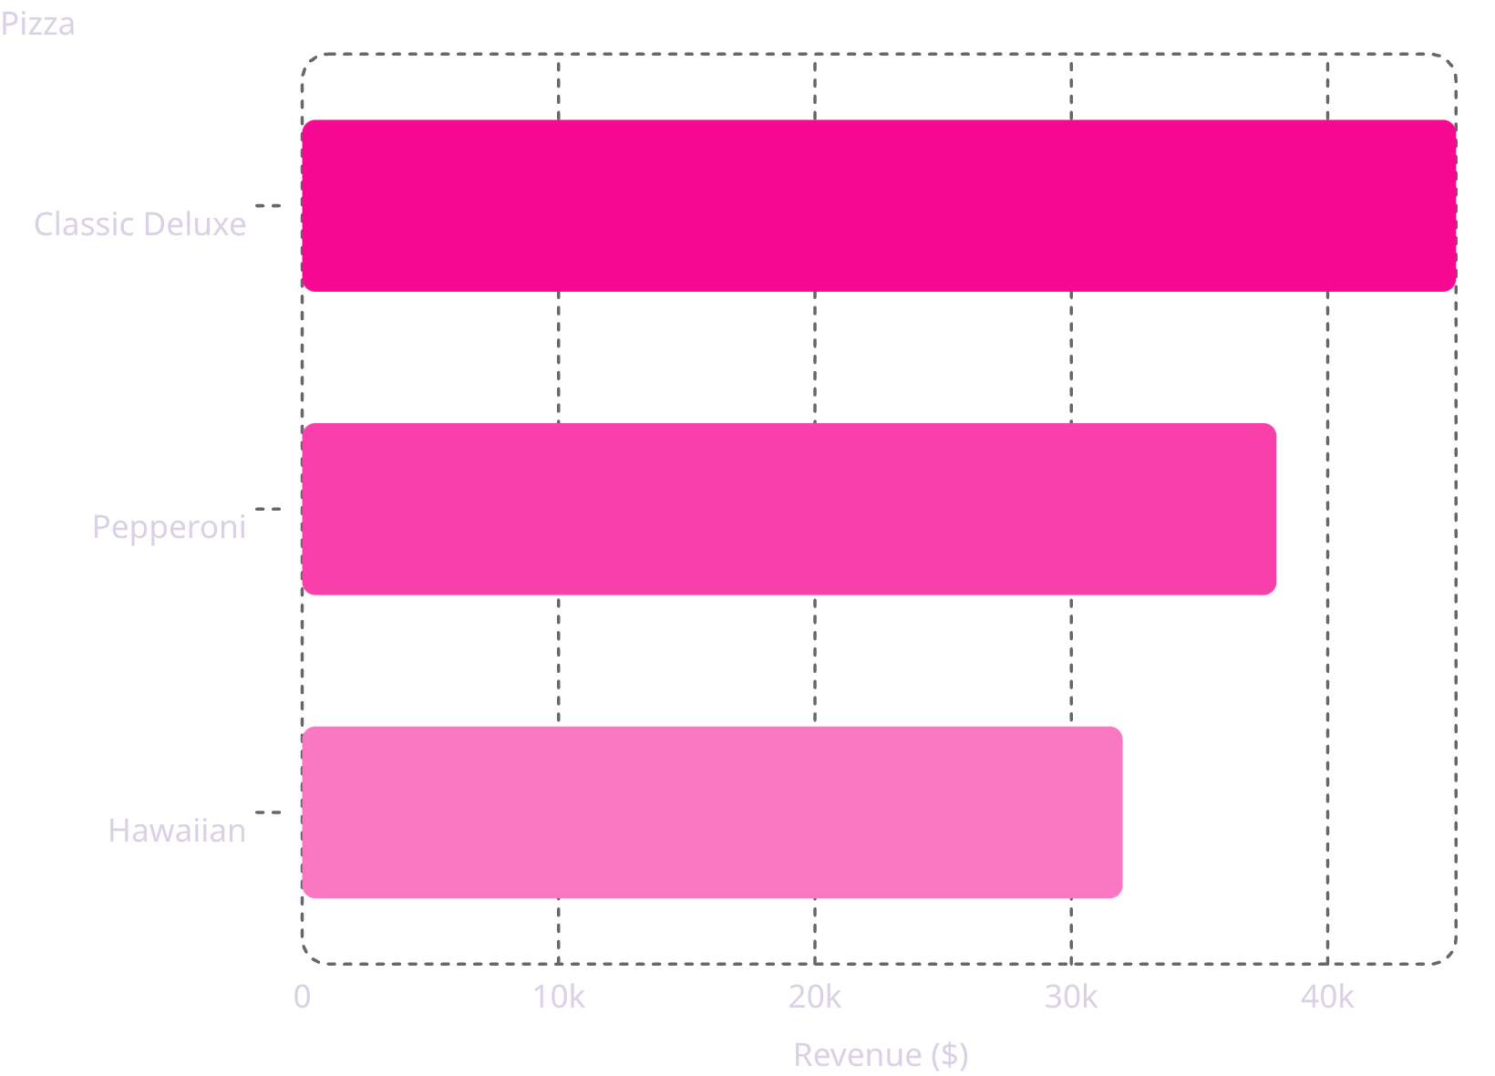
Q10–Q11: Revenue Analysis
Top 3 Pizzas by Revenue
Revenue Contribution %
Subquery calculates total revenue; outer query shows category share
Classic
Supreme
Highest revenue share
Second contributor

Slide 9

Q12–Q13: Advanced Analytics
Cumulative Revenue Over Time
Top 3 per Category
SUM() OVER (ORDER BY order_date) tracks running revenue total day by day
RANK() OVER (PARTITION BY category) finds best performers within each category
Shows growth trajectory and seasonality
Classic → Classic Deluxe
Supreme → The Supreme Pizza
Veggie → The Veggie Pizza

Slide 10
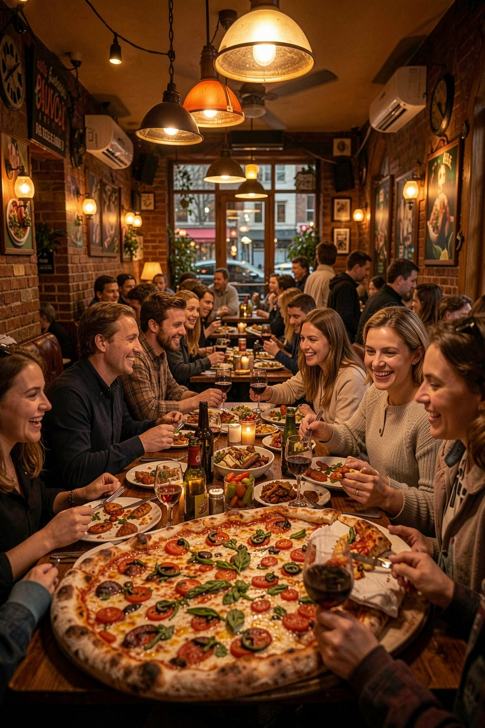




Key Findings & Conclusion
21,350 Orders · $817K Revenue
Classic Deluxe = Best Seller
Peak Hours: Lunch & Evening
Classic Category Drives Revenue
SQL uncovered ordering patterns, revenue drivers, and demand trends — insights that can guide inventory, staffing, and marketing decisions.

