Slide 1

Music Store Data Analysis Using SQL
Exploring customer behavior, sales trends, and music preferences through structured query language
SQL
MUSIC STORE DATABASE
BUSINESS INTELLIGENCE

Slide 2

What We're Analyzing
The Music Store Database tracks customers, employees, artists, albums, tracks, invoices, and playlists — a rich dataset for uncovering business insights through SQL.

Slide 3




Project Objectives
Sales Analysis
Top Customers
Analyze revenue by city and country
Identify highest-spending buyers
Popular Music
Business Insights
Find top artists and genres
Drive data-informed decisions

Slide 4
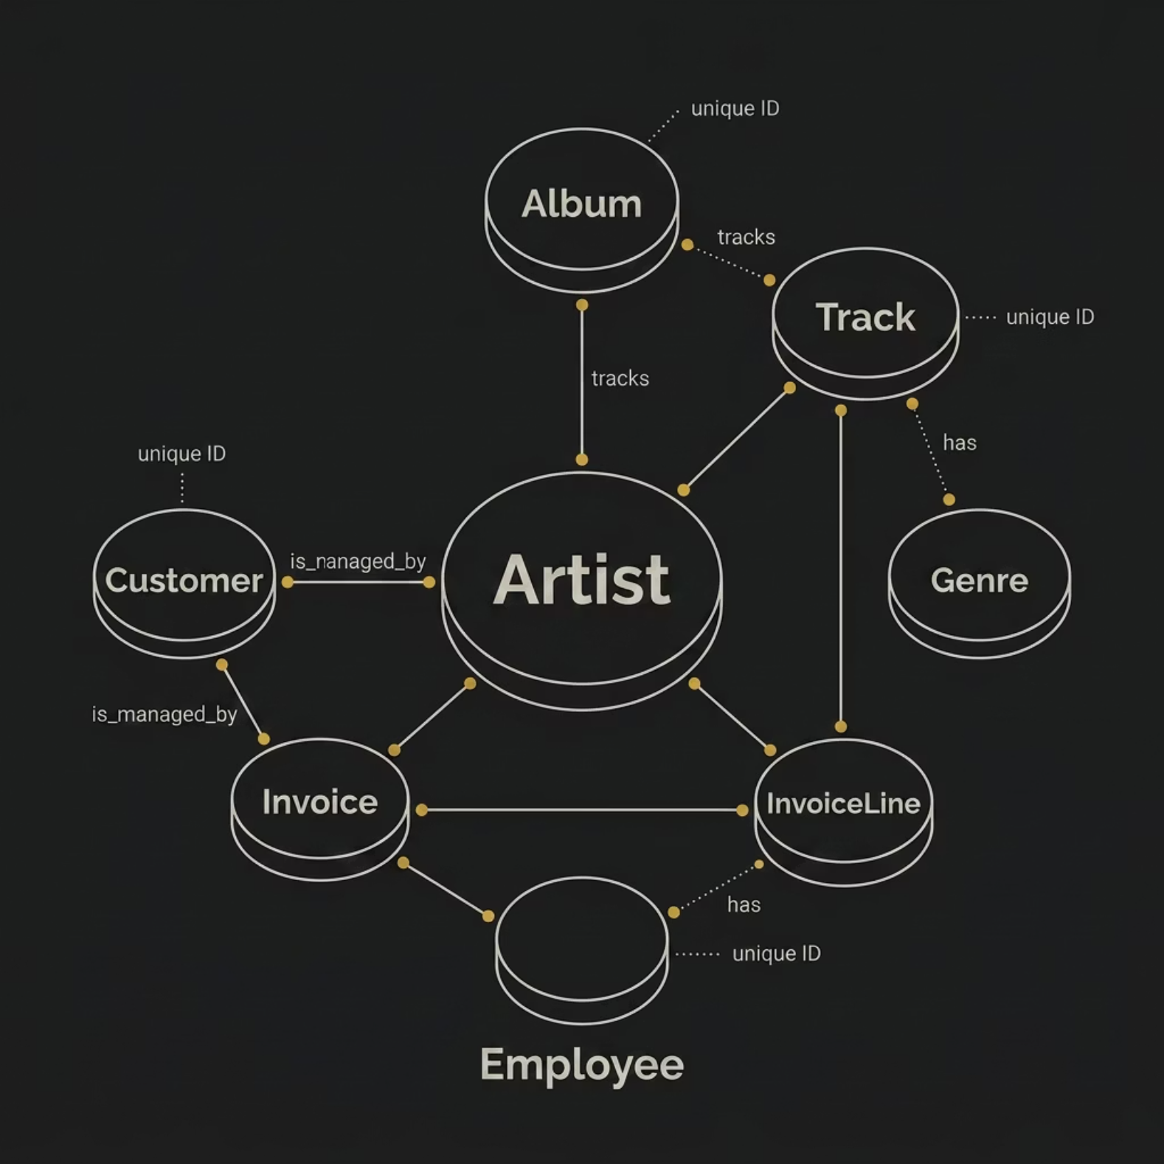
Database Schema
7 Core Tables
Artist — artist information
Album — album details
Track — song data
Genre — music categories
Customer — buyer profiles
Invoice — purchase records
InvoiceLine — line items

Slide 5

Table Relationships
Artist→Album
Album→Track
Each artist links to many albums.
Albums contain multiple tracks.
Customer→Invoice
Invoice→InvoiceLine
A customer can have many invoices.
Invoices comprise several line items.
These one-to-many relationships connect customer purchases to artists and tracks — the foundation of every analytical query in this project.

Slide 6
SQL Queries Performed
Easy Level
Moderate & Advanced
Senior-most employee
Countries with most invoices
Top 3 invoice totals
Highest-revenue city
Best customer by spend
Rock music listeners
Top rock artists
Popular genres by country
Customer spending analysis

Slide 7
SQL Concepts Applied
SELECT · WHERE
ORDER BY · GROUP BY
INNER JOIN · HAVING
COUNT · SUM · AVG · MAX
CTE

Slide 8
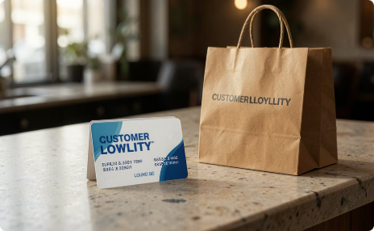



Key Business Findings
Best Customer Identified
Most Profitable City
Top Genres & Artists
Country Trends
Highest-revenue location pinpointed
Most popular music categories and performers found
Purchasing patterns analyzed by region
Top spender surfaced via spending analysis

Slide 9


Conclusion
SQL Delivers Real Insights
This project demonstrates how SQL extracts meaningful intelligence from large datasets — analyzing customer behavior, sales performance, and music popularity to support data-driven decisions.
Every query answered a real business question.

