Slide 1
4CS015 – Fundamentals of computing: Full adder
Dr Chris Dennett
c.dennett@wlv.ac.uk
Ext: 8534
1

Slide 2
Review
Logic Gates
Boolean and DeMorgan’s laws
Combinatorial logic
1

Slide 3
Today
Mathematical functions in logic!
Understanding addition
Making our own truth tables
Building a circuit that can perform maths
Reducing logic
1

Slide 4
Addition by Logic
Can we make use of Logical functions to perform addition of Binary Numbers?
What is 0 + 0 ?
What is 1 + 0 or 0+1 ?
What is 1 + 1 ?
1
Notes:
<number>

Slide 5
Addition Rules as a Table
Number 1 and Number 2 are the Inputs.
Sum and Carry are the results after addition.
Number 1 | Number 2 | Result | Carry Over
0 | 0 | 0 | 0
0 | 1 | 1 | 0
1 | 0 | 1 | 0
1 | 1 | 0 | 1
1
Notes:
<number>

Slide 6
Addition as Logical Functions
Input A Number 1 | Input B Number 2 | Sum | Carry
0 | 0 | 0 | 0
0 | 1 | 1 | 0
1 | 0 | 1 | 0
1 | 1 | 0 | 1
Assume that SUM is now a truth table Entry then:
Doing the same for CARRY we get:
1
Notes:
<number>

Slide 7
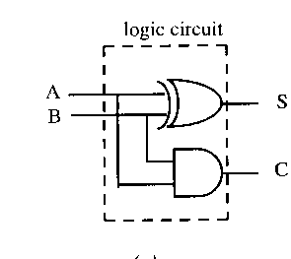
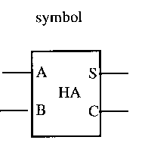
The Half Adder
Input A | Input B | S (Sum) | C (Carry)
0 | 0 | 0 | 0
0 | 1 | 1 | 0
1 | 0 | 1 | 0
1 | 1 | 0 | 1
1
Notes:
<number>

Slide 8
The Half Adder
Is there a problem with the Half Adder?
What would be the result of this addition?
Carry 1
 |  | 1 | 0 | <- Input A
 | + | 1 | 1 |  | <- Input B
 |  | 0 | 1 |  | <- Sum
1
1
Notes:
<number>

Slide 9
Solution
We need to consider the CARRY.
In decimal we carry FORWARDS.
In Binary we do the same.
What is 0 + 0 + Carry IN?
What is 1 + 0 + Carry IN, 0 + 1 + Carry IN?
What is 1 + 1 + Carry IN?
Depends on the State of Carry IN.
1
Notes:
<number>

Slide 10
Full Adder Function
Input A | Input B | Carry IN | Sum | Carry OUT
0 | 0 | 0 | 0 | 0
1 | 0 | 0 | 1 | 0
0 | 1 | 0 | 1 | 0
1 | 1 | 0 | 0 | 1
0 | 0 | 1 | 1 | 0
1 | 0 | 1 | 0 | 1
0 | 1 | 1 | 0 | 1
1 | 1 | 1 | 1 | 1
1
Notes:
<number>

Slide 11
Full Adder
We could derive the full Boolean expression for the Sum and Carry OUT.
However, there is a great deal of symmetry associated with the half and full adder and we can simply build a FULL from two Halves.
<number>
Notes:
<number>

Slide 12
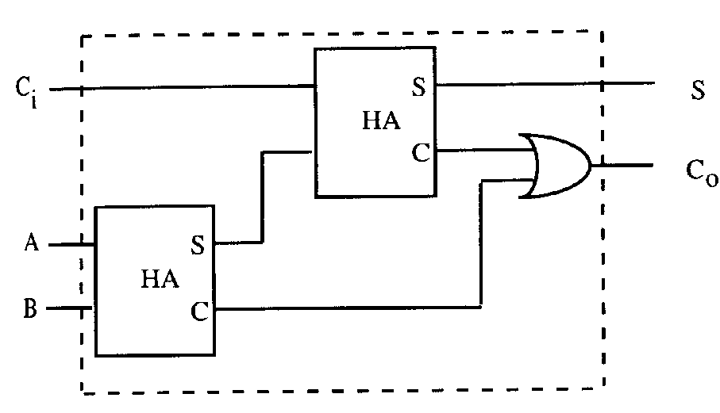
Full Adder from Two Half’s
The Full Adder:
The Half Adder
 |  | 1 | 1 | 0
+ |  | 1 | 1 | 1
Carry: | 1 | 1 | 0
 | 1 | 1 | 0 | 1
<number>
Notes:
<number>

Slide 13
Symbol for a Full Adder
A | B | C_{in} | S | C_{out}
0 | 0 | 0 | 0 | 0
1 | 0 | 0 | 1 | 0
0 | 1 | 0 | 1 | 0
1 | 1 | 0 | 0 | 1
0 | 0 | 1 | 1 | 0
1 | 0 | 1 | 0 | 1
0 | 1 | 1 | 0 | 1
1 | 1 | 1 | 1 | 1
<number>
Notes:
<number>

Slide 14
Reduction.
If you develop the sum of products for the full adder.
Sum = ABC+ABC+ABC+ABC
Carry OUT = ABC+ABC+ABC+ABC
These show very little resemblance to the circuits we are using.
By applying the laws and theorems of Boolean algebra we should be able to get from the above to our circuits.
A | B | C_{in} | S | C_{out}
0 | 0 | 0 | 0 | 0
1 | 0 | 0 | 1 | 0
0 | 1 | 0 | 1 | 0
1 | 1 | 0 | 0 | 1
0 | 0 | 1 | 1 | 0
1 | 0 | 1 | 0 | 1
0 | 1 | 1 | 0 | 1
1 | 1 | 1 | 1 | 1
<number>
Notes:
<number>

Slide 15
Reduction Basics
Theorem
(X+Y)(X+Y) = X
because
(X+Y)(X+Y) = X.(Y+Y)
and Y+Y = 1
and X.1 = X
AND relationship
0.X = 0
1.X = X
X.X = X
X.X = 0
OR relationship
0+X = X
1+X = 1
X+X = X
X+X = 1
Not
X = X
<number>
Notes:
<number>

Slide 16
Reduction
X.Y + X.Z
Y
As the outputs are same for all inputs we can use this to reduce XY+XZ
To X(Y+Z)
Absorption
Z
X
Y
X
X.(Y+Z)
Z
<number>
Notes:
<number>

Slide 17
Reduction
X
X.Y + X.Y
Y
(X)
=Y
Y
Always on
X
X
So X+X= 1
1 = always on
<number>
Notes:
<number>

Slide 18
Carry: Sum of Products
Carry = ABC+ABC+ABC+ABC
Carry = ABC+ABC+ABC+ABC+ABC+ABC
AB(C+C)
BC(A+A)
We have simply
applied Theorem 6
3 times.
AC(B+B)
Carry = A.B+B.C+A.C
<number>
Notes:
<number>

Slide 19
Sum: sum of products
Sum = ABC+ABC+ABC+ABC
1. Sum =A(BC+BC)+A (BC+BC)
2. BC+BC = B C
3. BC+BC = B C
4. Substitute X for B C
5. We get AX + AX
6. A X
7 substitute B C = X
8. Sum = A (B C)
<number>
Notes:
<number>

Slide 20
Summary
Addition in Boolean Logic
Logic Reduction Steps
<number>
Notes:
<number>

