Slide 1
4CC001 – Digital Electronics: Boolean Logic and Logic Gates
Dr Chris Dennett
c.dennett@wlv.ac.uk
Ext: 8534
1
Notes:
<number>

Slide 2
Boolean Logic
George Boole (1815-1864)
“An Investigation into the Laws of Thought”
Defined an algebra for solving logical problems
Limited to dealing with facts True or False
Now known as Boolean Algebra
1
Notes:
<number>

Slide 3
Basic Logic Definitions
In a Logic System a variable can have one of two possible states.
Single capital letters are used to represent variables.
The bits 1 and 0 are also used as constants.
TRUE | ON | CLOSED | ‘1’ | Yes | 5v
FALSE | OFF | OPEN | ‘0’ | No | 1v
1
Notes:
<number>
Boolean Logic used to perform data manipulations has only 2 unique symbols, the basic states of TRUE – FALSE.
By the BASE rules:
- FALSE = 0 and TRUE = 1
- Then as base = Highest Symbol + 1

Slide 4
Logic States
If a switch is closed:
The light will be ON.
This can represent Logic TRUE.
If a switch is open:
The light will be OFF.
This can represent Logic FALSE.
The switch is a Logic variable.
1
Notes:
<number>

Slide 5
Digital Logic
For this module:-
1 is equivalent to True.
0 is equivalent to False.
Boole fully defined his algebra using postulates and theorems.
Applying these to digital computers is the closest we can get to formally proving that computers work.
1
Notes:
<number>

Slide 6
Boolean Basics: operators
Boole defined three basic operations that could be used with these Boolean variables.
AND
OR
NOT
All logical expressions can be built from these three.
1
Notes:
<number>

Slide 7
Digital Logical Operators
Logical AND
Logical OR
Logical NOT
1
Notes:
<number>

Slide 8
Logical 'AND'
How can we switch the light on?
Switch A
Switch B
Light
Battery
1
Notes:
<number>

Slide 9
Logical 'AND'
Boolean Expression:
F = A AND B or F= A∙B
Gate Diagram:
Truth Table:
Input A | Input B | Output F
0 | 0 | 0
0 | 1 | 0
1 | 0 | 0
1 | 1 | 1
1
Notes:
<number>

Slide 10
The AND relationship.
Boolean representation
If F,A and B are Boolean variables.
Then the expression F = A∙B means
F is only true when A AND B are both true.
As A is capable of being 1 or 0 and B is capable of being 1 or 0 there are 4 possible states. 00, 01, 10 or 11
1
Notes:
<number>

Slide 11
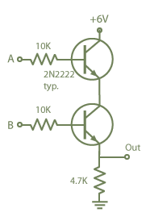



Relationship Between Integrated Circuits and Logic Gates
[2]
[1]
Transistors
1
Notes:
<number>
[1] http://computer.howstuffworks.com/question268.htm
[2] http://hyperphysics.phy-astr.gsu.edu/HBASE/electronic/trangate.html

Slide 12
Logical 'OR'
How can we switch on the light?
Switch A
Switch B
Light
Battery
1
Notes:
<number>

Slide 13
Logical 'OR'
Boolean Expression:
F = A OR B alternatively F = A+B
Gate Diagram:
Truth Table:
Input A | Input B | Output F
0 | 0 | 0
0 | 1 | 1
1 | 0 | 1
1 | 1 | 1
1
Notes:
<number>

Slide 14
The OR relationship.
Boolean representation +
If F,A and B are Boolean variables.
Then the expression F = A+B means
F is only true when A OR B, OR both, are true.
As A is capable of being 1 or 0 and B is capable of being 1 or 0 there are 4 possible states. 00, 01, 10 or 11
1
Notes:
<number>

Slide 15
Logical 'NOT'
How can we switch the light off?
Switch A
Light
Battery
1
Notes:
<number>

Slide 16
Logical 'NOT'
Boolean Expression:
F = NOT A or F=!A or F=A
Gate Diagram:
Truth Table:
The circle
means
NOT
Input A | Output F
0 | 1
1 | 0
1
Notes:
<number>

Slide 17
Boolean NOT
The NOT relationship reverses the value.
NOT True is False etc…
The Symbol used is usually a bar above the variable or expression to be reversed
E.g if A= true then A = false
In some circumstances we use !
E.g. if B = true !B = false (easier to type)
1
Notes:
<number>

Slide 18
Boolean Laws
Simple Boolean Laws:
A∙1 = A A ∙0 = 0
A+1 = 1 A+0 = A
DeMorgan’s Law:
A+B=A ∙B A+B=A ∙B
1
Notes:
<number>

Slide 19
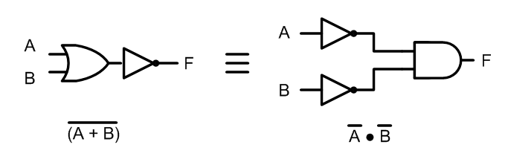

First DeMorgan’s Law
1
Notes:
<number>

Slide 20
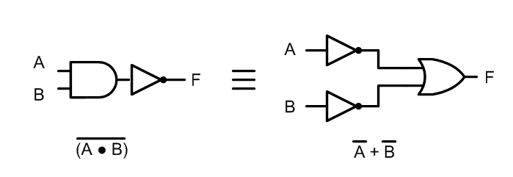
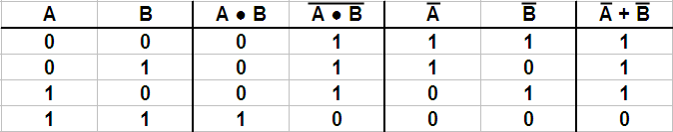
Second DeMorgan’s Law
1

Slide 21
Precedence of operators
As with normal mathematics when working out the value of a function it is very important to do it in the right order.
NOT AND OR
Parenthesis (brackets) override in the normal way.
When a bar goes above more than 1 symbol it becomes a bracket that reverses.
1
Notes:
<number>

Slide 22
Where
A=1
B=1
C=0
D=1
E=0
G=1
Evaluate these examples
0
Example 1. F= A.B.C
0
Example 2. F= C.A.B
1
Example 3. F= A+B+C
Example 4. F= A.B+C
1
1
Example 5. F= A+B.C
0
Example 6. F= A+B.C
Example 7. F= A .B + (C +A) .D+E+G
1
1
Notes:
<number>

Slide 23
Other Logic Gates
To make life a little easier the basic logical functions are expanded to include:
NAND.
This is an AND with a NOT output.
NOR.
This is an OR with a NOT output.
XOR.
This is the Exclusive OR function.
1
Notes:
<number>

Slide 24
NAND
Boolean Expression:
F = NOT(A AND B) or F = A∙B
Gate Diagram:
Truth Table:
Input A | Input B | Output F
0 | 0 | 1
0 | 1 | 1
1 | 0 | 1
1 | 1 | 0
<number>
Notes:
<number>

Slide 25
NOR
Boolean Expression:
F = NOT(A OR B) or F = A+B
Gate Diagram:
Truth Table:
Input A | Input B | Output F
0 | 0 | 1
0 | 1 | 0
1 | 0 | 0
1 | 1 | 0
<number>
Notes:
<number>

Slide 26
XOR
Boolean Expression:
F = A XOR B or F = A⊕B
Gate Diagram:
Truth Table:
Input A | Input B | Output F
0 | 0 | 0
0 | 1 | 1
1 | 0 | 1
1 | 1 | 0
<number>
Notes:
<number>

Slide 27
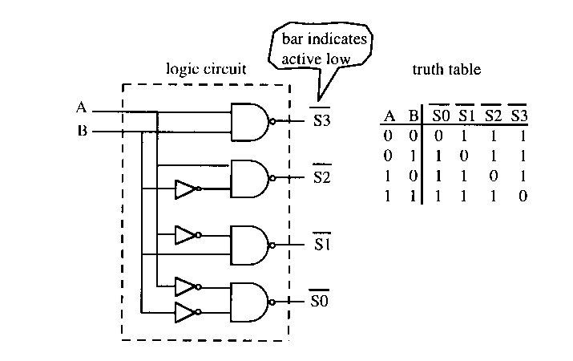
Simple Combinatorial Logic
A 2-to-4 decoder.
<number>
Notes:
<number>

Slide 28
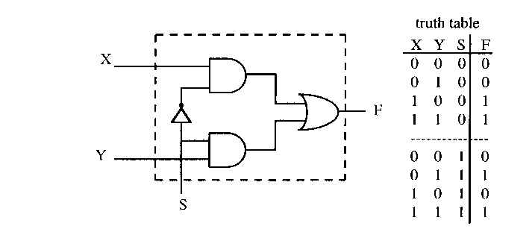
Simple Combinatorial Logic
A 2-input multiplexer.
<number>
Notes:
<number>

Slide 29
Summary
We have looked at the basic logic gates:
Identifying OR, AND, NOT, NAND, NOR and XOR.
We have seen that gates can be joined together to form Combinatorial Logic.
<number>
Notes:
<number>

