Slide 1
Dijkstra's Algorithm Single Source Shortest Path

Slide 2
Introduction
Consider the problem of finding shortest paths between all pairs of vertices in a graph
Problem might arise in making a table of distances between all pairs of cities for a road atlas
given a weighted, directed graph G =(V, E) with a weight function w: E → R that maps edges to real-valued weights

Slide 3
Introduction
We wish to find, for every pair of vertices u, v Є V , a shortest (least-weight) path from u to v, where the weight of a path is the sum of the weights of its constituent edges
We typically want the output in tabular form:
the entry in u’s row and v’s column should be the weight of a shortest path from u to v

Slide 4
Introduction
We can solve an all-pairs shortest-paths problem by running a single-source shortest-paths algorithm |V| times, once for each vertex as the source.
If all edge weights are nonnegative, we can use Dijkstra’s algorithm

Slide 5
Introduction
If we use the linear-array implementation of the min-priority queue, the running time is O(V³ + VE) = O(V³).
The binary min-heap implementation of the min-priority queue yields a running time of O(VE lg V), which is an improvement if the graph is sparse.
Alternatively, we can implement the min-priority queue with a Fibonacci heap, yielding a running time of O(V² lg V + VE)

Slide 6
Introduction
If the graph has negative-weight edges, we cannot use Dijkstra’s algorithm
Instead, we must run the slower Bellman-Ford algorithm once from each vertex
The resulting running time is O(V²E), which on a dense graph is O(V⁴)

Slide 7
Introduction
In this chapter we shall see how to do better.
We also investigate the relation of the all-pairs shortest-paths problem to matrix multiplication and study its algebraic structure.
Unlike the single-source algorithms, which assume an adjacency-list represen-tation of the graph, most of the algorithms in this chapter use an adjacency-matrix representation.

Slide 8
Introduction
(Johnson’s algorithm for sparse graphs, in Section 25.3, uses adjacency lists.)
For convenience, we assume that the vertices are numbered 1, 2,...,|V|, so that the input is an n x n matrix W representing the edge weights of an n-vertex directed graph G =(V, E).
That is, W = (w_{ij}), where

Slide 9
Introduction
We allow negative-weight edges, but we assume for the time being that the input graph contains no negative-weight cycles.

Slide 10
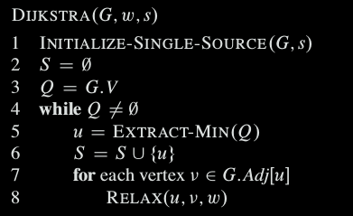
Dijkstra’s algorithm

Slide 11
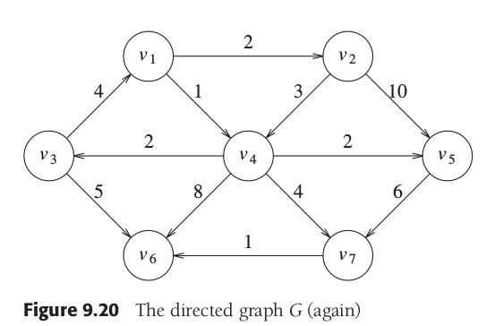
Dijkstra’s algorithm

Slide 12
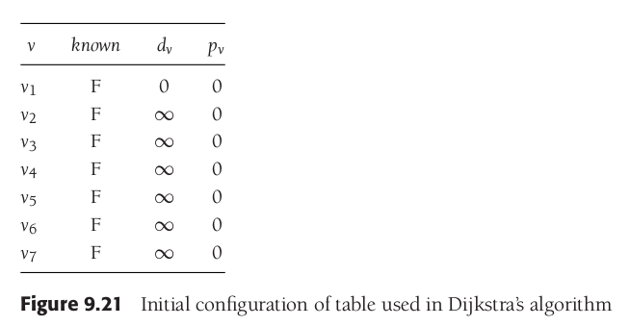
Dijkstra’s algorithm

Slide 13
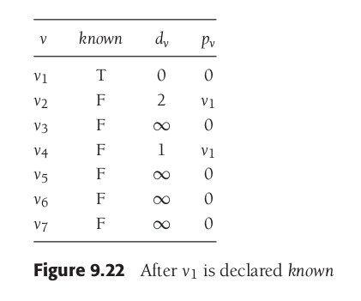
Dijkstra’s algorithm

Slide 14
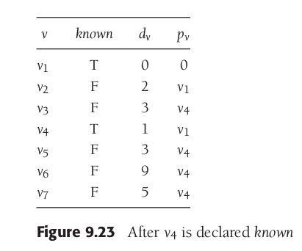
Dijkstra’s algorithm

Slide 15
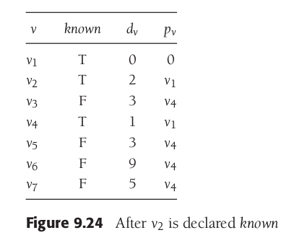
Dijkstra’s algorithm

Slide 16
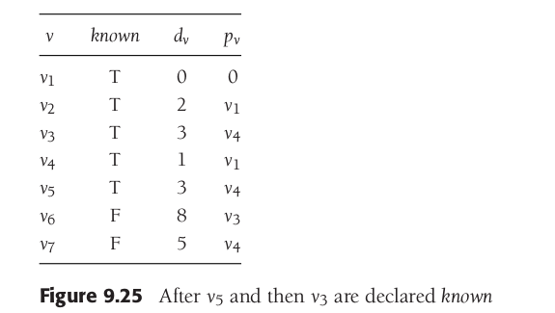
Dijkstra’s algorithm

Slide 17
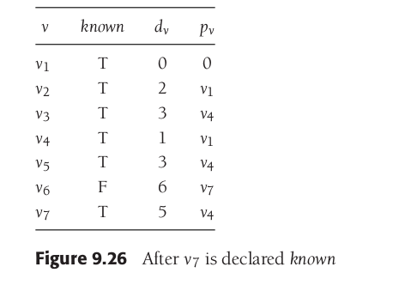
Dijkstra’s algorithm

Slide 18
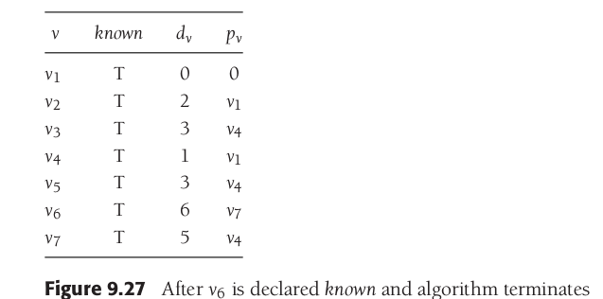
Dijkstra’s algorithm

Slide 19
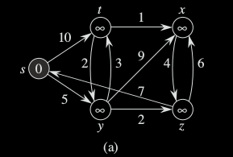
Dijkstra’s algorithm

Slide 20
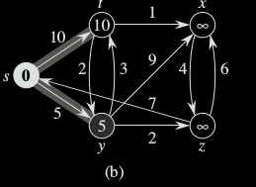
Dijkstra’s algorithm

Slide 21
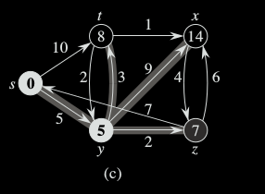
Dijkstra’s algorithm

Slide 22
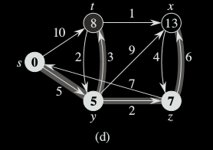
Dijkstra’s algorithm

Slide 23
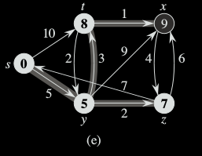
Dijkstra’s algorithm

Slide 24
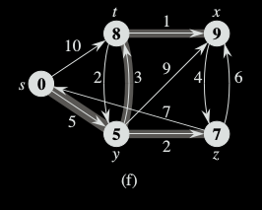
Dijkstra’s algorithm

Slide 25
Dijkstra’s algorithm
We allow negative-weight edges, but we assume for the time being that the input graph contains no negative-weight cycles.
Time Complexity of Dijkstra's Algorithm is O ( V² ) but with min-priority queue it drops down to O ( V + E l o g V )

