Slide 1
Dijkstra's Algorithm Single Source Shortest Path

Slide 2
Introduction
Consider the problem of finding shortest paths between all pairs of vertices in a graph
Problem might arise in making a table of distances between all pairs of cities for a road atlas
given a weighted, directed graph G =(V, E) with a weight function w: E → R that maps edges to real-valued weights

Slide 3
Introduction
We wish to find, for every pair of vertices u, v Є V , a shortest (least-weight) path from u to v, where the weight of a path is the sum of the weights of its constituent edges
We typically want the output in tabular form:
the entry in u’s row and v’s column should be the weight of a shortest path from u to v

Slide 4
Introduction
We can solve an all-pairs shortest-paths problem by running a single-source shortest-paths algorithm |V| times, once for each vertex as the source.
If all edge weights are nonnegative, we can use Dijkstra’s algorithm

Slide 5
Introduction
If the graph has negative-weight edges, we cannot use Dijkstra’s algorithm
Instead, we must run the slower Bellman-Ford algorithm once from each vertex
The resulting running time is O(V²E), which on a dense graph is O(V⁴)

Slide 6
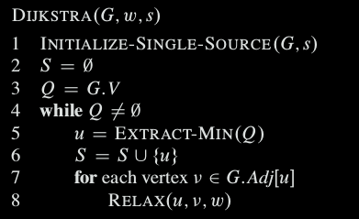
Dijkstra’s algorithm

Slide 7
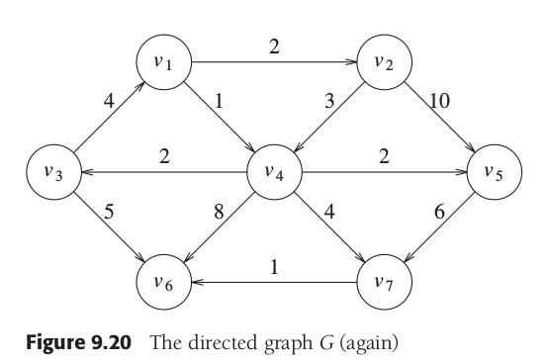
Dijkstra’s algorithm

Slide 8
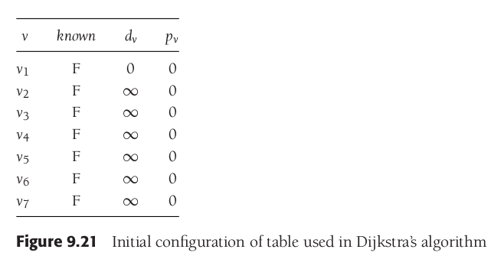
Dijkstra’s algorithm

Slide 9
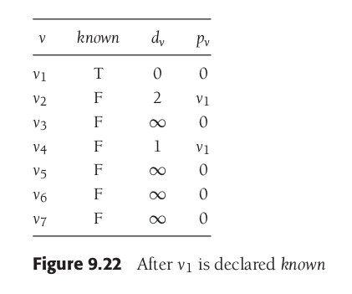
Dijkstra’s algorithm

Slide 10
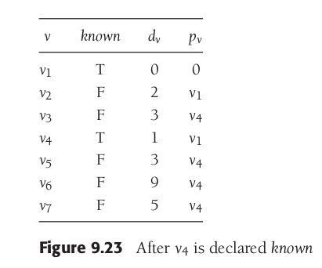
Dijkstra’s algorithm

Slide 11
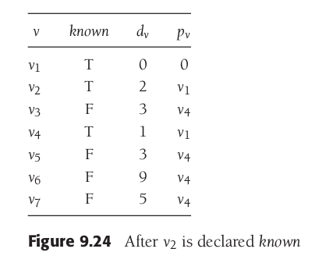
Dijkstra’s algorithm

Slide 12
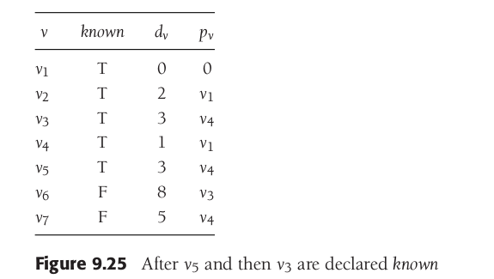
Dijkstra’s algorithm

Slide 13
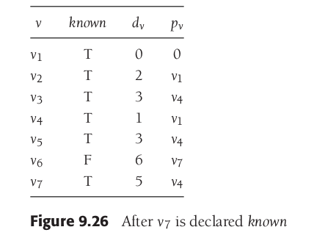
Dijkstra’s algorithm

Slide 14
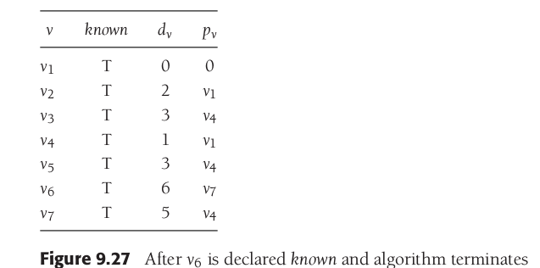
Dijkstra’s algorithm

Slide 15
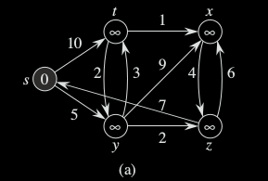
Dijkstra’s algorithm

Slide 16
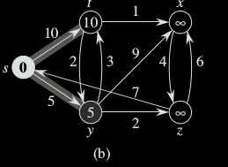
Dijkstra’s algorithm

Slide 17
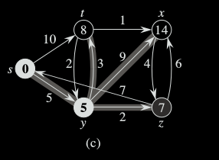
Dijkstra’s algorithm

Slide 18
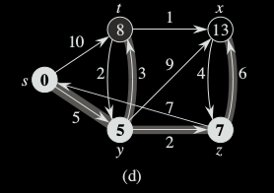
Dijkstra’s algorithm

Slide 19
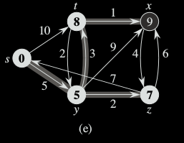
Dijkstra’s algorithm

Slide 20
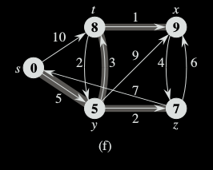
Dijkstra’s algorithm

Slide 21
Analysis
Because each vertex u Є V is added to set S exactly once, each edge in the adjacency list Adj[u] is examined in the for loop of lines 7–8 exactly once during the course of the algorithm.
Since the total number of edges in all the adjacency lists is |E|, this for loop iterates a total of |E| times, and thus the algorithm calls DECREASE-K EY at most |E| times overall

Slide 22
Analysis
running time of Dijkstra’s algorithm depends on how we implement the min-priority queue
Case I - simply store v.d in the v^{th} entry of an array
Each INSERT and DECREASE-K EY operation takes O(1) time, and each E XTRACT-M IN operation takes O(V) time
total time of O(V² + E) = O(V²)

Slide 23
Analysis
Case II - we can improve the algorithm by implementing the min-priority queue with a binary min-heap
Each EXTRACT-MIN operation then takes time O(lg V)
time to build the binary min-heap is O(V)
Each DECREASE -KEY operation takes time O(lg V), and there are still at most |E| such operations
total running time is therefore O(V + E) lg V ) which is O.E lg V / if all vertices are reachable from the source

Slide 24
Analysis
Case III - achieve a running time of O(V lg V + E) by implementing the min-priority queue with a Fibonacci heap
The amortized cost of each of the |V| EXTRACT -M IN operations is O(lg V), and each DECREASE -K EY call, of which there are at most |E|, takes only O(1) amortized time

Slide 25
Dijkstra’s algorithm
We allow negative-weight edges, but we assume for the time being that the input graph contains no negative-weight cycles.
Time Complexity of Dijkstra's Algorithm is O ( V² ) but with min-priority queue it drops down to O ( V + E l o g V )

Slide 26
Bellman-Ford algorithm
Solves the single-source shortest-paths problem in the general case in which edge weights may be negative
Given a weighted, directed graph G =(V, E) with source s and weight function w : E → R, the Bellman-Ford algorithm returns a boolean value indicating whether or not there is a negative-weight cycle that is reachable from the source.
If there is such a cycle, the algorithm indicates that no solution exists.

Slide 27
Bellman-Ford algorithm
No such cycle, the algorithm produces shortest paths and their weights
The algorithm relaxes edges, progressively decreasing an estimate v.d on the weight of a shortest path from the source s to each vertex v Є V until it achieves the actual shortest-path weight δ(s,v)
The algorithm returns TRUE if and only if the graph contains no negative-weight cycles that are reachable from the source.

Slide 28
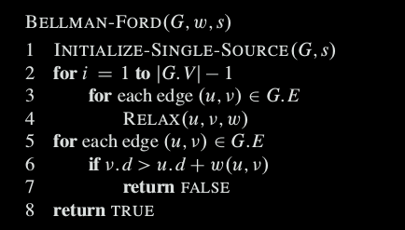
Bellman-Ford algorithm

Slide 29
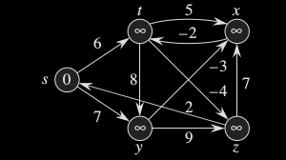
Bellman-Ford algorithm - Iteration 1
Edge Name | Old Cost | Updated Cost
s | 0 | 0
t | ∞
x | ∞ | ∞
y | ∞
z | ∞
(t, x)

Slide 30
Bellman-Ford algorithm - Iteration 1
Edge Name | Old Cost | Updated Cost
s | 0 | 0
t | ∞
x | ∞ | ∞
y | ∞ | ∞
z | ∞
(t, x) | (t, y)

Slide 31
Bellman-Ford algorithm - Iteration 1
Edge Name | Old Cost | Updated Cost
s | 0 | 0
t | ∞
x | ∞ | ∞
y | ∞ | ∞
z | ∞ | ∞
(t, x) | (t, y) | (t, z)

Slide 32
Bellman-Ford algorithm
Edge Name | Old Cost | Updated Cost
s | 0 | 0
t | ∞ | ∞
x | ∞ | ∞
y | ∞ | ∞
z | ∞ | ∞
(t, x) | (t, y) | (t, z) | (x, t)

Slide 33
Bellman-Ford algorithm - Iteration 1
Edge Name | Old Cost | Updated Cost
s | 0 | 0
t | ∞ | ∞
x | ∞ | ∞
y | ∞ | ∞
z | ∞ | ∞
(t, x) | (t, y) | (t, z) | (x, t) | (y, x)

Slide 34
Bellman-Ford algorithm - Iteration 1
Edge Name | Old Cost | Updated Cost
s | 0 | 0
t | ∞ | ∞
x | ∞ | ∞
y | ∞ | ∞
z | ∞ | ∞
(t, x) | (t, y) | (t, z) | (x, t) | (y, x) | (y,z)

Slide 35
Bellman-Ford algorithm - Iteration 1
Edge Name | Old Cost | Updated Cost
s | 0 | 0
t | ∞ | ∞
x | ∞ | ∞
y | ∞ | ∞
z | ∞ | ∞
(t, x) | (t, y) | (t, z) | (x, t) | (y, x) | (y,z) | (z, x)

Slide 36
Bellman-Ford algorithm - Iteration 1
Edge Name | Old Cost | Updated Cost
s | 0 | 0
t | ∞ | ∞
x | ∞ | ∞
y | ∞ | ∞
z | ∞ | ∞
(t, x) | (t, y) | (t, z) | (x, t) | (y, x) | (y,z) | (z, x) | (z,s)

Slide 37
Bellman-Ford algorithm - Iteration 1
Edge Name | Old Cost | Updated Cost
s | 0 | 0
t | ∞ | 6
x | ∞ | ∞
y | ∞ | ∞
z | ∞ | ∞
(t, x) | (t, y) | (t, z) | (x, t) | (y, x) | (y,z) | (z, x) | (z,s) | (s,t)

Slide 38
Bellman-Ford algorithm - Iteration 1
Edge Name | Old Cost | Updated Cost
s | 0 | 0
t | ∞ | 6
x | ∞ | ∞
y | ∞ | 7
z | ∞ | ∞
(t, x) | (t, y) | (t, z) | (x, t) | (y, x) | (y,z) | (z, x) | (z,s) | (s,t) | (s,y)

Slide 39
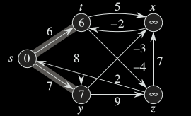
Bellman-Ford algorithm - Iteration 2
Edge Name | Old Cost | Updated Cost
s | 0
t | 6
x | ∞
y | 7
z | ∞
(t, x) | (t, y) | (t, z) | (x, t) | (y, x) | (y,z) | (z, x) | (z,s) | (s,t) | (s,y)

Slide 40
Bellman-Ford algorithm - Iteration 2
Edge Name | Old Cost | Updated Cost
s | 0
t | 6
x | ∞
y | 7
z | ∞
(t, x) | (t, y) | (t, z) | (x, t) | (y, x) | (y,z) | (z, x) | (z,s) | (s,t) | (s,y)

Slide 41
Bellman-Ford algorithm - Iteration 2
Edge Name | Old Cost | Updated Cost
s | 0
t | 6
x | ∞
y | 7
z | ∞
(t, x) | (t, y) | (t, z) | (x, t) | (y, x) | (y,z) | (z, x) | (z,s) | (s,t) | (s,y)

Slide 42
Bellman-Ford algorithm - Iteration 2
Edge Name | Old Cost | Updated Cost
s | 0
t | 6
x | ∞
y | 7
z | ∞
(t, x) | (t, y) | (t, z) | (x, t) | (y, x) | (y,z) | (z, x) | (z,s) | (s,t) | (s,y)

Slide 43
Bellman-Ford algorithm - Iteration 2
Edge Name | Old Cost | Updated Cost
s | 0
t | 6
x | ∞
y | 7
z | ∞
(t, x) | (t, y) | (t, z) | (x, t) | (y, x) | (y,z) | (z, x) | (z,s) | (s,t) | (s,y)

Slide 44
Bellman-Ford algorithm - Iteration 2
Edge Name | Old Cost | Updated Cost
s | 0
t | 6
x | ∞
y | 7
z | ∞
(t, x) | (t, y) | (t, z) | (x, t) | (y, x) | (y,z) | (z, x) | (z,s) | (s,t) | (s,y)

Slide 45
Bellman-Ford algorithm - Iteration 2
Edge Name | Old Cost | Updated Cost
s | 0
t | 6
x | ∞
y | 7
z | ∞
(t, x) | (t, y) | (t, z) | (x, t) | (y, x) | (y,z) | (z, x) | (z,s) | (s,t) | (s,y)

Slide 46
Bellman-Ford algorithm - Iteration 2
Edge Name | Old Cost | Updated Cost
s | 0
t | 6
x | ∞
y | 7
z | ∞
(t, x) | (t, y) | (t, z) | (x, t) | (y, x) | (y,z) | (z, x) | (z,s) | (s,t) | (s,y)

Slide 47
Bellman-Ford algorithm - Iteration 2
Edge Name | Old Cost | Updated Cost
s | 0
t | 6
x | ∞
y | 7
z | ∞
(t, x) | (t, y) | (t, z) | (x, t) | (y, x) | (y,z) | (z, x) | (z,s) | (s,t) | (s,y)

Slide 48
Bellman-Ford algorithm - Iteration 2
Edge Name | Old Cost | Updated Cost
s | 0
t | 6
x | ∞
y | 7
z | ∞
(t, x) | (t, y) | (t, z) | (x, t) | (y, x) | (y,z) | (z, x) | (z,s) | (s,t) | (s,y)

Slide 49
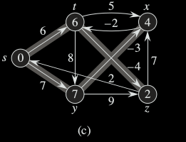
Bellman-Ford algorithm
each pass relaxes the edges in the order (t, x), (t, y), (t, z), (x, t), (y, x), (y,z), (z, x), (z,s), (s,t), (s,y)

Slide 50
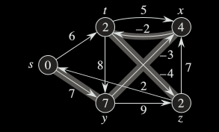
Bellman-Ford algorithm
each pass relaxes the edges in the order (t, x), (t, y), (t, z), (x, t), (y, x), (y,z), (z, x), (z,s), (s,t), (s,y)

Slide 51
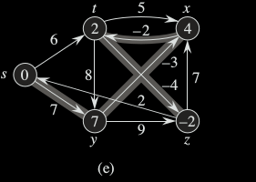
Bellman-Ford algorithm
each pass relaxes the edges in the order (t, x), (t, y), (t, z), (x, t), (y, x), (y,z), (z, x), (z,s), (s,t), (s,y)

Slide 52
Bellman-Ford algorithm
time complexity of Bellman-Ford is O(VE), which is more than Dijkstra.

