Slide 1

Title: Emergency Blood Request And Donor Finder
Student Name: Dikshita Siripireddy
Student ID: 2520090007
Cluster: 2
Section: 8
Under the Guidance
of
Supervisor Name: Ms. N. M. Deepika
Assistant Professor
Department of CSE

Slide 2
OUTLINE
Abstract
Existing System
Proposed System
System Architecture
Project Modules
Objectives
Co’s Attainments - FWD
Co1
Co2 …….. 5. Co5
Co’s Attainments - DSA
Co1
Co2 …….. 5. Co5
Screen Shots for FWD & DSA
Conclusion
Geo-Tagged Photos

Slide 3
Abstract
Emergency situations often require immediate access to blood, yet finding compatible donors within a short time frame remains a major challenge. The Emergency Blood Request and Donor Finder system is designed to bridge the gap between patients in urgent need and available blood donors through a fast, reliable, and user-friendly digital platform. This system allows hospitals, patients, or caregivers to raise emergency blood requests by specifying blood group, location.

Slide 4
Existing System
Currently, most blood donation systems rely on hospital records, blood bank databases, or manual communication methods. In many cases, patients or caregivers must contact hospitals, blood banks, or social media groups to find available blood donors.
Existing systems have several limitations:
Complex Interfaces: Many government blood bank portals are not user-friendly.
Slow Response Time: Finding donors during emergencies may take a long time.

Slide 5
Limited Filtering: Users cannot easily search donors by city and blood group together.
No Quick Emergency Feature: Most systems lack a one-click emergency donor search.
Low User Engagement: Donor registration and participation are often limited.

Slide 6
Proposed System
The proposed system is a web-based Emergency Blood Request & Donor Finder platform that helps patients quickly locate blood donors during emergencies. The system allows users to search for donors based on blood group and city location.
This system makes the process of finding blood donors faster, easier, and more accessible, helping save lives during medical emergencies.

Slide 7
It includes features such as:
Emergency donor search
Blood compatibility checker
Donor eligibility checker
Donor registration system
WhatsApp emergency contact option

Slide 8
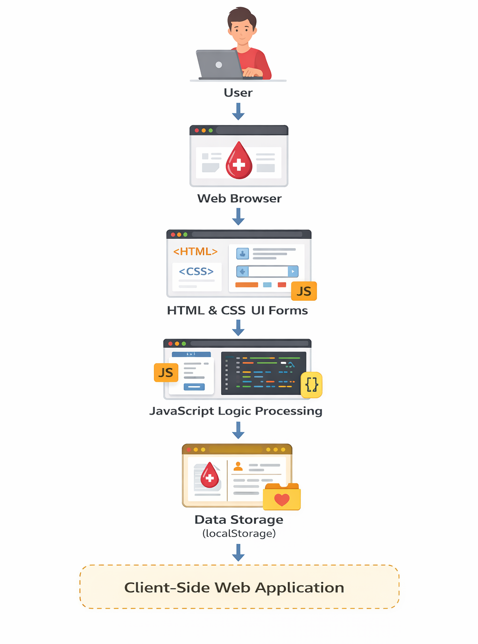
System Architecture

Slide 9
Project Modules
1. User Login Module
Allows users to login and access the system.
2. Donor Search Module
Users can search for donors based on blood group and city.
3. Emergency Mode Module
One-click feature to quickly find nearby donors.
4. Donor Registration Module
Allows users to register themselves as blood donors.

Slide 10
5. Blood Compatibility Checker
Shows compatible blood groups for a selected blood type.
6. Eligibility Checker
Checks whether a person is eligible to donate blood based on:
Age
Weight
Last donation date
7. Contact Donor Module
Generates a WhatsApp message to contact the donor instantly.

Slide 11
Objectives
To create a simple web application for emergency blood donor search.
To reduce the time required to find compatible blood donors.
To allow users to register as blood donors easily.
To provide quick communication with donors during emergencies.
To improve awareness and participation in blood donation.

Slide 12
Co’s Attainments - FWD
CO1 – Internet Fundamentals, HTML & Introductory CSS
Designed Login and Register pages using HTML.
Used semantic HTML elements (section, input, button, select).
Created blood group selection forms.
Applied CSS styling for layout and colors.
Used Flexbox layout for login page design.

Slide 13
CO2 – HTML Forms & Input Handling
Created user login and registration forms.
Implemented donor registration form.
Used different input types (email, password, text, date).
Applied form validation using JavaScript.
Designed dropdown selection for blood groups.

Slide 14
CO3 – JavaScript Programming Essentials
Used JavaScript variables, arrays, and objects to store donor data.
Implemented search algorithm to find donors.
Used conditions and loops for filtering donors.
Created functions for donor registration and login.
Implemented blood compatibility logic.

Slide 15
CO4 – JavaScript Interactivity, DOM & Events
Used DOM manipulation to display donor lists dynamically.
Implemented event handling for buttons (login, search, register).
Created Emergency Mode button interaction.
Generated dynamic WhatsApp contact messages.
Updated UI elements using JavaScript DOM updates.

Slide 16
CO5 – Advanced Web Development & Deployment
Implemented localStorage to store donor information.
Created dynamic donor database in browser storage.
Optimized page interaction for fast client-side performance.
Designed responsive layout for better user experience.
Prepared the project for web deployment.

Slide 17
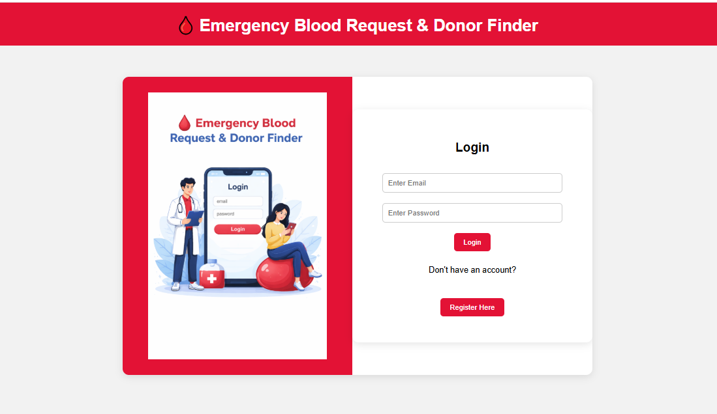
Screenshots for FWD

Slide 18
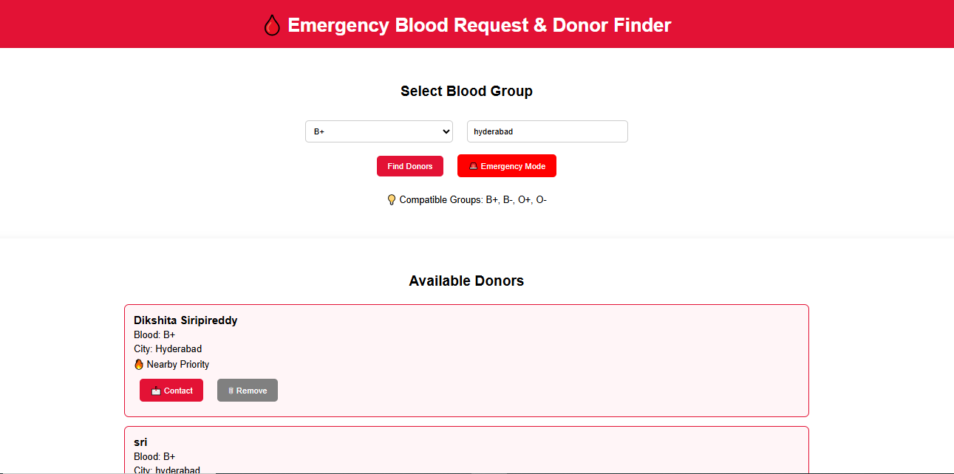

Slide 19
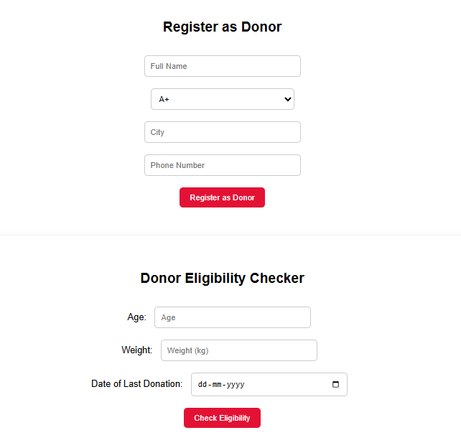

Slide 20
Conclusion
This project successfully developed a web-based Emergency Blood Request & Donor Finder System using HTML, CSS, and JavaScript. The system allows users to search donors based on blood group and location, activate emergency mode, and check donor eligibility using predefined health rules. The project enhanced our understanding of DOM manipulation, event handling, browser storage, and client-side application development. Overall, this project demonstrates how basic web technologies can be used to solve real-world problems effectively.

Slide 21
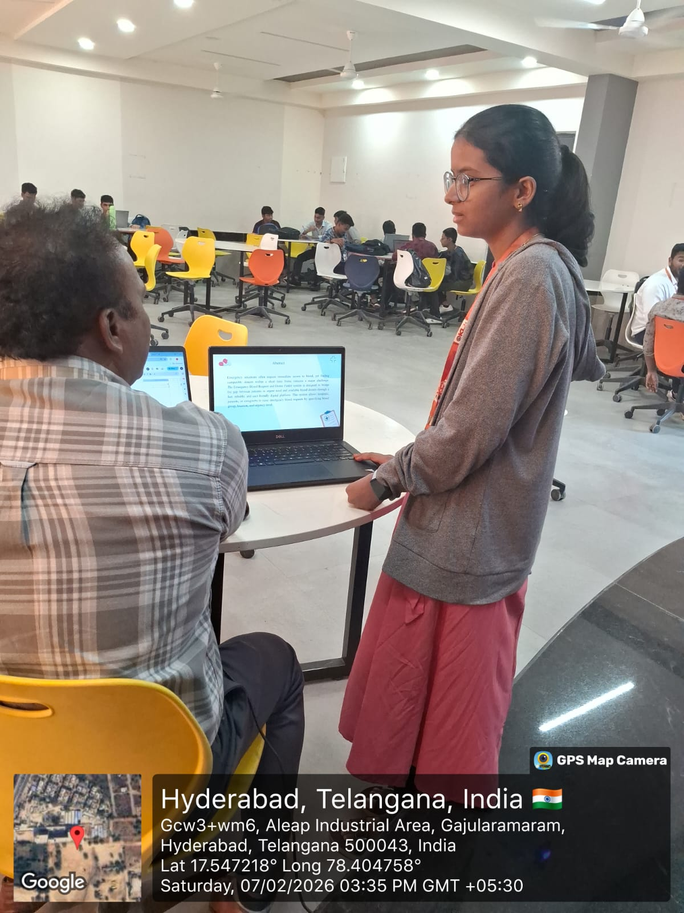
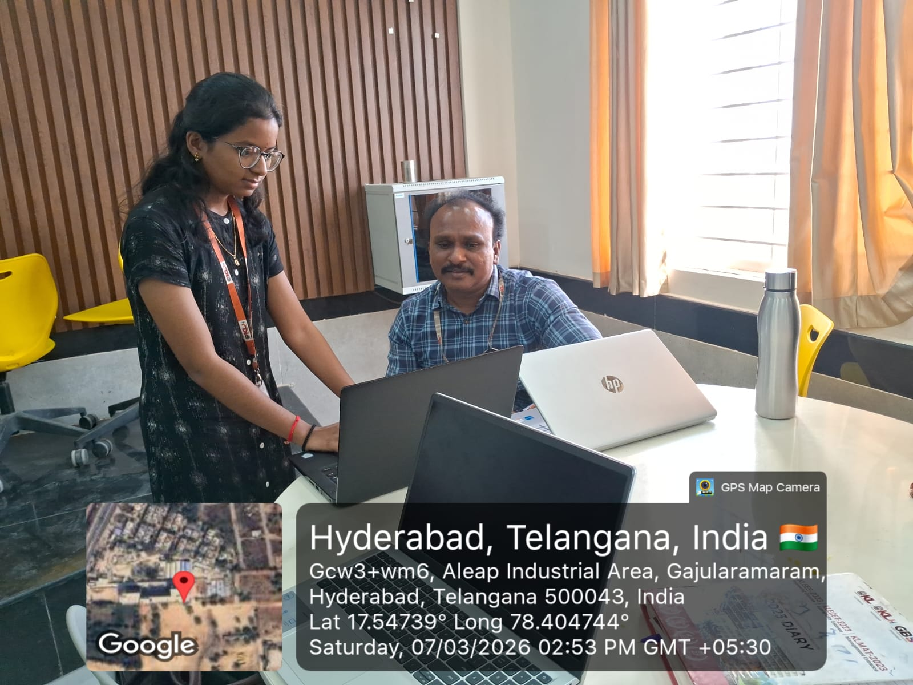
Geo- Tag Photos

Slide 22
THANK YOU

