Slide 1







IBM Capstone Project
Dikshita Reddy
4 January 2024

Slide 2



OUTLINE
Executive Summary
Introduction
Methodology
Results
Visualization – Charts
Dashboard
Discussion
Findings & Implications
Conclusion
Appendix

Slide 3

EXECUTIVE SUMMARY
Current Technology Usage Trend
Language
Database
Platform
Web frame
Future Technology Trend
Language
Database
Platform
Web frame
Demographic Survey
Country and Gender Difference

Slide 4

INTRODUCTION
Analyze technology trends in software and web development among developers in the world.
Purpose of this Analysis
Identify top programming languages, Databases, platforms and Web frames
Identify skill requirement in the future
Identify human resource gap in the industry
Audience for this Presentation
Programmers
IT Industry Leaders
Computer Science Students

Slide 5

METHODOLOGY
Data Collection Sources
Data Wrangling
Data Exploration
Data Cleaning
Data Visualization
IBM Cognos
Python Matplotlib and Seaborn
Presentation

Slide 6
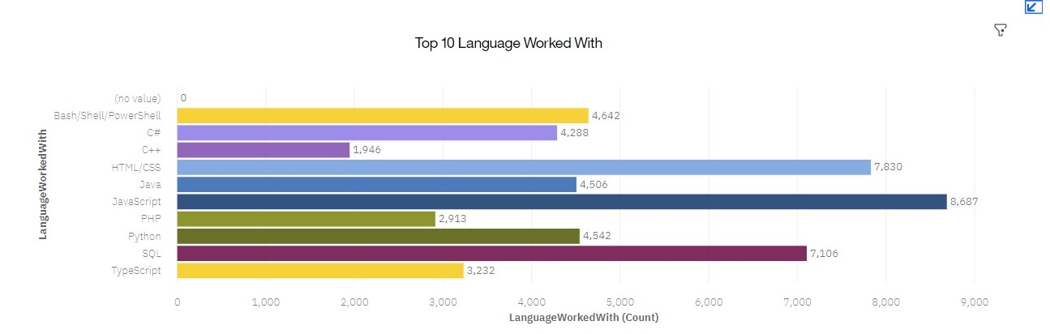
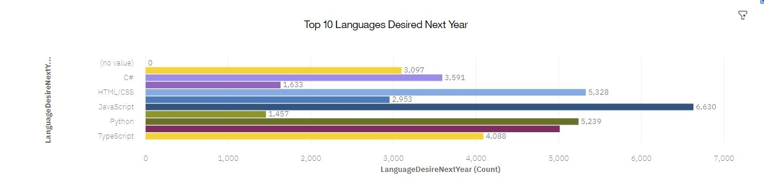
PROGRAMMING LANGUAGE TRENDS
Current Year
Next Year

Slide 7
PROGRAMMING LANGUAGE TRENDS - FINDINGS & IMPLICATIONS
Findings
JavaScript is still top trending language in the world.
Python and TypeScript are becoming more popular.
HTML/CSS and SQL still has great portion in language usage trend.
Implications
Web Development and Web Developers are still in high demand.
Java Script and TypeScript are crucial for developers to learn.
Python is the new trending language and popular in AI field.

Slide 8
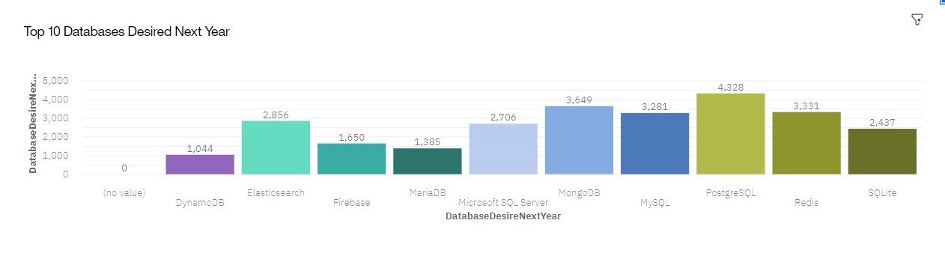
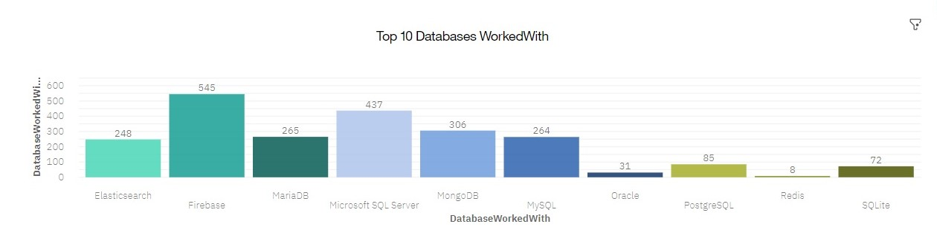
DATABASE TRENDS
Current Year
Next Year

Slide 9
DATABASE TRENDS - FINDINGS & IMPLICATIONS
Findings
MySQL is the most popular database
There are still many companies using Microsoft SQL Server
MongoDB and Redis are the most favorable NoSQL database
Implications
Open-Source Databases like MySQL are still preferable.
Software Development and Big Data technology still require SQL
NoSQL Databases will make an impact for relational databases

Slide 10

DASHBOARD
The permanent link of the read-only view of the Cognos dashboard goes here:
https://eu-de.dataplatform.cloud.ibm.com/dashboards/1b54985f-207e-416b-ba62-5a546cb06a4e/view/037fd60124892ac449ebc4e407cc2d047b367055b5bbd15289d77b495e612297a9381b91c87d4a5add470331f5ec475dc8

Slide 11
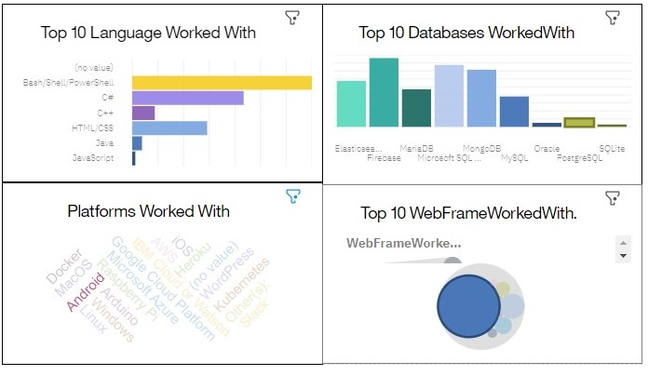
Current Technology Usage

Slide 12
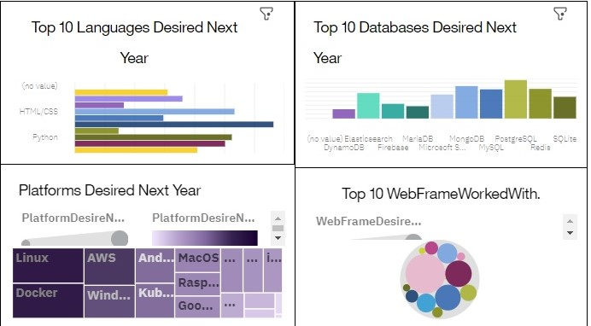
Future Technology Trend

Slide 13
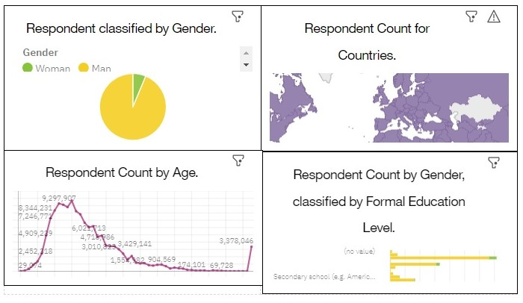
Demographics

Slide 14
DISCUSSION
Technology Usage Trends Now and Then
Gender, Age and Discrimination in IT industry

Slide 15
OVERALL FINDINGS & IMPLICATIONS
Findings
Technology trend change every year.
USA is the top technology country
There are extreme gender and age discrimination
Implications
Programmers should always follow latest technology trends
More countries should have the equal chance to be exposed to new technology.
Gender and Age should nt be one of the concerns or benefits of employment.

Slide 16

CONCLUSION
Technology Trends
Programming languages, Databases, Platforms and Web frame trends
Demographic Trends
Gender and Education
Programming Language and Salary Trends

Slide 17

APPENDIX
IBM Cognos Dashboard Embedded(CDE)is an AI-fueled business intelligence service that supports the entire Data Analytics cycle from Discovery to . It provides users with data discovery capabilities to visually explore and interact with their data to identify the key insight for improving data driven decisions. Users can perform data discovery and quickly assemble the information onto the dashboard, all without the formal training.

Slide 18
JOB POSTINGS

Slide 19
POPULAR LANGUAGES

