Slide 1

JSF

Slide 2
JSF Overview
The differentiator that JSF brings, which other similar
frameworks do not have, is the backing of a standard
specification (JSR127).
Because JSF is part of the J2EE standard specification, it
is a top priority for every major J2EE tools vendor in the
market (including Oracle, IBM, Borland, and Sun) to
support it, which in turn will guarantee a wide adoption
and good tools support.

Slide 3
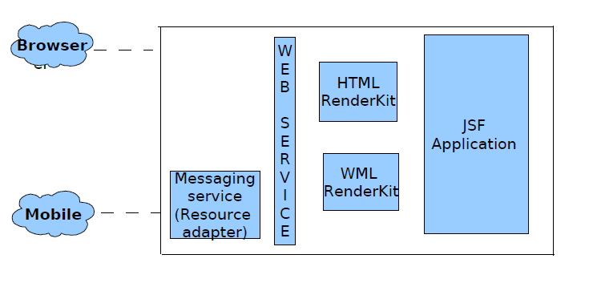

Slide 4
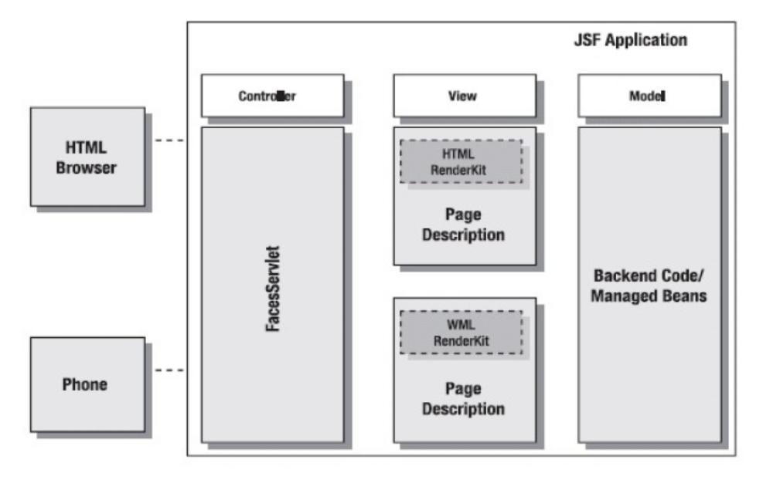

Slide 5
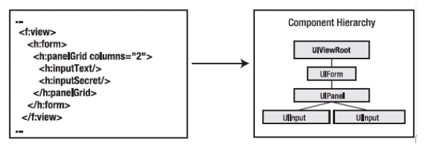

Slide 6
