Slide 1
CS-355 Project
Progress 2
Submitted by:
Diksha Bansal
1701CS19

Slide 2
ER Diagram

Slide 3
Dept
Name
Author Rank
Topic
Date
Designation
PID
Faculty
Author
Publication
doj
FID
Paper Name
Pages
Takes
Is a
Role in project
Journal
P.ID
Money
Project
Conference
Start Date
JID
Name
Sponsor
Conference Name
CID
Journal Name

Slide 4
Entities

Slide 5
Entities
Faculty:
FID: unique ID assigned to faculty member(primary key) .
Name: name of the faculty member
Dept: department of the faculty member
Profile: url of the faculty member’s profile
doj: date of joining
designation: designation of faculty member.
Project:
PID: unique ID assigned to a project(primary key) .
Start Date: start date of project
tenure: Expected tenure of the project.
Name: name of the project
Sponsor: agency sponsoring the project.nique ID assigned to a sponsors(primary key) .
Name: name of the sponsors
Contact Details: details of the sponsors

Slide 6
Entities continued..
3. Publications:
PID: unique ID assigned to publication(primary key)
Topic: topic of the publication
Date: date of the publication
Name: name of the publication in a conference
Page: number of pages
Can be:
Conference:
Conference Name: Name of conference where publication is done
CID: unique id assigned to of the publication in a conference(primary key)
Journal:
JID: unique id assigned to of the publication in a journal(primary key)
Journal Name: Name of journal where publication is done

Slide 7
Relations
Author : faculty member publishes a Publication.
Cardinality: Many to many relation (a faculty member can publish any number of publications and a publication can be published by any number of faculty members).
Takes: faculty members takes a project.
Cardinality: Many to many relation (Each project can be taken by any number of faculty members and a faculty member can take any number of projects.

Slide 8
SQL Codes

Slide 9
SQL CODE-1
CREATE TABLE faculty(
fid int,
fname varchar(40),
dept varchar(40),
doj date,
designation varchar(20),
PRIMARY KEY (fid)
);
insert into faculty values(1, "Samrat Mondal", "CSE", "2015-08-01", “Asst. Professor");
insert into faculty values(2, "Jimson Mathew", "CSE", "2014-07-07", "HOD”);
insert into faculty values(6, "Ahmad Ali", "EE", "2014-08-07", "HOD”);
insert into faculty values(7, "Dr Mohad", "ME", "2017-08-07", "HOD”);
insert into faculty values(3, "Sourav Dandapat", "CSE", "2016-03-02", "Professor");
insert into faculty values(4, "AK Verma", "MA", "2017-08-11", "HOD");
insert into faculty values(5, "Rishi Raj", "ME", "2016-08-01", "Professor");

Slide 10
SQL CODE-2
CREATE TABLE project(
pid int,
pname varchar(100),
budget int,
sponsor varchar(100),
dos date,
PRIMARY KEY (pid)
);
insert into project values(“1”, “A Platform for Cross-lingual and Multilingual Event Monitoring in Indian Languages”, 12345 , “ MEITY and MHRD, Govt. of India”, “2014-07-07” );
insert into project values(“2”, “A Software Tool for the Planning and Design of Smart Micro Power Grids”, 45000 , “MHRD”, “2015-07-07” );
insert into project values(“3”, “Elsevier Center of Excellence for Natural Language Processing”, 23467 , “Elsevier”, “2016-07-07” );
insert into project values(“4”, “ICT For Satellite Communication”, 34567 , “DEITY”, “2014-08-07” );
insert into project values(“5”, “Analytical investigation of subthreshold behavior of SiNT FETs”, 45678 , “DRDO”, “2019-07-07” );

Slide 11
SQL CODE-3
CREATE TABLE publications(
pubid int,
pname varchar(100),
dop date,
pages varchar(20),
topic varchar(50),
PRIMARY KEY (pubid)
);
insert into publications values(1001, "Query Expansion in Resource Scarce Languages", "2019-01-01", "1034-1050", "ML");
insert into publications values(1002, "Feature selection and ensemble construction", "2017-05-15", "101-105", "ML");
insert into publications values(1003, "A Multiobjective Optimization based Entity Matching Technique for Bibliographic Databases", "2018-12-14", "13-18", "ML");
insert into publications values(1004, "Binary Decision Diagram Assisted Modeling of FPGA-based Physically Unclonable Function", "2016-11-29", "201-222" , "ML");
insert into publications values(1005, "Modified parallel cascade control strategy for stable, unstable and integrating processes", "2018-11-09", "231-240", "Thermodynamics");

Slide 12
SQL CODE-4
CREATE TABLE takes(
pid int,
fid int,
role varchar(30),
PRIMARY KEY (pid, fid),
FOREIGN KEY (pid) references project(pid),
FOREIGN KEY (fid) references faculty(fid)
);
insert into takes values(1, 1, "President");
insert into takes values(1, 2, "VP");
insert into takes values(2, 3, "Fund Manager");
insert into takes values(2, 4, "President");
insert into takes values(3, 1, "VP");
insert into takes values(4, 3, "President");
insert into takes values(4, 2, "VP");
insert into takes values(5, 2, "President");
insert into takes values(6, 5, "Fund Manager");
insert into takes values(7, 5, "President");

Slide 13
SQL CODE-5
CREATE TABLE author(
fid int,
pubid int,
ARank int,
FOREIGN KEY (pubid) references publications(pubid),
FOREIGN KEY (fid) references faculty(fid),
PRIMARY KEY (fid, pubid)
);
insert into author values(1, 1001, 2);
insert into author values(1, 1005, 3);
insert into author values(3, 1003, 2);
insert into author values(2, 1001, 3);
insert into author values(2, 1004, 3);
insert into author values(2, 1002, 2);
insert into author values(3, 1004, 2);
insert into author values(3, 1002, 4);
insert into author values(4, 1004, 1);
insert into author values(5, 1005, 1);

Slide 14
SQL CODE-6
CREATE TABLE conference(
pubid int,
cname varchar(30),
PRIMARY KEY (pubid)
);
insert into conference values(1005, "ICML");
insert into conference values(1001, "ICACCI");
insert into conference values(1003, "ICONIP");

Slide 15
SQL CODE -7
CREATE TABLE journal(
pubid int,
jname varchar(30),
PRIMARY KEY (pubid)
);
insert into journal values(1002, "IEEE Transactions", 1, 4);
insert into journal values(1004, "IEEE Intelligent Systems", 2, 6);

Slide 16
Queries

Slide 17
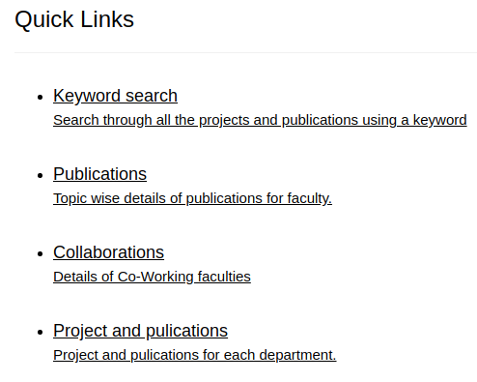
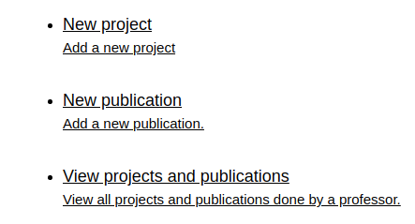
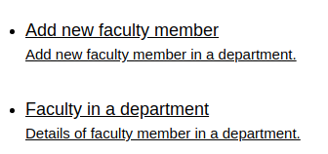
Queries:

Slide 18
Adding a new project

Slide 19
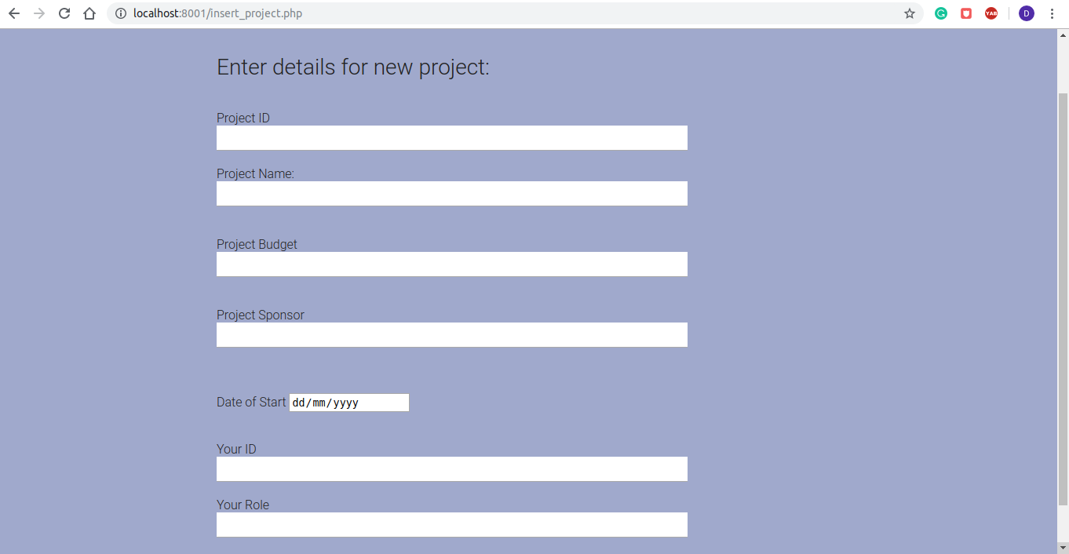

Slide 20
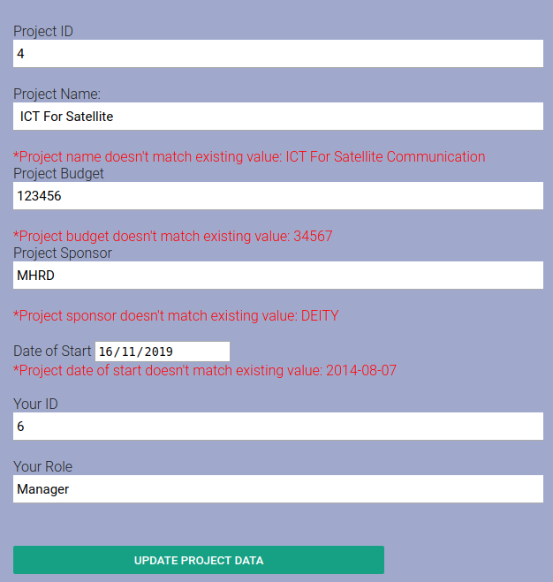
Dealing with inconsistencies
If new project is added to database where project data is already present in the database(added by another faculty), it will check if project name, budget, sponsor and date of start of new data matches with existing one.
if it matches, project is updated with the role of new faculty.
if it doesn’t match, error messages are shown as in figure, and it shows an option to update project data when clicked will update project data with new values.

Slide 21
Adding a new publication

Slide 22


Slide 23
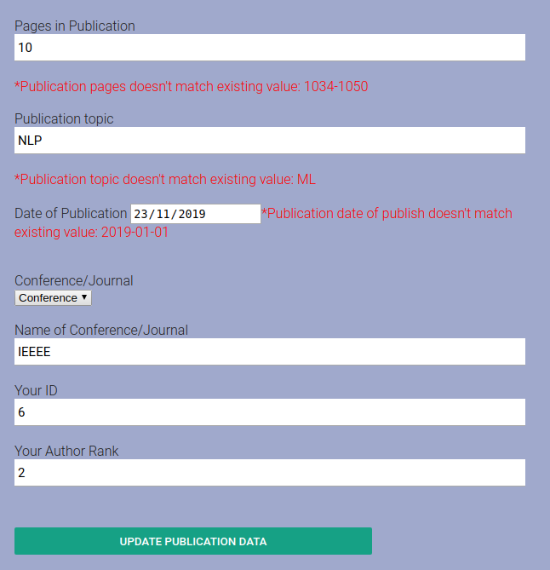
Dealing with inconsistencies
If new publication is added to database where publication data is already present in the database(added by another faculty), it will check if publication details of new data matches with existing one.
if it matches, publication is updated with the rank of new faculty.
if it doesn’t match, error messages are shown as in figure, and it shows an option to update publication data when clicked will update publication data with new values.

Slide 24
Adding a new faculty member

Slide 25
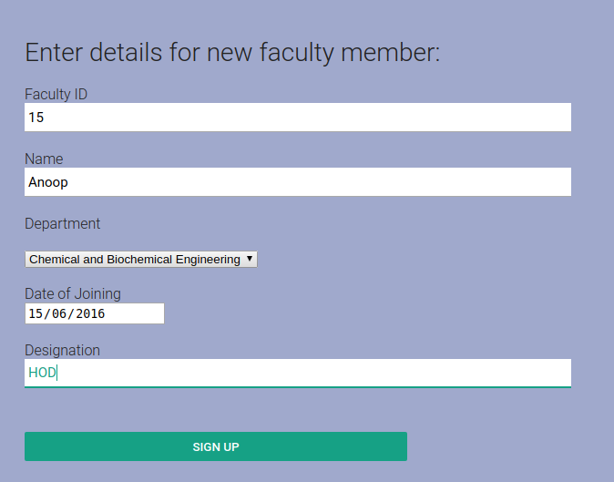
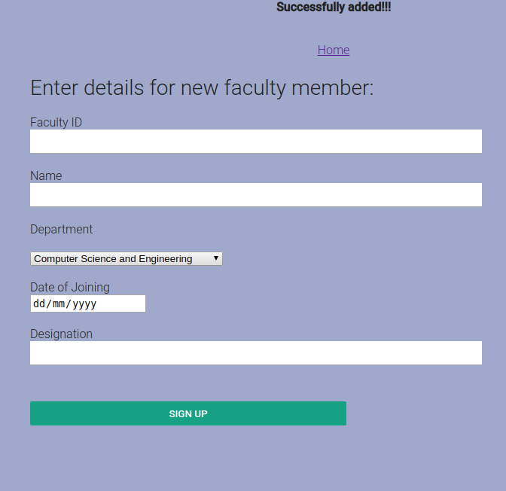

Slide 26
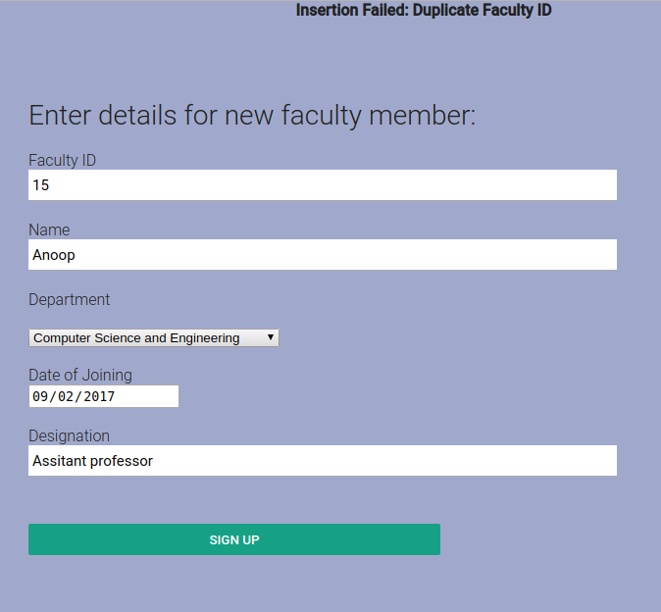
Dealing with inconsistencies
If insertion is failed it will show the error with values pre-filled in the form.

Slide 27
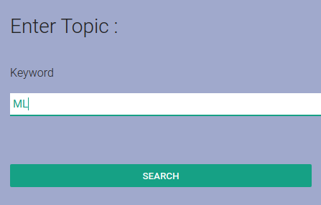
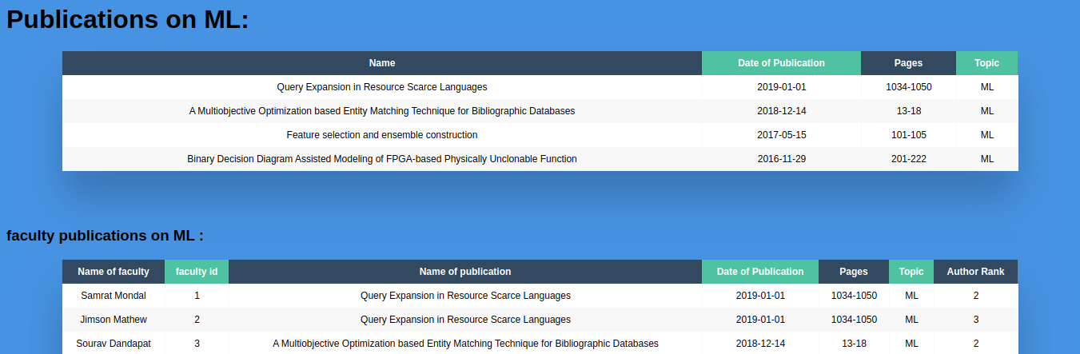
Keyword search
Keyword search enables user to search through all publications and projects using a word related to query.

Slide 28
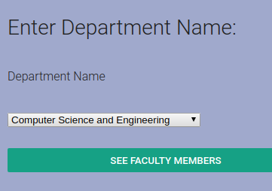
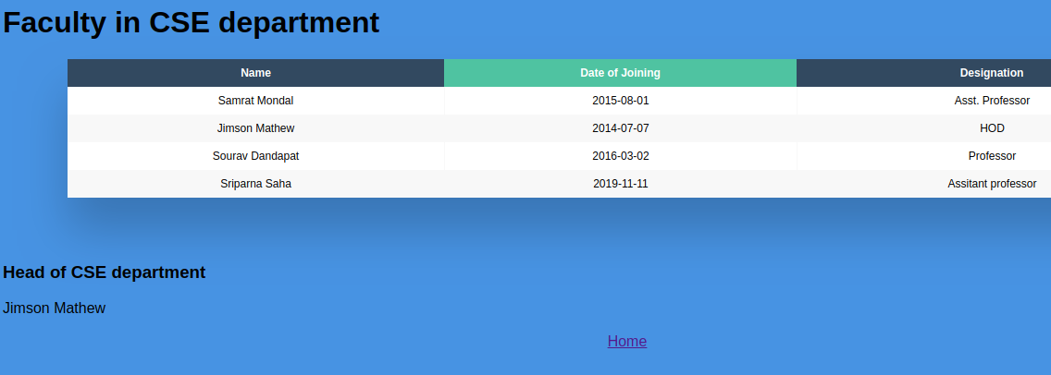
Faculty in each department

Slide 29
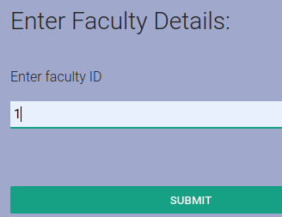
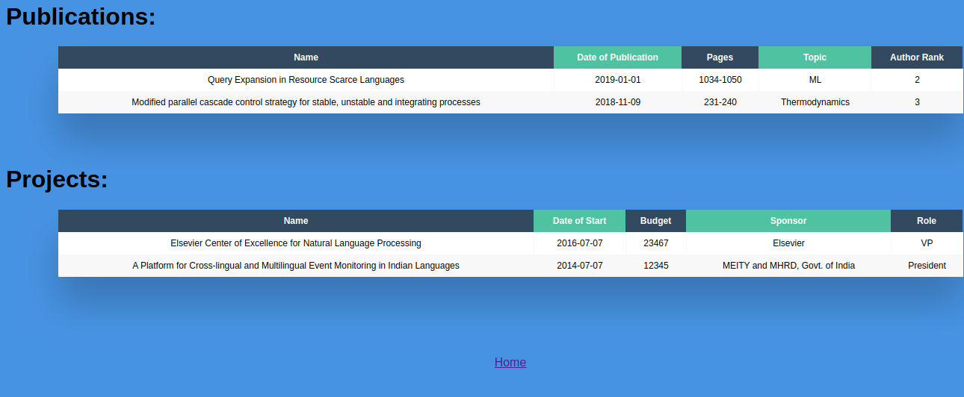
View publication/projects by individual faculty

Slide 30
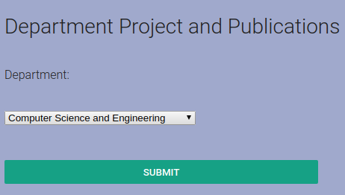
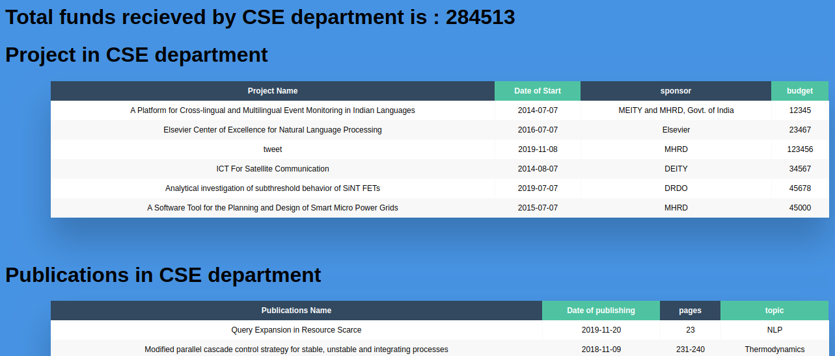
Department wise projects and publications

Slide 31
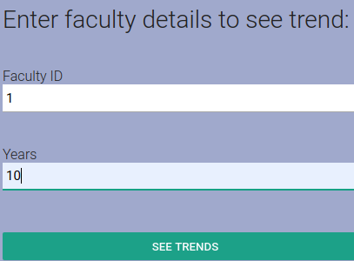
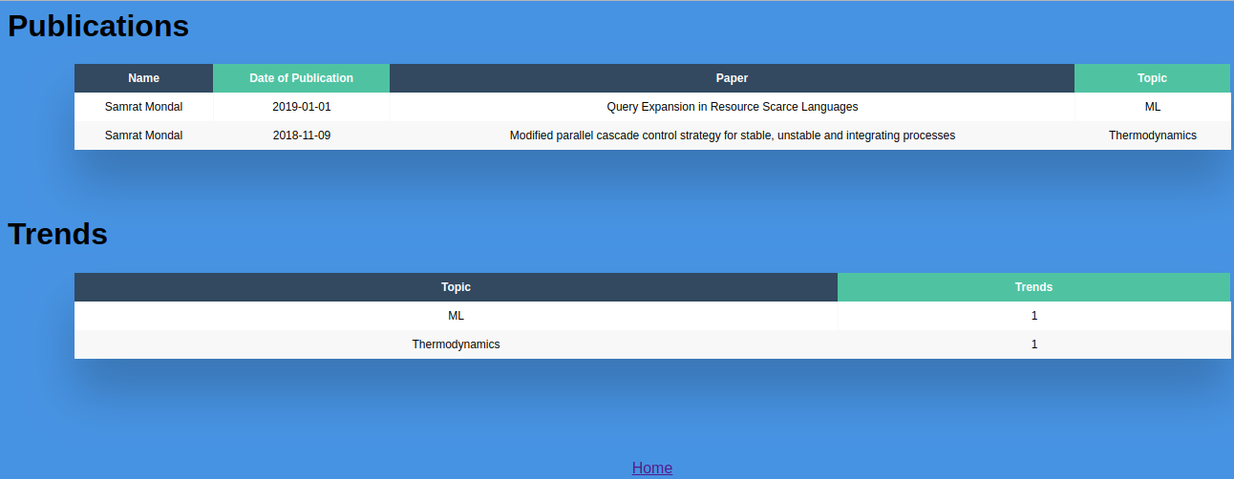
Publication:
topic wise details of a publications done by a faculty

Slide 32
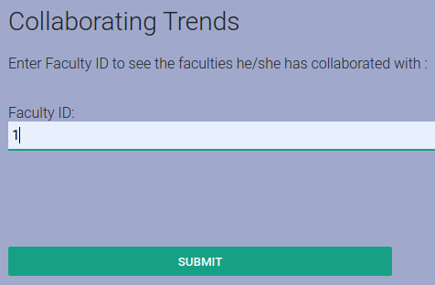
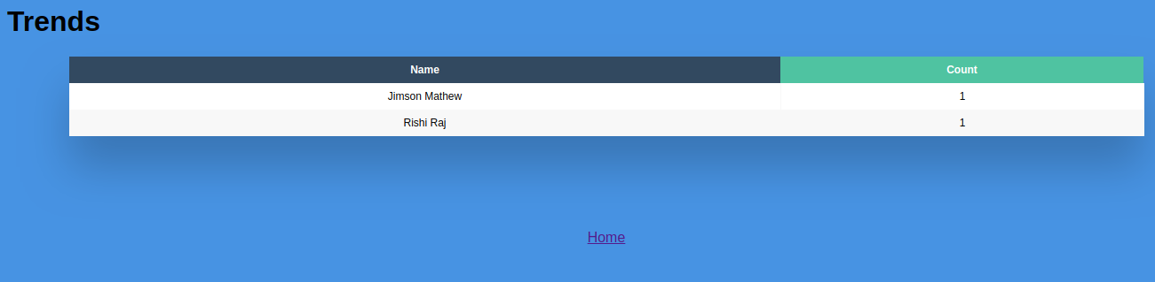
Collaborations:
Collaborations done by a faculty

Slide 33
Thank You

