Slide 1
Operating Systems:
Perspectives and Summary
Computer Systems
Nov. 23, 2017
Troels Henriksen
Based on slides by:
Randal E. Bryant and David R. O’Hallaron

Slide 2
Motivation for Performance
The only purpose of a computing machine is to be faster than a human.
All novel programs are the result of a good idea combined with a performance surplus.
  Surplus can be generated by new/more/better machines.
  … or by clever programming.
We can no longer (only) depend on engineers solving our problems by building better machines.

Slide 3
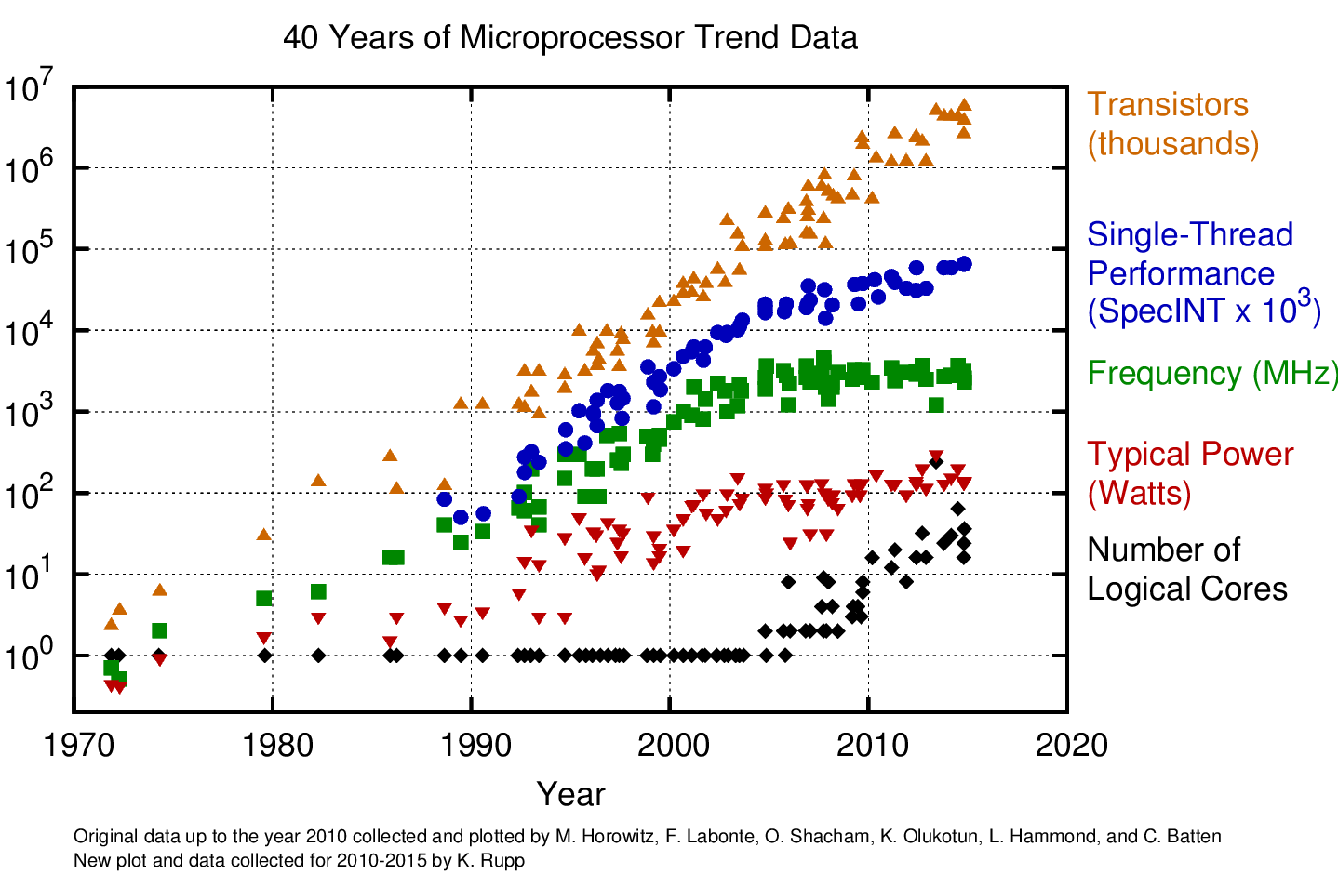
Our Situation

Slide 4
Inspirational quote
"The most amazing achievement of the computer software industry is its continuing cancellation of the steady and staggering gains made by the computer hardware industry." - Henry Petroski

Slide 5

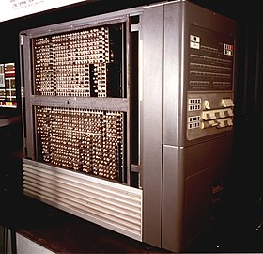
Example: high-level languages
The performance surplus: computers of the 50s got faster and faster (1000s of statements per second!).
The good idea: a high-level language (FORTRAN) could improve productivity, in most cases offsetting the lower performance compared to hand-coding.
The edge: an optimizing compiler (particularly CSE) was used to narrow the gap (see THE FORTRAN AUTOMATIC CODING SYSTEM from 1957).

Slide 6
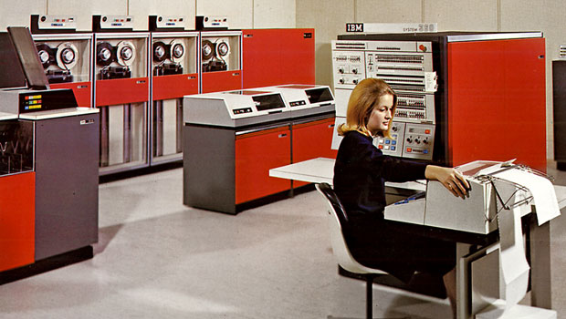
Example: operating systems
The performance surplus: increasing transistor budgets afforded non-computational circuits like MMUs.
The good idea: impose a virtualisation layer that permitted running multiple applications simultaneously, safely.
The edge: a clean distinction between API and implementation, making a single program runnable on machines of vastly different capabilities (IBM System/360).

Slide 7
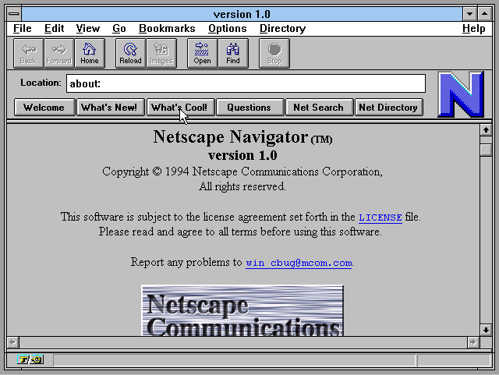
Example: Visual web browsers
The performance surplus: personal computers of the early 90s got fast enough to run sophisticated GUIs.
The good idea: accessible hypertext along with really clever programming in the browsers – particularly to handle concurrent network requests alongside rendering.
  Later: JIT compilation of Javascript (particularly Chrome’s V8 in 2008) sped up web applications to create a new software-based performance surplus.

Slide 8
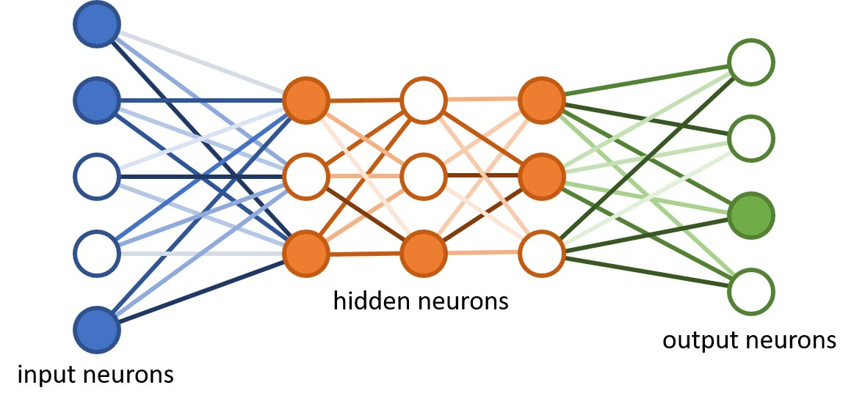
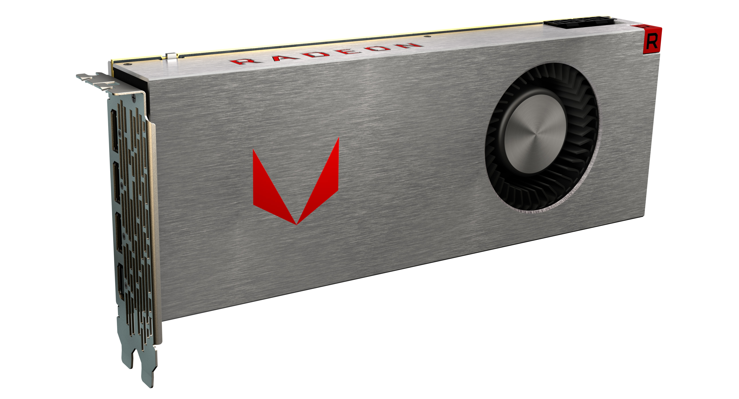
Example: Deep Learning
The good (and old) idea: deep sequences of simple layers of neurons can be trained to perform input classification, if given sufficient (huge) numbers of examples.
The performance surplus: cheap massive parallelism in the form of generally programmable graphics processors (GPUs), funded by millions of gamers in the 90s.
The edge: programming tools and techniques that made GPUs accessible to more than just graphics.

Slide 9
Non-Unix operating systems
Not everything has to be as I have taught you. It is healthy to look at very different ways of doing things.
All applied computer science is something someone made up!
Forth: mostly on bare hardware.
Lisp Machines: hardware support for a high-level language.
Smalltalk: image-based development https://squeak.org/.
VMS: historical competitor to Unix.
z/OS: mainframe OS from IBM.

Slide 10
Summary: Control Flow

Slide 11
Control Flow
Processors do only one thing:
  From startup to shutdown, a CPU simply reads and executes (interprets) a sequence of instructions, one at a time
  This sequence is the CPU’s control flow (or flow of control)
Physical control flow
<startup>
inst₁
inst₂
inst₃
…
inst_{n}
<shutdown>
Time

Slide 12
Exceptional Control Flow
Exists at all levels of a computer system
Low level mechanisms
  1. Exceptions
    Change in control flow in response to a system event
    (i.e., change in system state)
    Implemented using combination of hardware and OS software
Higher level mechanisms
  2. Process context switch
    Implemented by OS software and hardware timer
  3. Signals
    Implemented by OS software
  4. Nonlocal jumps: setjmp() and longjmp()
    Implemented by C runtime library

Slide 13
Exceptions
An exception is a transfer of control to the OS kernel in response to some event (i.e., change in processor state)
  Kernel is the memory-resident part of the OS
  Examples of events: Divide by 0, arithmetic overflow, page fault, I/O request completes, typing Ctrl-C
User code
Kernel code
Event
I_current
Exception
I_next
Exception processing
by exception handler
Return to I_current
Return to I_next
Abort

Slide 14
Asynchronous Exceptions (Interrupts)
Caused by events external to the processor
  Indicated by setting the processor’s interrupt pin
  Handler returns to “next” instruction
Examples:
  Timer interrupt
    Every few ms, an external timer chip triggers an interrupt
    Used by the kernel to take back control from user programs
  I/O interrupt from external device
    Hitting Ctrl-C at the keyboard
    Arrival of a packet from a network
    Arrival of data from a disk

Slide 15
Synchronous Exceptions
Caused by events that occur as a result of executing an instruction:
  Traps
    Intentional
    Examples: system calls, breakpoint traps, special instructions
    Returns control to “next” instruction
  Faults
    Unintentional but possibly recoverable
    Examples: page faults (recoverable), protection faults (unrecoverable), floating point exceptions
    Either re-executes faulting (“current”) instruction or aborts
  Aborts
    Unintentional and unrecoverable
    Examples: illegal instruction (actually SIGILL), parity error, machine check
    Aborts current program

Slide 16
System Calls
Each x86-64 system call has a unique ID number
Examples:
Number | Name | Description
0 | read | Read file
1 | write | Write file
2 | open | Open file
3 | close | Close file
4 | stat | Get info about file
57 | fork | Create process
59 | execve | Execute a program
60 | _exit | Terminate process
62 | kill | Send signal to process

Slide 17
System Call Example: Opening File
User calls: open(filename, options)
Calls __open function, which invokes system call instruction syscall
00000000000e5d70 <__open>:
...
e5d79: b8 02 00 00 00 mov $0x2,%eax # open is syscall #2
e5d7e: 0f 05 syscall # Return value in %rax
e5d80: 48 3d 01 f0 ff ff cmp $0xfffffffffffff001,%rax
...
e5dfa: c3 retq
User code
Kernel code
%rax contains syscall number
Other arguments in %rdi, %rsi, %rdx, %r10, %r8, %r9
Return value in %rax
Negative value is an error corresponding to negative errno
syscall
Exception
cmp
Open file
Returns

Slide 18
Fault Example: Page Fault
int a[1000];
main ()
{
a[500] = 13;
}
User writes to memory location
That portion (page) of user’s memory
is currently on disk
80483b7: c7 05 10 9d 04 08 0d movl $0xd,0x8049d10
User code
Kernel code
Exception: page fault
movl
Copy page from disk to memory
Return and reexecute movl

Slide 19
Summary: Processes

Slide 20
Processes
Definition: A process is an instance of a running program.
  One of the most profound ideas in computer science
  Not the same as “program” or “processor”
Process provides each program with two key abstractions:
  Logical control flow
    Each program seems to have exclusive use of the CPU
    Provided by kernel mechanism called context switching
  Private address space
    Each program seems to have exclusive use of main memory.
    Provided by kernel mechanism called virtual memory
Memory
Stack
Heap
Data
Code
CPU
Registers

Slide 21
Multiprocessing: The Illusion
Memory
Memory
Memory
Stack
Stack
Stack
Heap
Heap
…
Heap
Data
Data
Data
Code
Code
Code
CPU
CPU
CPU
Registers
Registers
Registers
Computer runs many processes simultaneously
  Applications for one or more users
    Web browsers, email clients, editors, …
  Background tasks
    Monitoring network & I/O devices

Slide 22
Multiprocessing: The (Traditional) Reality
Memory
Stack
Stack
Stack
Heap
Heap
…
Heap
Data
Data
Data
Code
Code
Code
Saved registers
Saved registers
Saved registers
CPU
Registers
Single processor executes multiple processes concurrently
  Process executions interleaved (multitasking)
  Address spaces managed by virtual memory system (later in course)
  Register values for nonexecuting processes saved in memory

Slide 23
Multiprocessing: The (Traditional) Reality
Memory
Stack
Stack
Stack
Heap
Heap
…
Heap
Data
Data
Data
Code
Code
Code
Saved registers
Saved registers
Saved registers
CPU
Registers
Save current registers in memory

Slide 24
Multiprocessing: The (Traditional) Reality
Memory
Stack
Stack
Stack
Heap
Heap
…
Heap
Data
Data
Data
Code
Code
Code
Saved registers
Saved registers
Saved registers
CPU
Registers
Schedule next process for execution

Slide 25
Multiprocessing: The (Traditional) Reality
Memory
Stack
Stack
Stack
Heap
Heap
…
Heap
Data
Data
Data
Code
Code
Code
Saved registers
Saved registers
Saved registers
CPU
Registers
Load saved registers and switch address space (context switch)

Slide 26
Concurrent Processes
Each process is a logical control flow.
Two processes run concurrently (are concurrent) if their flows overlap in time
Otherwise, they are sequential
Examples (running on single core):
  Concurrent: A & B, A & C
  Sequential: B & C
Process A
Process B
Process C
Time

Slide 27
User View of Concurrent Processes
Control flows for concurrent processes are physically disjoint in time
However, we can think of concurrent processes as running in parallel with each other
Process A
Process B
Process C
Time

Slide 28
Creating and Terminating Processes
From a programmer’s perspective, we can think of a process as being in one of three states
Running
  Process is either executing, or waiting to be executed and will eventually be scheduled (i.e., chosen to execute) by the kernel
Stopped
  Process execution is suspended and will not be scheduled until further notice
Terminated
  Process is stopped permanently

Slide 29
Terminating Processes
Process becomes terminated for one of three reasons:
  Receiving a signal whose default action is to terminate (next lecture)
  Returning from the main routine
  Calling the exit function
  Last thread terminates with pthread_exit
void exit(int status)
  Terminates with an exit status of status
  Convention: normal return status is 0, nonzero on error
  Another way to explicitly set the exit status is to return an integer value from the main routine
exit is called once but never returns.

Slide 30
Creating Processes
Parent process creates a new running child process by calling fork
int fork(void)
  Returns 0 to the child process, child’s PID to parent process
  Child is almost identical to parent:
    Child get an identical (but separate) copy of the parent’s virtual address space.
    Child gets identical copies of the parent’s open file descriptors
    Child has a different PID than the parent
fork is interesting (and often confusing) because
it is called once but returns twice

Slide 31
Reaping Child Processes
Idea
  When process terminates, it still consumes system resources
    Examples: Exit status, various OS tables
  Called a “zombie”
    Living corpse, half alive and half dead
Reaping
  Performed by parent on terminated child (using wait or waitpid)
  Parent is given exit status information
  Kernel then deletes zombie child process
What if parent doesn’t reap?
  If any parent terminates without reaping a child, then the orphaned child will be reaped by init process (pid == 1)
  So, only need explicit reaping in long-running processes
    e.g., shells and servers

Slide 32
wait: Synchronizing with Children
Parent reaps a child by calling the wait function
int wait(int *child_status)
  Suspends current process until one of its children terminates
  Return value is the pid of the child process that terminated
  If child_status != NULL, then the integer it points to will be set to a value that indicates reason the child terminated and the exit status:
    Checked using macros defined in wait.h
      WIFEXITED, WEXITSTATUS, WIFSIGNALED, WTERMSIG, WIFSTOPPED, WSTOPSIG, WIFCONTINUED
      See textbook for details

Slide 33
Summary: Signals

Slide 34
Signals
A signal is a small message that notifies a process that an event of some type has occurred in the system
  Akin to exceptions and interrupts
  Sent from the kernel (sometimes at the request of another process) to a process
  Signal type is identified by small integer ID’s (1-30)
  Only information in a signal is its ID and the fact that it arrived
ID | Name | Default Action | Corresponding Event
2 | SIGINT | Terminate | User typed ctrl-c
9 | SIGKILL | Terminate | Kill program (cannot override or ignore)
11 | SIGSEGV | Terminate | Segmentation violation
14 | SIGALRM | Terminate | Timer signal
17 | SIGCHLD | Ignore | Child stopped or terminated

Slide 35
Signal Concepts: Sending a Signal
Kernel sends (delivers) a signal to a destination process by updating some state in the context of the destination process
Kernel sends a signal for one of the following reasons:
  Kernel has detected a system event such as divide-by-zero (SIGFPE) or the termination of a child process (SIGCHLD)
  Another process has invoked the kill system call to explicitly request the kernel to send a signal to the destination process

Slide 36
Signal Concepts: Receiving a Signal
A destination process receives a signal when it is forced by the kernel to react in some way to the delivery of the signal
Some possible ways to react:
  Ignore the signal (do nothing)
  Terminate the process (with optional core dump)
  Catch the signal by executing a user-level function called signal handler
    Akin to a hardware exception handler being called in response to an asynchronous interrupt:
(1) Signal received by process
(2) Control passes
to signal handler
I_{curr}
I_{next}
(3) Signal handler runs
(4) Signal handler
returns to
next instruction

Slide 37
Signal Concepts: Pending and Blocked Signals
A signal is pending if sent but not yet received
  There can be at most one pending signal of any particular type
  Important: Signals are not queued
    If a process has a pending signal of type k, then subsequent signals of type k that are sent to that process are discarded
A process can block the receipt of certain signals
  Blocked signals can be delivered, but will not be received until the signal is unblocked
A pending signal is received at most once

Slide 38
Signal Concepts: Pending/Blocked Bits
Kernel maintains pending and blocked bit vectors in the context of each process
  pending: represents the set of pending signals
    Kernel sets bit k in pending when a signal of type k is delivered
    Kernel clears bit k in pending when a signal of type k is received
  blocked: represents the set of blocked signals
    Can be set and cleared by using the sigprocmask function
    Also referred to as the signal mask.

Slide 39
Receiving Signals
Suppose kernel is returning from an exception handler and is ready to pass control to process p
Kernel computes pnb = pending & ~blocked
  The set of pending nonblocked signals for process p
If (pnb == 0)
  Pass control to next instruction in the logical flow for p
Else
  Choose least nonzero bit k in pnb and force process p to receive signal k
  The receipt of the signal triggers some action by p
  Repeat for all nonzero k in pnb
  Pass control to next instruction in logical flow for p

Slide 40
Signals Handlers as Concurrent Flows
A signal handler is a separate logical flow (not process) that runs concurrently with the main program
Process A
while (1)
;
Process A
handler(){
…
}
Process B
Time

Slide 41
Nested Signal Handlers
Handlers can be interrupted by other handlers
Main program
Handler S
Handler T
(2) Control passes to handler S
(1) Program catches signal s
I_{curr}
(4) Control passes to handler T
(3) Program catches signal t
(7) Main program resumes
I_{next}
(6) Handler S
returns to main program
(5) Handler T
returns to handler S

Slide 42
Summary: Virtual Memory

Slide 43
A System Using Virtual Addressing
Main memory
0:
CPU Chip
1:
Virtual address
(VA)
Physical address
(PA)
2:
CPU
MMU
3:
4
4:
4100
5:
6:
Data word
7:
8:
...
M-1:
Used in all modern servers, laptops, and smart phones
One of the great ideas in computer science

Slide 44
Why Virtual Memory (VM)?
Uses main memory efficiently
  Use DRAM as a cache for parts of a virtual address space
Simplifies memory management
  Each process gets the same uniform linear address space
Isolates address spaces
  One process can’t interfere with another’s memory
  User program cannot access privileged kernel information and code

Slide 45
Enabling Data Structure: Page Table
A page table is an array of page table entries (PTEs) that maps virtual pages to physical pages.
  Per-process kernel data structure in DRAM
Physical memory
(DRAM)
Physical page
number or
disk address
Valid
VP 1
PP 0
PTE 0
0
null
VP 2
1
VP 7
VP 4
PP 3
1
0
1
0
null
Virtual memory
(disk)
0
PTE 7
1
VP 1
Memory resident
page table
(DRAM)
VP 2
VP 3
VP 4
VP 6
VP 7

Slide 46
Page Hit
Page hit: reference to VM word that is in physical memory (DRAM cache hit)
Physical memory
(DRAM)
Physical page
number or
disk address
Virtual address
Valid
VP 1
PP 0
PTE 0
0
null
VP 2
1
VP 7
VP 4
PP 3
1
0
1
0
null
Virtual memory
(disk)
0
PTE 7
1
VP 1
Memory resident
page table
(DRAM)
VP 2
VP 3
VP 4
VP 6
VP 7

Slide 47
Page Fault
Page fault: reference to VM word that is not in physical memory (DRAM cache miss)
Physical memory
(DRAM)
Physical page
number or
disk address
Virtual address
Valid
VP 1
PP 0
PTE 0
0
null
VP 2
1
VP 7
VP 4
PP 3
1
0
1
0
null
Virtual memory
(disk)
0
PTE 7
1
VP 1
Memory resident
page table
(DRAM)
VP 2
VP 3
VP 4
VP 6
VP 7

Slide 48
Handling Page Fault
Page miss causes page fault (an exception)
Physical memory
(DRAM)
Physical page
number or
disk address
Virtual address
Valid
VP 1
PP 0
PTE 0
0
null
VP 2
1
VP 7
VP 4
PP 3
1
0
1
0
null
Virtual memory
(disk)
0
PTE 7
1
VP 1
Memory resident
page table
(DRAM)
VP 2
VP 3
VP 4
VP 6
VP 7

Slide 49
Handling Page Fault
Page miss causes page fault (an exception)
Page fault handler selects a victim to be evicted (here VP 4)
Physical memory
(DRAM)
Physical page
number or
disk address
Virtual address
Valid
VP 1
PP 0
PTE 0
0
null
VP 2
1
VP 7
VP 4
PP 3
1
0
1
0
null
Virtual memory
(disk)
0
PTE 7
1
VP 1
Memory resident
page table
(DRAM)
VP 2
VP 3
VP 4
VP 6
VP 7

Slide 50
Handling Page Fault
Page miss causes page fault (an exception)
Page fault handler selects a victim to be evicted (here VP 4)
Physical memory
(DRAM)
Physical page
number or
disk address
Virtual address
Valid
VP 1
PP 0
PTE 0
0
null
VP 2
1
VP 7
VP 3
PP 3
1
1
0
0
null
Virtual memory
(disk)
0
PTE 7
1
VP 1
Memory resident
page table
(DRAM)
VP 2
VP 3
VP 4
VP 6
VP 7

Slide 51
Handling Page Fault
Page miss causes page fault (an exception)
Page fault handler selects a victim to be evicted (here VP 4)
Offending instruction is restarted: page hit!
Physical memory
(DRAM)
Physical page
number or
disk address
Virtual address
Valid
VP 1
PP 0
PTE 0
0
null
VP 2
1
VP 7
VP 3
PP 3
1
1
0
0
null
Virtual memory
(disk)
0
PTE 7
1
VP 1
Memory resident
page table
(DRAM)
VP 2
VP 3
Key point: Waiting until the miss to copy the page to DRAM is known as demand paging
VP 4
VP 6
VP 7

Slide 52
VM as a Tool for Memory Management
Key idea: each process has its own virtual address space
  It can view memory as a simple linear array
  Mapping function scatters addresses through physical memory
    Well-chosen mappings can improve locality
0
Address
translation
0
Virtual Address Space for Process 1:
Physical
Address
Space (DRAM)
VP 1
VP 2
PP 2
...
N-1
PP 6
(e.g., read-only
library code)
Virtual Address Space for Process 2:
0
PP 8
VP 1
VP 2
...
...
N-1
M-1

Slide 53
VM as a Tool for Memory Protection
Extend PTEs with permission bits
MMU checks these bits on each access
Physical
Address Space
Process i:
SUP
READ
WRITE
EXEC
Address
VP 0:
No
Yes
No
Yes
PP 6
VP 1:
No
Yes
Yes
Yes
PP 4
VP 2:
Yes
Yes
Yes
No
PP 2
PP 2
•
•
•
PP 4
PP 6
Process j:
SUP
READ
WRITE
EXEC
Address
PP 8
VP 0:
No
Yes
No
Yes
PP 9
PP 9
VP 1:
Yes
Yes
Yes
Yes
PP 6
VP 2:
No
Yes
Yes
Yes
PP 11
PP 11

Slide 54
Address Translation With a Page Table
Virtual address
Page table
base register
(PTBR)
n-1
p
p-1
0
Virtual page number (VPN)
Virtual page offset (VPO)
Page table
Valid
Physical page number (PPN)
Physical page table
address for the current
process
Valid bit = 0:
Page not in memory
(page fault)
Valid bit = 1
m-1
p
p-1
0
Physical page number (PPN)
Physical page offset (PPO)
Physical address

Slide 55
Address Translation: Page Hit
CPU Chip
2
Cache/
Memory
MMU
PTEA
1
PTE
CPU
VA
3
PA
4
Data
5
1) Processor sends virtual address to MMU
2-3) MMU fetches PTE from page table in memory
4) MMU sends physical address to cache/memory
5) Cache/memory sends data word to processor

Slide 56
Address Translation: Page Fault
Exception
Page fault handler
4
CPU Chip
2
Cache/
Memory
Disk
MMU
PTEA
Victim page
1
5
CPU
VA
PTE
7
3
New page
6
1) Processor sends virtual address to MMU
2-3) MMU fetches PTE from page table in memory
4) Valid bit is zero, so MMU triggers page fault exception
5) Handler identifies victim (and, if dirty, pages it out to disk)
6) Handler pages in new page and updates PTE in memory
7) Handler returns to original process, restarting faulting instruction

Slide 57
User-Level Memory Mapping
void *mmap(void *start, int len,
int prot, int flags, int fd, int offset)
Map len bytes starting at offset offset of the file specified by file description fd, preferably at address start
  start: may be 0 for “pick an address”
  prot: PROT_READ, PROT_WRITE, ...
  flags: MAP_ANON, MAP_PRIVATE, MAP_SHARED, ...
Return a pointer to start of mapped area (may not be start)

Slide 58
User-Level Memory Mapping
void *mmap(void *start, int len,
int prot, int flags, int fd, int offset)
len bytes
start
(or address
chosen by kernel)
len bytes
offset
(bytes)
0
0
Disk file specified by
file descriptor fd
Process virtual memory

Slide 59
Summary: Dynamic Memory Allocation

Slide 60
Dynamic Memory Allocation
Programmers use dynamic memory allocators (such as malloc) to acquire VM at run time.
  For data structures whose size is only known at runtime.
Dynamic memory allocators manage an area of process virtual memory known as the heap.
Application
Dynamic Memory Allocator
Heap
User stack
Top of heap
(brk ptr)
Heap (via malloc)
Uninitialized data (.bss)
Initialized data (.data)
Program text (.text)
0

Slide 61
The malloc Package
#include <stdlib.h>
void *malloc(size_t size)
  Successful:
    Returns a pointer to a memory block of at least size bytes
    aligned to an 8-byte (x86) or 16-byte (x86-64) boundary
    If size == 0, returns NULL
  Unsuccessful: returns NULL (0) and sets errno
void free(void *p)
  Returns the block pointed at by p to pool of available memory
  p must come from a previous call to malloc or realloc
Other functions
  calloc: Version of malloc that initializes allocated block to zero.
  realloc: Changes the size of a previously allocated block.
  sbrk: Used internally by allocators to grow or shrink the heap

Slide 62
Allocation Example
p1 = malloc(4)
p2 = malloc(5)
p3 = malloc(6)
free(p2)
p4 = malloc(2)

Slide 63
Constraints
Applications
  Can issue arbitrary sequence of malloc and free requests
  free request must be to a malloc’d block (or NULL)
Allocators
  Can’t control number or size of allocated blocks
  Must respond immediately to malloc requests
    i.e., can’t reorder or buffer requests
  Must allocate blocks from free memory
    i.e., can only place allocated blocks in free memory
  Must align blocks so they satisfy all alignment requirements
    8-byte (x86) or 16-byte (x86-64) alignment on Linux boxes
  Can manipulate and modify only free memory
  Can’t move the allocated blocks once they are malloc’d
    i.e., compaction is not allowed (why?)

Slide 64
Performance Goal: Throughput
Given some sequence of malloc and free requests:
  R₀, R₁, ..., R_{k}, ... , R_{n-1}
Goals: maximize throughput and peak memory utilization
  These goals are often conflicting
Throughput:
  Number of completed requests per unit time
  Example:
    5,000 malloc calls and 5,000 free calls in 10 seconds
    Throughput is 1,000 operations/second

Slide 65
Performance Goal: Peak Memory Utilization
Given some sequence of malloc and free requests:
  R₀, R₁, ..., R_{k}, ... , R_{n-1}
Def: Aggregate payload P_{k}
  malloc(p) results in a block with a payload of p bytes
  After request R_{k} has completed, the aggregate payload P_{k} is the sum of currently allocated payloads
Def: Current heap size H_{k}
  Assume H_{k} is monotonically nondecreasing
    i.e., heap only grows when allocator uses sbrk
Def: Peak memory utilization after k+1 requests
  U_{k} = ( max_{i<=k} P_{i} ) / H_{k}

Slide 66
Fragmentation
Poor memory utilization caused by fragmentation
  internal fragmentation
  external fragmentation

Slide 67
Internal Fragmentation
For a given block, internal fragmentation occurs if payload is smaller than block size
Caused by
  Overhead of maintaining heap data structures
  Padding for alignment purposes
  Explicit policy decisions
  (e.g., to return a big block to satisfy a small request)
Depends only on the pattern of previous requests
  Thus, easy to measure
Block
Internal
fragmentation
Payload
Internal
fragmentation

Slide 68
External Fragmentation
Occurs when there is enough aggregate heap memory, but no single free block is large enough
Depends on the pattern of future requests
  Thus, difficult to measure
p1 = malloc(4)
p2 = malloc(5)
p3 = malloc(6)
free(p2)
p4 = malloc(6)
Oops! (what would happen now?)

Slide 69
Implementation Issues
How do we know how much memory to free given just a pointer?
How do we keep track of the free blocks?
What do we do with the extra space when allocating a structure that is smaller than the free block it is placed in?
How do we pick a block to use for allocation -- many might fit?
How do we reinsert freed block?

Slide 70
Knowing How Much to Free
Standard method
  Keep the length of a block in the word preceding the block.
    This word is often called the header field or header
  Requires an extra word for every allocated block
p0
p0 = malloc(4)
5
block size
payload
free(p0)

Slide 71
Keeping Track of Free Blocks
Method 1: Implicit list using length—links all blocks
Method 2: Explicit list among the free blocks using pointers
Method 3: Segregated free list
  Different free lists for different size classes
Method 4: Blocks sorted by size
  Can use a balanced tree (e.g. Red-Black tree) with pointers within each free block, and the length used as a key
5
4
6
2
5
4
6
2

Slide 72
Summary: Concurrent Programming is Hard!

Slide 73
Concurrent Programming is Hard!
Classical problem classes of concurrent programs:
  Races: outcome depends on arbitrary scheduling decisions elsewhere in the system
    Example: who gets the last seat on the airplane?
  Deadlock: improper resource allocation prevents forward progress
    Example: traffic gridlock
  Livelock / Starvation / Fairness: external events and/or system scheduling decisions can prevent sub-task progress
    Example: people always jump in front of you in line

Slide 74
A Process With Multiple Threads
Multiple threads can be associated with a process
  Each thread has its own logical control flow
  Each thread shares the same code, data, and kernel context
  Each thread has its own stack for local variables
    but not protected from other threads
  Each thread has its own thread id (TID)
Thread 1 (main thread)
Thread 2 (peer thread)
Shared code and data
shared libraries
stack 1
stack 2
run-time heap
Thread 1 context:
Data registers
Condition codes
SP1
PC1
Thread 2 context:
Data registers
Condition codes
SP2
PC2
read/write data
read-only code/data
0
Kernel context:
VM structures
Descriptor table
brk pointer

Slide 75
Logical View of Threads
Threads associated with process form a pool of peers
  Unlike processes which form a tree hierarchy
Threads associated with process foo
Process hierarchy
T2
P0
T4
T1
P1
shared code, data
and kernel context
sh
sh
sh
T5
T3
foo
bar

Slide 76
Concurrent Thread Execution
Single Core Processor
  Simulate parallelism by time slicing
Multi-Core Processor
  Can have true parallelism
Thread A
Thread B
Thread C
Thread A
Thread B
Thread C
Time
Run 3 threads on 2 cores

Slide 77
Threads vs. Processes
How threads and processes are similar
  Each has its own logical control flow
  Each can run concurrently with others (possibly on different cores)
  Each is context switched
How threads and processes are different
  Threads share all code and data (except local stacks)
    Processes (typically) do not
  Threads are somewhat less expensive than processes
    Process control (creating and reaping) twice as expensive as thread control
    Linux numbers:
      ~20K cycles to create and reap a process
      ~10K cycles (or less) to create and reap a thread
      Much larger difference on non-Unices.

Slide 78
Shared Variables in Threaded C Programs
Question: Which variables in a threaded C program are shared among threads?
  The answer is not as simple as “global variables are shared” and
  “stack variables are private”
Def: A variable x is shared if and only if multiple threads reference some instance of x.
Requires answers to the following questions:
  What is the memory model for threads?
  How are instances of variables mapped to memory?
  How many threads might reference each of these instances?

Slide 79
Threads Memory Model
Conceptual model:
  Multiple threads run within the context of a single process
  Each thread has its own separate thread context
    Thread ID, stack, stack pointer, PC, condition codes, and GP registers
  All threads share the remaining process context
    Code, data, heap, and shared library segments of the process virtual address space
    Open files and installed handlers
Operationally, this model is not strictly enforced:
  Register values are truly separate and protected, but…
  Any thread can read and write the stack of any other thread
The mismatch between the conceptual and operation model
is a source of confusion and errors

Slide 80
Example Program to Illustrate Sharing
char **ptr; /* global var */
int main()
{
long i;
pthread_t tid;
char *msgs[2] = {
"Hello from foo",
"Hello from bar"
};
ptr = msgs;
for (i = 0; i < 2; i++)
Pthread_create(&tid,
NULL,
thread,
(void *)i);
Pthread_exit(NULL);
}
void *thread(void *vargp)
{
long myid = (long)vargp;
static int cnt = 0;
printf("[%ld]: %s (cnt=%d)\n",
myid, ptr[myid], ++cnt);
return NULL;
}
Peer threads reference main thread’s stack
indirectly through global ptr variable
sharing.c

Slide 81
Mapping Variable Instances to Memory
Global variables
  Def: Variable declared outside of a function
  Virtual memory contains exactly one instance of any global variable
Local variables (including thread-local variables)
  Def: Variable declared inside function without static attribute.
      Or global variable with __thread in GCC.
  Each thread stack contains one instance of each local variable
Local static variables
  Def: Variable declared inside function with the static attribute
  Virtual memory contains exactly one instance of any local static variable.

Slide 82
Synchronizing Threads
Shared variables are handy...
…but introduce the possibility of nasty synchronization errors.

Slide 83
badcnt.c: Improper Synchronization
/* Global shared variable */
volatile long cnt = 0; /* Counter */
int main(int argc, char **argv)
{
long niters;
pthread_t tid1, tid2;
niters = atoi(argv[1]);
Pthread_create(&tid1, NULL,
thread, &niters);
Pthread_create(&tid2, NULL,
thread, &niters);
Pthread_join(tid1, NULL);
Pthread_join(tid2, NULL);
/* Check result */
if (cnt != (2 * niters))
printf("BOOM! cnt=%ld\n", cnt);
else
printf("OK cnt=%ld\n", cnt);
exit(0);
}
/* Thread routine */
void *thread(void *vargp)
{
long i, niters =
*((long *)vargp);
for (i = 0; i < niters; i++)
cnt++;
return NULL;
}
$ ./badcnt 10000
OK cnt=20000
$ ./badcnt 10000
BOOM! cnt=13051
$
cnt should equal 20,000.
What went wrong?
badcnt.c

Slide 84
Assembly Code for Counter Loop
C code for counter loop in thread i
for (i = 0; i < niters; i++)
cnt++;
Asm code for thread i
movq (%rdi), %rcx
testq %rcx,%rcx
jle .L2
movl $0, %eax
.L3:
movq cnt(%rip),%rdx
addq $1, %rdx
movq %rdx, cnt(%rip)
addq $1, %rax
cmpq %rcx, %rax
jne .L3
.L2:
H_{i} : Head
L_{i} : Load cnt
U_{i} : Update cnt
S_{i} : Store cnt
T_{i} : Tail

Slide 85
Semaphores
Semaphore: non-negative global integer synchronization variable. Manipulated by P (passering) and V (vrijgave) erations.
P(s):
  If s is nonzero, then decrement s by 1 and return immediately.
    Test and decrement operations occur atomically (indivisibly)
  If s is zero, then suspend thread until s becomes nonzero and the thread is restarted by a V operation.
  After restarting, the P operation decrements s and returns control to the caller.
V(s):
  Increment s by 1.
    Increment operation occurs atomically
  If there are any threads blocked in a P operation waiting for s to become non-zero, then restart exactly one of those threads, which then completes its P operation by decrementing s.
Semaphore invariant: (s >= 0)

Slide 86
C Semaphore Operations
Pthreads functions:
#include <semaphore.h>
int sem_init(sem_t *s, 0, unsigned int val);} /* s = val */
int sem_wait(sem_t *s); /* P(s) */
int sem_post(sem_t *s); /* V(s) */
CS:APP wrapper functions:
#include "csapp.h”
void P(sem_t *s); /* Wrapper function for sem_wait */
void V(sem_t *s); /* Wrapper function for sem_post */

Slide 87
Using Semaphores for Mutual Exclusion
Basic idea:
  Associate a unique semaphore mutex, initially 1, with each shared variable (or related set of shared variables).
  Surround corresponding critical sections with P(mutex) and
V(mutex) operations.
Terminology:
  Binary semaphore: semaphore whose value is always 0 or 1
  Mutex: binary semaphore used for mutual exclusion
    P operation: “locking” the mutex
    V operation: “unlocking” or “releasing” the mutex
    “Holding” a mutex: locked and not yet unlocked.
  Counting semaphore: used as a counter for set of available resources.

Slide 88
goodcnt.c: Proper Synchronization
Define and initialize a mutex for the shared variable cnt:
volatile long cnt = 0; /* Counter */
sem_t mutex; /* Semaphore that protects cnt */
Sem_init(&mutex, 0, 1); /* mutex = 1 */
Surround critical section with P and V:
for (i = 0; i < niters; i++) {
P(&mutex);
cnt++;
V(&mutex);
}
$ ./goodcnt 10000
OK cnt=20000
$ ./goodcnt 10000
OK cnt=20000
$
goodcnt.c
Warning: It’s orders of magnitude slower than badcnt.c.

Slide 89
Summary: Unix I/O

Slide 90
Unix I/O Overview
A Linux file is a sequence of m bytes:
  B₀ , B₁ , .... , B_{k} , .... , B_{m-1}
Cool fact: All I/O devices are represented as files:
  /dev/sda2 (/usr disk partition)
  /dev/tty2 (terminal)
Even the kernel is represented as a file:
  /boot/vmlinuz-3.13.0-55-generic (kernel image)
  /proc (kernel data structures)
  /sys (other kernel data structures)

Slide 91
Unix I/O Overview
Elegant mapping of files to devices allows kernel to export simple interface called Unix I/O:
  Opening and closing files
    open()and close()
  Reading and writing a file
    read() and write()
  Changing the current file position (seek)
    indicates next offset into file to read or write
    lseek()
B₀
B₁
• • •
B_{k-1}
B_{k}
B_{k+1}
• • •
Current file position = k

Slide 92
File Types
Each file has a type indicating its role in the system
  Regular file: Contains arbitrary data
  Directory: Index for a related group of files
  Socket: For communicating with a process on another machine
Other file types beyond our scope
  Named pipes (FIFOs)
  Symbolic links
  Character and block devices

Slide 93
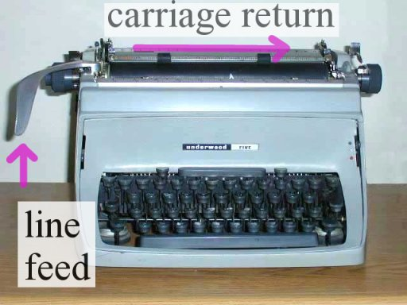
Regular Files
A regular file contains arbitrary data
Applications often distinguish between text files and binary files
  Text files are regular files with only ASCII or Unicode characters
  Binary files are everything else
    e.g., object files, JPEG images
  Kernel doesn’t know the difference!
Text file is sequence of text lines
  Text line is sequence of chars terminated by newline char (‘\n’)
    Newline is 0xa, same as ASCII line feed character (LF)
End of line (EOL) indicators in other systems
  Linux and Mac OS: ‘\n’ (0xa)
    line feed (LF)
  Windows and Internet protocols: ‘\r\n’ (0xd 0xa)
    Carriage return (CR) followed by line feed (LF)

Slide 94
Directories
Directory consists of an array of links
  Each link maps a filename to a file
Each directory contains at least two entries
  . (dot) is a link to itself
  .. (dot dot) is a link to the parent directory in the directory hierarchy (next slide)
Commands for manipulating directories
  mkdir: create empty directory
  ls: view directory contents
  rmdir: delete empty directory

Slide 95
Opening Files
Opening a file informs the kernel that you are getting ready to access that file
Returns a small identifying integer file descriptor
  fd == -1 indicates that an error occurred
Each process created by a Linux shell begins life with three open files associated with a terminal:
  0: standard input (stdin)
  1: standard output (stdout)
  2: standard error (stderr)
int fd; /* file descriptor */
if ((fd = open("/etc/hosts", O_RDONLY)) < 0) {
perror("open");
exit(1);
}

Slide 96
Closing Files
Closing a file informs the kernel that you are finished accessing that file
Closing an already closed file is a recipe for disaster in threaded programs
Moral: Always check return codes, even for seemingly benign functions such as close()
int fd; /* file descriptor */
int retval; /* return value */
if ((retval = close(fd)) < 0) {
perror("close");
exit(1);
}

Slide 97
Reading Files
Reading a file copies bytes from the current file position to memory, and then updates file position
Returns number of bytes read from file fd into buf
  Return type ssize_t is signed integer
  nbytes < 0 indicates that an error occurred
  Short counts (nbytes < sizeof(buf) ) are possible and are not errors!
char buf[512];
int fd; /* file descriptor */
int nbytes; /* number of bytes read */
/* Open file fd ... */
/* Then read up to 512 bytes from file fd */
if ((nbytes = read(fd, buf, sizeof(buf))) < 0) {
perror("read");
exit(1);
}

Slide 98
On Short Counts
Short counts often occurs in these situations:
  Encountering (end-of-file) EOF on reads
  Reading text lines from a terminal
  Reading and writing network sockets
Short counts rarely occurs in these situations:
  Reading from disk files (except for EOF)
    ...but may happen for huge reads.
  Writing to disk files
    …similarly.
Best practice is to always allow for short counts.

Slide 99
Implementation of rio_readn
/*
* rio_readn - Robustly read n bytes (unbuffered)
*/
ssize_t rio_readn(int fd, void *usrbuf, size_t n)
{
size_t nleft = n;
ssize_t nread;
char *bufp = usrbuf;
while (nleft > 0) {
if ((nread = read(fd, bufp, nleft)) < 0) {
if (errno == EINTR) /* Interrupted by sig handler return */
nread = 0; /* and call read() again */
else
return -1; /* errno set by read() */
}
else if (nread == 0)
break; /* EOF */
nleft -= nread;
bufp += nread;
}
return (n - nleft); /* Return >= 0 */
}
csapp.c

Slide 100
Buffered I/O: Motivation
Applications often read/write one character at a time
  getc, putc, ungetc
  gets, fgets
    Read line of text one character at a time, stopping at newline
Implementing as Unix I/O calls expensive
  read and write require Unix kernel calls
    > 10,000 clock cycles
Solution: Buffered read
  Use Unix read to grab block of bytes
  User input functions take one byte at a time from buffer
    Refill buffer when empty
Buffer
already read
unread

Slide 101
Buffering in Standard I/O
Standard I/O functions use buffered I/O
Buffer flushed to output fd on “\n”, call to fflush or exit, or return from main.
printf("h");
printf("e");
printf("l");
printf("l");
printf("o");
buf
printf("\n");
h
e
l
l
o
\n
.
.
fflush(stdout);
write(1, buf, 6);

Slide 102
Buffered I/O: Declaration
All information contained in struct
rio_cnt
Buffer
already read
unread
rio_buf
rio_bufptr
typedef struct {
int rio_fd; /* descriptor for this internal buf */
int rio_cnt; /* unread bytes in internal buf */
char *rio_bufptr; /* next unread byte in internal buf */
char rio_buf[RIO_BUFSIZE]; /* internal buffer */
} rio_t;

Slide 103
File Metadata
Metadata is data about data, in this case file data
Per-file metadata maintained by kernel
  accessed by users with the stat and fstat functions
/* Metadata returned by the stat and fstat functions */
struct stat {
dev_t st_dev; /* Device */
ino_t st_ino; /* inode */
mode_t st_mode; /* Protection and file type */
nlink_t st_nlink; /* Number of hard links */
uid_t st_uid; /* User ID of owner */
gid_t st_gid; /* Group ID of owner */
dev_t st_rdev; /* Device type (if inode device) */
off_t st_size; /* Total size, in bytes */
unsigned long st_blksize; /* Blocksize for filesystem I/O */
unsigned long st_blocks; /* Number of blocks allocated */
time_t st_atime; /* Time of last access */
time_t st_mtime; /* Time of last modification */
time_t st_ctime; /* Time of last change */
};

Slide 104
How the Unix Kernel Represents Open Files
Two descriptors referencing two distinct open files. Descriptor 1 (stdout) points to terminal, and descriptor 4 points to open disk file
Descriptor table
[one table per process]
Open file table
[shared by all processes]
v-node table
[shared by all processes]
File A (terminal)
stdin
fd 0
File access
stdout
fd 1
File pos
File size
Info in
stat struct
stderr
fd 2
fd 3
refcnt=1
File type
fd 4
...
...
File B (disk)
File access
File pos
File size
refcnt=1
File type
...
...

Slide 105
File Sharing
Two distinct descriptors sharing the same disk file through two distinct open file table entries
  E.g., Calling open twice with the same filename argument
Descriptor table
[one table per process]
Open file table
[shared by all processes]
v-node table
[shared by all processes]
File A (disk)
stdin
fd 0
File access
stdout
fd 1
File pos
File size
stderr
fd 2
fd 3
refcnt=1
File type
fd 4
...
...
File B (disk)
File pos
refcnt=1
...

Slide 106
How Processes Share Files: fork
A child process inherits its parent’s open files
  Note: situation unchanged by exec functions (use fcntl to change)
Before fork call:
Descriptor table
[one table per process]
Open file table
[shared by all processes]
v-node table
[shared by all processes]
File A (terminal)
stdin
fd 0
File access
stdout
fd 1
File pos
File size
stderr
fd 2
fd 3
refcnt=1
File type
fd 4
...
...
File B (disk)
File access
File pos
File size
refcnt=1
File type
...
...

Slide 107
How Processes Share Files: fork
A child process inherits its parent’s open files
After fork:
  Child’s table same as parent’s, and +1 to each refcnt
Descriptor table
[one table per process]
Open file table
[shared by all processes]
v-node table
[shared by all processes]
Parent
File A (terminal)
fd 0
File access
fd 1
File pos
File size
fd 2
File type
fd 3
refcnt=2
fd 4
...
...
Child
File B (disk)
File access
fd 0
File size
fd 1
File pos
fd 2
refcnt=2
File type
fd 3
...
fd 4
...

Slide 108
I/O Redirection
Question: How does a shell implement I/O redirection?
linux> ls > foo.txt
Answer: By calling the dup2(oldfd, newfd) function
  Copies (per-process) descriptor table entry oldfd to entry newfd
Descriptor table
before dup2(4,1)
Descriptor table
after dup2(4,1)
fd 0
fd 0
fd 1
a
fd 1
b
fd 2
fd 2
fd 3
fd 3
fd 4
b
fd 4
b

Slide 109
I/O Redirection Example
Step #1: open file to which stdout should be redirected
  Happens in child executing shell code, before exec
Descriptor table
[one table per process]
Open file table
[shared by all processes]
v-node table
[shared by all processes]
File A
stdin
fd 0
File access
stdout
fd 1
File pos
File size
stderr
fd 2
fd 3
refcnt=1
File type
fd 4
...
...
File B
File access
File pos
File size
refcnt=1
File type
...
...

Slide 110
I/O Redirection Example (cont.)
Step #2: call dup2(4,1)
  cause fd=1 (stdout) to refer to disk file pointed at by fd=4
Descriptor table
[one table per process]
Open file table
[shared by all processes]
v-node table
[shared by all processes]
File A
stdin
fd 0
File access
stdout
fd 1
File pos
File size
stderr
fd 2
fd 3
refcnt=0
File type
fd 4
...
...
File B
File access
File pos
File size
refcnt=2
File type
...
...

Slide 111
Unix I/O vs. Standard I/O vs. RIO
Standard I/O and RIO are implemented using low-level Unix I/O
Which ones should you use in your programs?
fopen fdopen
fread fwrite fscanf fprintf sscanf sprintf fgets fputs fflush fseek
fclose
C application program
rio_readn
rio_writen
rio_readinitb
rio_readlineb
rio_readnb
Standard I/O
functions
RIO
functions
open read
write lseek
stat close
Unix I/O functions
(accessed via system calls)

Slide 112
Choosing I/O Functions
General rule: use the highest-level I/O functions you can
  Many C programmers are able to do all of their work using the standard I/O functions
  But, be sure to understand the functions you use!
When to use standard I/O
  When working with disk or terminal files
When to use raw Unix I/O
  Inside signal handlers, because Unix I/O is async-signal-safe
  In rare cases when you need absolute highest performance
When to use RIO
  When you are reading and writing network sockets
  Avoid using standard I/O on sockets

Slide 113
Goodbye for now
This was my last lecture this year. Final advice:
  Check your return codes.
  Use assert() liberally.
  Use a better language than C if at all possible.
  If such a language does not exist, invent it.
  No, C++ is not that language.
If you like this kind of stuff, take these courses:
  Programming Massively Parallel Hardware (PMPH), in block 1.
  Parallel Functional Programming in block 2 (changes its name to Data Parallel Programming next year).
  (Nominally master’s courses, but don’t let that stop you.)
  Also, check out my research: https://futhark-lang.org
  And my talk tomorrow: https://di.ku.dk/begivenhedsmappe/begivenheder-2020/diku-bits-effektiv-beregning-af-histogrammer-paa-gpu/

