Slide 1
Integer arithmetic and floating point
Computer Systems
Michael Kirkedal
Based on slides by:
Randal E. Bryant and David R. O’Hallaron

Slide 2
Today: Integer arithmetic and floating point
Recap
  Representing information as bits
  Bit-level manipulations
  Integers
Integer arithmetic
Floating Points

Slide 3
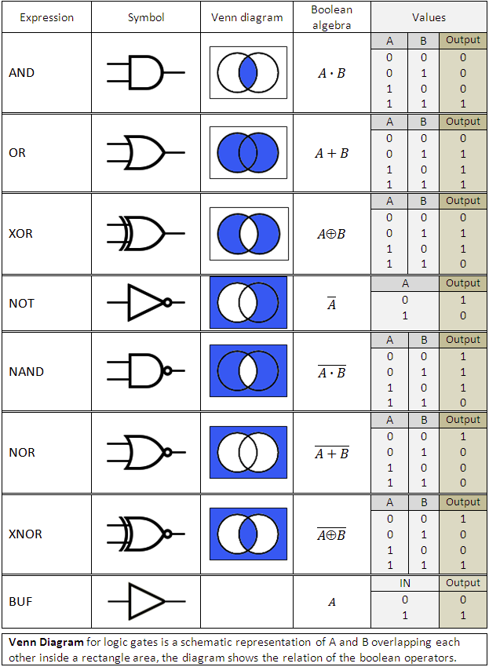
Everything is bits!
Why bits? Why no decimals?
What can we do with bits?
How do we make integral values? Unsigned/signed?
Student recap
What can you tell me
Notes:
Does everything have to be bits.

Slide 4
Everything is bits
Why bits? Electronic Implementation
  Easy to store with bistable elements
  Reliably transmitted on noisy and inaccurate wires
... But there exist many models that are not
  E.g. Ternary (3-state) logic, analog computers, quantum computers
0
1
0
1.1V
0.9V
0.2V
0.0V
Notes:
Does everything have to be bits.

Slide 5
Encoding Byte Values
Byte = 8 bits
  Binary 000000002 to 111111112
  Decimal: 010 to 25510
  Hexadecimal 0016 to FF16
    Base 16 number representation
    Use characters ‘0’ to ‘9’ and ‘A’ to ‘F’
    Write FA1D37B16 in C as
      0xFA1D37B
      0xfa1d37b
Decimal
Hex
Binary
0
0
0000
1
1
0001
2
2
0010
3
3
0011
4
4
0100
5
5
0101
6
6
0110
7
7
0111
8
8
1000
9
9
1001
A
10
1010
B
11
1011
C
12
1100
D
13
1101
E
14
1110
F
15
1111

Slide 6
Example Data Representations
C Data Type | Typical 32-bit | Typical 64-bit | x86-64
char | 1 | 1 | 1
short | 2 | 2 | 2
int | 4 | 4 | 4
long | 4 | 8 | 8
int32_t | 4 | 4 | 4
int64_t | 8 | 8 | 8
float | 4 | 4 | 4
double | 8 | 8 | 8
long double | − | − | 10/16
pointer | 4 | 8 | 8

Slide 7
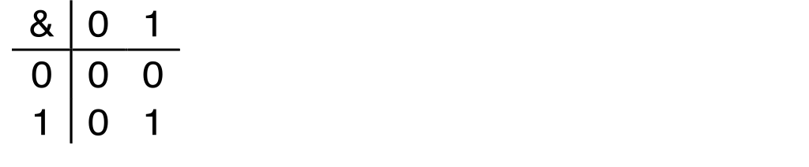
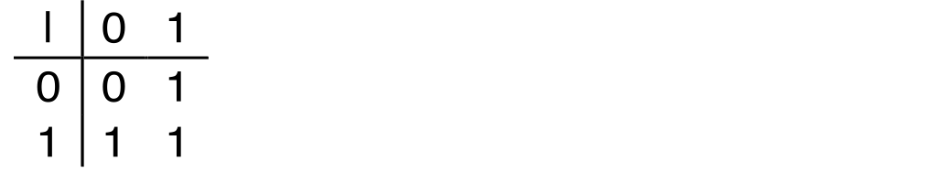
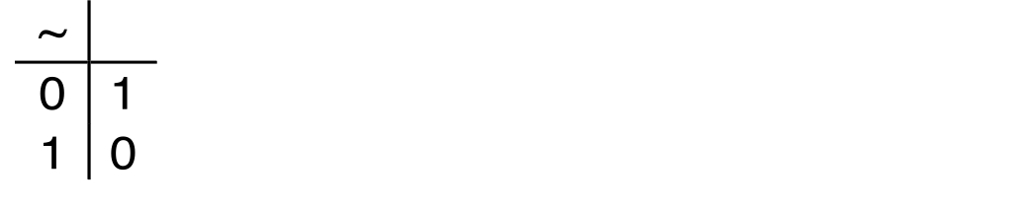
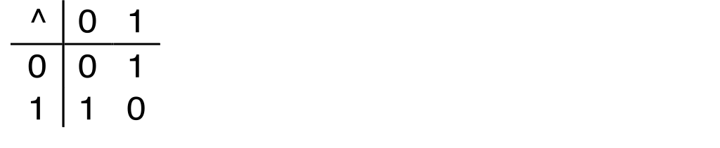
Boolean Algebra
Developed by George Boole in 19th Century
  Algebraic representation of logic
    Encode “True” as 1 and “False” as 0
And
A&B = 1 when both A=1 and B=1
Or
A|B = 1 when either A=1 or B=1
Not
~A = 1 when A=0
Exclusive-Or (Xor)
A^B = 1 when either A=1 or B=1, but not both
Notes:
Can also be considered at modular-2 arithmetic

Slide 8


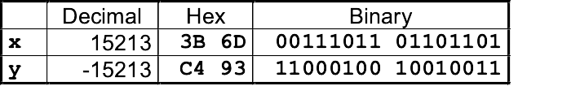
Encoding Integers
Unsigned
Two’s Complement
short int x = 15213;
short int y = -15213;
Sign
Bit
C short 2 bytes long
Sign Bit
  For 2’s complement, most significant bit indicates sign
    0 for nonnegative
    1 for negative

Slide 9
Conversion Visualized
2’s Comp. → Unsigned
  Ordering Inversion
  Negative → Big Positive
UMax
UMax – 1
TMax + 1
Unsigned
Range
TMax
TMax
2’s Complement Range
0
0
–1
–2
TMin

Slide 10
Shift Operations
Left Shift: x << y
  Shift bit-vector x left y positions
      Throw away extra bits on left
    Fill with 0’s on right
Right Shift: x >> y
  Shift bit-vector x right y positions
    Throw away extra bits on right
  Logical shift
    Fill with 0’s on left
  Arithmetic shift
    Replicate most significant bit on left
Undefined Behavior
  Shift amount < 0 or ≥ word size
Argument x
01100010
<< 3
00010000
00010000
00010000
Log. >> 2
00011000
00011000
00011000
Arith. >> 2
00011000
00011000
00011000
Argument x
10100010
<< 3
00010000
00010000
00010000
Log. >> 2
00101000
00101000
00101000
Arith. >> 2
11101000
11101000
11101000

Slide 11
Today: Integer arithmetic and floating point
Recap
Integer arithmetic
  Addition, negation, multiplication, shifting
  Summary
Floating Points

Slide 12
Example: Decimal addition
 |  | 4 | 6 | 4
 | + | 8 | 7 | 5

Slide 13
Example: Binary addition
 | 1 | 0 | 1 | 1
+ | 1 | 1 | 1 | 0

Slide 14
Unsigned Addition
u
Operands: w bits
• • •
+
v
• • •
True Sum: w+1 bits
u + v
• • •
Discard Carry: w bits
UAdd_{w}(u , v)
• • •
Standard Addition Function
  Ignores carry output
Implements Modular Arithmetic
s = UAdd_{w}(u , v) = u + v mod 2^{w}

Slide 15
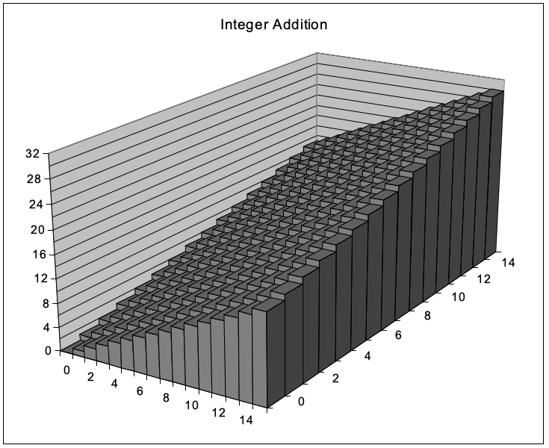
Visualizing (Mathematical) Integer Addition
Integer Addition
  4-bit integers u, v
  Compute true sum Add₄(u , v)
  Values increase linearly with u and v
  Forms planar surface
Add₄(u , v)
v
u

Slide 16
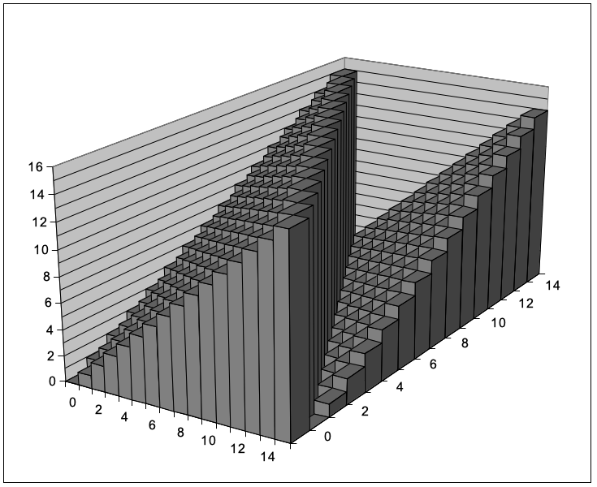
Visualizing Unsigned Addition
Wraps Around
  If true sum ≥ 2^{w}
  At most once
Overflow
UAdd₄(u , v)
True Sum
2^{w+1}
Overflow
2^{w}
v
0
Modular Sum
u

Slide 17
Two’s Complement Addition
Operands: w bits
u
• • •
+
v
• • •
True Sum: w+1 bits
u + v
• • •
Discard Carry: w bits
TAdd_{w}(u , v)
• • •
TAdd and UAdd have Identical Bit-Level Behavior
  Signed vs. unsigned addition in C:
int s, t, u, v;
s = (int) ((unsigned) u + (unsigned) v);
t = u + v
  Will give s == t

Slide 18
TAdd Overflow
Functionality
  True sum requires w+1 bits
  Drop off MSB
  Treat remaining bits as 2’s comp. integer
True Sum
0 111…1
2^{w}–1
PosOver
TAdd Result
0 100…0
2^{w –1}–1
011…1
0 000…0
0
000…0
1 011…1
–2^{w –1}
100…0
1 000…0
–2^{w}
NegOver

Slide 19
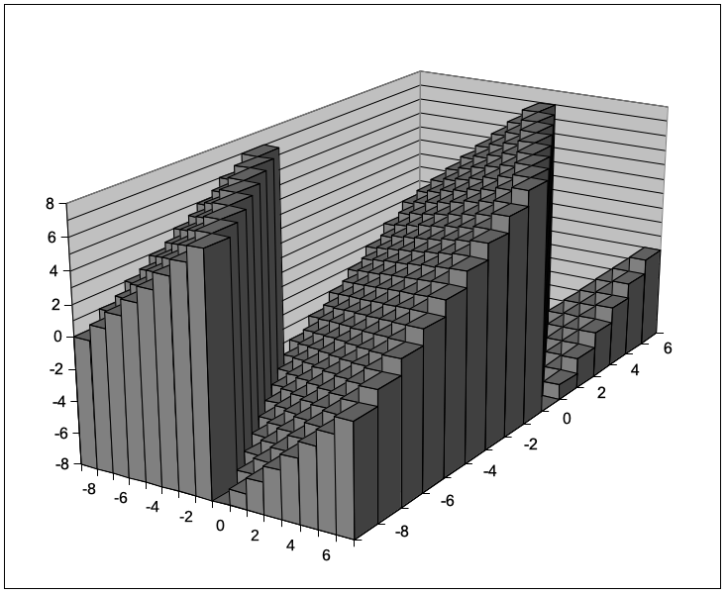
Visualizing 2’s Complement Addition
NegOver
Values
  4-bit two’s comp.
  Range from -8 to +7
Wraps Around
  If sum ≥ 2^{w–1}
    Becomes negative
    At most once
  If sum < –2^{w–1}
    Becomes positive
    At most once
TAdd₄(u , v)
v
u
PosOver

Slide 20
Play the game
https://topps.diku.dk/compsys/integer-arithmetic.html

Slide 21
Multiplication
Goal: Computing Product of w-bit numbers x, y
  Either signed or unsigned
But, exact results can be bigger than w bits
  Unsigned: up to 2w bits
    Result range: 0 ≤ x * y ≤ (2^{w} – 1) ² = 2^{2w} – 2^{w+1} + 1
  Two’s complement min (negative): Up to 2w-1 bits
    Result range: x * y ≥ (–2^{w–1})*(2^{w–1}–1) = –2^{2w–2} + 2^{w–1}
  Two’s complement max (positive): Up to 2w bits, but only for (TMin_{w})²
    Result range: x * y ≤ (–2^{w–1}) ² = 2^{2w–2}
So, maintaining exact results…
  would need to keep expanding word size with each product computed
  is done in software, if needed
    e.g., by “arbitrary precision” arithmetic packages

Slide 22
Unsigned Multiplication in C
u
• • •
Operands: w bits
*
v
• • •
True Product: 2*w bits
u · v
• • •
• • •
UMult_{w}(u , v)
Discard w bits: w bits
• • •
Standard Multiplication Function
  Ignores high order w bits
Implements Modular Arithmetic
UMult_{w}(u , v) = u · v mod 2^{w}

Slide 23
Signed Multiplication in C
u
• • •
Operands: w bits
*
v
• • •
True Product: 2*w bits
u · v
• • •
• • •
TMult_{w}(u , v)
Discard w bits: w bits
• • •
Standard Multiplication Function
  Ignores high order w bits
  Some of which are different for signed vs. unsigned multiplication
  Lower bits are the same

Slide 24
Power-of-2 Multiply with Shift
Operation
  u << k gives u * 2^{k}
  Both signed and unsigned
Examples
  u << 3 == u * 8
  (u << 5) – (u << 3) == u * 24
  Most machines shift and add faster than multiply
    Compiler generates this code automatically
k
u
• • •
Operands: w bits
*
2^{k}
0
•••
0
1
0
•••
0
0
True Product: w+k bits
u · 2^{k}
• • •
0
•••
0
0
Discard k bits: w bits
UMult_{w}(u , 2^{k})
•••
0
•••
0
0
TMult_{w}(u , 2^{k})

Slide 25
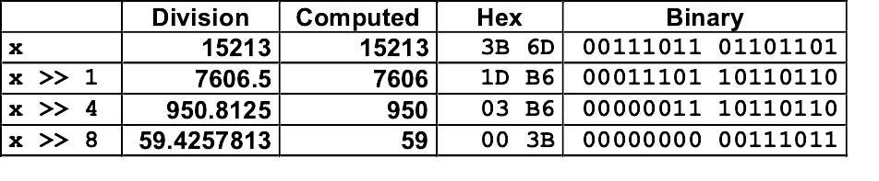
Unsigned Power-of-2 Divide with Shift
Quotient of Unsigned by Power of 2
  u >> k gives ⎣ u / 2^{k} ⎦
  Uses logical shift
k
u
•••
•••
Binary Point
Operands:
/
2^{k}
0
•••
0
1
0
•••
0
0
Division:
u / 2^{k}
0
.
0
•••
0
0
•••
•••
Result:
⎣ u / 2^{k} ⎦
0
0
•••
0
0
•••

Slide 26
Today: Integer arithmetic and floating point
Recap
Integer arithmetic
  Addition, negation, multiplication, shifting
  Summary
Floating Points

Slide 27
Arithmetic: Basic Rules
Addition:
  Unsigned/signed: Normal addition followed by truncate,
  same operation on bit level
  Unsigned: addition mod 2^{w}
    Mathematical addition + possible subtraction of 2^{w}
  Signed: modified addition mod 2^{w} (result in proper range)
    Mathematical addition + possible addition or subtraction of 2^{w}
Multiplication:
  Unsigned/signed: Normal multiplication followed by truncate, same operation on bit level
  Unsigned: multiplication mod 2^{w}
  Signed: modified multiplication mod 2^{w} (result in proper range)

Slide 28
Why Should I Use Unsigned?
Don’t use without understanding implications
  Easy to make mistakes
unsigned i;
for (i = cnt-2; i >= 0; i--)
a[i] += a[i+1];
  Can be very subtle
#define DELTA sizeof(int)
int i;
for (i = CNT; i-DELTA >= 0; i-= DELTA)
. . .

Slide 29
Counting Down with Unsigned
Proper way to use unsigned as loop index
unsigned i;
for (i = cnt-2; i < cnt; i--)
a[i] += a[i+1];
See Robert Seacord, Secure Coding in C and C++
  C Standard guarantees that unsigned addition will behave like modular arithmetic
    0 – 1 → UMax
Even better
size_t i;
for (i = cnt-2; i < cnt; i--)
a[i] += a[i+1];
  Data type size_t defined as unsigned value with length = word size
  Code will work even if cnt = UMax
  What if cnt is signed and < 0?

Slide 30
Why Should I Use Unsigned? (cont.)
Do Use When Performing Modular Arithmetic
  Multiprecision arithmetic
Do Use When Using Bits to Represent Sets
  Logical right shift, no sign extension

Slide 31
Today: Integer arithmetic and floating point
Recap
Integer arithmetic
Floating Points
  Background: Fractional binary numbers
  IEEE floating point standard: Definition
  Example and properties
  Rounding, addition, multiplication
  Floating point in C
  Summary

Slide 32
Fractional binary numbers
What is 1011.101₂?

Slide 33
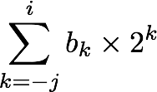
Fractional Binary Numbers
2^{i}
2^{i-1}
4
2
1
• • •
bi | bi-1 | ••• | b2 | b1 | b0 | b-1 | b-2 | b-3 | ••• | b-j
1/2
1/4
1/8
2^{-j}
• • •
Representation
  Bits to right of “binary point” represent fractional powers of 2
  Represents rational number:
Notes:
Latex source for equation: \sum_{k=-j}^i b_k \times 2^k

Slide 34
Fractional Binary Numbers: Examples
Value Representation
5 3/4 101.112
2 7/8 010.1112
1 7/16 001.01112
Observations
  Divide by 2 by shifting right (unsigned)
  Multiply by 2 by shifting left
  Numbers of form 0.111111…2 are just below 1.0
    1/2 + 1/4 + 1/8 + … + 1/2^{i} + … ➙ 1.0
    Use notation 1.0 – ε

Slide 35
Representable Numbers
Limitation #1
  Can only exactly represent numbers of the form x/2^{k}
    Other rational numbers have repeating bit representations
  Value Representation
    1/3 0.0101010101[01]…2
    1/5 0.001100110011[0011]…2
    1/10 0.0001100110011[0011]…2
Limitation #2
  Just one setting of binary point within the w bits
    Limited range of numbers (very small values? very large?)

Slide 36
Today: Integer arithmetic and floating point
Recap
Integer arithmetic
Floating Points
  Background: Fractional binary numbers
  IEEE floating point standard: Definition
  Example and properties
  Rounding, addition, multiplication
  Floating point in C
  Summary

Slide 37
IEEE Floating Point
IEEE Standard 754
  Established in 1985 as uniform standard for floating point arithmetic
    Before that, many idiosyncratic formats
  Supported by all major CPUs
Driven by numerical concerns
  Nice standards for rounding, overflow, underflow
  Hard to make fast in hardware
    Numerical analysts predominated over hardware designers in defining standard

Slide 38
Floating Point Representation
Numerical Form:
(–1)^{s} M 2E
  Sign bit s determines whether number is negative or positive
  Significand M normally a fractional value in range [1.0,2.0).
  Exponent E weights value by power of two
Encoding
  MSB s is sign bit s
  exp field encodes E (but is not equal to E)
  frac field encodes M (but is not equal to M)
s | exp | frac

Slide 39
Precision options
Single precision: 32 bits
Double precision: 64 bits
Extended precision: 80 bits (Intel only)
s | exp | frac
1 | 8-bits | 23-bits
s | exp | frac
1 | 11-bits | 52-bits
s | exp | frac
1 | 15-bits | 63 or 64-bits

Slide 40
“Normalized” Values
v = (–1)^{s} M 2E
When: exp ≠ 000…0 and exp ≠ 111…1
Exponent coded as a biased value: E = Exp – Bias
  Exp: unsigned value of exp field
  Bias = 2^{k-1} - 1, where k is number of exponent bits
    Single precision: 127 (Exp: 1…254, E: -126…127)
    Double precision: 1023 (Exp: 1…2046, E: -1022…1023)
Significand coded with implied leading 1: M = 1.xxx…x2
  xxx…x: bits of frac field
  Minimum when frac=000…0 (M = 1.0)
  Maximum when frac=111…1 (M = 2.0 – ε)
  Get extra leading bit for “free”

Slide 41
Normalized Encoding Example
v = (–1)^{s} M 2E
E = Exp – Bias
Value: float F = 15213.0;
  15213₁₀ = 11101101101101₂
= 1.1101101101101₂ x 2¹³
Significand
M = 1.1101101101101₂
frac = 11011011011010000000000₂
Exponent
E = 13
Bias = 127
Exp = 140 = 10001100₂
Result:
0 10001100 11011011011010000000000
s
exp
frac

Slide 42
Denormalized Values
v = (–1)^{s} M 2E
E = 1 – Bias
Condition: exp = 000…0
Exponent value: E = 1 – Bias (instead of E = 0 – Bias)
Significand coded with implied leading 0: M = 0.xxx…x2
  xxx…x: bits of frac
Cases
  exp = 000…0, frac = 000…0
    Represents zero value
    Note distinct values: +0 and –0 (why?)
  exp = 000…0, frac ≠ 000…0
    Numbers closest to 0.0
    Equispaced

Slide 43
Special Values
Condition: exp = 111…1
Case: exp = 111…1, frac = 000…0
  Represents value ∞ (infinity)
  Operation that overflows
  Both positive and negative
  E.g., 1.0/0.0 = −1.0/−0.0 = +∞, 1.0/−0.0 = −∞
Case: exp = 111…1, frac ≠ 000…0
  Not-a-Number (NaN)
  Represents case when no numeric value can be determined
  E.g., sqrt(–1), ∞ − ∞, ∞ × 0

Slide 44
Visualization: Floating Point Encodings
−∞
+∞
−Normalized
−Denorm
+Denorm
+Normalized
NaN
NaN
−0
+0

Slide 45
Today: Integer arithmetic and floating point
Recap
Integer arithmetic
Floating Points
  Background: Fractional binary numbers
  IEEE floating point standard: Definition
  Example and properties
  Rounding, addition, multiplication
  Floating point in C
  Summary

Slide 46
Play the game
https://topps.diku.dk/compsys/floating-point.html

Slide 47
Tiny Floating Point Example
s | exp | frac
1 | 4-bits | 3-bits
8-bit Floating Point Representation
  the sign bit is in the most significant bit
  the next four bits are the exponent, with a bias of 7
  the last three bits are the frac
Same general form as IEEE Format
  normalized, denormalized
  representation of 0, NaN, infinity

Slide 48
Dynamic Range (Positive Only)
v = (–1)^{s} M 2E
n: E = Exp – Bias
d: E = 1 – Bias
s exp frac E Value
0 0000 000 -6 0
0 0000 001 -6 1/8*1/64 = 1/512
0 0000 010 -6 2/8*1/64 = 2/512
…
0 0000 110 -6 6/8*1/64 = 6/512
0 0000 111 -6 7/8*1/64 = 7/512
0 0001 000 -6 8/8*1/64 = 8/512
0 0001 001 -6 9/8*1/64 = 9/512
…
0 0110 110 -1 14/8*1/2 = 14/16
0 0110 111 -1 15/8*1/2 = 15/16
0 0111 000 0 8/8*1 = 1
0 0111 001 0 9/8*1 = 9/8
0 0111 010 0 10/8*1 = 10/8
…
0 1110 110 7 14/8*128 = 224
0 1110 111 7 15/8*128 = 240
0 1111 000 n/a inf
Denormalized
numbers
closest to zero
largest denorm
smallest norm
Normalized
numbers
closest to 1 below
closest to 1 above
largest norm

Slide 49
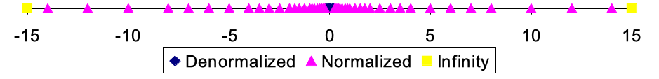
Distribution of Values
6-bit IEEE-like format
  e = 3 exponent bits
  f = 2 fraction bits
  Bias is 2³⁻¹-1 = 3
Notice how the distribution gets denser toward zero.
s | exp | frac
1 | 3-bits | 2-bits
8 values

Slide 50
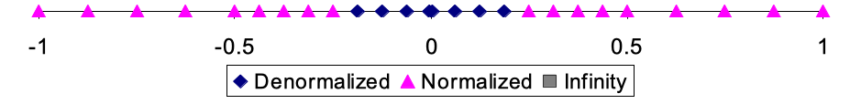
Distribution of Values (close-up view)
6-bit IEEE-like format
  e = 3 exponent bits
  f = 2 fraction bits
  Bias is 3
s | exp | frac
1 | 3-bits | 2-bits

Slide 51
Special Properties of the IEEE Encoding
FP Zero Same as Integer Zero
  All bits = 0
Can (Almost) Use Unsigned Integer Comparison
  Must first compare sign bits
  Must consider −0 = 0
  NaNs problematic
    Will be greater than any other values
    What should comparison yield?
  Otherwise OK
    Denorm vs. normalized
    Normalized vs. infinity
For more details: https://www.gnu.org/software/libc/manual/html_node/Infinity-and-NaN.html

Slide 52
Today: Integer arithmetic and floating point
Recap
Integer arithmetic
Floating Points
  Background: Fractional binary numbers
  IEEE floating point standard: Definition
  Example and properties
  Rounding, addition, multiplication
  Floating point in C
  Summary

Slide 53
Floating Point Operations: Basic Idea
x +f y = Round(x + y)
x ×f y = Round(x × y)
Basic idea
  First compute exact result
  Make it fit into desired precision
    Possibly overflow if exponent too large
    Possibly round to fit into frac

Slide 54
Rounding
Rounding Modes (illustrate with $ rounding)
$1.40 $1.60 $1.50 $2.50 –$1.50
  Towards zero $1 $1 $1 $2 –$1
  Round down (−∞) $1 $1 $1 $2 –$2
  Round up (+∞) $2 $2 $2 $3 –$1
  Nearest Even (default) $1 $2 $2 $2 –$2

Slide 55
Closer Look at Round-To-Even
Default Rounding Mode
  Hard to get any other kind without dropping into assembly
  All others are statistically biased
    Sum of set of positive numbers will consistently be over- or under- estimated
Applying to Other Decimal Places / Bit Positions
  When exactly halfway between two possible values
    Round so that least significant digit is even
  E.g., round to nearest hundredth
7.8949999 7.89 (Less than half way)
7.8950001 7.90 (Greater than half way)
7.8950000 7.90 (Half way—round up)
7.8850000 7.88 (Half way—round down)

Slide 56
Rounding Binary Numbers
Binary Fractional Numbers
  “Even” when least significant bit is 0
  “Half way” when bits to right of rounding position = 100…2
Examples
  Round to nearest 1/4 (2 bits right of binary point)
Value Binary Rounded Action Rounded Value
2 3/32 10.000112 10.002 (<1/2—down) 2
2 3/16 10.001102 10.012 (>1/2—up) 2 1/4
2 7/8 10.111002 11.002 ( 1/2—up) 3
2 5/8 10.101002 10.102 ( 1/2—down) 2 1/2

Slide 57
FP Multiplication
(–1)^{s1} M1 2^{E1} x (–1)^{s2} M2 2^{E2}
Exact Result: (–1)^{s} M 2E
  Sign s: s1 ^ s2
  Significand M: M1 x M2
  Exponent E: E1 + E2
Fixing
  If M ≥ 2, shift M right, increment E
  If E out of range, overflow
  Round M to fit frac precision
Implementation
  Biggest chore is multiplying significands

Slide 58
Floating Point Addition
(–1)^{s1} M1 2^{E1} + (-1)^{s2} M2 2^{E2}
  Assume E1 > E2
Exact Result: (–1)^{s} M 2E
  Sign s, significand M:
    Result of signed align & add
  Exponent E: E1
Fixing
  If M ≥ 2, shift M right, increment E
  if M < 1, shift M left k positions, decrement E by k
  Overflow if E out of range
  Round M to fit frac precision
Get binary points lined up
E1–E2
(–1)^{s1} M1
+
(–1)^{s2} M2
(–1)^{s} M

Slide 59
Mathematical Properties of FP Add
Compare to those of Abelian Group
  Closed under addition?
    But may generate infinity or NaN
  Commutative?
  Associative?
    Overflow and inexactness of rounding
    (3.14+1e10)-1e10 = 0, 3.14+(1e10-1e10) = 3.14
  0 is additive identity?
  Every element has additive inverse?
    Yes, except for infinities & NaNs
Monotonicity
  a ≥ b ⇒ a+c ≥ b+c?
    Except for infinities & NaNs
Yes
Yes
No
Yes
Almost
Almost

Slide 60
Mathematical Properties of FP Mult
Compare to Commutative Ring
  Closed under multiplication?
    But may generate infinity or NaN
  Multiplication Commutative?
  Multiplication is Associative?
    Possibility of overflow, inexactness of rounding
    Ex: (1e20*1e20)*1e-20= inf, 1e20*(1e20*1e-20)= 1e20
  1 is multiplicative identity?
  Multiplication distributes over addition?
    Possibility of overflow, inexactness of rounding
    1e20*(1e20-1e20)= 0.0, 1e20*1e20 – 1e20*1e20 = NaN
Monotonicity
  a ≥ b & c ≥ 0 ⇒ a * c ≥ b *c?
    Except for infinities & NaNs
Yes
Yes
No
Yes
No
Almost

Slide 61
Today: Integer arithmetic and floating point
Recap
Integer arithmetic
Floating Points
  Background: Fractional binary numbers
  IEEE floating point standard: Definition
  Example and properties
  Rounding, addition, multiplication
  Floating point in C
  Summary

Slide 62
Floating Point in C
C Guarantees Two Levels
  float single precision
  double double precision
Conversions/Casting
  Casting between int, float, and double changes bit representation
  double/float → int
    Truncates fractional part
    Like rounding toward zero
    Not defined when out of range or NaN: Generally sets to TMin
  int → double
    Exact conversion, as long as int has ≤ 53 bit word size
  int → float
    Will round according to rounding mode

Slide 63
Floating Point Puzzles
For each of the following C expressions, either:
  Argue that it is true for all argument values
  Explain why not true
x == (int)(float) x
x == (int)(double) x
f == (float)(double) f
d == (double)(float) d
f == -(-f);
2/3 == 2/3.0
d < 0.0 ⇒ ((d*2) < 0.0)
d > f ⇒ -f > -d
d * d >= 0.0
(d+f)-d == f
int x = …;
float f = …;
double d = …;
Assume neither
d nor f is NaN

Slide 64
Today: Integer arithmetic and floating point
Recap
Integer arithmetic
Floating Points
  Background: Fractional binary numbers
  IEEE floating point standard: Definition
  Example and properties
  Rounding, addition, multiplication
  Floating point in C
  Summary

Slide 65
Summary
IEEE Floating Point has clear mathematical properties
Represents numbers of form M x 2E
One can reason about operations independent of implementation
  As if computed with perfect precision and then rounded
Not the same as real arithmetic
  Violates associativity/distributivity
  Makes life difficult for compilers & serious numerical applications programmers

Slide 66
Creating Floating Point Number
Steps
  Normalize to have leading 1
  Round to fit within fraction
  Postnormalize to deal with effects of rounding
Case Study
  Convert 8-bit unsigned numbers to tiny floating point format
Example Numbers
128 10000000
15 00001101
33 00010001
35 00010011
138 10001010
63 00111111
s | exp | frac
1 | 4-bits | 3-bits

Slide 67
Normalize
s | exp | frac
1 | 4-bits | 3-bits
Requirement
  Set binary point so that numbers of form 1.xxxxx
  Adjust all to have leading one
    Decrement exponent as shift left
Value Binary Fraction Exponent
128 10000000 1.0000000 7
15 00001101 1.1010000 3
17 00010001 1.0001000 4
19 00010011 1.0011000 4
138 10001010 1.0001010 7
63 00111111 1.1111100 5

Slide 68
Rounding
1.BBGRXXX
Guard bit: LSB of result
Sticky bit: OR of remaining bits
Round bit: 1st bit removed
Round up conditions
  Round = 1, Sticky = 1 ➙ > 0.5
  Guard = 1, Round = 1, Sticky = 0 ➙ Round to even
Value Fraction GRS Incr? Rounded
128 1.0000000 000 N 1.000
15 1.1010000 100 N 1.101
17 1.0001000 010 N 1.000
19 1.0011000 110 Y 1.010
138 1.0001010 011 Y 1.001
63 1.1111100 111 Y 10.000

Slide 69
Postnormalize
Issue
  Rounding may have caused overflow
  Handle by shifting right once & incrementing exponent
Value Rounded Exp Adjusted Result
128 1.000 7 128
15 1.101 3 15
17 1.000 4 16
19 1.010 4 20
138 1.001 7 134
63 10.000 5 1.000/6 64

Slide 70
Interesting Numbers
{single,double}
Description exp frac Numeric Value
Zero 00…00 00…00 0.0
Smallest Pos. Denorm. 00…00 00…01 2^{– {23,52}} x 2^{– {126,1022}}
  Single ≈ 1.4 x 10^{–45}
  Double ≈ 4.9 x 10^{–324}
Largest Denormalized 00…00 11…11 (1.0 – ε) x 2^{– {126,1022}}
  Single ≈ 1.18 x 10^{–38}
  Double ≈ 2.2 x 10^{–308}
Smallest Pos. Normalized 00…01 00…00 1.0 x 2^{– {126,1022}}
  Just larger than largest denormalized
One 01…11 00…00 1.0
Largest Normalized 11…10 11…11 (2.0 – ε) x 2^{{127,1023}}
  Single ≈ 3.4 x 10³⁸
  Double ≈ 1.8 x 10³⁰⁸

