Slide 1
System-Level I/O
Computer Systems
Troels Henriksen
Based on slides by:
Randal E. Bryant and David R. O’Hallaron

Slide 2
Today
Unix I/O
Metadata, sharing, and redirection
RIO (robust I/O) package
Standard I/O
Closing remarks

Slide 3
Unix I/O Overview
A Linux file is a sequence of m bytes:
  B₀ , B₁ , .... , B_{k} , .... , B_{m-1}
Cool fact: All I/O devices are represented as files:
  /dev/tty (the current terminal)
  /dev/sda2 (a disk partition)
  /dev/tty2 (some other terminal)
Even the kernel is represented as a file:
  /boot/vmlinuz-3.13.0-55-generic (kernel image)
  /proc (process information)
  /sys (kernel data structures)

Slide 4
Unix I/O Overview
Elegant mapping of files to devices allows kernel to export simple interface called Unix I/O:
  Opening and closing files
    open()and close()
  Reading and writing a file
    read() and write()
  Changing the current file position (seek)
    indicates next offset into file to read or write
    lseek()
    Not all files support seeking (e.g. pipes, sockets)
B₀
B₁
• • •
B_{k-1}
B_{k}
B_{k+1}
• • •
Current file position = k

Slide 5
File Types
Each file has a type indicating its role in the system
  Regular file: Contains arbitrary data
  Directory: Index for a related group of files
  Socket: For communicating with a process on another machine
Other file types beyond our core scope
  Named pipes (FIFOs)
  Symbolic links
  Character and block devices

Slide 6
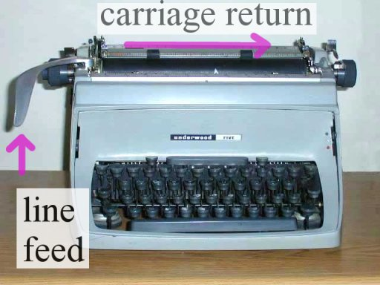
Regular Files
A regular file contains arbitrary data
Applications often distinguish between text files and binary files
  Text files are regular files with only ASCII or Unicode characters
  Binary files are everything else
    e.g., object files, JPEG images, PDFs
  Kernel doesn’t know the difference!
  Question of interpretation of the byte contents
Text file is sequence of text lines
  Text line is sequence of chars terminated by newline char (‘\n’)
    Newline is 0xA, same as ASCII line feed character (LF)
End of line (EOL) indicators in other systems
  Linux and macOS: ‘\n’ (0xA)
  Windows and Internet protocols: ‘\r\n’ (0xD 0xA)
    Carriage return (CR) followed by line feed (LF)
  C64, Pre-OS X Mac OS, Lisp Machines: ‘\r’

Slide 7
Directories
Directory consists of an array of links
  Each link maps a filename to an inode
  An inode contains metadata and disk location of file.
  Multiple links may point to same file!
Each directory contains at least two entries
  . (dot) is a link to itself
  .. (dot dot) is a link to the parent directory in the directory hierarchy (next slide)
Commands for manipulating directories
  mkdir: create empty directory
  ls: view directory contents
  rmdir: delete empty directory

Slide 8
Directory Hierarchy
All files are organized as a hierarchy anchored by root directory named / (slash)
Kernel maintains current working directory (cwd) for each process
  Modified using the cd command or chdir() syscall
  Question: is cd a normal program run by the shell with fork+exec?
/
bin/
dev/
etc/
home/
usr/
bash
tty1
group
passwd
michael/
troels/
include/
bin/
hello.c
stdio.h
sys/
vim
unistd.h

Slide 9
Pathnames
Locations of files in the hierarchy denoted by pathnames
  Absolute pathname starts with ‘/’ and denotes path from root
    /home/troels/hello.c
  Relative pathname denotes path from current working directory
    ../home/michael/hello.c
/
cwd: /home/troels
bin/
dev/
etc/
home/
usr/
bash
tty1
group
passwd
michael/
troels/
include/
bin/
hello.c
stdio.h
sys/
vim
unistd.h

Slide 10
Opening Files
Opening a file informs the kernel that you are getting ready to access that file
Returns a small identifying integer file descriptor
  fd == -1 indicates that an error occurred
Each process created by a Linux shell begins life with three open files associated with a terminal:
  0: standard input (stdin)
  1: standard output (stdout)
  2: standard error (stderr)
int fd; /* file descriptor */
if ((fd = open("/etc/hosts", O_RDONLY)) < 0) {
perror("open");
exit(1);
}

Slide 11
Closing Files
Closing a file informs the kernel that you are finished accessing that file
Closing an already closed file is a recipe for disaster in threaded programs, because the file descriptor number may have been re-used
Always check return codes, even for seemingly benign functions such as close()
int fd; /* file descriptor */
int retval; /* return value */
if ((retval = close(fd)) < 0) {
perror("close");
exit(1);
}

Slide 12
Reading Files
Reading a file copies bytes from the current file position to memory, and then updates file position
Returns number of bytes read from file fd into buf
  Return type ssize_t is signed integer
  nbytes < 0 indicates that an error occurred
  Short counts (nbytes < sizeof(buf) ) are possible and are not errors!
char buf[512];
int fd; /* file descriptor */
int nbytes; /* number of bytes read */
/* Open file fd ... */
/* Then read at least 1 byte and
up to 512 bytes from file fd */
if ((nbytes = read(fd, buf, sizeof(buf))) < 0) {
perror("read");
exit(1);
}

Slide 13
Writing Files
Writing a file copies bytes from memory to the current file position, and then updates current file position
Returns number of bytes written from buf to file fd
  nbytes < 0 indicates that an error occurred
  As with reads, short counts are possible and are not errors!
char buf[512];
int fd; /* file descriptor */
int nbytes; /* number of bytes read */
/* Open the file fd ... */
/* Then write up to 512 bytes from buf to file fd */
if ((nbytes = write(fd, buf, sizeof(buf)) < 0) {
perror("write");
exit(1);
}

Slide 14
Simple Unix I/O example
Copying stdin to stdout, one byte at a time
Slow (examples later)
#include "csapp.h"
int main(void)
{
char c;
while(Read(STDIN_FILENO, &c, 1) != 0)
Write(STDOUT_FILENO, &c, 1);
exit(0);
}

Slide 15
On Short Counts
Short counts often occurs in these situations:
  Encountering (end-of-file) EOF on reads
  Reading text lines from a terminal
  Reading and writing network sockets
Short counts rarely occurs in these situations:
  Reading from disk files (except for EOF)
    ...but may happen for huge reads, depending on file system.
  Writing to disk files
    …similarly.
Best practice is to always allow for short counts.
Distinctly Unix: https://www.dreamsongs.com/RiseOfWorseIsBetter.html

Slide 16
Today
Unix I/O
Metadata, sharing, and redirection
RIO (robust I/O) package
Standard I/O
Closing remarks

Slide 17
File Metadata
Metadata is data about data, in this case file data
Per-file metadata maintained by kernel
  accessed by users with the stat and fstat functions
/* Metadata returned by the stat and fstat functions */
struct stat {
dev_t st_dev; /* Device */
ino_t st_ino; /* inode */
mode_t st_mode; /* Protection and file type */
nlink_t st_nlink; /* Number of hard links */
uid_t st_uid; /* User ID of owner */
gid_t st_gid; /* Group ID of owner */
dev_t st_rdev; /* Device type (if inode device) */
off_t st_size; /* Total size, in bytes */
unsigned long st_blksize; /* Blocksize for filesystem I/O */
unsigned long st_blocks; /* Number of blocks allocated */
time_t st_atime; /* Time of last access */
time_t st_mtime; /* Time of last modification */
time_t st_ctime; /* Time of last change */
};

Slide 18
Example of Accessing File Metadata
$ ./statcheck statcheck.c
type: regular, read: yes
$ chmod 000 statcheck.c
$ ./statcheck statcheck.c
type: regular, read: no
$ ./statcheck ..
type: directory, read: yes
int main (int argc, char **argv)
{
struct stat stat;
char *type, *readok;
Stat(argv[1], &stat);
if (S_ISREG(stat.st_mode)) /* Determine file type */
type = "regular";
else if (S_ISDIR(stat.st_mode))
type = "directory";
else
type = "other";
if ((stat.st_mode & S_IRUSR)) /* Check read access */
readok = "yes";
else
readok = "no";
printf("type: %s, read: %s\n", type, readok);
exit(0);
}
statcheck.c

Slide 19
How the Unix Kernel Represents Open Files
Two descriptors referencing two distinct open files. Descriptor 1 (stdout) points to terminal, and descriptor 4 points to open disk file
Descriptor table
[one table per process]
Open file table
[shared by all processes]
v-node table
[shared by all processes]
File A (e.g. terminal)
stdin
fd 0
File access
stdout
fd 1
File pos
File size
Info in
stat struct
stderr
fd 2
fd 3
refcnt=1
File type
fd 4
...
...
File B (e.g. disk file)
File access
File pos
File size
refcnt=1
File type
...
...

Slide 20
File Sharing
Two distinct descriptors sharing the same disk file through two distinct open file table entries
  E.g., Calling open twice with the same filename argument
  Not necessarily a good idea - but the kernel won’t stop you
Descriptor table
[one table per process]
Open file table
[shared by all processes]
v-node table
[shared by all processes]
File A (disk)
stdin
fd 0
File access
stdout
fd 1
File pos
File size
stderr
fd 2
fd 3
refcnt=1
File type
fd 4
...
...
File B (disk)
File pos
refcnt=1
...

Slide 21
How Processes Share Files: fork
A child process inherits its parent’s open files
  Note: situation unchanged by exec functions (use fcntl to change)
Before fork call:
Descriptor table
[one table per process]
Open file table
[shared by all processes]
v-node table
[shared by all processes]
File A (terminal)
stdin
fd 0
File access
stdout
fd 1
File pos
File size
stderr
fd 2
fd 3
refcnt=1
File type
fd 4
...
...
File B (disk)
File access
File pos
File size
refcnt=1
File type
...
...

Slide 22
How Processes Share Files: fork
A child process inherits its parent’s open files
After fork:
  Child’s table same as parent’s, and +1 to each refcnt
  If one process does a read, the read position will change for both!
Descriptor table
[one table per process]
Open file table
[shared by all processes]
v-node table
[shared by all processes]
Parent
File A (terminal)
fd 0
File access
fd 1
File pos
File size
fd 2
File type
fd 3
refcnt=2
fd 4
...
...
Child
File B (disk)
File access
fd 0
File size
fd 1
File pos
fd 2
refcnt=2
File type
fd 3
...
fd 4
...

Slide 23
I/O Redirection
Question: How does a shell implement I/O redirection?
$ ls > foo.txt
Answer: By calling the dup2(oldfd, newfd) function
  Copies (per-process) descriptor table entry oldfd to entry newfd
Descriptor table
before dup2(4,1)
Descriptor table
after dup2(4,1)
fd 0
fd 0
fd 1
a
fd 1
b
fd 2
fd 2
fd 3
fd 3
fd 4
b
fd 4
b

Slide 24
I/O Redirection Example
Step #1: open file to which stdout should be redirected
  Happens in child executing shell code, before exec
Descriptor table
[one table per process]
Open file table
[shared by all processes]
v-node table
[shared by all processes]
File A
stdin
fd 0
File access
stdout
fd 1
File pos
File size
stderr
fd 2
fd 3
refcnt=1
File type
fd 4
...
...
File B
File access
File pos
File size
refcnt=1
File type
...
...

Slide 25
I/O Redirection Example (cont.)
Step #2: call dup2(4,1)
  cause fd=1 (stdout) to refer to disk file pointed at by fd=4
Descriptor table
[one table per process]
Open file table
[shared by all processes]
v-node table
[shared by all processes]
File A
stdin
fd 0
File access
stdout
fd 1
File pos
File size
stderr
fd 2
fd 3
refcnt=0
File type
fd 4
...
...
File B
File access
File pos
File size
refcnt=2
File type
...
...

Slide 26
Today
Unix I/O
Metadata, sharing, and redirection
RIO (robust I/O) package
Standard I/O
Closing remarks

Slide 27
The RIO Package
RIO is a set of wrappers that provide efficient and robust I/O in apps, such as network programs that are subject to short counts
RIO provides two different kinds of functions
  Unbuffered input and output of binary data
    rio_readn and rio_writen
  Buffered input of text lines and binary data
    rio_readlineb and rio_readnb
    Buffered RIO routines are thread-safe and can be interleaved arbitrarily on the same descriptor
Part of csapp.c/csapp.h

Slide 28
Unbuffered RIO Input and Output
Same interface as Unix read and write
Especially useful for transferring data on network sockets
  rio_readn returns short count only if it encounters EOF
    Only use it when you know how many bytes to read
  rio_writen never returns a short count
  Calls to rio_readn and rio_writen can be interleaved arbitrarily on the same descriptor
#include "csapp.h"
ssize_t rio_readn(int fd, void *usrbuf, size_t n);
ssize_t rio_writen(int fd, void *usrbuf, size_t n);
Return: num. bytes transferred if OK, 0 on EOF (rio_readn only), -1 on error

Slide 29
Implementation of rio_readn
/*
* rio_readn - Robustly read n bytes (unbuffered)
*/
ssize_t rio_readn(int fd, void *usrbuf, size_t n)
{
size_t nleft = n;
ssize_t nread;
char *bufp = usrbuf;
while (nleft > 0) {
if ((nread = read(fd, bufp, nleft)) < 0) {
if (errno == EINTR) /* Interrupted by sig handler return */
nread = 0; /* and call read() again */
else
return -1; /* errno set by read() */
}
else if (nread == 0)
break; /* EOF */
nleft -= nread;
bufp += nread;
}
return (n - nleft); /* Return >= 0 */
}
csapp.c

Slide 30
Buffered RIO Input Functions
Efficiently read text lines and binary data from a file partially cached in an internal memory buffer
  rio_readlineb reads a text line of up to maxlen bytes from file fd and stores the line in usrbuf
    Especially useful for reading text lines from network sockets
  Stopping conditions
    maxlen bytes read
    EOF encountered
    Newline (‘\n’) encountered
#include "csapp.h"
void rio_readinitb(rio_t *rp, int fd);
ssize_t rio_readlineb(rio_t *rp, void *usrbuf, size_t maxlen);
ssize_t rio_readnb(rio_t *rp, void *usrbuf, size_t n);
Return: num. bytes read if OK, 0 on EOF, -1 on error

Slide 31
Buffered RIO Input Functions (cont)
#include "csapp.h"
void rio_readinitb(rio_t *rp, int fd);
ssize_t rio_readlineb(rio_t *rp, void *usrbuf, size_t maxlen);
ssize_t rio_readnb(rio_t *rp, void *usrbuf, size_t n);
Return: num. bytes read if OK, 0 on EOF, -1 on error
  rio_readnb reads up to n bytes from file fd
  Stopping conditions
    maxlen bytes read
    EOF encountered
  Calls to rio_readlineb and rio_readnb can be interleaved arbitrarily on the same descriptor
    Warning: Don’t interleave with calls to rio_readn

Slide 32
Buffered I/O: Implementation
For reading from file
File has associated buffer to hold bytes that have been read from file but not yet read by user code
Layered on Unix file:
rio_cnt
Buffer
already read
unread
rio_buf
rio_bufptr
Buffered Portion
not in buffer
already read
unread
unseen
Current File Position

Slide 33
Buffered I/O: Declaration
All information contained in struct
rio_cnt
Buffer
already read
unread
rio_buf
rio_bufptr
typedef struct {
int rio_fd; /* descriptor for this internal buf */
int rio_cnt; /* unread bytes in internal buf */
char *rio_bufptr; /* next unread byte in internal buf */
char rio_buf[RIO_BUFSIZE]; /* internal buffer */
} rio_t;

Slide 34
Buffered I/O: Read some bytes
static ssize_t rio_read(rio_t *rp, char *usrbuf, size_t n)
{
int cnt;
while (rp->rio_cnt <= 0) { /* Refill if buf is empty */
rp->rio_cnt = read(rp->rio_fd, rp->rio_buf,
sizeof(rp->rio_buf));
if (rp->rio_cnt < 0) {
if (errno != EINTR) /* If not interrupted */
return -1; /* Then it must be a real error */
}
else if (rp->rio_cnt == 0) /* EOF */
return 0;
else
rp->rio_bufptr = rp->rio_buf; /* Reset buffer ptr */
}
/* Copy min(n, rp->rio_cnt) bytes from internal buf to user buf */
cnt = n;
if (rp->rio_cnt < n)
cnt = rp->rio_cnt;
memcpy(usrbuf, rp->rio_bufptr, cnt);
rp->rio_bufptr += cnt;
rp->rio_cnt -= cnt;
return cnt;
}
csapp.c

Slide 35
Buffered I/O: Read n bytes robustly
ssize_t rio_readnb(rio_t *rp, void *usrbuf, size_t n)
{
size_t nleft = n;
ssize_t nread;
char *bufp = usrbuf;
while (nleft > 0) {
if ((nread = rio_read(rp, bufp, nleft)) < 0)
return -1; /* errno set by read() */
else if (nread == 0)
break; /* EOF */
nleft -= nread;
bufp += nread;
}
return (n - nleft); /* return >= 0 */
}
csapp.c

Slide 36
RIO Example
Copying the lines of a text file from standard input to standard output
#include "csapp.h"
int main(int argc, char **argv)
{
int n;
rio_t rio;
char buf[MAXLINE];
Rio_readinitb(&rio, STDIN_FILENO);
while((n = Rio_readlineb(&rio, buf, MAXLINE)) != 0)
Rio_writen(STDOUT_FILENO, buf, n);
exit(0);
}
cpfile.c

Slide 37
Today
Unix I/O
Metadata, sharing, and redirection
RIO (robust I/O) package
Standard I/O
Closing remarks

Slide 38
Standard I/O Functions
The C standard library (libc.so) contains a collection of higher-level standard I/O functions
  Documented in 8.2 of your C book
  Or read the manpages!
Examples of standard I/O functions:
  Opening and closing files (fopen and fclose)
  Reading and writing bytes (fread and fwrite)
  Reading and writing text lines (fgets and fputs)
  Formatted reading and writing (fscanf and fprintf)

Slide 39
Standard I/O Streams
Standard I/O models open files as streams
  Abstraction for a file descriptor and a buffer in memory
C programs begin life with three open streams
(defined in stdio.h)
  stdin (standard input)
  stdout (standard output)
  stderr (standard error)
#include <stdio.h>
extern FILE *stdin; /* standard input (descriptor 0) */
extern FILE *stdout; /* standard output (descriptor 1) */
extern FILE *stderr; /* standard error (descriptor 2) */
int main() {
fprintf(stdout, "Hello, world\n");
}

Slide 40
Buffered I/O: Motivation
Applications often read/write one character at a time
  getc, putc, ungetc
  gets, fgets
    Read line of text one character at a time, stopping at newline
Implementing as Unix I/O calls expensive
  read and write require Unix kernel calls
    > 10,000 clock cycles
Solution: Buffered read and write
  Use Unix read to grab block of bytes
  User input functions take one byte at a time from buffer
    Refill buffer when empty
Buffer
already read
unread

Slide 41
Buffering in Standard I/O
Standard I/O functions use buffered I/O
Buffer flushed to output fd on “\n”, call to fflush or exit, or return from main.
printf("h");
printf("e");
printf("l");
printf("l");
printf("o");
buf
printf("\n");
h
e
l
l
o
\n
.
.
fflush(stdout);
write(1, buf, 6);

Slide 42
Standard I/O Buffering in Action
You can see this buffering in action for yourself, using the always fascinating Linux strace program:
#include <stdio.h>
int main()
{
printf("h");
printf("e");
printf("l");
printf("l");
printf("o");
printf("\n");
fflush(stdout);
exit(0);
}
$ strace ./hello
execve("./hello", ["hello"], [/* ... */]).
...
write(1, "hello\n", 6) = 6
...
exit_group(0) = ?

Slide 43
Today
Unix I/O
Metadata, sharing, and redirection
RIO (robust I/O) package
Standard I/O
Closing remarks

Slide 44
Unix I/O vs. Standard I/O vs. RIO
Standard I/O and RIO are implemented using low-level Unix I/O
Which ones should you use in your programs?
fopen fdopen
fread fwrite fscanf fprintf sscanf sprintf fgets fputs fflush fseek
fclose
C application program
rio_readn
rio_writen
rio_readinitb
rio_readlineb
rio_readnb
Standard I/O
functions
RIO
functions
open read
write lseek
stat close
Unix I/O functions
(accessed via system calls)

Slide 45
Pros and Cons of Unix I/O
Pros
  Unix I/O is the most general and lowest overhead form of I/O
    All other I/O packages are implemented using Unix I/O functions
  Unix I/O provides functions for accessing file metadata
  Unix I/O functions are async-signal-safe and can be used safely in signal handlers
Cons
  Dealing with short counts is tricky and error prone
  Efficient reading of text lines requires some form of buffering, also tricky and error prone
  Both of these issues are addressed by the standard I/O and RIO packages

Slide 46
Pros and Cons of Standard I/O
Pros:
  Buffering increases efficiency by decreasing the number of read and write system calls
  Short counts are handled automatically
Cons:
  Provides no function for accessing file metadata
  Standard I/O functions are not async-signal-safe, and not appropriate for signal handlers
  Standard I/O is not appropriate for input and output on network sockets
    There are poorly documented restrictions on streams that interact badly with restrictions on sockets (CS:APP3e, Sec 10.11)

Slide 47
Choosing I/O Functions
General rule: use the highest-level I/O functions you can
  Many C programmers are able to do all of their work using the standard I/O functions
  But, be sure to understand the functions you use!
When to use standard I/O
  When working with disk or terminal files
When to use raw Unix I/O
  Inside signal handlers, because Unix I/O is async-signal-safe
  In rare cases when you need absolute highest performance
When to use RIO
  When you are reading and writing network sockets
  Avoid using standard I/O on sockets

Slide 48
Aside: Working with Binary Files
Functions you should never use on binary files
  Text-oriented I/O such as fgets, scanf, rio_readlineb
    Interpret EOL characters.
    Use functions like rio_readn or rio_readnb instead
  String functions
    strlen, strcpy, strcat
    Interprets byte value 0 (end of string) as special

Slide 49
Motivation for Performance
The only purpose of a computing machine is to be faster than a human.
All novel programs are the result of a good idea combined with a performance surplus.
  Surplus can be generated by new/more/better machines.
  … or by clever programming.
We can no longer (only) depend on engineers solving our problems by building better machines.

Slide 50

Our Situation

Slide 51
Inspirational quote
"The most amazing achievement of the computer software industry is its continuing cancellation of the steady and staggering gains made by the computer hardware industry." - Henry Petroski

Slide 52

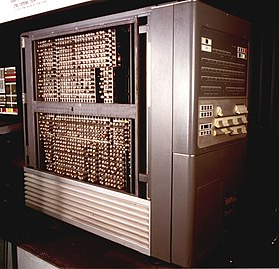
Example: high-level languages
The performance surplus: computers of the 50s got faster and faster (1000s of statements per second!).
The good idea: a high-level language (FORTRAN) could improve productivity, in most cases offsetting the lower performance compared to hand-coding.
The edge: an optimizing compiler (particularly CSE) was used to narrow the gap (see THE FORTRAN AUTOMATIC CODING SYSTEM from 1957).

Slide 53
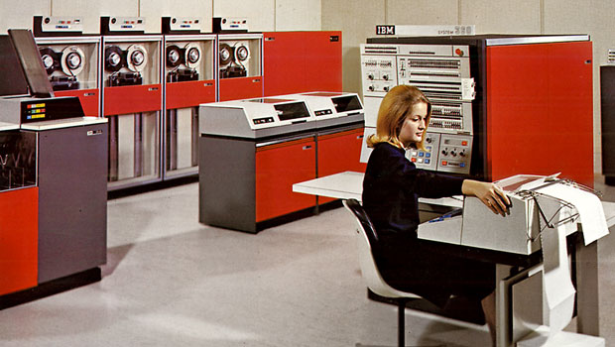
Example: operating systems
The performance surplus: increasing transistor budgets afforded non-computational circuits like MMUs.
The good idea: impose a virtualisation layer that permitted running multiple applications simultaneously, safely.
The edge: a clean distinction between API and implementation, making a single program runnable on machines of vastly different capabilities (IBM System/360).

Slide 54
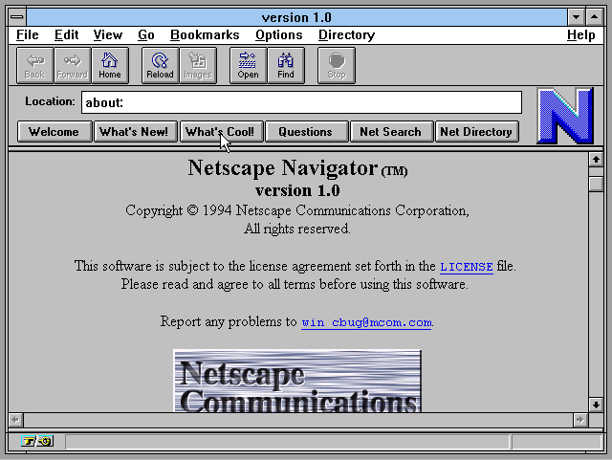
Example: Visual web browsers
The performance surplus: personal computers of the early 90s got fast enough to run sophisticated GUIs.
The good idea: accessible hypertext along with really clever programming in the browsers – particularly to handle concurrent network requests alongside rendering.
  Later: JIT compilation of Javascript (particularly Chrome’s V8 in 2008) sped up web applications to create a new software-based performance surplus.

Slide 55
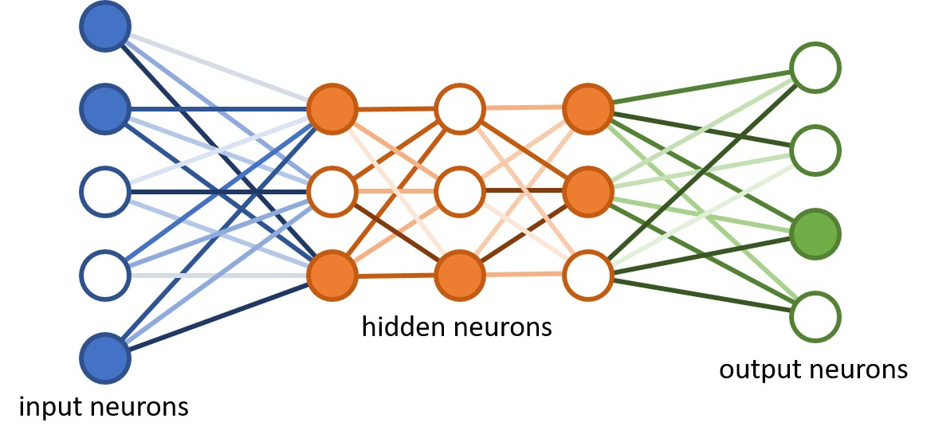
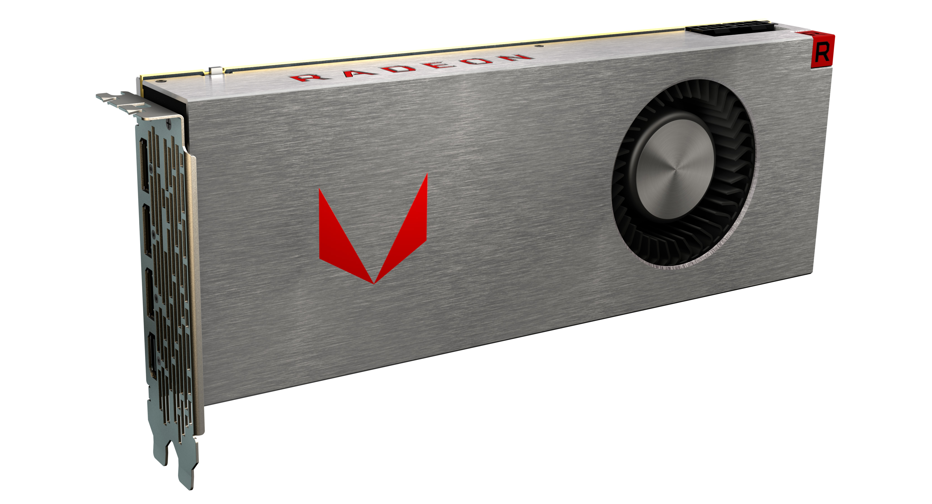
Example: Deep Learning
The good (and old) idea: deep sequences of simple layers of neurons can be trained to perform input classification, if given sufficient (huge) numbers of examples.
The performance surplus: cheap massive parallelism in the form of generally programmable graphics processors (GPUs), funded by millions of gamers in the 90s.
The edge: programming tools and techniques that made GPUs accessible to more than just graphics.

Slide 56
Goodbye for now
This was my last lecture this year. Final advice:
  Check your return codes.
  Use assert() liberally.
  Use a better language than C if at all possible.
  If such a language does not exist, invent it.
  No, C++ is not that language.
If you like this kind of stuff, take these courses:
  Programming Massively Parallel Hardware (PMPH), in block 1.
  Data Parallel Programming in block 2.
  (Nominally master’s courses, but don’t let that stop you.)
  Also, check out my research: https://futhark-lang.org

Slide 57
Extra Slides

Slide 58
Fun with File Descriptors (1)
#include "csapp.h"
int main(int argc, char *argv[])
{
int fd1, fd2, fd3;
char c1, c2, c3;
char *fname = argv[1];
fd1 = Open(fname, O_RDONLY, 0);
fd2 = Open(fname, O_RDONLY, 0);
fd3 = Open(fname, O_RDONLY, 0);
Dup2(fd2, fd3);
Read(fd1, &c1, 1);
Read(fd2, &c2, 1);
Read(fd3, &c3, 1);
printf("c1 = %c, c2 = %c, c3 = %c\n", c1, c2, c3);
return 0;
}
ffiles1.c
What would this program print for file containing “abcde”?

Slide 59
Fun with File Descriptors (2)
#include "csapp.h"
int main(int argc, char *argv[])
{
int fd1;
int s = getpid() & 0x1;
char c1, c2;
char *fname = argv[1];
fd1 = Open(fname, O_RDONLY, 0);
Read(fd1, &c1, 1);
if (fork()) { /* Parent */
sleep(s);
Read(fd1, &c2, 1);
printf("Parent: c1 = %c, c2 = %c\n", c1, c2);
} else { /* Child */
sleep(1-s);
Read(fd1, &c2, 1);
printf("Child: c1 = %c, c2 = %c\n", c1, c2);
}
return 0;
}
ffiles2.c
What would this program print for file containing “abcde”?

Slide 60
Fun with File Descriptors (3)
#include "csapp.h"
int main(int argc, char *argv[])
{
int fd1, fd2, fd3;
char *fname = argv[1];
fd1 = Open(fname, O_CREAT|O_TRUNC|O_RDWR, S_IRUSR|S_IWUSR);
Write(fd1, "pqrs", 4);
fd3 = Open(fname, O_APPEND|O_WRONLY, 0);
Write(fd3, "jklmn", 5);
fd2 = dup(fd1); /* Allocates descriptor */
Write(fd2, "wxyz", 4);
Write(fd3, "ef", 2);
return 0;
}
ffiles3.c
What would be the contents of the resulting file?

Slide 61
Accessing Directories
Only recommended operation on a directory: read its entries
  dirent structure contains information about a directory entry
  DIR structure contains information about directory while stepping through its entries
#include <sys/types.h>
#include <dirent.h>
{
DIR *directory;
struct dirent *de;
...
if (!(directory = opendir(dir_name)))
error("Failed to open directory");
...
while (0 != (de = readdir(directory))) {
printf("Found file: %s\n", de->d_name);
}
...
closedir(directory);
}

