Slide 1
Course Overview
Computer Systems
1st Lecture, Sep. 6, 2021
Lecture:
Troels Henriksen
Based on slides by:
Randal E. Bryant and David R. O’Hallaron

Slide 2
Overview
Course introduction
Overall theme
What is part of the course

Slide 3

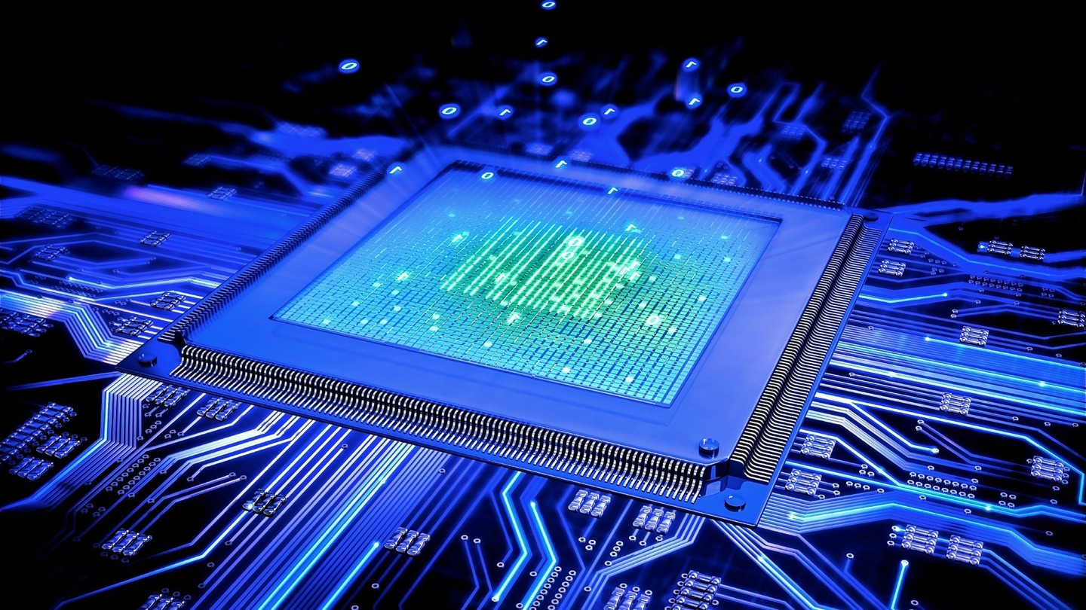

What is a computer system for you?
5 minutes! What to you is a computer system? What does it effect?
  For inspiration (and more):
  CPU, logic gate, transistor, RAM, memory hierarchy, virtual memory, process, thread, network, disk, I/O, http, TCP/IP, RSA, bus, cache, WiFi, switch, internet, synchronization, pipeline,..

Slide 4
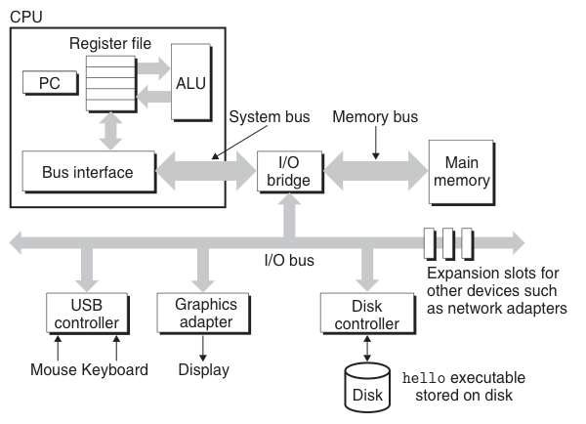
Simple Computer System (hardware)

Slide 5
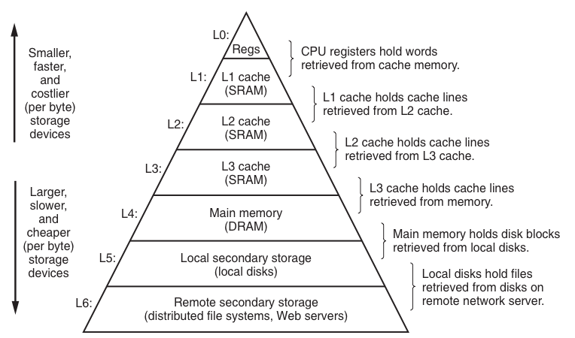
The Memory Hierarchy

Slide 6
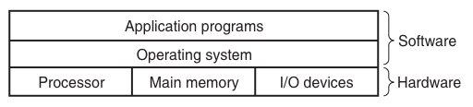
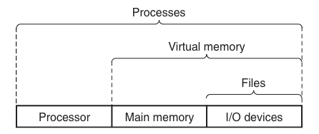
The Memory Hierarchy
Carnegie Mellon
Layered view of computer system
Abstractions provided by OS

Slide 7
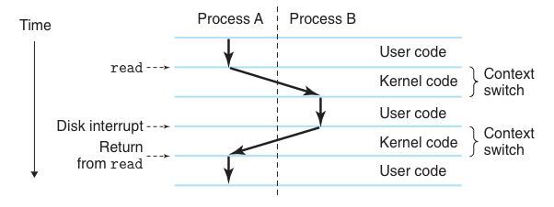
The Processes
Multi-process system
Multi-process on sequential processor
Multi-process on multi-core processor

Slide 8
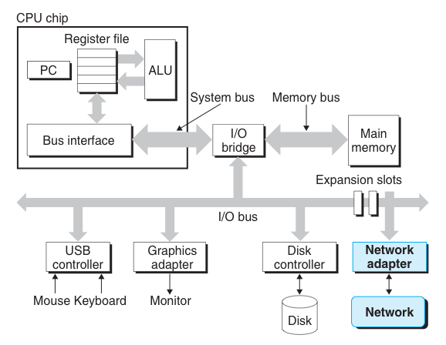
The Network – system side
How to interface with computer system
Learn the difference abstractions and how they are implemented
Understand how security can be improved

Slide 9
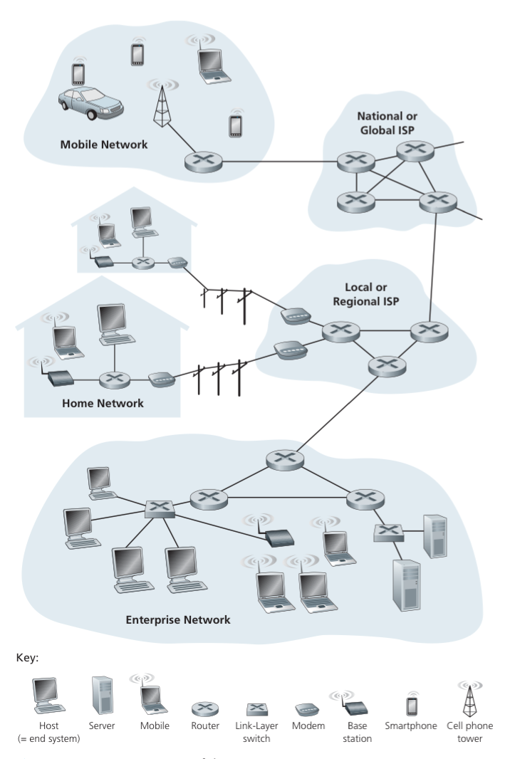
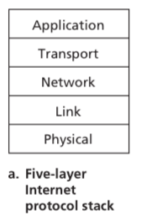
The Network – network side

Slide 10
Course Theme:
Abstraction Is Good But Don’t Forget Reality
Most CS courses emphasize high-level abstraction
  Abstract data types
  Asymptotic analysis
These abstractions have limits
  Especially in the presence of bugs
  Need to understand details of underlying implementations
Useful outcomes from taking CompSys
  Knowledge about concepts of (low-level abstractions)
    Machine Architecture, Memory hierarchy, Operating Systems, Computer Networks, and Encryption.
  Become more effective programmers
    Able to find and eliminate bugs efficiently
    Able to understand and tune for program performance

Slide 11
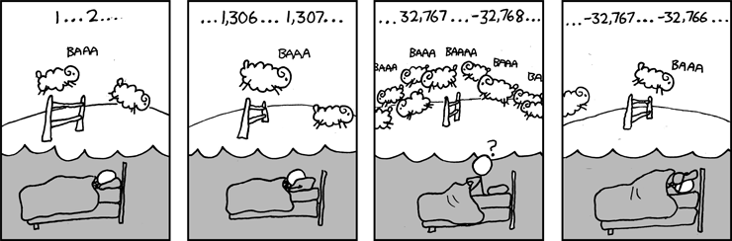
Great Reality #1:
Ints are not Integers, Floats are not Reals
Example 1: Is x² ≥ 0?
  Floats: Yes!
  Ints:
    40000 * 40000 ➙ 1600000000
    50000 * 50000 ➙ ??
Example 2: Is (x + y) + z = x + (y + z)?
  Unsigned & Signed Int’s: Yes!
  Float’s:
    (1e20 + -1e20) + 3.14 --> 3.14
    1e20 + (-1e20 + 3.14) --> ??
Source: xkcd.com/571

Slide 12
Computer Arithmetic
Does not generate random values
  Arithmetic operations have important mathematical properties
Cannot assume all “usual” mathematical properties
  Due to finiteness of representations
  Integer operations satisfy “ring” properties
    Commutativity, associativity, distributivity
  Floating point operations satisfy “ordering” properties
    Monotonicity, values of signs
    Well, almost...
Observation
  Need to understand which abstractions apply in which contexts
  Important issues for compiler writers and serious application programmers

Slide 13
Great Reality #2:
You’ve Got to Know Assembly
Chances are, you’ll never write programs in assembly
  Compilers are much better and more patient than you are
But: Understanding assembly is key to machine-level execution model
  Behavior of programs in presence of bugs
    High-level language models break down
  Tuning program performance
    Understand optimizations done / not done by the compiler
    Understanding sources of program inefficiency
  Implementing system software
    Compiler has machine code as target
    Operating systems must manage process state
  Creating / fighting malware
    Assembly is the language of choice!

Slide 14
Great Reality #3: Memory Matters
Random Access Memory Is an Unphysical Abstraction
Memory is not unbounded
  It must be allocated and managed
  Many applications are memory dominated
Memory referencing bugs especially pernicious
  Effects are distant in both time and space
Memory performance is not uniform
  Cache and virtual memory effects can greatly affect program performance
  Adapting program to characteristics of memory system can lead to major speed improvements

Slide 15
Memory Referencing Bug Example
typedef struct {
int a[2];
double d;
} struct_t;
double fun(int i) {
volatile struct_t s;
s.d = 3.14;
s.a[i] = 1073741824; /* Possibly out of bounds */
return s.d;
}
fun(0) ➙ 3.14
fun(1) ➙ 3.14
fun(2) ➙ 3.1399998664856
fun(3) ➙ 2.00000061035156
fun(4) ➙ 3.14
fun(6) ➙ Segmentation fault
  Result is system specific

Slide 16
Memory Referencing Bug Example
typedef struct {
int a[2];
double d;
} struct_t;
fun(0) ➙ 3.14
fun(1) ➙ 3.14
fun(2) ➙ 3.1399998664856
fun(3) ➙ 2.00000061035156
fun(4) ➙ 3.14
fun(6) ➙ Segmentation fault
Explanation:
Critical State | 6
? | 5
? | 4
d7 ... d4 | 3
d3 ... d0 | 2
a[1] | 1
a[0] | 0
Location accessed by fun(i)
struct_t

Slide 17
Memory Referencing Errors
C and C++ do not provide any memory protection
  Out of bounds array references
  Invalid pointer values
  Abuses of malloc/free
Can lead to nasty bugs
  Whether or not bug has any effect depends on system and compiler
  Action at a distance
    Corrupted object logically unrelated to one being accessed
    Effect of bug may be first observed long after it is generated
How can I deal with this?
  Program in F#, Python, Haskell, Futhark, …
  Understand what possible interactions may occur
  Use or develop tools to detect referencing errors (e.g. Valgrind)

Slide 18
Great Reality #4: There’s more to performance than asymptotic complexity
Constant factors matter too!
And even exact op count does not predict performance
  Easily see 10:1 performance range depending on how code written
  Must optimize at multiple levels: algorithm, data representations, procedures, and loops
Must understand system to optimize performance
  How programs compiled and executed
  How to measure program performance and identify bottlenecks
  How to improve performance without destroying code modularity and generality

Slide 19
Memory System Performance Example
void copyij(int src[2048][2048],
int dst[2048][2048])
{
int i,j;
for (i = 0; i < 2048; i++)
for (j = 0; j < 2048; j++)
dst[i][j] = src[i][j];
}
void copyji(int src[2048][2048],
int dst[2048][2048])
{
int i,j;
for (j = 0; j < 2048; j++)
for (i = 0; i < 2048; i++)
dst[i][j] = src[i][j];
}
4.3ms
81.8ms
2.0 GHz Intel Core i7 Haswell
Hierarchical memory organization
Performance depends on access patterns
  Including how step through multi-dimensional array

Slide 20
Why The Performance Differs
copyij
copyji

Slide 21
Great Reality #5:
Computers do more than execute programs
They need to get data in and out
  I/O system critical to program reliability and performance
They communicate with each other over networks
  Many system-level issues arise in presence of network
    Concurrent operations by autonomous processes
    Coping with unreliable media
    Cross platform compatibility
    Complex performance issues

Slide 22
Course Perspective
Most Systems Courses are Builder-Centric
  Computer Architecture
    Design pipelined processor in LogiSim
  Operating Systems
    Implement sample portions of operating system in KUDOS
  Networking
    Implement and simulate network protocols
  Encryption
    Understand and use encryption to improve security

Slide 23
Course Perspective
Course is Programmer-Centric
  Purpose is to show that by knowing more about the underlying system, one can be more effective as a programmer
  Enable you to
    Write programs that are more reliable and efficient
    Incorporate features that require hooks into OS
      E.g., concurrency, signal handlers
  Cover material in this course that you won’t see elsewhere
  Not just a course for dedicated hackers
    We bring out the hidden hacker in everyone!

Slide 24
Welcome and Enjoy!

