Slide 1
Bits, Bytes, and Integers
Computer Systems
Troels Henriksen
Based on slides by:
Randal E. Bryant and David R. O’Hallaron

Slide 2
Today: Bits, Bytes, and Integers
Representing information as bits
Bit-level manipulations
Integers
  Representation: unsigned and signed
  Conversion, casting
  Expanding, truncating

Slide 3

Everything is bits
Each bit is 0 or 1
By encoding/interpreting
sets of bits in various ways
  Computers determine what
  to do (instructions)
  … and represent and
  manipulate numbers, sets,
  strings, etc…
Why bits? Why no decimals? Does there exist another possibility?
Notes:
Does everything have to be bits.

Slide 4
Everything is bits
Why bits? Electronic Implementation
  Easy to store with bistable elements
  Reliably transmitted on noisy and inaccurate wires
... But there exist many models that are not
  E.g. Ternary (3-state) logic, analog computers, quantum computers
0
1
0
1.1V
0.9V
0.2V
0.0V
Notes:
Does everything have to be bits.

Slide 5
Binary numbers
Base 2 Number Representation
  Represent 15213₁₀ as 11101101101101₂
  Represent 1.20₁₀ as 1.0011001100110011[0011]…₂
  Represent 1.5213 x 10⁴ as 1.1101101101101₂ x 2¹³

Slide 6
Encoding Byte Values
Byte = 8 bits
  Binary 000000002 to 111111112
  Decimal: 010 to 25510
  Hexadecimal 0016 to FF16
    Base 16 number representation
    Use characters ‘0’ to ‘9’ and ‘A’ to ‘F’
    Write FA1D37B16 in C as
      0xFA1D37B
      0xfa1d37b
Decimal
Hex
Binary
0
0
0000
1
1
0001
2
2
0010
3
3
0011
4
4
0100
5
5
0101
6
6
0110
7
7
0111
8
8
1000
9
9
1001
A
10
1010
B
11
1011
C
12
1100
D
13
1101
E
14
1110
F
15
1111

Slide 7
Let’s play a game
http://topps.diku.dk/compsys/integers.html

Slide 8
Example Data Representations
C Data Type | Typical 32-bit | Typical 64-bit | x86-64
char | 1 | 1 | 1
short | 2 | 2 | 2
int | 4 | 4 | 4
long | 4 | 8 | 8
int32_t | 4 | 4 | 4
int64_t | 8 | 8 | 8
float | 4 | 4 | 4
double | 8 | 8 | 8
long double | − | − | 10/16
pointer | 4 | 8 | 8

Slide 9
Today: Bits, Bytes, and Integers
Representing information as bits
Bit-level manipulations
Integers
  Representation: unsigned and signed
  Conversion, casting
  Expanding, truncating
  Summary

Slide 10
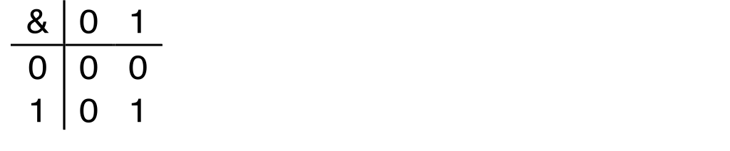
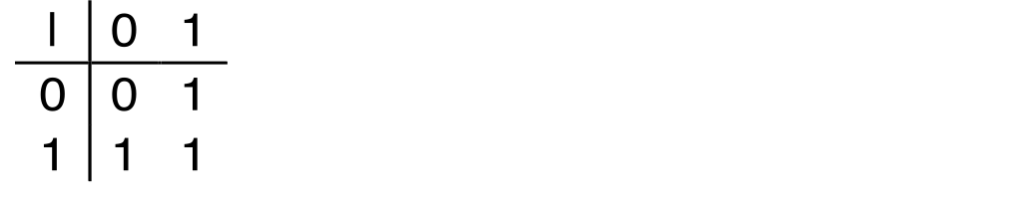
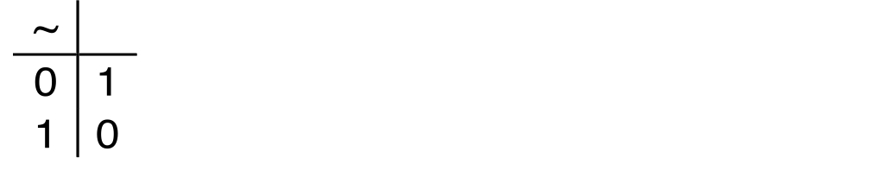
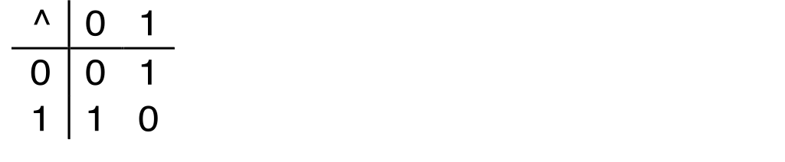
Boolean Algebra
Developed by George Boole in 19th Century
  Algebraic representation of logic
    Encode “True” as 1 and “False” as 0
And
A&B = 1 when both A=1 and B=1
Or
A|B = 1 when either A=1 or B=1
Not
~A = 1 when A=0
Exclusive-Or (Xor)
A^B = 1 when either A=1 or B=1, but not both
Notes:
Can also be considered at modular-2 arithmetic

Slide 11
Application of Boolean Algebra
Applied to Digital Systems by Claude Shannon
  1937 MIT Master’s Thesis
  Reason about networks of relay switches
    Encode closed switch as 1, open switch as 0
A&~B
Connection when
A&~B | ~A&B
A
~B
~A
B
~A&B
= A^B

Slide 12
General Boolean Algebras
Operate on Bit Vectors
  Operations applied bitwise
All of the Properties of Boolean Algebra Apply
01101001
& 01010101
01000001
01101001
| 01010101
01111101
01101001
^ 01010101
00111100
~ 01010101
10101010
01000001
01111101
00111100
10101010

Slide 13
Example: Representing & Manipulating Sets
Representation
  Width w bit vector represents subsets of {0, …, w–1}
  a_{j} = 1 if j ∈ A
    01101001 { 0, 3, 5, 6 }
    76543210
    01010101 { 0, 2, 4, 6 }
    76543210
Operations
  & Intersection 01000001 { 0, 6 }
  | Union 01111101 { 0, 2, 3, 4, 5, 6 }
  ^ Symmetric difference 00111100 { 2, 3, 4, 5 }
  ~ Complement 10101010 { 1, 3, 5, 7 }

Slide 14
Bit-Level Operations in C
Operations &, |, ~, ^ Available in C
  Apply to any “integral” data type
    long, int, short, char, unsigned
  View arguments as bit vectors
  Arguments applied bit-wise
Examples (Char data type)
  ~0x41 ➙ 0xBE
    ~010000012 ➙ 101111102
  ~0x00 ➙ 0xFF
    ~000000002 ➙ 111111112
  0x69 & 0x55 ➙ 0x41
    011010012 & 010101012 ➙ 010000012
  0x69 | 0x55 ➙ 0x7D
    011010012 | 010101012 ➙ 011111012

Slide 15
Contrast: Logic Operations in C
Contrast to Logical Operators
  &&, ||, !
    View 0 as “False”
    Anything nonzero as “True”
    Always return 0 or 1
    Early termination
Examples (char data type)
  !0x41 ➙ 0x00
  !0x00 ➙ 0x01
  !!0x41 ➙ 0x01
  0x69 && 0x55 ➙ 0x01
  0x69 || 0x55 ➙ 0x01
  p && *p (avoids null pointer access)

Slide 16
Contrast: Logic Operations in C
Contrast to Logical Operators
  &&, ||, !
    View 0 as “False”
    Anything nonzero as “True”
    Always return 0 or 1
    Early termination
Examples (char data type)
  !0x41 ➙ 0x00
  !0x00 ➙ 0x01
  !!0x41 ➙ 0x01
  0x69 && 0x55 ➙ 0x01
  0x69 || 0x55 ➙ 0x01
  p && *p (avoids null pointer access)
Watch out for && vs. & (and || vs. |)…
one of the more common oopsies in
C programming

Slide 17
Shift Operations
Left Shift: x << y
  Shift bit-vector x left y positions
      Throw away extra bits on left
    Fill with 0’s on right
Right Shift: x >> y
  Shift bit-vector x right y positions
    Throw away extra bits on right
  Logical shift
    Fill with 0’s on left
  Arithmetic shift
    Replicate most significant bit on left
Undefined Behavior
  Shift amount < 0 or ≥ word size
Argument x
01100010
<< 3
00010000
00010000
00010000
Log. >> 2
00011000
00011000
00011000
Arith. >> 2
00011000
00011000
00011000
Argument x
10100010
<< 3
00010000
00010000
00010000
Log. >> 2
00101000
00101000
00101000
Arith. >> 2
11101000
11101000
11101000

Slide 18
Today: Bits, Bytes, and Integers
Representing information as bits
Bit-level manipulations
Integers
  Representation: unsigned and signed
  Conversion, casting
  Expanding, truncating
  Summary

Slide 19


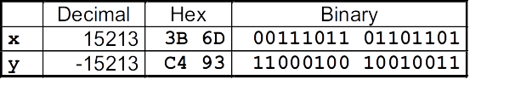
Encoding Integers
Unsigned
Two’s Complement
short int x = 15213;
short int y = -15213;
Sign
Bit
C short 2 bytes long
Sign Bit
  For 2’s complement, most significant bit indicates sign
    0 for nonnegative
    1 for negative

Slide 20
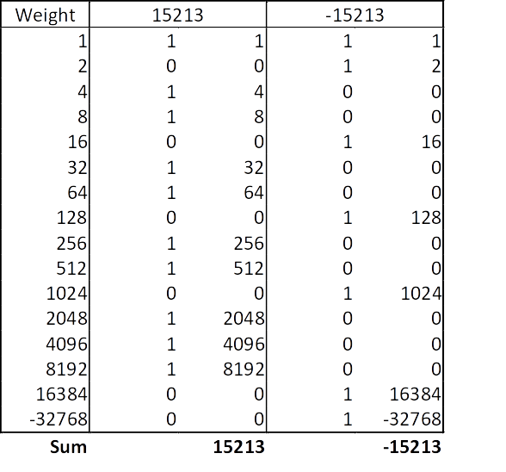
Two-complement Encoding Example (Cont.)
x = 15213: 00111011 01101101
y = -15213: 11000100 10010011

Slide 21
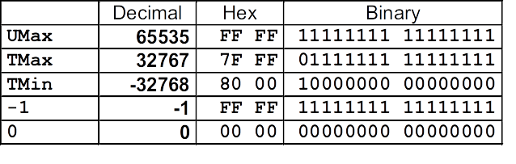
Numeric Ranges
Unsigned Values
  UMin = 0
000…0
  UMax = 2^{w} – 1
Two’s Complement Values
  TMin = –2^{w–1}
100…0
  TMax = 2^{w–1} – 1
011…1
Other Values
  Minus 1
Values for W = 16

Slide 22
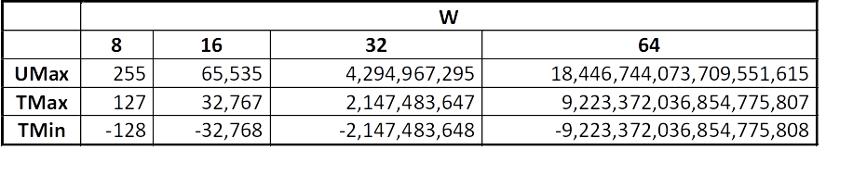
Values for Different Word Sizes
Observations
  |TMin | = TMax + 1
    Asymmetric range
  UMax = 2 * TMax + 1
C Programming
  #include <limits.h>
  Declares constants, e.g.,
    ULONG_MAX
    LONG_MAX
    LONG_MIN
  Values platform specific

Slide 23
Unsigned & Signed Numeric Values
Equivalence
  Same encodings for nonnegative values
Uniqueness
  Every bit pattern represents unique integer value
  Each representable integer has unique bit encoding
⇒ Can Invert Mappings
  U2B(x) = B2U⁻¹(x)
    Bit pattern for unsigned integer
  T2B(x) = B2T⁻¹(x)
    Bit pattern for two’s comp integer
X
B2U(X)
B2T(X)
0000
0
0
0001
1
1
0010
2
2
0011
3
3
0100
4
4
0101
5
5
0110
6
6
0111
7
7
1000
8
–8
1001
9
–7
1010
10
–6
1011
11
–5
1100
12
–4
1101
13
–3
1110
14
–2
1111
15
–1

Slide 24
Today: Bits, Bytes, and Integers
Representing information as bits
Bit-level manipulations
Integers
  Representation: unsigned and signed
  Conversion, casting
  Expanding, truncating
  Addition, negation, multiplication, shifting
  Summary

Slide 25
Mapping Between Signed & Unsigned
Two’s Complement
Unsigned
T2U
x
T2B
B2U
ux
X
Maintain Same Bit Pattern
Unsigned
U2T
Two’s Complement
ux
U2B
B2T
x
X
Maintain Same Bit Pattern
Mappings between unsigned and two’s complement numbers:
Keep bit representations and reinterpret

Slide 26
Mapping Signed ↔ Unsigned
Bits
0000
0001
0010
0011
0100
0101
0110
0111
1000
1001
1010
1011
1100
1101
1110
1111
Signed
0
1
2
3
4
5
6
7
-8
-7
-6
-5
-4
-3
-2
-1
Unsigned
0
1
2
3
4
5
6
7
8
9
10
11
12
13
14
15
T2U
U2T

Slide 27
Mapping Signed ↔ Unsigned
Bits
0000
0001
0010
0011
0100
0101
0110
0111
1000
1001
1010
1011
1100
1101
1110
1111
Signed
0
1
2
3
4
5
6
7
-8
-7
-6
-5
-4
-3
-2
-1
Unsigned
0
1
2
3
4
5
6
7
8
9
10
11
12
13
14
15
=
+/- 16

Slide 28
Relation between Signed & Unsigned
Two’s Complement
Unsigned
T2U
x
T2B
B2U
ux
X
Maintain Same Bit Pattern
w–1
0
ux
+
+
+
• • •
+
+
+
x
-
+
+
• • •
+
+
+
Large negative weight
becomes
Large positive weight

Slide 29
Conversion Visualized
2’s Comp. → Unsigned
  Ordering Inversion
  Negative → Big Positive
UMax
UMax – 1
TMax + 1
Unsigned
Range
TMax
TMax
2’s Complement Range
0
0
–1
–2
TMin

Slide 30
Signed vs. Unsigned in C
Constants
  By default are considered to be signed integers
  Unsigned if have “U” as suffix
0U, 4294967259U
Casting
  Explicit casting between signed & unsigned same as U2T and T2U
int tx, ty;
unsigned ux, uy;
tx = (int) ux;
uy = (unsigned) ty;
  Implicit casting also occurs via assignments and procedure calls
tx = ux;
uy = ty;

Slide 31
Casting Surprises
Expression Evaluation
  If there is a mix of unsigned and signed in single expression,
  signed values implicitly cast to unsigned
  Including comparison operations <, >, ==, <=, >=
  Examples for W = 32: TMIN = -2,147,483,648 , TMAX = 2,147,483,647
Constant₁ Constant₂ Relation Evaluation
0 0U
-1 0
-1 0U
2147483647 -2147483647-1
2147483647U -2147483647-1
-1 -2
(unsigned)-1 -2
2147483647 2147483648U
2147483647 (int) 2147483648U
0 0U == unsigned
-1 0 < signed
-1 0U > unsigned
2147483647 -2147483648 > signed
2147483647U -2147483648 < unsigned
-1 -2 > signed
(unsigned) -1 -2 > unsigned
2147483647 2147483648U < unsigned
2147483647 (int) 2147483648U > signed

Slide 32
Summary
Casting Signed ↔ Unsigned: Basic Rules
Bit pattern is maintained
But reinterpreted
Can have unexpected effects: adding or subtracting 2^{w}
Expression containing signed and unsigned int
  int is cast to unsigned!!

Slide 33
Recap: Shift Operations
Left Shift: x << y
  Shift bit-vector x left y positions
      Throw away extra bits on left
    Fill with 0’s on right
Right Shift: x >> y
  Shift bit-vector x right y positions
    Throw away extra bits on right
  Logical shift
    Fill with 0’s on left
  Arithmetic shift
    Replicate most significant bit on left
Singed values use arithmetic shift
Unsigned values use logical shift
Argument x
01100010
<< 3
00010000
00010000
00010000
Log. >> 2
00011000
00011000
00011000
Arith. >> 2
00011000
00011000
00011000
Argument x
10100010
<< 3
00010000
00010000
00010000
Log. >> 2
00101000
00101000
00101000
Arith. >> 2
11101000
11101000
11101000

Slide 34
Today: Bits, Bytes, and Integers
Representing information as bits
Bit-level manipulations
Integers
  Representation: unsigned and signed
  Conversion, casting
  Expanding, truncating
  Summary

Slide 35
Sign Extension
Task:
  Given w-bit signed integer x
  Convert it to w+k-bit integer with same value
Rule:
  Make k copies of sign bit:
  X ′ = x_{w–1} ,…, x_{w–1} , x_{w–1} , x_{w–2} ,…, x₀
k copies of MSB
w
X
• • •
• • •
X ′
• • •
• • •
k
w

Slide 36
Sign Extension Example
short int x = 15213;
int ix = (int) x;
short int y = -15213;
int iy = (int) y;
Decimal
Hex
Binary
x
15213
3B 6D
00111011 01101101
ix
15213
00 00 3B 6D
00000000 00000000 00111011 01101101
y
-15213
C4 93
11000100 10010011
iy
-15213
FF FF C4 93
11111111 11111111 11000100 10010011
Converting from smaller to larger integer data type
C automatically performs sign extension

Slide 37
Today: Bits, Bytes, and Integers
Representing information as bits
Bit-level manipulations
Integers
  Representation: unsigned and signed
  Conversion, casting
  Expanding, truncating
  Summary

Slide 38
Summary:
Expanding, Truncating: Basic Rules
Expanding (e.g., short int to int)
  Unsigned: zeros added
  Signed: sign extension
  Both yield expected result
Truncating (e.g., unsigned to unsigned short)
  Unsigned/signed: bits are truncated
  Result reinterpreted
  Unsigned: mod operation
  Signed: similar to mod
  For small numbers yields expected behavior

Slide 39
Integer C Puzzles
x < 0 => ((x*2) < 0)
ux >= 0
x & 7 == 7 => (x<<30) < 0
ux > -1
x > y => -x < -y
x * x >= 0
x > 0 && y > 0 => x + y > 0
x >= 0 => -x <= 0
x <= 0 => -x >= 0
(x|-x)>>31 == -1
ux >> 3 == ux/8
x >> 3 == x/8
x & (x-1) != 0
Initialization
int x = foo();
int y = bar();
unsigned ux = x;
unsigned uy = y;

