Slide 1
Digitallogik
Finn Schiermer Andersen
Baseret mestendels på figurer fra COD, App A.

Slide 2
Agenda
Simple byggeklodser (porte)
Mere komplicerede byggeklodser
Tilstandselementer og Clocking
CMOS Implementation

Slide 3

Simple byggeklodser. Vi kan bygge alt funktionalitet
med de her primitiver.
Faktisk kan vi nøjes med NOR eller NAND
Figure A.2.1 Standard drawing for an AND gate, OR gate, and an inverter, shown from
left to right. The signals to the left of each symbol are the inputs, while the output appears on the right. The
AND and OR gates both have two inputs. Inverters have a single input.
Copyright © 2021 Elsevier Inc. All rights reserved.

Slide 4
Et lille indskud om CMOS

Slide 5
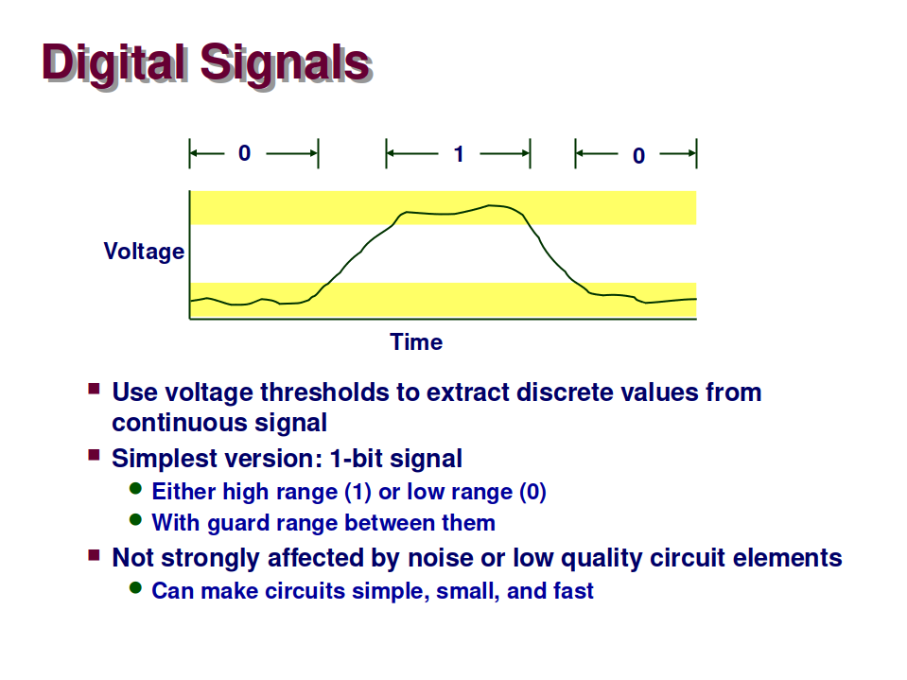
Signaler og data
(fra “Computer Systems, a programmers perspective”)

Slide 6

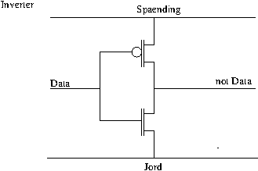

CMOS Implementation af digitallogik
PMOS leder v lavt input
NMOS leder v højt input

Slide 7
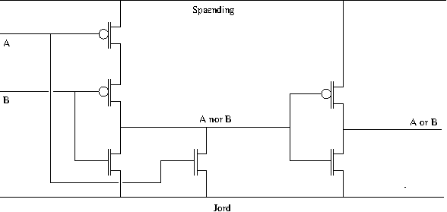
CMOS-implementation af Or-port
A | B | Nor | Or
0 | 0 | 1 | 0
0 | 1 | 0 | 1
1 | 0 | 0 | 1
1 | 1 | 0 | 1

Slide 8
Lidt om CMOS produktionsprocessen
1. Reducer hele dit design til porte
2. Placer dine porte i et plan og forbind dem.
Også kaldet "place and route". Der er kun få
adskildte lag hvori forbindelser kan løbe.
3. Beregn alle forsinkelser for signaler under en
række forskellige scenarier (varians i ledningsevne,
forsyningsspænding, skifte-aktivitet)
4. Beregn herfra max clock frekvens og strømforbrug
5. Hvis du er utilfreds, start forfra
6. Oversæt dit design til "masker" der kan styre en
efterfølgende litografisk process
7. Producer.
8. Test og sorter. Sælg!
https://en.wikipedia.org/wiki/Semiconductor_device_fabrication

Slide 9
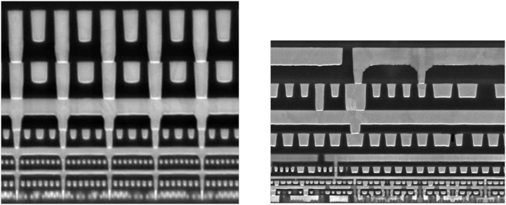
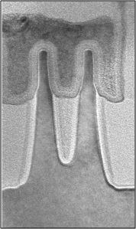
Transistorer udgøres af flere lag med forskellige elektriske egenskaber.
Lagene føres på et efter et via en kompliceret litografisk process.
Transistor
Ca 20nm bred
Eksempler fra Intel 22nm og 14nm CMOS

Slide 10
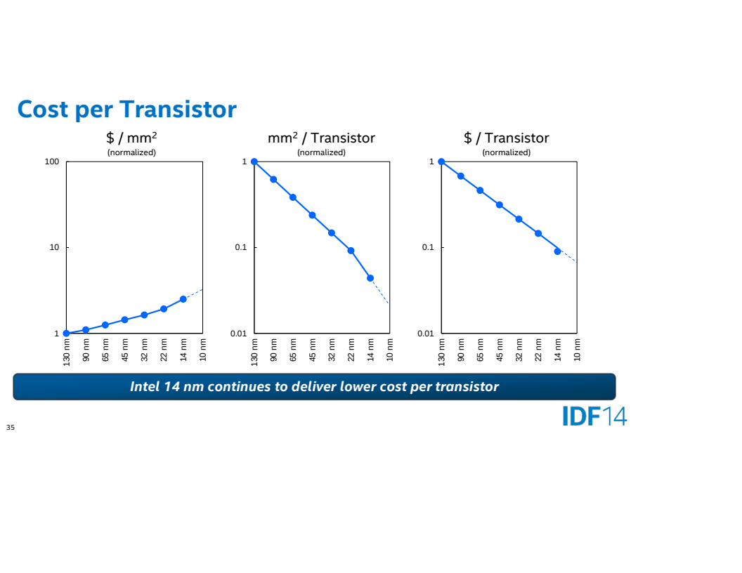
Moores lov for dummies:

Slide 11
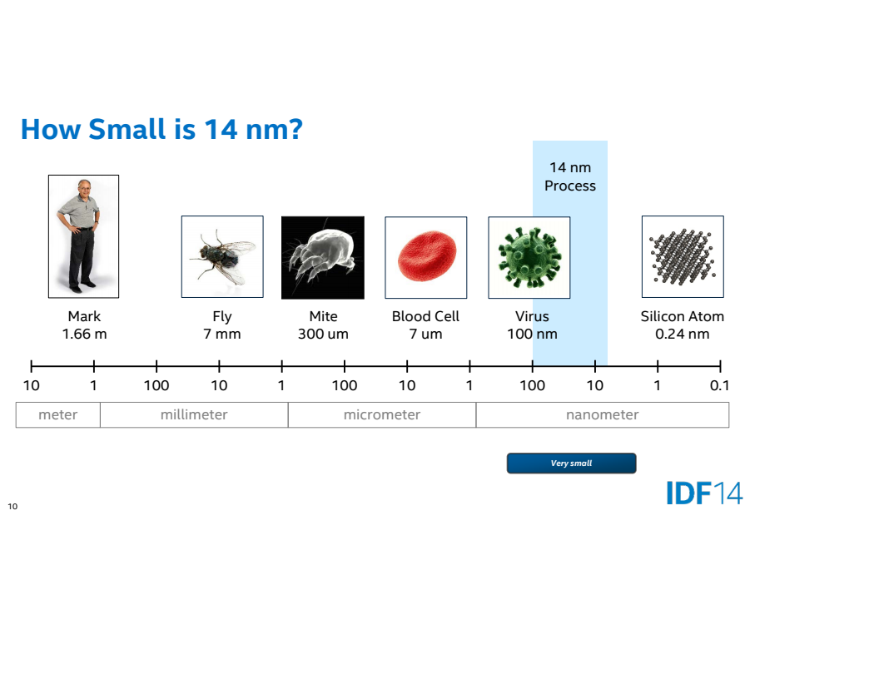
Fra Intel Developer Forum 2014 – beskriver Intels 14nm proces
Seneste processorer er lavet i 7 eller 5nm processer

Slide 12
Udviklingen indenfor CMOS teknologi
Antallet af transistorer er vokset eksponentielt siden en gang i 70'erne
Tilsvarende fremskridt for regnehastighed (udtrykt ved clock-frekvens) frem til ca 2005.
Siden 2005 er max clock frekvens kun steget marginalt. Energiomsætning (varme)
er nu væsentligste begrænsning
Denne her teknologiudvikling (af CMOS fremstilingsprocessen) har stået på I 50 år.
Den har drevet/muliggjort alt mulig anden teknologi. Den har forandret samfundet.
Det bliver vanskeligere og vanskeligere at opretholde Moores lov. Muligvis er
det allerede slut. Det afhænger lidt af den præcise definition.
Selvom vi nærmer os "end of the road" for CMOS, så er der ikke noget der
kan konkurrere. Endnu.

Slide 13
CMOS udflugt slut – tilbage til det digitallogiske niveau

Slide 14
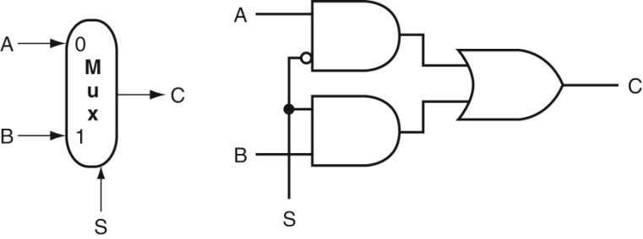
En mux bruges til at vælge mellem mulige resultater.
Det er det tætteste vi kommer på en if-then-else I hardware
Figure A.3.2 A two-input multiplexor on the left and its implementation with gates on
the right. The multiplexor has two data inputs (A and B), which are labeled 0 and 1, and one selector input
(S), as well as an output C.
Bemærk den lille “boble”...negation af input-signal
Copyright © 2021 Elsevier Inc. All rights reserved.

Slide 15
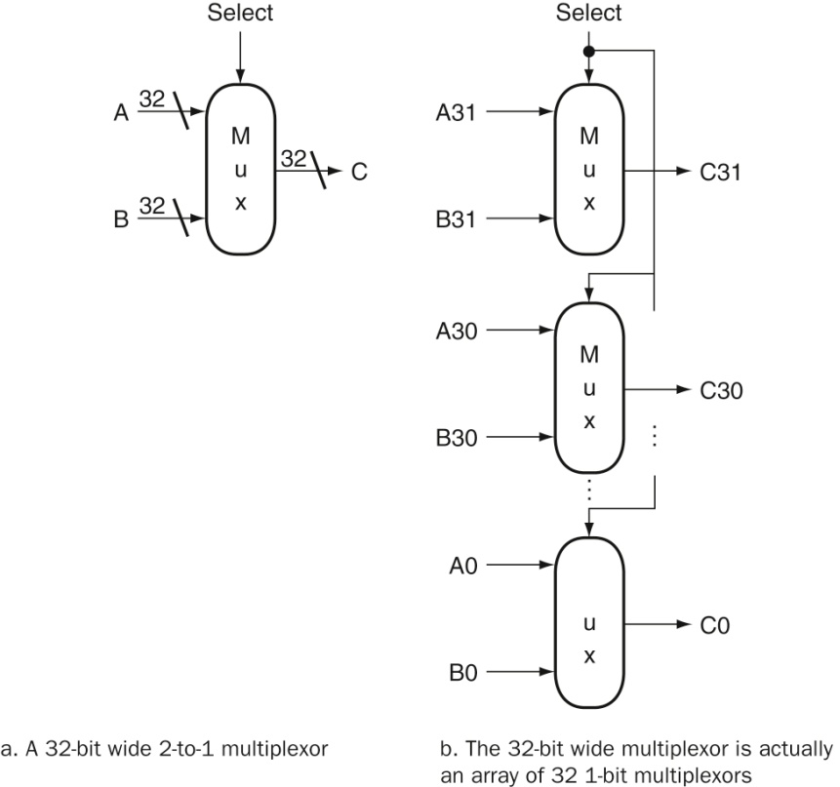
Figure A.3.6 A multiplexor is arrayed 64 times to perform a selection between two
64-bit inputs. Note that there is still only one data selection signal used for all 32 1-bit multiplexors.
Copyright © 2021 Elsevier Inc. All rights reserved.

Slide 16
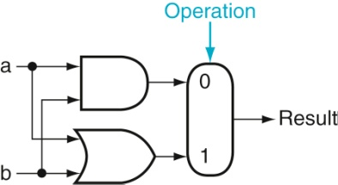
En proto-ALU :-)
Vi kan udvide med flere funktioner hvis resultater
derpå udvælges af en større mux
Figure A.5.1 The 1-bit logical unit for AND and OR.
Copyright © 2021 Elsevier Inc. All rights reserved.

Slide 17
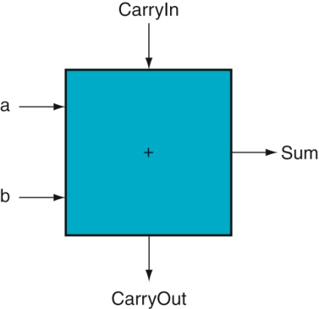
Figure A.5.2 A 1-bit adder. This adder is called a full adder; it is also called a (3,2) adder because it
has three inputs and two outputs. An adder with only the a and b inputs is called a (2,2) adder or half-adder.
Copyright © 2021 Elsevier Inc. All rights reserved.

Slide 18
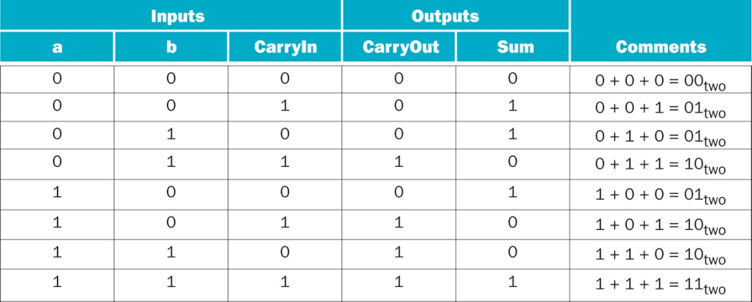
Figure A.5.3 Input and output specification for a 1-bit adder.
Copyright © 2021 Elsevier Inc. All rights reserved.

Slide 19
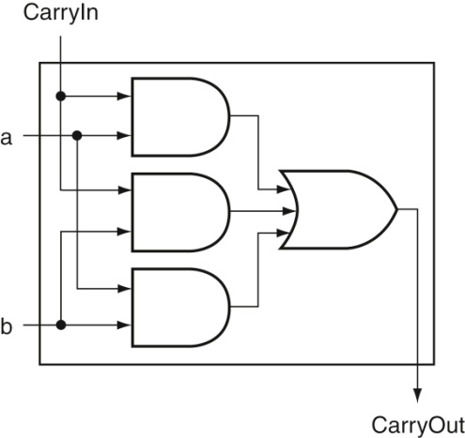
Figure A.5.5 Adder hardware for the CarryOut signal. The rest of the adder hardware is the logic
for the Sum output given in the equation on this page.
Copyright © 2021 Elsevier Inc. All rights reserved.

Slide 20
Hvordan beregner vi “sum” signalet med
brug af digitallogiske porte?

Slide 21
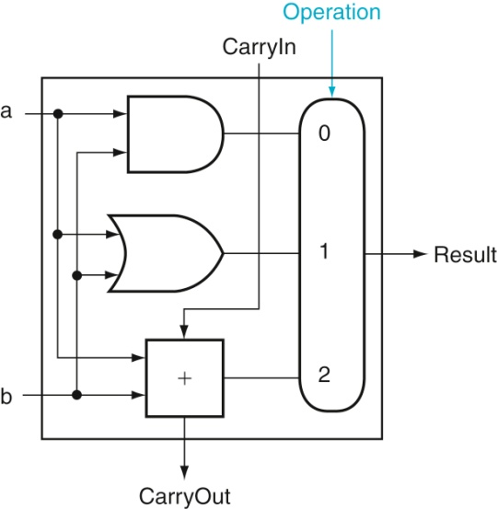
En lidt mere ALU-agtig ALU (nu med “plus”)
Figure A.5.6 A 1-bit ALU that performs AND, OR, and addition (see Figure A.5.5).
Copyright © 2021 Elsevier Inc. All rights reserved.

Slide 22
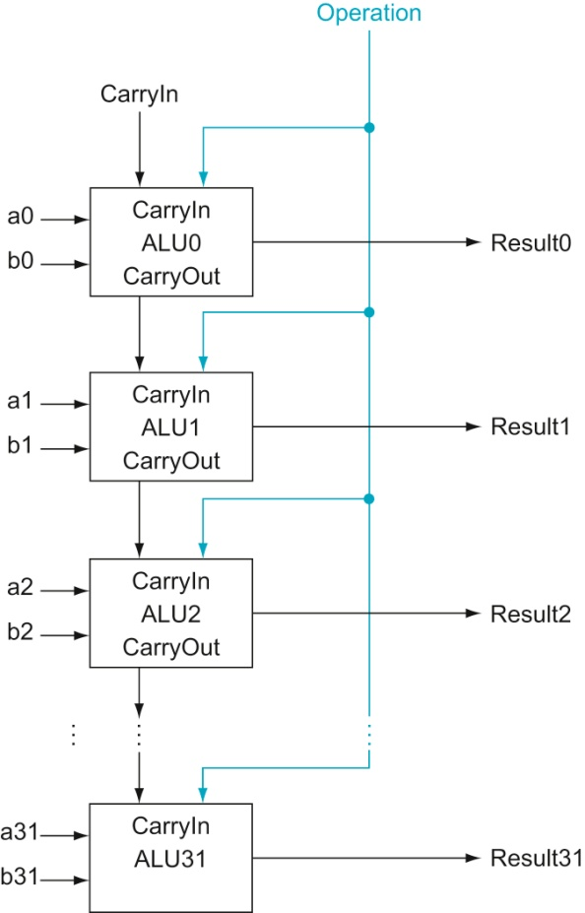
Figure A.5.7 A 32-bit ALU constructed from 32 1-bit ALUs. CarryOut of the less significant bit
is connected to the CarryIn of the more significant bit. This organization is called ripple carry.
Copyright © 2021 Elsevier Inc. All rights reserved.

Slide 23
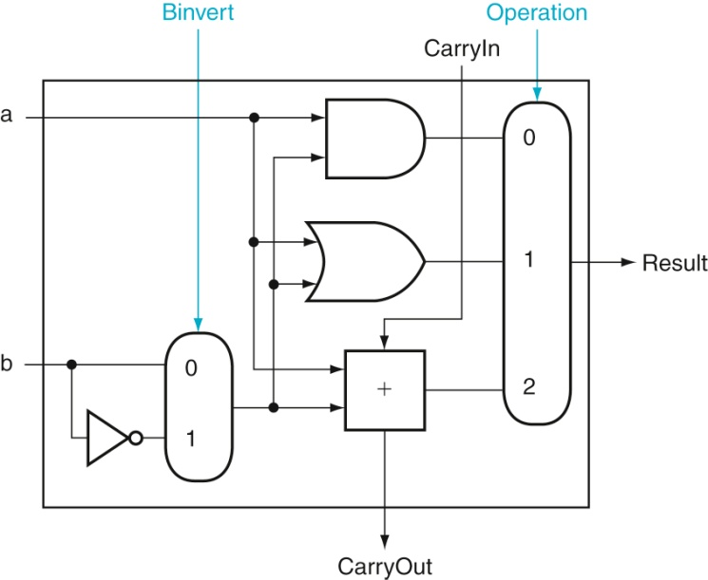
Vi skal også kunne trække fra
Det gør vi ved at negere og addere
Hvordan er det nu vi negerer et 2-komplement tal?
Figure A.5.8 A 1-bit ALU that performs AND, OR, and addition on a and b or a and b. By
selecting b (Binvert = 1) and setting CarryIn to 1 in the least significant bit of the ALU, we get two’s complement
subtraction of b from a instead of addition of b to a.
Copyright © 2021 Elsevier Inc. All rights reserved.

Slide 24
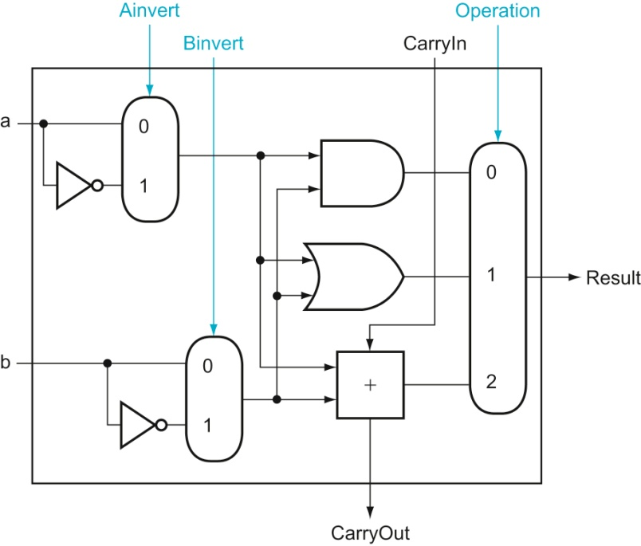
Vi kan også beregne bitvist “NOR” – men bruger det vist ikke?
Figure A.5.9 A 1-bit ALU that performs AND, OR, and addition on a and b or a
and b. By selecting a (Ainvert = 1) and b (Binvert = 1), we get a NOR b instead of a AND b.
Copyright © 2021 Elsevier Inc. All rights reserved.

Slide 25
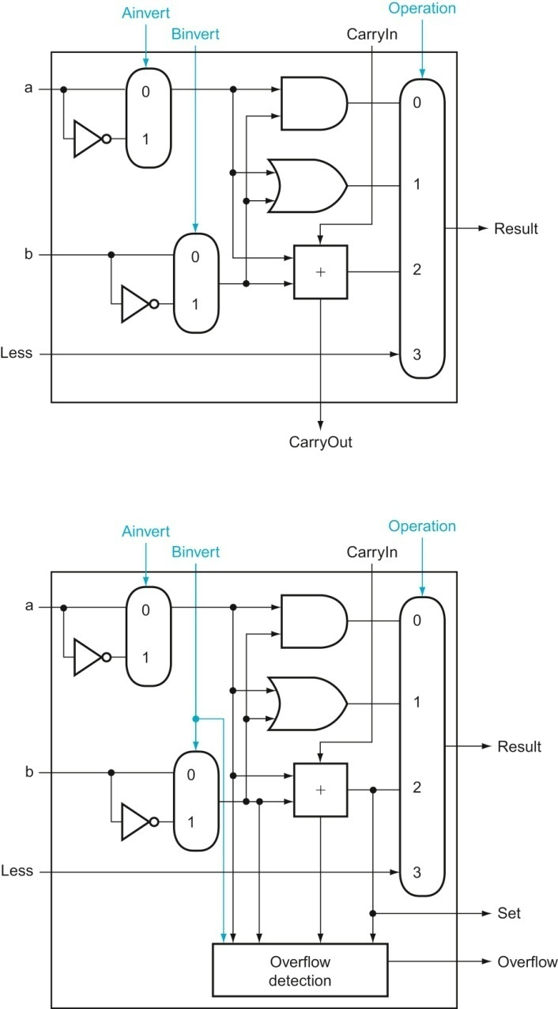
Figure A.5.10 (Top) A 1-bit ALU that performs AND, OR, and addition on a and b or b, and (bottom) a 1-bit ALU for the most significant bit. The top drawing includes a direct input that is connected to perform the set on less than operation (see Figure A.5.11); the bottom has a direct output from the adder for the less than comparison called Set. (See Exercise A.24 at the end of this appendix to see how to calculate overflow with fewer inputs.)
Copyright © 2021 Elsevier Inc. All rights reserved.

Slide 26
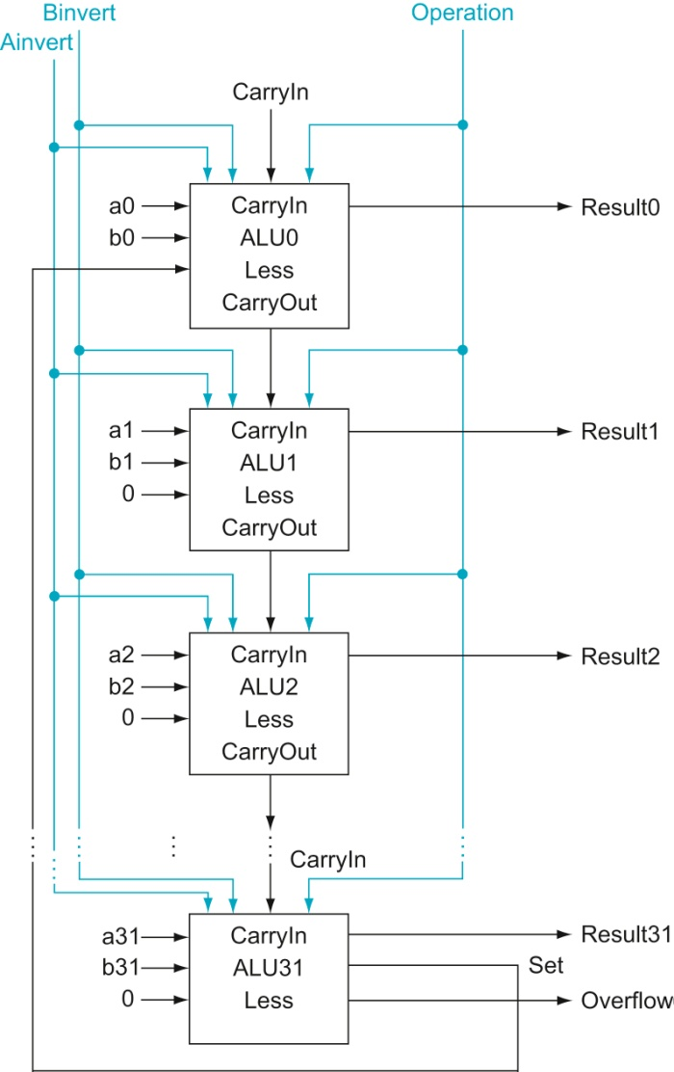
Figure A.5.11 A 32-bit ALU constructed from the 31 copies of the 1-bit ALU in the top of
Figure A.5.10 and one 1-bit ALU in the bottom of that figure. The Less inputs are connected to 0
except for the least significant bit, which is connected to the Set output of the most significant bit. If the ALU
performs a − b and we select the input 3 in the multiplexor in Figure A.5.10, then Result = 0 … 001 if a < b,
and Result = 0 … 000 otherwise.
Copyright © 2021 Elsevier Inc. All rights reserved.

Slide 27
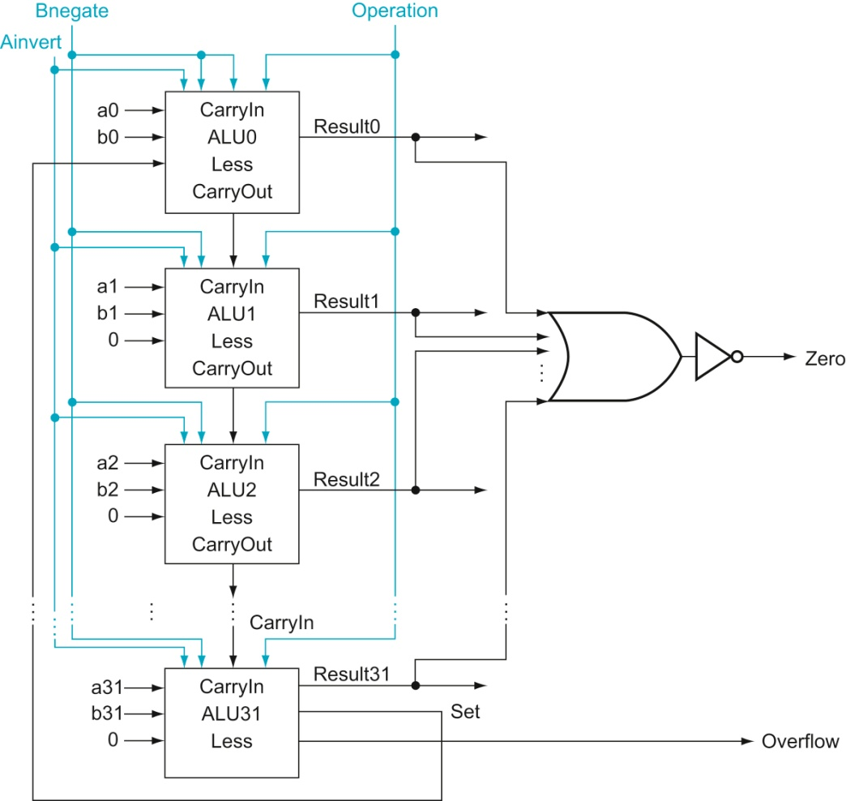
Figure A.5.12 The final 32-bit ALU. This adds a Zero detector to Figure A.5.11.
Copyright © 2021 Elsevier Inc. All rights reserved.

Slide 28
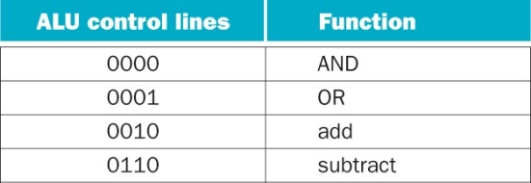
Styring af ALUen
Figure A.5.13 The values of the three ALU control lines, Ainvert, Bnegate, and Operation,
and the corresponding ALU operations.
Copyright © 2021 Elsevier Inc. All rights reserved.

Slide 29
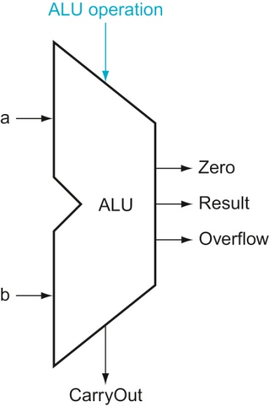
Figure A.5.14 The symbol commonly used to represent an ALU, as shown in Figure
A.5.12. This symbol is also used to represent an adder, so it is normally labeled either with ALU or Adder..
Copyright © 2021 Elsevier Inc. All rights reserved.

Slide 30
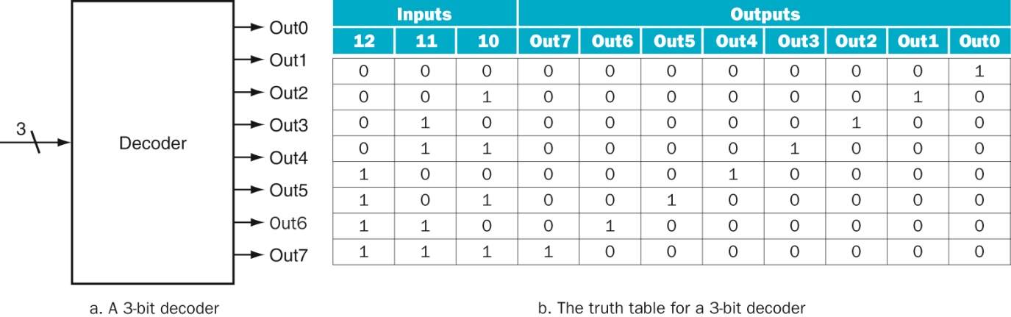
En afkoder
Figure A.3.1 A 3-bit decoder has three inputs, called 12, 11, and 10, and 23 = 8 outputs, called Out0 to Out7. Only the
output corresponding to the binary value of the input is true, as shown in the truth table. The label 3 on the input to the decoder says that the input signal is 3 bits wide.
Hvordan beregnes outputs ved brug af digitallogiske porte?
Copyright © 2021 Elsevier Inc. All rights reserved.

Slide 31
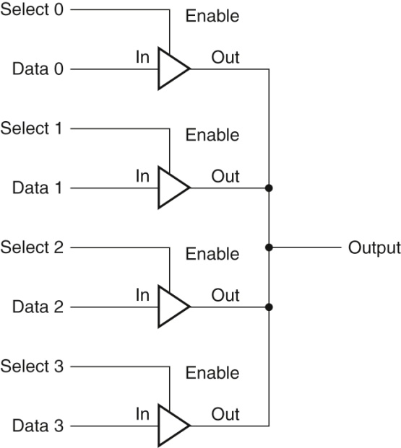
En 4-input mux konstrueret med “wired or” i stedet for digitallogiske porte
Kombineres ofte med en decoder til at styre select signalerne
Figure A.9.2 Four three-state buffers are used to form a multiplexor. Only one of the four
Select inputs can be asserted. A three-state buffer with a deasserted Output enable has a high-impedance
output that allows a three-state buffer whose Output enable is asserted to drive the shared output line.
Copyright © 2021 Elsevier Inc. All rights reserved.

Slide 32
Tilstandselementer
De byggeklodser vi har set indtil nu er “kombinatioriske”.
De genberegner kontinuerligt output ud fra input
Nu skal vi se på byggeklodser der kan “holde” eller “huske”
Data. De har en “tilstand” og kaldes tilstandselementer

Slide 33
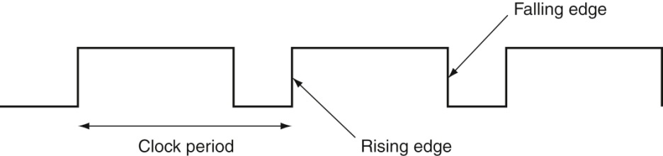
Tilstandselementer styres af en “clock”
Figure A.7.1 A clock signal oscillates between high and low values. The clock period is the
time for one full cycle. In an edge-triggered design, either the rising or falling edge of the clock is active and
causes state to be changed.
Copyright © 2021 Elsevier Inc. All rights reserved.

Slide 34
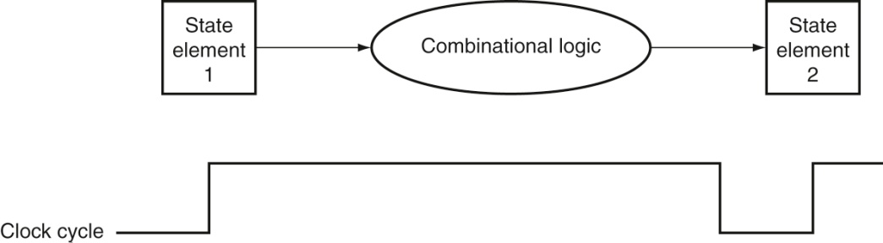
En “clock” bestemmer hvornår tilstandselementer skal opdateres
Figure A.7.2 The inputs to a combinational logic block come from a state element, and
the outputs are written into a state element. The clock edge determines when the contents of the
state elements are updated.
Copyright © 2021 Elsevier Inc. All rights reserved.

Slide 35
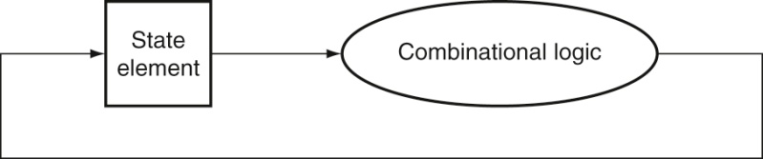
En vigtig figur:
Sammenhængen mellem clock og digitallogisk design
Signalet skal kunne nå rundt i hver clock-cycle
Længere signalvej → lavere clock frekvens
Kortere signalvej → højere clock frekvens
Figure A.7.3 An edge-triggered methodology allows a state element to be read and
written in the same clock cycle without creating a race that could lead to undetermined
data values. Of course, the clock cycle must still be long enough so that the input values are stable when
the active clock edge occurs.
Copyright © 2021 Elsevier Inc. All rights reserved.

Slide 36
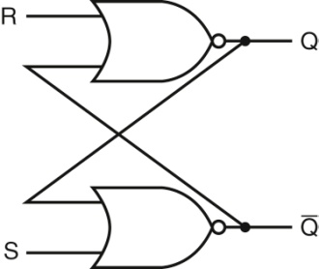
En SR-latch
Det simpleste tilstandselement bygget af digitallogiske porte
Figure A.8.1 A pair of cross-coupled NOR gates can store an internal value. The value
stored on the output Q is recycled by inverting it to obtain Q and then inverting Q to obtain Q. If either R or
Q is asserted, Q will be deasserted and vice versa.
Copyright © 2021 Elsevier Inc. All rights reserved.

Slide 37
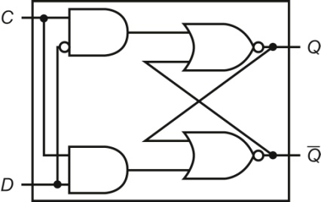
En D-Latch
Vi udvider SR-latchen med styring af S og R
Figure A.8.2 A D latch implemented with NOR gates. A NOR gate acts as an inverter if the other
input is 0. Thus, the cross-coupled pair of NOR gates acts to store the state value unless the clock input, C, is
asserted, in which case the value of input D replaces the value of Q and is stored. The value of input D must
be stable when the clock signal C changes from asserted to deasserted.
Copyright © 2021 Elsevier Inc. All rights reserved.

Slide 38
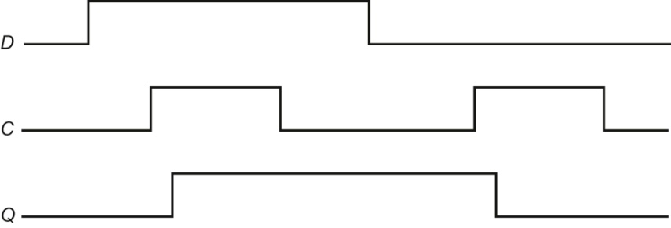
Figure A.8.3 Operation of a D latch, assuming the output is initially deasserted. When
the clock, C, is asserted, the latch is open and the Q output immediately assumes the value of the D input.
Copyright © 2021 Elsevier Inc. All rights reserved.

Slide 39
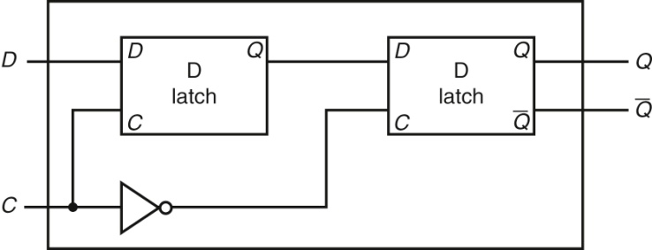
En D-Flip-flop
Vi går fra “level-triggered” til “edge-triggered” opdatering
Det giver mere præcis styring fordi en “signalkant” varer
meget kort tid.
Figure A.8.4 A D flip-flop with a falling-edge trigger. The first latch, called the master, is open and
follows the input D when the clock input, C, is asserted. When the clock input, C, falls, the first latch is closed, but
the second latch, called the slave, is open and gets its input from the output of the master latch.
Copyright © 2021 Elsevier Inc. All rights reserved.

Slide 40
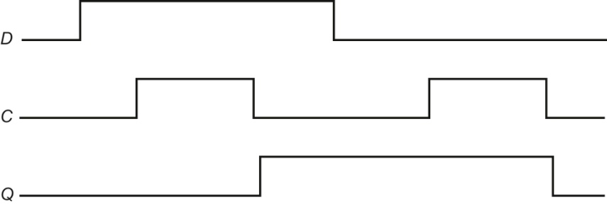
Figure A.8.5 Operation of a D flip-flop with a falling-edge trigger, assuming the output is
initially deasserted. When the clock input (C) changes from asserted to deasserted, the Q output stores
the value of the D input. Compare this behavior to that of the clocked D latch shown in Figure A.8.3. In a
clocked latch, the stored value and the output, Q, both change whenever C is high, as opposed to only when
C transitions.
Copyright © 2021 Elsevier Inc. All rights reserved.

Slide 41
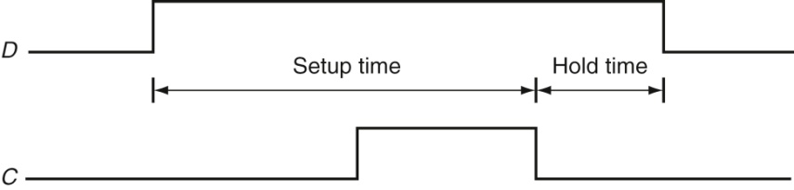
Figure A.8.6 Setup and hold time requirements for a D flip-flop with a falling-edge trigger.
The input must be stable for a period of time before the clock edge, as well as after the clock edge. The
minimum time the signal must be stable before the clock edge is called the setup time, while the minimum
time the signal must be stable after the clock edge is called the hold time. Failure to meet these minimum
requirements can result in a situation where the output of the flip-flop may not be predictable, as described
in Section A.11. Hold times are usually either 0 or very small and thus not a cause of worry.
Copyright © 2021 Elsevier Inc. All rights reserved.

Slide 42
Større (sammensatte) tilstandselementer
Registre og SRAM

Slide 43
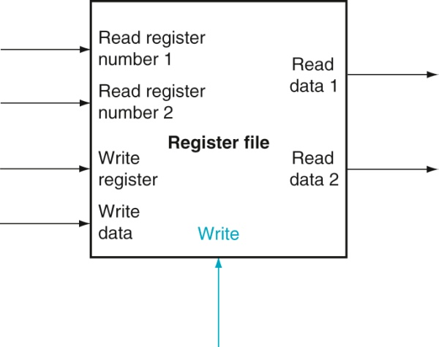
Registerbank
Figure A.8.7 A register file with two read ports and one write port has five inputs and
two outputs. The control input Write is shown in color.
Copyright © 2021 Elsevier Inc. All rights reserved.

Slide 44
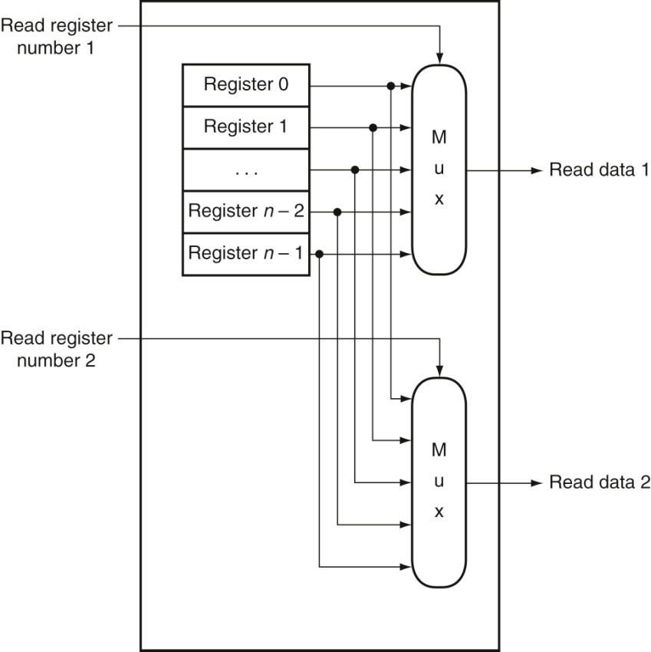
Registerbank – læsesiden – to læseporte
Figure A.8.8 The implementation of two read ports for a register file with n registers
can be done with a pair of n-to-1 multiplexors, each 32 bits wide. The register read number
signal is used as the multiplexor selector signal. Figure A.8.9 shows how the write port is implemented.
Copyright © 2021 Elsevier Inc. All rights reserved.

Slide 45
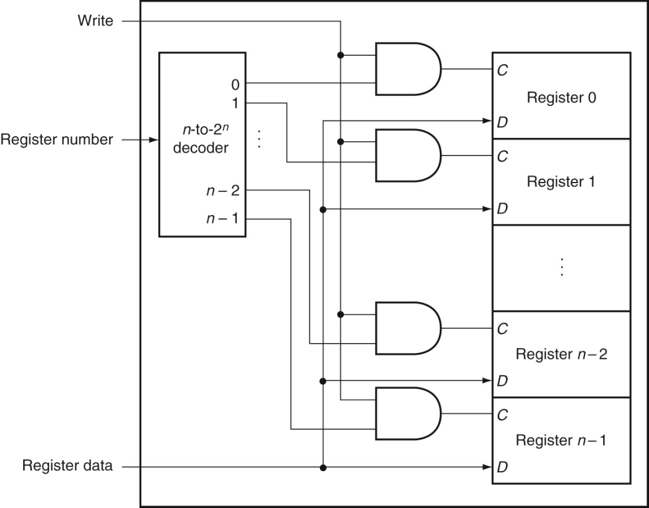
Registerbank – skrivesiden – en skriveport
Figure A.8.9 The write port for a register file is implemented with a decoder that is used
with the write signal to generate the C input to the registers. All three inputs (the register
number, the data, and the write signal) will have setup and hold-time constraints that ensure that the correct
data are written into the register file.
Copyright © 2021 Elsevier Inc. All rights reserved.

Slide 46
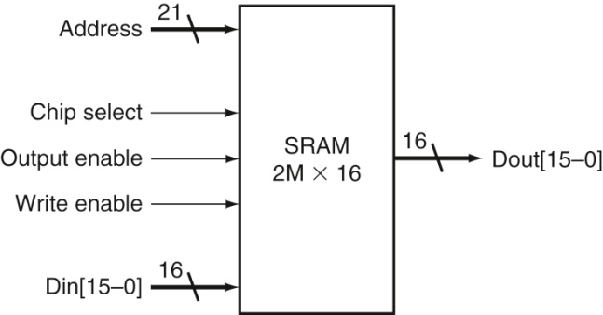
Figure A.9.1 A 2M × 16 SRAM showing the 21 address lines (2^21 = 2M) and 16 data
inputs, the three control lines, and the 16 data outputs.
Copyright © 2021 Elsevier Inc. All rights reserved.

Slide 47
Wired-or muxing - recap
Figure A.9.2 Four three-state buffers are used to form a multiplexor. Only one of the four
Select inputs can be asserted. A three-state buffer with a deasserted Output enable has a high-impedance
output that allows a three-state buffer whose Output enable is asserted to drive the shared output line.
Copyright © 2021 Elsevier Inc. All rights reserved.

Slide 48
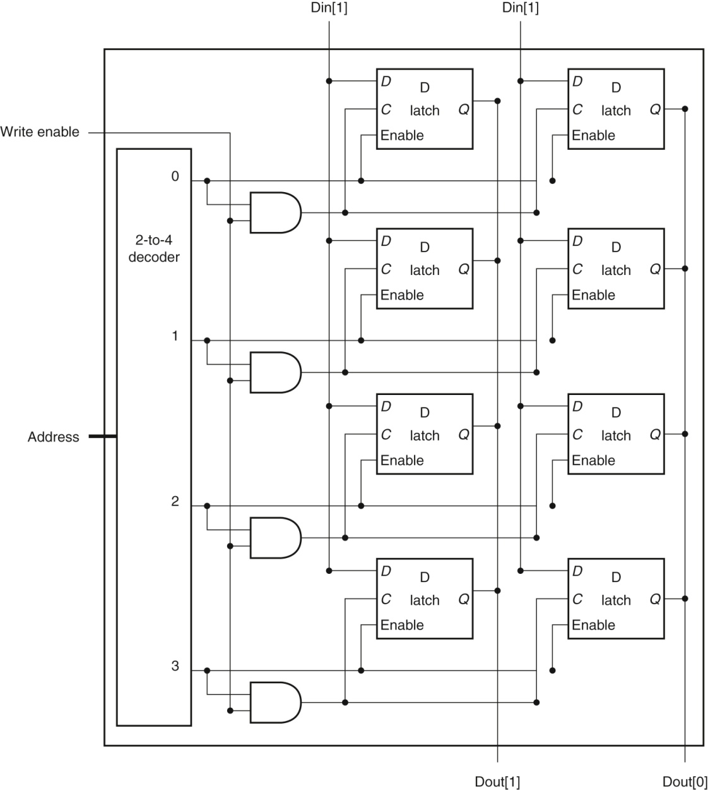
Wired-or muxing
af Q-signalerne
Styres af Enable
signalet
Der er fejl i figuren
mht styring af Enable
for højre kolonne.
Doh!
Figure A.9.3 The basic structure of a 4 × 2 SRAM consists of a decoder that selects which pair of cells to activate.
The activated cells use a three-state output connected to the vertical bit lines that supply the requested data. The address that selects the cell is sent on one of a set of horizontal address lines, called word lines. For simplicity, the Output enable and Chip select signals have been omitted, but they could easily be added with a few AND gates.
Copyright © 2021 Elsevier Inc. All rights reserved.

Slide 49
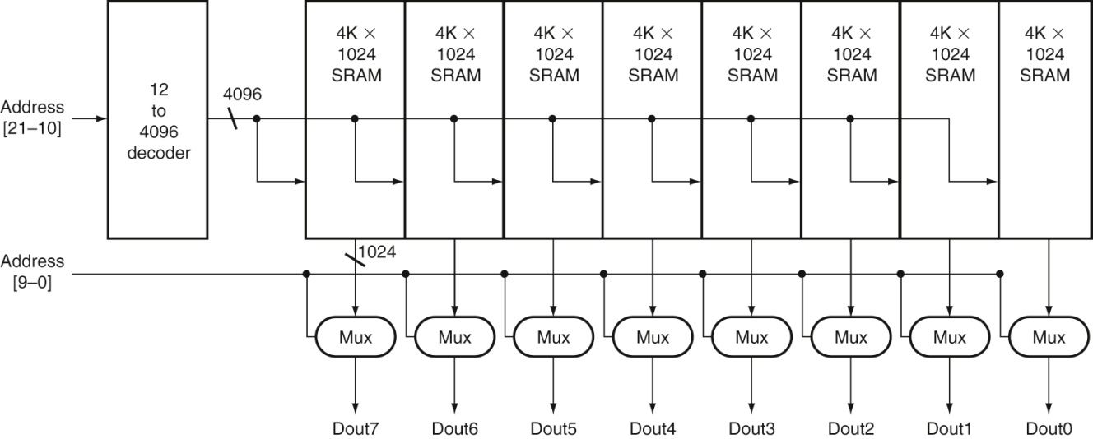
4Mx8 SRAM bygget af 1024 4Kx1K SRAM
Figure A.9.4 Typical organization of a 4M × 8 SRAM as an array of 4K × 1024 arrays. The first decoder generates the
addresses for eight 4K × 1024 arrays; then a set of multiplexors is used to select 1 bit from each 1024-bit-wide array. This is a much easier design than a single-level decode that would need either an enormous decoder or a gigantic multiplexor. In practice, a modern SRAM of this size would probably use an even larger number of blocks, each somewhat smaller.
Det kunne have været mindre forvirrende hvis bogen konsekvent havde
præsenteret enten 4Mx8 eller 2Mx16
Copyright © 2021 Elsevier Inc. All rights reserved.

Slide 50
DRAM
Dynamic Random Access Memory
“dynamisk” = tilstand skal “opfriskes” periodisk
for ikke at gå tabt

Slide 51
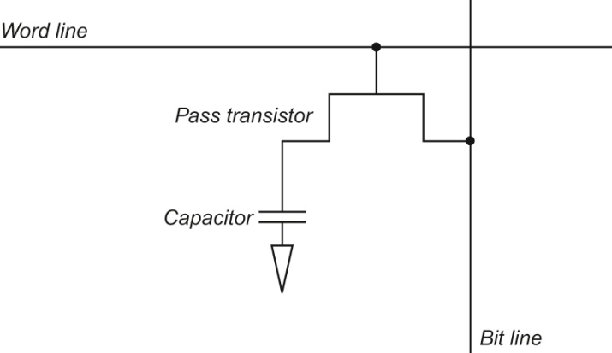
DRAM bruger en enkelt-transistor pr bit
SRAM bruger en D-latch pr bit, hvilket typisk kræver 6 eller 8 transistorer
SRAM er hurtigere og dyrere, DRAM billigere og langsommere
Figure A.9.5 A single-transistor DRAM cell contains a capacitor that stores the cell
contents and a transistor used to access the cell.
Copyright © 2021 Elsevier Inc. All rights reserved.

Slide 52
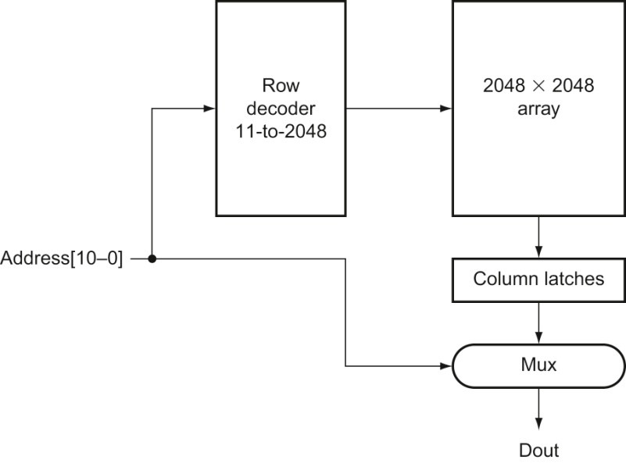
Figure A.9.6 A 4M × 1 DRAM is built with a 2048 × 2048 array. The row access uses 11 bits to
select a row, which is then latched in 2048 1-bit latches. A multiplexor chooses the output bit from these 2048
latches. The RAS and CAS signals control whether the address lines are sent to the row decoder or column
multiplexor.
Copyright © 2021 Elsevier Inc. All rights reserved.

Slide 53
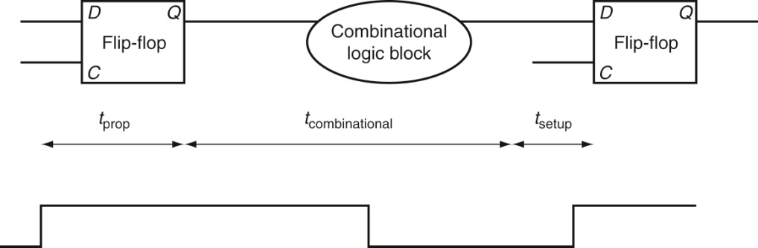
Digitallogisk design og maximal clock-frekvens (igen)
Figure A.11.1 In an edge-triggered design, the clock must be long enough to allow
signals to be valid for the required setup time before the next clock edge. The time for a
flip-flop input to propagate to the flip-flip outputs is tprop; the signal then takes tcombinational to
travel through the combinational logic and must be valid tsetup before the next clock edge.
Copyright © 2021 Elsevier Inc. All rights reserved.

