Slide 1
RISC-V 2-trins afkodning
Slides fra COD – maltrakteret af Finn Schiermer Andersen

Slide 2
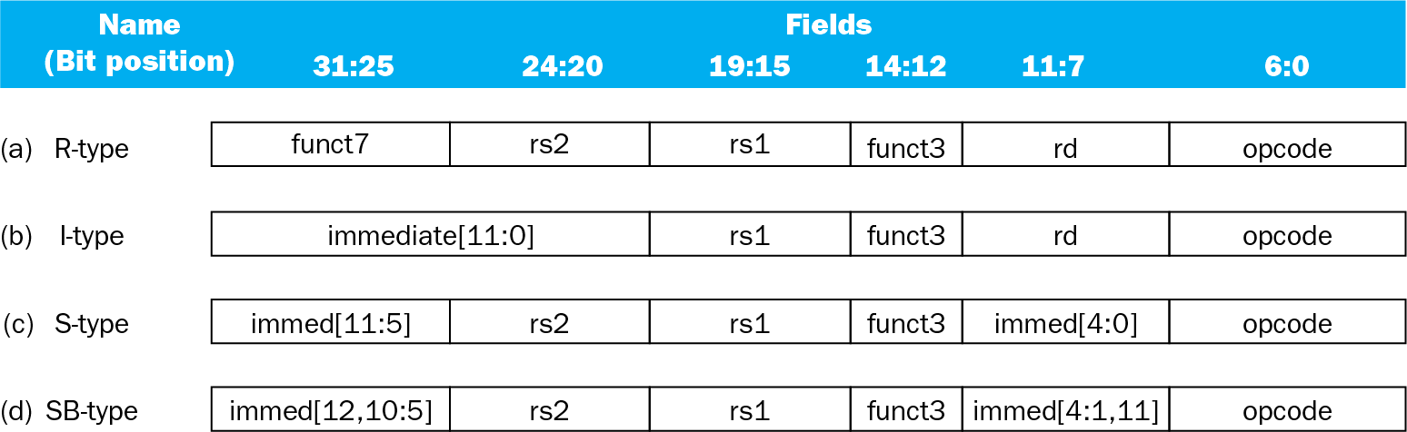
Decoding RISC-V
Instruction layouts
Chapter 4 — The Processor — <number>
Notes:
Morgan Kaufmann Publishers
4 December 2022
Chapter 4 — The Processor

Slide 3
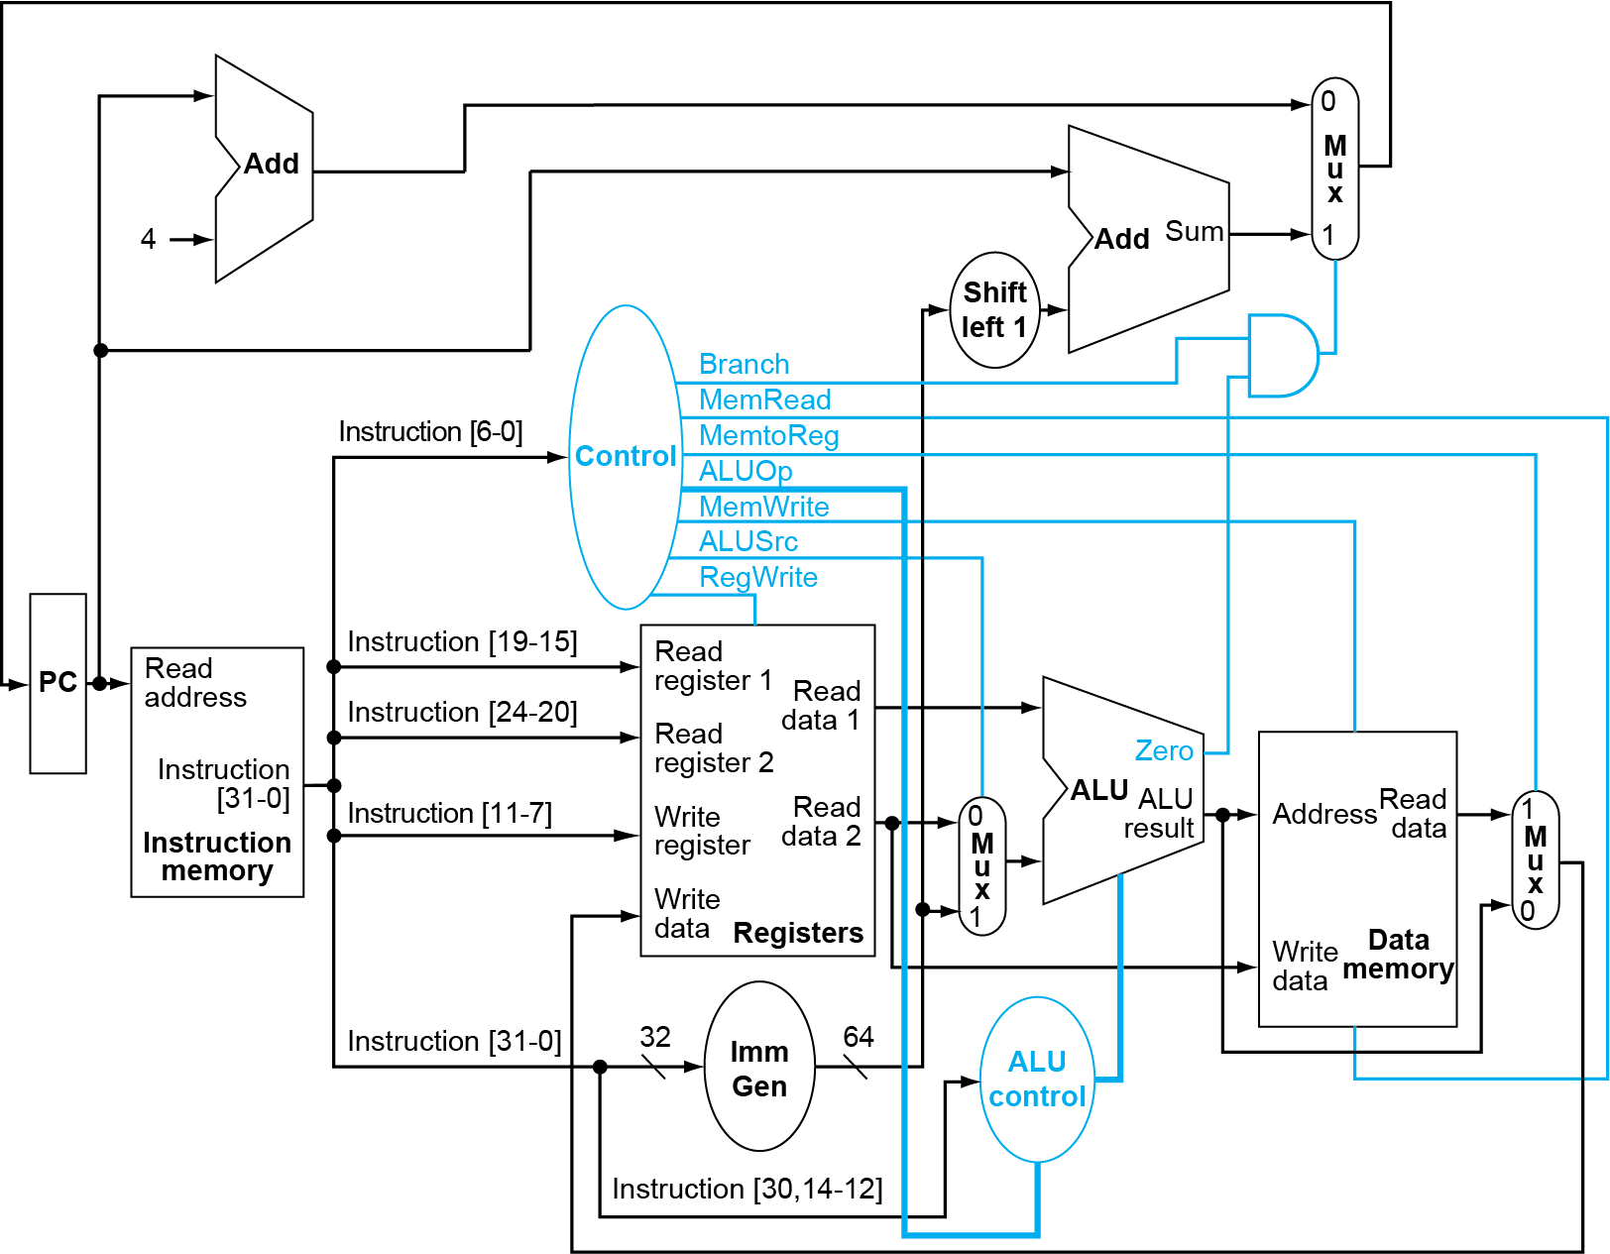
Datapath With Control
Chapter 4 — The Processor — <number>
Notes:
Morgan Kaufmann Publishers
4 December 2022
Chapter 4 — The Processor

Slide 4
ALU Control
ALU used for
  Load/Store: F = add
  Branch: F = subtract
  R-type: F depends on opcode
§4.4 A Simple Implementation Scheme
ALU control | Function
0000 | AND
0001 | OR
0010 | add
0110 | subtract
Chapter 4 — The Processor — <number>
Notes:
Morgan Kaufmann Publishers
4 December 2022
Chapter 4 — The Processor

Slide 5
ALU Control
Assume 2-bit ALUOp derived from opcode
  Combinational logic derives ALU control
opcode | ALUOp | Operation | Opcode field | ALU function | ALU control
ld | 00 | load register | XXXXXXXXXXX | add | 0010
sd | 00 | store register | XXXXXXXXXXX | add | 0010
beq | 01 | branch on equal | XXXXXXXXXXX | subtract | 0110
R-type | 10 | add | 100000 | add | 0010
 |  | subtract | 100010 | subtract | 0110
 |  | AND | 100100 | AND | 0000
 |  | OR | 100101 | OR | 0001
Chapter 4 — The Processor — <number>
Notes:
Morgan Kaufmann Publishers
4 December 2022
Chapter 4 — The Processor

Slide 6
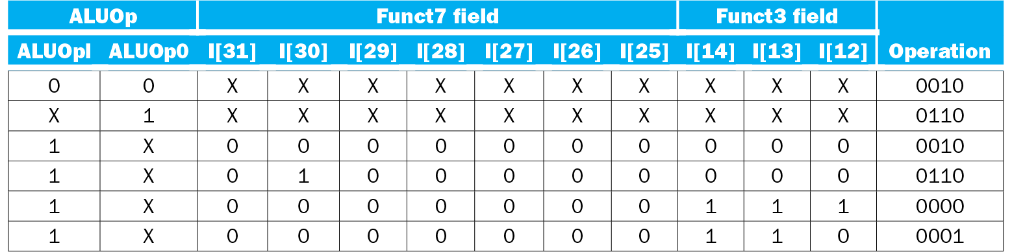
The ALU Control Unit
Control signals derived from
  ALUOp
  Funct7
  Funct3
Chapter 4 — The Processor — <number>
Notes:
Morgan Kaufmann Publishers
4 December 2022
Chapter 4 — The Processor

Slide 7
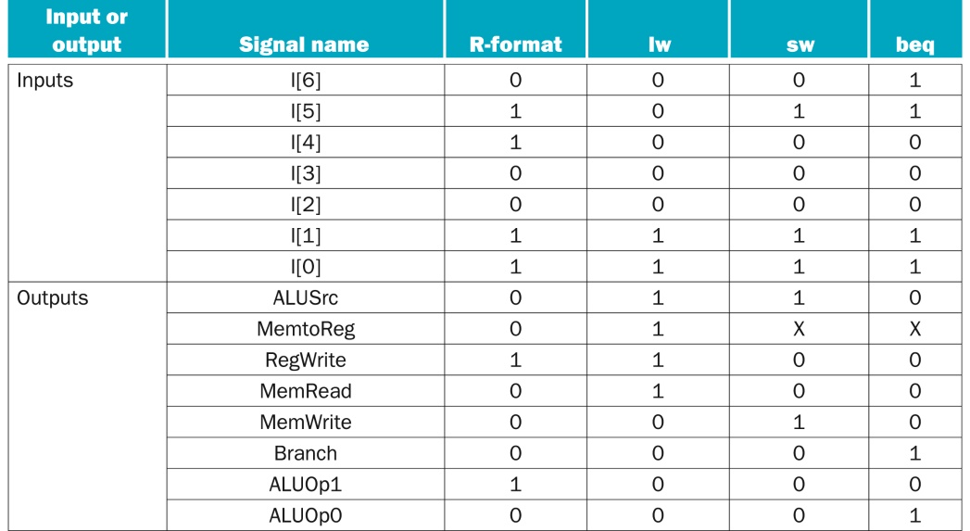
Main Control Unit
Figure 4.26 The control function for the simple single-cycle implementation is completely
specified by this truth table. The top seven rows of the table gives the combinations of input signals
that correspond to the four instruction classes, one per column, that determine the control output settings.
The bottom portion of the table gives the outputs for each of the four opcodes. Thus, the output RegWrite
is asserted for two different combinations of the inputs. If we consider only the four opcodes shown in
this table, then we can simplify the truth table by using don’t cares in the input portion. For example, we
can detect an R-format instruction with the expression Op4 ∙ Op5, since this is sufficient to distinguish the
R-format instructions from lw, sw, and beq. We do not take advantage of this simplification, since the rest
of the RISC-V opcodes are used in a full implementation.
Copyright © 2021 Elsevier Inc. All rights reserved.

