Slide 1
Link-State (LS) & Distance Vector (DV) Algorithms.
Worked through examples.

Slide 2
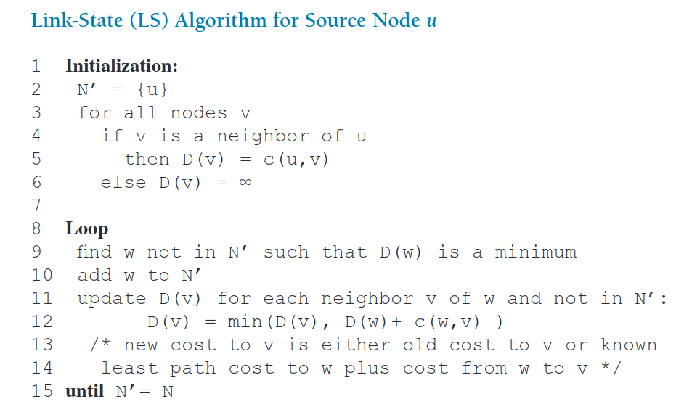
Link-State Algorithm (Dijkstra’s) – K&R, p. 414

Slide 3
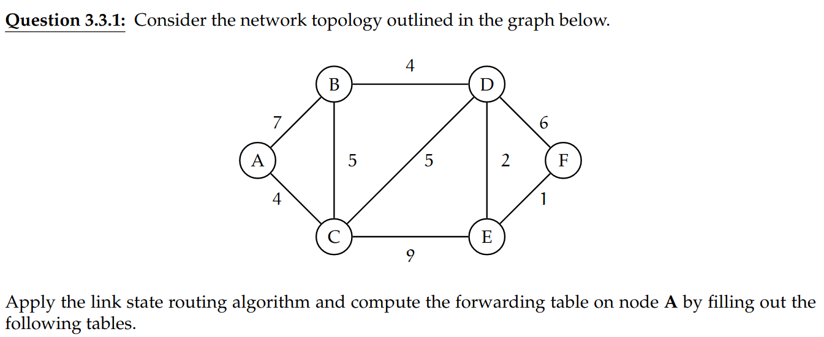
Re-exam 2021-22, Question 3.3.1

Slide 4
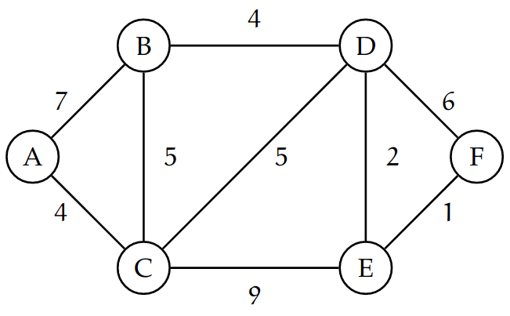
Step | N’ | D(B),p(B) | D(C),p(C) | D(D),p(D) | D(E), p(E) | D(F), p(F)
0 | A | 7, A | 4, A | ∞ | ∞ | ∞
p(X) = predecessor, the node before X, this can and will change as we relax more nodes
D(X) = distance (cost) to X, from our initial node, in this case A

Slide 5
Step | N’ | D(B),p(B) | D(C),p(C) | D(D),p(D) | D(E), p(E) | D(F), p(F)
0 | A | 7, A | 4, A | ∞ | ∞ | ∞
1 | A, C | 7, A | 4, A | 9, C | 13, C | ∞
p(X) = predecessor, the node before X, this can and will change as we relax more nodes
D(X) = distance (cost) to X, from our initial node, in this case A

Slide 6
Step | N’ | D(B),p(B) | D(C),p(C) | D(D),p(D) | D(E), p(E) | D(F), p(F)
0 | A | 7, A | 4, A | ∞ | ∞ | ∞
1 | A, C | 7, A | 4, A | 9, C | 13, C | ∞
2 | A, C, B | 7, A |  | 9, C | 13, C | ∞
p(X) = predecessor, the node before X, this can and will change as we relax more nodes
D(X) = distance (cost) to X, from our initial node, in this case A

Slide 7
Step | N’ | D(B),p(B) | D(C),p(C) | D(D),p(D) | D(E), p(E) | D(F), p(F)
0 | A | 7, A | 4, A | ∞ | ∞ | ∞
1 | A, C | 7, A | 4, A | 9, C | 13, C | ∞
2 | A, C, B | 7, A |  | 9, C | 13, C | ∞
3 | A, C, B, D |  |  | 9, C | 11, D | 15, D
p(X) = predecessor, the node before X, this can and will change as we relax more nodes
D(X) = distance (cost) to X, from our initial node, in this case A

Slide 8
Step | N’ | D(B),p(B) | D(C),p(C) | D(D),p(D) | D(E), p(E) | D(F), p(F)
0 | A | 7, A | 4, A | ∞ | ∞ | ∞
1 | A, C | 7, A | 4, A | 9, C | 13, C | ∞
2 | A, C, B | 7, A |  | 9, C | 13, C | ∞
3 | A, C, B, D |  |  | 9, C | 11, D | 15, D
4 | A, C, B, D, E |  |  |  | 11, D | 12, E
p(X) = predecessor, the node before X, this can and will change as we relax more nodes
D(X) = distance (cost) to X, from our initial node, in this case A

Slide 9
Step | N’ | D(B),p(B) | D(C),p(C) | D(D),p(D) | D(E), p(E) | D(F), p(F)
0 | A | 7, A | 4, A | ∞ | ∞ | ∞
1 | A, C | 7, A | 4, A | 9, C | 13, C | ∞
2 | A, C, B | 7, A |  | 9, C | 13, C | ∞
3 | A, C, B, D |  |  | 9, C | 11, D | 15, D
4 | A, C, B, D, E |  |  |  | 11, D | 12, E
5 | A, C, B, D, E, F |  |  |  |  | 12, E
p(X) = predecessor, the node before X, this can and will change as we relax more nodes
D(X) = distance (cost) to X, from our initial node, in this case A

Slide 10
Step | N’ | D(B),p(B) | D(C),p(C) | D(D),p(D) | D(E), p(E) | D(F), p(F)
0 | A | 7, A | 4, A | ∞ | ∞ | ∞
1 | A, C | 7, A | 4, A | 9, C | 13, C | ∞
2 | A, C, B | 7, A |  | 9, C | 13, C | ∞
3 | A, C, B, D |  |  | 9, C | 11, D | 15, D
4 | A, C, B, D, E |  |  |  | 11, D | 12, E
5 | A, C, B, D, E, F |  |  |  |  | 12, E
Forwarding table for A:
Destination | Edge
B | (A,B)
C | (A,C)
D | (A,C)
E | (A,C)
F | (A,C)
p(X) = predecessor, the node before X, this can and will change as we relax more nodes
D(X) = distance (cost) to X, from our initial node, in this case A

Slide 11
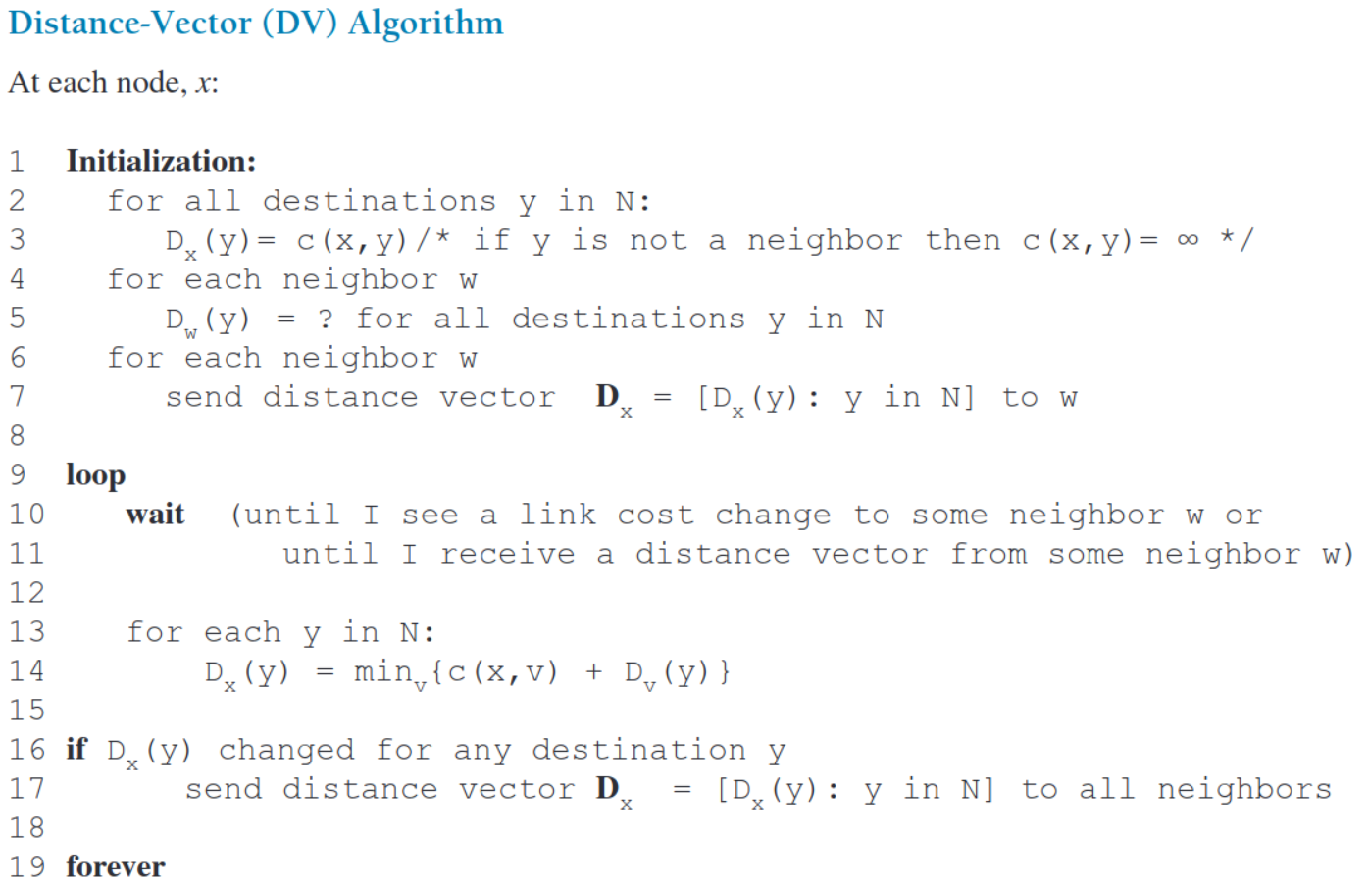
P. 419 K&R.

Slide 12
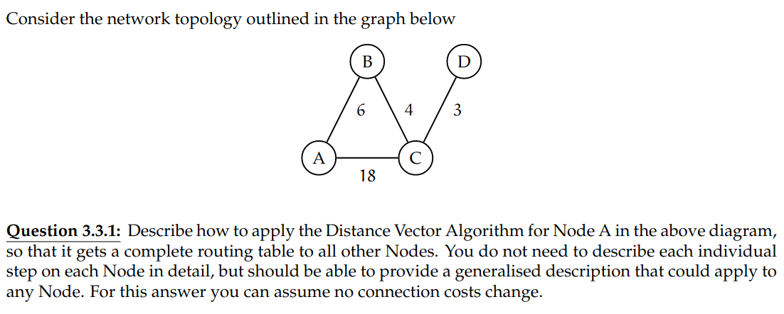
Exam 2021-22, Question 3.3.1

Slide 13
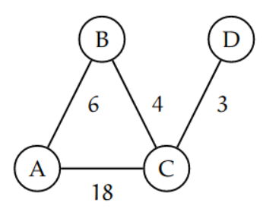
Start of the algorithm, nodes only know price to neighbor
A
 | A | B | C | D
A | 0 | 6 | 18 | ∞
B | ∞ | ∞ | ∞ | ∞
C | ∞ | ∞ | ∞ | ∞
D | ∞ | ∞ | ∞ | ∞
B
 | A | B | C | D
A | ∞ | ∞ | ∞ | ∞
B | 6 | 0 | 4 | ∞
C | ∞ | ∞ | ∞ | ∞
D | ∞ | ∞ | ∞ | ∞
C
 | A | B | C | D
A | ∞ | ∞ | ∞ | ∞
B | ∞ | ∞ | ∞ | ∞
C | 18 | 4 | 0 | 3
D | ∞ | ∞ | ∞ | ∞
D
 | A | B | C | D
A | ∞ | ∞ | ∞ | ∞
B | ∞ | ∞ | ∞ | ∞
C | ∞ | ∞ | ∞ | ∞
D | ∞ | ∞ | 3 | 0

Slide 14
Start of the algorithm, nodes only know price to neighbor
Distance vectors are exchanged to neighboring nodes, and local distance vectors are updated
A
 | A | B | C | D
A | 0 | 6 | 18 | ∞
B | ∞ | ∞ | ∞ | ∞
C | ∞ | ∞ | ∞ | ∞
D | ∞ | ∞ | ∞ | ∞
 | A | B | C | D
A | 0 | 6 | 10 | 21
B | 6 | 0 | 4 | ∞
C | 18 | 4 | 0 | 3
D | ∞ | ∞ | ∞ | ∞
B
 | A | B | C | D
A | ∞ | ∞ | ∞ | ∞
B | 6 | 0 | 4 | ∞
C | ∞ | ∞ | ∞ | ∞
D | ∞ | ∞ | ∞ | ∞
 | A | B | C | D
A | 0 | 6 | 18 | ∞
B | 6 | 0 | 4 | 7
C | 18 | 4 | 0 | 3
D | ∞ | ∞ | ∞ | ∞
C
 | A | B | C | D
A | ∞ | ∞ | ∞ | ∞
B | ∞ | ∞ | ∞ | ∞
C | 18 | 4 | 0 | 3
D | ∞ | ∞ | ∞ | ∞
 | A | B | C | D
A | 0 | 6 | 18 | ∞
B | 6 | 0 | 4 | ∞
C | 10 | 4 | 0 | 3
D | ∞ | ∞ | 3 | ∞
D
 | A | B | C | D
A | ∞ | ∞ | ∞ | ∞
B | ∞ | ∞ | ∞ | ∞
C | ∞ | ∞ | ∞ | ∞
D | ∞ | ∞ | 3 | 0
 | A | B | C | D
A | ∞ | ∞ | ∞ | ∞
B | ∞ | ∞ | ∞ | ∞
C | 18 | 4 | 0 | 3
D | 21 | 7 | 3 | 0
Iteration 1

Slide 15
Start of the algorithm, nodes only know price to neighbor
Distance vectors are exchanged, and local distance vectors are updated
D_A(D) and D_D(A) get the final value 13
A
 | A | B | C | D
A | 0 | 6 | 18 | ∞
B | ∞ | ∞ | ∞ | ∞
C | ∞ | ∞ | ∞ | ∞
D | ∞ | ∞ | ∞ | ∞
 | A | B | C | D
A | 0 | 6 | 10 | 21
B | 6 | 0 | 4 | ∞
C | 18 | 4 | 0 | 3
D | ∞ | ∞ | ∞ | ∞
 | A | B | C | D
A | 0 | 6 | 10 | 13
B | 6 | 0 | 4 | 7
C | 10 | 4 | 0 | 3
D | ∞ | ∞ | ∞ | ∞
B
 | A | B | C | D
A | ∞ | ∞ | ∞ | ∞
B | 6 | 0 | 4 | ∞
C | ∞ | ∞ | ∞ | ∞
D | ∞ | ∞ | ∞ | ∞
 | A | B | C | D
A | 0 | 6 | 18 | ∞
B | 6 | 0 | 4 | 7
C | 18 | 4 | 0 | 3
D | ∞ | ∞ | ∞ | ∞
 | A | B | C | D
A | 0 | 6 | 10 | 21
B | 6 | 0 | 4 | 7
C | 10 | 4 | 0 | 3
D | ∞ | ∞ | ∞ | ∞
C
 | A | B | C | D
A | ∞ | ∞ | ∞ | ∞
B | ∞ | ∞ | ∞ | ∞
C | 18 | 4 | 0 | 3
D | ∞ | ∞ | ∞ | ∞
 | A | B | C | D
A | 0 | 6 | 18 | ∞
B | 6 | 0 | 4 | ∞
C | 10 | 4 | 0 | 3
D | ∞ | ∞ | 3 | 0
 | A | B | C | D
A | 0 | 6 | 10 | 21
B | 6 | 0 | 4 | 7
C | 10 | 4 | 0 | 3
D | 21 | 7 | 3 | 0
D
 | A | B | C | D
A | ∞ | ∞ | ∞ | ∞
B | ∞ | ∞ | ∞ | ∞
C | ∞ | ∞ | ∞ | ∞
D | ∞ | ∞ | 3 | 0
 | A | B | C | D
A | ∞ | ∞ | ∞ | ∞
B | ∞ | ∞ | ∞ | ∞
C | 18 | 4 | 0 | 3
D | 21 | 7 | 3 | 0
 | A | B | C | D
A | ∞ | ∞ | ∞ | ∞
B | ∞ | ∞ | ∞ | ∞
C | 10 | 4 | 0 | 3
D | 13 | 7 | 3 | 0
Iteration 1

Slide 16
Start of the algorithm, nodes only know cost to their neighbor
Distance vectors are exchanged, and local distance vectors are updated
D_A(D) and D_D(A) get the final value 13
No more locale DVs to be exchanged. The algorithm has converged.
A
 | A | B | C | D
A | 0 | 6 | 18 | ∞
B | ∞ | ∞ | ∞ | ∞
C | ∞ | ∞ | ∞ | ∞
D | ∞ | ∞ | ∞ | ∞
 | A | B | C | D
A | 0 | 6 | 10 | 21
B | 6 | 0 | 4 | ∞
C | 18 | 4 | 0 | 3
D | ∞ | ∞ | ∞ | ∞
 | A | B | C | D
A | 0 | 6 | 10 | 13
B | 6 | 0 | 4 | 7
C | 10 | 4 | 0 | 3
D | ∞ | ∞ | ∞ | ∞
 | A | B | C | D
A | 0 | 6 | 10 | 13
B | 6 | 0 | 4 | 7
C | 10 | 4 | 0 | 3
D | ∞ | ∞ | ∞ | ∞
B
 | A | B | C | D
A | ∞ | ∞ | ∞ | ∞
B | 6 | 0 | 4 | ∞
C | ∞ | ∞ | ∞ | ∞
D | ∞ | ∞ | ∞ | ∞
 | A | B | C | D
A | 0 | 6 | 18 | ∞
B | 6 | 0 | 4 | 7
C | 18 | 4 | 0 | 3
D | ∞ | ∞ | ∞ | ∞
 | A | B | C | D
A | 0 | 6 | 10 | 21
B | 6 | 0 | 4 | 7
C | 10 | 4 | 0 | 3
D | ∞ | ∞ | ∞ | ∞
 | A | B | C | D
A | 0 | 6 | 10 | 13
B | 6 | 0 | 4 | 7
C | 10 | 4 | 0 | 3
D | ∞ | ∞ | ∞ | ∞
C
 | A | B | C | D
A | ∞ | ∞ | ∞ | ∞
B | ∞ | ∞ | ∞ | ∞
C | 18 | 4 | 0 | 3
D | ∞ | ∞ | ∞ | ∞
 | A | B | C | D
A | 0 | 6 | 18 | ∞
B | 6 | 0 | 4 | ∞
C | 10 | 4 | 0 | 3
D | ∞ | ∞ | 3 | ∞
 | A | B | C | D
A | 0 | 6 | 10 | 21
B | 6 | 0 | 4 | 7
C | 10 | 4 | 0 | 3
D | 21 | 7 | 3 | ∞
 | A | B | C | D
A | 0 | 6 | 10 | 13
B | 6 | 0 | 4 | 7
C | 10 | 4 | 0 | 3
D | 13 | 7 | 3 | 0
D
 | A | B | C | D
A | ∞ | ∞ | ∞ | ∞
B | ∞ | ∞ | ∞ | ∞
C | ∞ | ∞ | ∞ | ∞
D | ∞ | ∞ | 3 | 0
 | A | B | C | D
A | ∞ | ∞ | ∞ | ∞
B | ∞ | ∞ | ∞ | ∞
C | 18 | 4 | 0 | 3
D | 21 | 7 | 3 | 0
 | A | B | C | D
A | ∞ | ∞ | ∞ | ∞
B | ∞ | ∞ | ∞ | ∞
C | 10 | 4 | 0 | 3
D | 13 | 7 | 3 | 0
 | A | B | C | D
A | ∞ | ∞ | ∞ | ∞
B | ∞ | ∞ | ∞ | ∞
C | 10 | 4 | 0 | 3
D | 13 | 7 | 3 | 0
Iteration 1

Slide 17
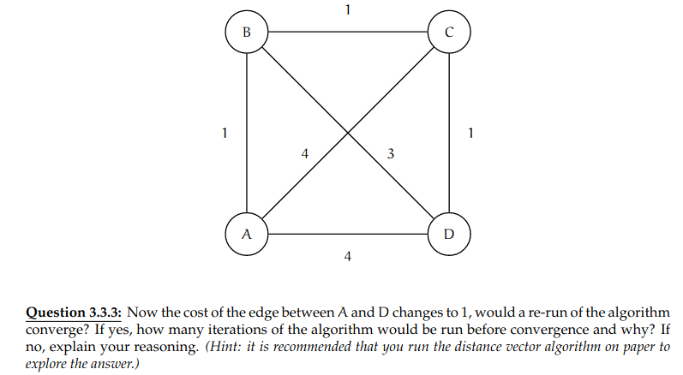
Exam 2020-21, Question 3.3.3

Slide 18
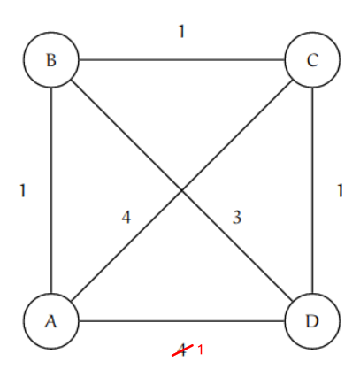
Converged start state
A
 | A | B | C | D
A | 0 | 1 | 2 | 3
B | 1 | 0 | 1 | 2
C | 2 | 1 | 0 | 1
D | 3 | 2 | 1 | 0
B
 | A | B | C | D
A | 0 | 1 | 2 | 3
B | 1 | 0 | 1 | 2
C | 2 | 1 | 0 | 1
D | 3 | 2 | 1 | 0
C
 | A | B | C | D
A | 0 | 1 | 2 | 3
B | 1 | 0 | 1 | 2
C | 2 | 1 | 0 | 1
D | 3 | 2 | 1 | 0
D
 | A | B | C | D
A | 0 | 1 | 2 | 3
B | 1 | 0 | 1 | 2
C | 2 | 1 | 0 | 1
D | 3 | 2 | 1 | 0

Slide 19
Converged start state
A detects link cost change
A
 | A | B | C | D
A | 0 | 1 | 2 | 3
B | 1 | 0 | 1 | 2
C | 2 | 1 | 0 | 1
D | 3 | 2 | 1 | 0
 | A | B | C | D
A | 0 | 1 | 2 | 1
B | 1 | 0 | 1 | 2
C | 2 | 1 | 0 | 1
D | 3 | 2 | 1 | 0
B
 | A | B | C | D
A | 0 | 1 | 2 | 3
B | 1 | 0 | 1 | 2
C | 2 | 1 | 0 | 1
D | 3 | 2 | 1 | 0
 | A | B | C | D
A | 0 | 1 | 2 | 3
B | 1 | 0 | 1 | 2
C | 2 | 1 | 0 | 1
D | 3 | 2 | 1 | 0
C
 | A | B | C | D
A | 0 | 1 | 2 | 3
B | 1 | 0 | 1 | 2
C | 2 | 1 | 0 | 1
D | 3 | 2 | 1 | 0
 | A | B | C | D
A | 0 | 1 | 2 | 3
B | 1 | 0 | 1 | 2
C | 2 | 1 | 0 | 1
D | 3 | 2 | 1 | 0
D
 | A | B | C | D
A | 0 | 1 | 2 | 3
B | 1 | 0 | 1 | 2
C | 2 | 1 | 0 | 1
D | 3 | 2 | 1 | 0
 | A | B | C | D
A | 0 | 1 | 2 | 3
B | 1 | 0 | 1 | 2
C | 2 | 1 | 0 | 1
D | 3 | 2 | 1 | 0
Iteration 1

Slide 20
A propagates its changed distance vector. D updates is distance vector.
Converged start state
A detects link cost change
A
 | A | B | C | D
A | 0 | 1 | 2 | 3
B | 1 | 0 | 1 | 2
C | 2 | 1 | 0 | 1
D | 3 | 2 | 1 | 0
 | A | B | C | D
A | 0 | 1 | 2 | 1
B | 1 | 0 | 1 | 2
C | 2 | 1 | 0 | 1
D | 3 | 2 | 1 | 0
 | A | B | C | D
A | 0 | 1 | 2 | 1
B | 1 | 0 | 1 | 2
C | 2 | 1 | 0 | 1
D | 3 | 2 | 1 | 0
B
 | A | B | C | D
A | 0 | 1 | 2 | 3
B | 1 | 0 | 1 | 2
C | 2 | 1 | 0 | 1
D | 3 | 2 | 1 | 0
 | A | B | C | D
A | 0 | 1 | 2 | 3
B | 1 | 0 | 1 | 2
C | 2 | 1 | 0 | 1
D | 3 | 2 | 1 | 0
 | A | B | C | D
A | 0 | 1 | 2 | 1
B | 1 | 0 | 1 | 2
C | 2 | 1 | 0 | 1
D | 3 | 2 | 1 | 0
C
 | A | B | C | D
A | 0 | 1 | 2 | 3
B | 1 | 0 | 1 | 2
C | 2 | 1 | 0 | 1
D | 3 | 2 | 1 | 0
 | A | B | C | D
A | 0 | 1 | 2 | 3
B | 1 | 0 | 1 | 2
C | 2 | 1 | 0 | 1
D | 3 | 2 | 1 | 0
 | A | B | C | D
A | 0 | 1 | 2 | 1
B | 1 | 0 | 1 | 2
C | 2 | 1 | 0 | 1
D | 3 | 2 | 1 | 0
D
 | A | B | C | D
A | 0 | 1 | 2 | 3
B | 1 | 0 | 1 | 2
C | 2 | 1 | 0 | 1
D | 3 | 2 | 1 | 0
 | A | B | C | D
A | 0 | 1 | 2 | 3
B | 1 | 0 | 1 | 2
C | 2 | 1 | 0 | 1
D | 3 | 2 | 1 | 0
 | A | B | C | D
A | 0 | 1 | 2 | 1
B | 1 | 0 | 1 | 2
C | 2 | 1 | 0 | 1
D | 1 | 2 | 1 | 0
Iteration 1
Iteration 2

Slide 21
D propagates its distance vector. Since no other nodes update their distance vector, no more distance vectors are sent. The algorithm has converged
A propagates its changed distance vector. D updates is distance vector.
Converged start state
A detects link cost change
A
 | A | B | C | D
A | 0 | 1 | 2 | 3
B | 1 | 0 | 1 | 2
C | 2 | 1 | 0 | 1
D | 3 | 2 | 1 | 0
 | A | B | C | D
A | 0 | 1 | 2 | 1
B | 1 | 0 | 1 | 2
C | 2 | 1 | 0 | 1
D | 3 | 2 | 1 | 0
 | A | B | C | D
A | 0 | 1 | 2 | 1
B | 1 | 0 | 1 | 2
C | 2 | 1 | 0 | 1
D | 3 | 2 | 1 | 0
 | A | B | C | D
A | 0 | 1 | 2 | 1
B | 1 | 0 | 1 | 2
C | 2 | 1 | 0 | 1
D | 1 | 2 | 1 | 0
B
 | A | B | C | D
A | 0 | 1 | 2 | 3
B | 1 | 0 | 1 | 2
C | 2 | 1 | 0 | 1
D | 3 | 2 | 1 | 0
 | A | B | C | D
A | 0 | 1 | 2 | 3
B | 1 | 0 | 1 | 2
C | 2 | 1 | 0 | 1
D | 3 | 2 | 1 | 0
 | A | B | C | D
A | 0 | 1 | 2 | 1
B | 1 | 0 | 1 | 2
C | 2 | 1 | 0 | 1
D | 3 | 2 | 1 | 0
 | A | B | C | D
A | 0 | 1 | 2 | 1
B | 1 | 0 | 1 | 2
C | 2 | 1 | 0 | 1
D | 1 | 2 | 1 | 0
C
 | A | B | C | D
A | 0 | 1 | 2 | 3
B | 1 | 0 | 1 | 2
C | 2 | 1 | 0 | 1
D | 3 | 2 | 1 | 0
 | A | B | C | D
A | 0 | 1 | 2 | 3
B | 1 | 0 | 1 | 2
C | 2 | 1 | 0 | 1
D | 3 | 2 | 1 | 0
 | A | B | C | D
A | 0 | 1 | 2 | 1
B | 1 | 0 | 1 | 2
C | 2 | 1 | 0 | 1
D | 3 | 2 | 1 | 0
 | A | B | C | D
A | 0 | 1 | 2 | 1
B | 1 | 0 | 1 | 2
C | 2 | 1 | 0 | 1
D | 1 | 2 | 1 | 0
D
 | A | B | C | D
A | 0 | 1 | 2 | 3
B | 1 | 0 | 1 | 2
C | 2 | 1 | 0 | 1
D | 3 | 2 | 1 | 0
 | A | B | C | D
A | 0 | 1 | 2 | 3
B | 1 | 0 | 1 | 2
C | 2 | 1 | 0 | 1
D | 3 | 2 | 1 | 0
 | A | B | C | D
A | 0 | 1 | 2 | 1
B | 1 | 0 | 1 | 2
C | 2 | 1 | 0 | 1
D | 1 | 2 | 1 | 0
 | A | B | C | D
A | 0 | 1 | 2 | 1
B | 1 | 0 | 1 | 2
C | 2 | 1 | 0 | 1
D | 1 | 2 | 1 | 0
Iteration 1
Iteration 2
Iteration 3

Slide 22
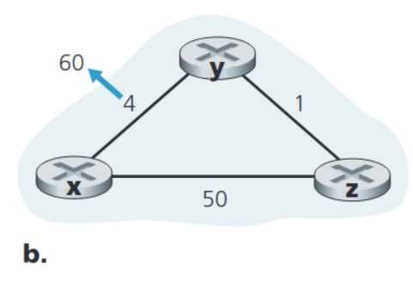
DVA - Example with cost increase from K&R, p. 423,

Slide 23
X and Y detect link cost change. Y “thinks” there is a cheaper way to x based on D_z(x)
Converged start state
X
 | x | y | z
x | 0 | 4 | 5
y | 4 | 0 | 1
z | 5 | 1 | 0
 | x | y | z
x | 0 | 51 | 50
y | 4 | 0 | 1
z | 5 | 1 | 0
Y
 | x | y | z
x | 0 | 4 | 5
y | 4 | 0 | 1
z | 5 | 1 | 0
 | x | y | z
x | 0 | 4 | 5
y | 6 | 0 | 1
z | 5 | 1 | 0
Z
 | x | y | z
x | 0 | 4 | 5
y | 4 | 0 | 1
z | 5 | 1 | 0
 | x | y | z
x | 0 | 4 | 5
y | 4 | 0 | 1
z | 5 | 1 | 0
Iteration 1

Slide 24
X and Y detect link cost change. Y “thinks” there is a cheaper way to x based on D_z(x)
Y propogates its DV. Z calculates its D_z(x) based on the incorrect one received from Y.
Converged start state
X
 | x | y | z
x | 0 | 4 | 5
y | 4 | 0 | 1
z | 5 | 1 | 0
 | x | y | z
x | 0 | 51 | 50
y | 4 | 0 | 1
z | 5 | 1 | 0
 | x | y | z
x | 0 | 51 | 50
y | 6 | 0 | 1
z | 5 | 1 | 0
Y
 | x | y | z
x | 0 | 4 | 5
y | 4 | 0 | 1
z | 5 | 1 | 0
 | x | y | z
x | 0 | 4 | 5
y | 6 | 0 | 1
z | 5 | 1 | 0
 | x | y | z
x | 0 | 51 | 50
y | 6 | 0 | 1
z | 5 | 1 | 0
Z
 | x | y | z
x | 0 | 4 | 5
y | 4 | 0 | 1
z | 5 | 1 | 0
 | x | y | z
x | 0 | 4 | 5
y | 4 | 0 | 1
z | 5 | 1 | 0
 | x | y | z
x | 0 | 51 | 50
y | 6 | 0 | 1
z | 7 | 1 | 0
Iteration 1
Iteration 2

Slide 25
X and Y detect link cost change. Y “thinks” there is a cheaper way to x based on D_z(x)
Y propogates its DV. Z calculates its D_z(x) based on the incorrect one received from Y.
Y updates its D_Y(x) based on the incorrect DV from Z
Converged start state
And so on, back and forth.
X
 | x | y | z
x | 0 | 4 | 5
y | 4 | 0 | 1
z | 5 | 1 | 0
 | x | y | z
x | 0 | 51 | 50
y | 4 | 0 | 1
z | 5 | 1 | 0
 | x | y | z
x | 0 | 51 | 50
y | 6 | 0 | 1
z | 5 | 1 | 0
 | x | y | z
x | 0 | 51 | 50
y | 6 | 0 | 1
z | 7 | 1 | 0
Y
 | x | y | z
x | 0 | 4 | 5
y | 4 | 0 | 1
z | 5 | 1 | 0
 | x | y | z
x | 0 | 4 | 5
y | 6 | 0 | 1
z | 5 | 1 | 0
 | x | y | z
x | 0 | 51 | 50
y | 6 | 0 | 1
z | 5 | 1 | 0
 | x | y | z
x | 0 | 51 | 50
y | 8 | 0 | 1
z | 7 | 1 | 0
Z
 | x | y | z
x | 0 | 4 | 5
y | 4 | 0 | 1
z | 5 | 1 | 0
 | x | y | z
x | 0 | 4 | 5
y | 4 | 0 | 1
z | 5 | 1 | 0
 | x | y | z
x | 0 | 51 | 50
y | 6 | 0 | 1
z | 7 | 1 | 0
 | x | y | z
x | 0 | 51 | 50
y | 6 | 0 | 1
z | 7 | 1 | 0
. . .
Iteration 1
Iteration 2
Iteration 3

Slide 26
X and Y detect link cost change. Y “thinks” there is a cheaper way to x based on D_z(x)
Y propogates its DV. Z calculates its D_z(x) based on the incorrect one received from Y.
Y updates its D_Y(x) based on the incorrect DV from Z
Until D_Y(x) is equal to the cost c(z,x)
Converged start state
And so on, back and forth.
X
 | x | y | z
x | 0 | 4 | 5
y | 4 | 0 | 1
z | 5 | 1 | 0
 | x | y | z
x | 0 | 51 | 50
y | 4 | 0 | 1
z | 5 | 1 | 0
 | x | y | z
x | 0 | 51 | 50
y | 6 | 0 | 1
z | 5 | 1 | 0
 | x | y | z
x | 0 | 51 | 50
y | 6 | 0 | 1
z | 7 | 1 | 0
 | x | y | z
x | 0 | 51 | 50
y | 50 | 0 | 1
z | 49 | 1 | 0
Y
 | x | y | z
x | 0 | 4 | 5
y | 4 | 0 | 1
z | 5 | 1 | 0
 | x | y | z
x | 0 | 4 | 5
y | 6 | 0 | 1
z | 5 | 1 | 0
 | x | y | z
x | 0 | 51 | 50
y | 6 | 0 | 1
z | 5 | 1 | 0
 | x | y | z
x | 0 | 51 | 50
y | 8 | 0 | 1
z | 7 | 1 | 0
 | x | y | z
x | 0 | 51 | 50
y | 50 | 0 | 1
z | 49 | 1 | 0
Z
 | x | y | z
x | 0 | 4 | 5
y | 4 | 0 | 1
z | 5 | 1 | 0
 | x | y | z
x | 0 | 4 | 5
y | 4 | 0 | 1
z | 5 | 1 | 0
 | x | y | z
x | 0 | 51 | 50
y | 6 | 0 | 1
z | 7 | 1 | 0
 | x | y | z
x | 0 | 51 | 50
y | 6 | 0 | 1
z | 7 | 1 | 0
 | x | y | z
x | 0 | 51 | 50
y | 50 | 0 | 1
z | 50 | 1 | 0
. . .
Iteration 1
Iteration 2
Iteration 3
Iteration 46

Slide 27
X and Y detect link cost change. Y “thinks” there is a cheaper way to x based on D_z(x)
Y propogates its DV. Z calculates its D_z(x) based on the incorrect one received from Y.
Y updates its D_Y(x) based on the incorrect DV from Z
Until D_Y(x) is equal to the cost c(z,x)
Z propagates its DV and Y updates its D_Y(x) to the correct value.
Converged start state
And so on, back and forth.
X
 | x | y | z
x | 0 | 4 | 5
y | 4 | 0 | 1
z | 5 | 1 | 0
 | x | y | z
x | 0 | 51 | 50
y | 4 | 0 | 1
z | 5 | 1 | 0
 | x | y | z
x | 0 | 51 | 50
y | 6 | 0 | 1
z | 5 | 1 | 0
 | x | y | z
x | 0 | 51 | 50
y | 6 | 0 | 1
z | 7 | 1 | 0
 | x | y | z
x | 0 | 51 | 50
y | 50 | 0 | 1
z | 49 | 1 | 0
 | x | y | z
x | 0 | 51 | 50
y | 50 | 0 | 1
z | 50 | 1 | 0
 | x | y | z
x | 0 | 51 | 50
y | 50 | 0 | 1
z | 50 | 1 | 0
Y
 | x | y | z
x | 0 | 4 | 5
y | 4 | 0 | 1
z | 5 | 1 | 0
 | x | y | z
x | 0 | 4 | 5
y | 6 | 0 | 1
z | 5 | 1 | 0
 | x | y | z
x | 0 | 51 | 50
y | 6 | 0 | 1
z | 5 | 1 | 0
 | x | y | z
x | 0 | 51 | 50
y | 8 | 0 | 1
z | 7 | 1 | 0
 | x | y | z
x | 0 | 51 | 50
y | 50 | 0 | 1
z | 49 | 1 | 0
 | x | y | z
x | 0 | 51 | 50
y | 51 | 0 | 1
z | 50 | 1 | 0
Z
 | x | y | z
x | 0 | 4 | 5
y | 4 | 0 | 1
z | 5 | 1 | 0
 | x | y | z
x | 0 | 4 | 5
y | 4 | 0 | 1
z | 5 | 1 | 0
 | x | y | z
x | 0 | 51 | 50
y | 6 | 0 | 1
z | 7 | 1 | 0
 | x | y | z
x | 0 | 51 | 50
y | 6 | 0 | 1
z | 7 | 1 | 0
 | x | y | z
x | 0 | 51 | 50
y | 50 | 0 | 1
z | 50 | 1 | 0
 | x | y | z
x | 0 | 51 | 50
y | 50 | 0 | 1
z | 50 | 1 | 0
. . .
Iteration 1
Iteration 2
Iteration 3
Iteration 46
Iteration 47

Slide 28
Y propogates its DV. Z calculates its D_z(x) based on the incorrect one received from Y.
After Y has propagated its DV, no other DVs are being updated. The algorithm has converged.
X and Y detect link cost change. Y “thinks” there is a cheaper way to x based on D_z(x)
Y updates its D_Y(x) based on the incorrect DV from Z
Until D_Y(x) is equal to the cost c(z,x)
Z propagates its DV and Y updates its D_Y(x) to the correct value.
Converged start state
And so on, back and forth.
X
 | x | y | z
x | 0 | 4 | 5
y | 4 | 0 | 1
z | 5 | 1 | 0
 | x | y | z
x | 0 | 51 | 50
y | 4 | 0 | 1
z | 5 | 1 | 0
 | x | y | z
x | 0 | 51 | 50
y | 6 | 0 | 1
z | 5 | 1 | 0
 | x | y | z
x | 0 | 51 | 50
y | 6 | 0 | 1
z | 7 | 1 | 0
 | x | y | z
x | 0 | 51 | 50
y | 50 | 0 | 1
z | 49 | 1 | 0
 | x | y | z
x | 0 | 51 | 50
y | 50 | 0 | 1
z | 50 | 1 | 0
 | x | y | z
x | 0 | 51 | 50
y | 50 | 0 | 1
z | 50 | 1 | 0
 | x | y | z
x | 0 | 51 | 50
y | 51 | 0 | 1
z | 50 | 1 | 0
Y
 | x | y | z
x | 0 | 4 | 5
y | 4 | 0 | 1
z | 5 | 1 | 0
 | x | y | z
x | 0 | 4 | 5
y | 6 | 0 | 1
z | 5 | 1 | 0
 | x | y | z
x | 0 | 51 | 50
y | 6 | 0 | 1
z | 5 | 1 | 0
 | x | y | z
x | 0 | 51 | 50
y | 8 | 0 | 1
z | 7 | 1 | 0
 | x | y | z
x | 0 | 51 | 50
y | 50 | 0 | 1
z | 49 | 1 | 0
 | x | y | z
x | 0 | 51 | 50
y | 51 | 0 | 1
z | 50 | 1 | 0
 | x | y | z
x | 0 | 51 | 50
y | 51 | 0 | 1
z | 50 | 1 | 0
Z
 | x | y | z
x | 0 | 4 | 5
y | 4 | 0 | 1
z | 5 | 1 | 0
 | x | y | z
x | 0 | 4 | 5
y | 4 | 0 | 1
z | 5 | 1 | 0
 | x | y | z
x | 0 | 51 | 50
y | 6 | 0 | 1
z | 7 | 1 | 0
 | x | y | z
x | 0 | 51 | 50
y | 6 | 0 | 1
z | 7 | 1 | 0
 | x | y | z
x | 0 | 51 | 50
y | 50 | 0 | 1
z | 50 | 1 | 0
 | x | y | z
x | 0 | 51 | 50
y | 50 | 0 | 1
z | 50 | 1 | 0
 | x | y | z
x | 0 | 51 | 50
y | 51 | 0 | 1
z | 50 | 1 | 0
. . .
Iteration 1
Iteration 2
Iteration 3
Iteration 46
Iteration 47
Iteration 48

Slide 29
Adding a poisoned reverse, to solve the looping problem.

Slide 30
DVA with poisoned reverse.
X and Y detect link cost change. Y “thinks” there is a cheaper way to x based on D_z(x)
Converged start state
X
 | x | y | z
x | 0 | 4 | 5
y | 4 | 0 | 1
z | 5 | 1 | 0
 | x | y | z
x | 0 | 51 | 50
y | 4 | 0 | 1
z | 5 | 1 | 0
Y
 | x | y | z
x | 0 | 4 | 5
y | 4 | 0 | 1
z | 5 | 1 | 0
 | x | y | z
x | 0 | 4 | 5
y | 6 | 0 | 1
z | 5 | 1 | 0
Z
 | x | y | z
x | 0 | 4 | 5
y | 4 | 0 | 1
z | 5 | 1 | 0
 | x | y | z
x | 0 | 4 | 5
y | 4 | 0 | 1
z | 5 | 1 | 0
Iteration 1

Slide 31
DVA with poisoned reverse.
X and Y detect link cost change. Y “thinks” there is a cheaper way to x based on D_z(x)
Y propogates its DV. Z calculates its D_z(x) based on the incorrect one received from Y.
Converged start state
X
 | x | y | z
x | 0 | 4 | 5
y | 4 | 0 | 1
z | 5 | 1 | 0
 | x | y | z
x | 0 | 51 | 50
y | 4 | 0 | 1
z | 5 | 1 | 0
 | x | y | z
x | 0 | 51 | 50
y | 6 | 0 | 1
z | 5 | 1 | 0
Y
 | x | y | z
x | 0 | 4 | 5
y | 4 | 0 | 1
z | 5 | 1 | 0
 | x | y | z
x | 0 | 4 | 5
y | 6 | 0 | 1
z | 5 | 1 | 0
 | x | y | z
x | 0 | 51 | 50
y | 6 | 0 | 1
z | 5 | 1 | 0
Z
 | x | y | z
x | 0 | 4 | 5
y | 4 | 0 | 1
z | 5 | 1 | 0
 | x | y | z
x | 0 | 4 | 5
y | 4 | 0 | 1
z | 5 | 1 | 0
 | x | y | z
x | 0 | 51 | 50
y | 6 | 0 | 1
z | 7 | 1 | 0
Iteration 1
Iteration 2

Slide 32
DVA with poisoned reverse.
X and Y detect link cost change. Y “thinks” there is a cheaper way to x based on D_z(x)
Y propogates its DV. Z calculates its D_z(x) based on the incorrect one received from Y.
Because z is routing through y, it sets D_z(x) = ∞
Converged start state
X
 | x | y | z
x | 0 | 4 | 5
y | 4 | 0 | 1
z | 5 | 1 | 0
 | x | y | z
x | 0 | 51 | 50
y | 4 | 0 | 1
z | 5 | 1 | 0
 | x | y | z
x | 0 | 51 | 50
y | 6 | 0 | 1
z | 5 | 1 | 0
 | x | y | z
x | 0 | 51 | 50
y | 6 | 0 | 1
z | 7 | 1 | 0
Y
 | x | y | z
x | 0 | 4 | 5
y | 4 | 0 | 1
z | 5 | 1 | 0
 | x | y | z
x | 0 | 4 | 5
y | 6 | 0 | 1
z | 5 | 1 | 0
 | x | y | z
x | 0 | 51 | 50
y | 6 | 0 | 1
z | 5 | 1 | 0
 | x | y | z
x | 0 | 51 | 50
y | 60 | 0 | 1
z | ∞ | 1 | 0
Z
 | x | y | z
x | 0 | 4 | 5
y | 4 | 0 | 1
z | 5 | 1 | 0
 | x | y | z
x | 0 | 4 | 5
y | 4 | 0 | 1
z | 5 | 1 | 0
 | x | y | z
x | 0 | 51 | 50
y | 6 | 0 | 1
z | 7 | 1 | 0
 | x | y | z
x | 0 | 51 | 50
y | 6 | 0 | 1
z | 7 | 1 | 0
Iteration 1
Iteration 2
Iteration 3

Slide 33
DVA with poisoned reverse.
X and Y detect link cost change. Y “thinks” there is a cheaper way to x based on D_z(x)
Y propogates its DV. Z calculates its D_z(x) based on the incorrect one received from Y.
Z receives the correct DV from y and updates its DV to the right value.
Because z is routing through y, it sets D_z(x) = ∞
Converged start state
X
 | x | y | z
x | 0 | 4 | 5
y | 4 | 0 | 1
z | 5 | 1 | 0
 | x | y | z
x | 0 | 51 | 50
y | 4 | 0 | 1
z | 5 | 1 | 0
 | x | y | z
x | 0 | 51 | 50
y | 6 | 0 | 1
z | 5 | 1 | 0
 | x | y | z
x | 0 | 51 | 50
y | 6 | 0 | 1
z | 7 | 1 | 0
 | x | y | z
x | 0 | 51 | 50
y | 60 | 0 | 1
z | 7 | 1 | 0
Y
 | x | y | z
x | 0 | 4 | 5
y | 4 | 0 | 1
z | 5 | 1 | 0
 | x | y | z
x | 0 | 4 | 5
y | 6 | 0 | 1
z | 5 | 1 | 0
 | x | y | z
x | 0 | 51 | 50
y | 6 | 0 | 1
z | 5 | 1 | 0
 | x | y | z
x | 0 | 51 | 50
y | 60 | 0 | 1
z | ∞ | 1 | 0
 | x | y | z
x | 0 | 51 | 50
y | 8 | 0 | 1
z | ∞ | 1 | 0
Z
 | x | y | z
x | 0 | 4 | 5
y | 4 | 0 | 1
z | 5 | 1 | 0
 | x | y | z
x | 0 | 4 | 5
y | 4 | 0 | 1
z | 5 | 1 | 0
 | x | y | z
x | 0 | 51 | 50
y | 6 | 0 | 1
z | 7 | 1 | 0
 | x | y | z
x | 0 | 51 | 50
y | 6 | 0 | 1
z | 7 | 1 | 0
 | x | y | z
x | 0 | 51 | 50
y | 60 | 0 | 1
z | 50 | 1 | 0
Iteration 1
Iteration 2
Iteration 3
Iteration 4

Slide 34
DVA with poisoned reverse.
X and Y detect link cost change. Y “thinks” there is a cheaper way to x based on D_z(x)
Y propogates its DV. Z calculates its D_z(x) based on the incorrect one received from Y.
Z receives the correct DV from y and updates its DV to the right value.
Z, no longer routing through y, propagates DV, and Y updates to the correct value.
Because z is routing through y, it sets D_z(x) = ∞
Converged start state
X
 | x | y | z
x | 0 | 4 | 5
y | 4 | 0 | 1
z | 5 | 1 | 0
 | x | y | z
x | 0 | 51 | 50
y | 4 | 0 | 1
z | 5 | 1 | 0
 | x | y | z
x | 0 | 51 | 50
y | 6 | 0 | 1
z | 5 | 1 | 0
 | x | y | z
x | 0 | 51 | 50
y | 6 | 0 | 1
z | 7 | 1 | 0
 | x | y | z
x | 0 | 51 | 50
y | 60 | 0 | 1
z | 7 | 1 | 0
 | x | y | z
x | 0 | 51 | 50
y | 60 | 0 | 1
z | 50 | 1 | 0
Y
 | x | y | z
x | 0 | 4 | 5
y | 4 | 0 | 1
z | 5 | 1 | 0
 | x | y | z
x | 0 | 4 | 5
y | 6 | 0 | 1
z | 5 | 1 | 0
 | x | y | z
x | 0 | 51 | 50
y | 6 | 0 | 1
z | 5 | 1 | 0
 | x | y | z
x | 0 | 51 | 50
y | 60 | 0 | 1
z | ∞ | 1 | 0
 | x | y | z
x | 0 | 51 | 50
y | 60 | 0 | 1
z | ∞ | 1 | 0
 | x | y | z
x | 0 | 51 | 50
y | 51 | 0 | 1
z | 50 | 1 | 0
Z
 | x | y | z
x | 0 | 4 | 5
y | 4 | 0 | 1
z | 5 | 1 | 0
 | x | y | z
x | 0 | 4 | 5
y | 4 | 0 | 1
z | 5 | 1 | 0
 | x | y | z
x | 0 | 51 | 50
y | 6 | 0 | 1
z | 7 | 1 | 0
 | x | y | z
x | 0 | 51 | 50
y | 6 | 0 | 1
z | 7 | 1 | 0
 | x | y | z
x | 0 | 51 | 50
y | 60 | 0 | 1
z | 50 | 1 | 0
 | x | y | z
x | 0 | 51 | 50
y | 60 | 0 | 1
z | 50 | 1 | 0
Iteration 1
Iteration 2
Iteration 3
Iteration 4
Iteration 5

Slide 35
DVA with poisoned reverse.
X and Y detect link cost change. Y “thinks” there is a cheaper way to x based on D_z(x)
Y propogates its DV. Z calculates its D_z(x) based on the incorrect one received from Y.
Z receives the correct DV from y and updates its DV to the right value.
Z, no longer routing through y, propagates DV, and Y updates to the correct value.
Y propagetes, and no more DVs are being updated. The algorithm has converged after only 6 iterations.
Because z is routing through y, it sets D_z(x) = ∞
Converged start state
X
 | x | y | z
x | 0 | 4 | 5
y | 4 | 0 | 1
z | 5 | 1 | 0
 | x | y | z
x | 0 | 51 | 50
y | 4 | 0 | 1
z | 5 | 1 | 0
 | x | y | z
x | 0 | 51 | 50
y | 6 | 0 | 1
z | 5 | 1 | 0
 | x | y | z
x | 0 | 51 | 50
y | 6 | 0 | 1
z | 7 | 1 | 0
 | x | y | z
x | 0 | 51 | 50
y | 60 | 0 | 1
z | 7 | 1 | 0
 | x | y | z
x | 0 | 51 | 50
y | 60 | 0 | 1
z | 50 | 1 | 0
 | x | y | z
x | 0 | 51 | 50
y | 51 | 0 | 1
z | 50 | 1 | 0
Y
 | x | y | z
x | 0 | 4 | 5
y | 4 | 0 | 1
z | 5 | 1 | 0
 | x | y | z
x | 0 | 4 | 5
y | 6 | 0 | 1
z | 5 | 1 | 0
 | x | y | z
x | 0 | 51 | 50
y | 6 | 0 | 1
z | 5 | 1 | 0
 | x | y | z
x | 0 | 51 | 50
y | 60 | 0 | 1
z | ∞ | 1 | 0
 | x | y | z
x | 0 | 51 | 50
y | 8 | 0 | 1
z | ∞ | 1 | 0
 | x | y | z
x | 0 | 51 | 50
y | 51 | 0 | 1
z | 50 | 1 | 0
 | x | y | z
x | 0 | 51 | 50
y | 51 | 0 | 1
z | 50 | 1 | 0
Z
 | x | y | z
x | 0 | 4 | 5
y | 4 | 0 | 1
z | 5 | 1 | 0
 | x | y | z
x | 0 | 4 | 5
y | 4 | 0 | 1
z | 5 | 1 | 0
 | x | y | z
x | 0 | 51 | 50
y | 6 | 0 | 1
z | 7 | 1 | 0
 | x | y | z
x | 0 | 51 | 50
y | 6 | 0 | 1
z | 7 | 1 | 0
 | x | y | z
x | 0 | 51 | 50
y | 60 | 0 | 1
z | 50 | 1 | 0
 | x | y | z
x | 0 | 51 | 50
y | 60 | 0 | 1
z | 50 | 1 | 0
 | x | y | z
x | 0 | 51 | 50
y | 51 | 0 | 1
z | 50 | 1 | 0
Iteration 1
Iteration 2
Iteration 3
Iteration 4
Iteration 5
Iteration 6

