Slide 1
Network Apps: Overview of Socket API
Network Apps: HTTP & Content Delivery
DIKU
David Marchant
Based on slides compiled by Marcos Vaz Salles, with adaptiona by Vivek Shah and Michal Kirkedal Thomsen

Slide 2
Exam / reexam weeks changes
DIKU
Week 45
  Monday lecture and exercises as per normal
  No lecture, exercises or cafes Wednesday 8th
  Lecture Friday 10th 10.15→12, Location TBD
  Cafe on Friday as per normal
Week 46
  No lectures or exercises all week
  Cafes at regular times, Location TBD
Will update as soon as we can get locations confirmed

Slide 3
Recap: Key Concepts in Networking
DIKU
Protocols
  Speaking the same language
  Syntax and semantics
Layering
  Standing on the shoulders of giants
  A key to managing complexity
Resource allocation
  Dividing scarce resources among competing parties
  Memory, link bandwidth, wireless spectrum, paths
Naming
  What to call computers, services, protocols, …
Source: Freedman

Slide 4


DIKU
Layer Encapsulation in HTTP
Application
Transport
Network
Link
Physical
Source: Freedman

Slide 5
DIKU
Layer Encapsulation in HTTP
Source: Freedman

Slide 6




Creating a network application
DIKU
application
transport
network
data link
physical
write programs that
  run on (different) end systems
  communicate over network
  e.g., web server software communicates with browser software
No need to write software for network-core devices
  network-core devices do not run user applications
  applications on end systems allows for rapid app development, propagation
application
transport
network
data link
physical
application
transport
network
data link
physical
Source: Kurose & Ross

Slide 7
Some network apps
DIKU
e-mail
remote login
web
instant messaging
P2P file sharing
multi-user network games
streaming stored video (YouTube)
voice over IP
real-time video conferencing
social networking
cloud computing
…
…
Source: Kurose & Ross

Slide 8
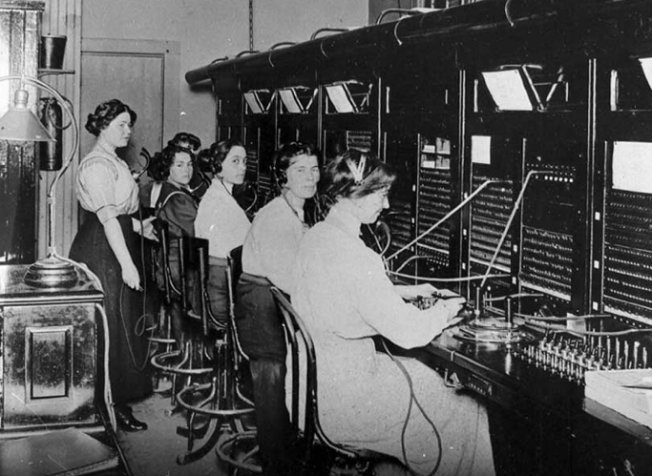
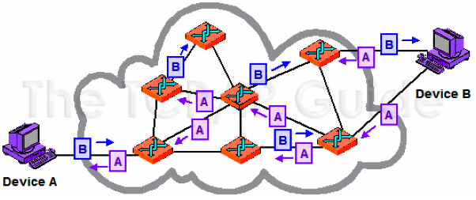
Network applications need streams of data
Circuit switching
Packet switching
Today’s networks provide packet delivery, not streams!
http://www.tcpipguide.com/free/t_CircuitSwitchingandPacketSwitchingNetworks-2.htm
Source: Freedman (partial)

Slide 9


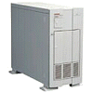
What if the Data Doesn’t Fit?
DIKU
GET /courses/archive/spr09/cos461/ HTTP/1.1
Host: www.cs.princeton.edu
User-Agent: Mozilla/4.03
CRLF
Request
Problem: Packet size
  Typical Web page is 10 kbytes
  On Ethernet, max IP packet is 1500 bytes
GET index.html
hive/s
es/arc
cours
GET /
Solution: Split the data across multiple packets
Source: Freedman

Slide 10
Layering = Functional Abstraction
Sub-divide the problem
  Each layer relies on services from layer below
  Each layer exports services to layer above
Interface between layers defines interaction
  Hides implementation details
  Layers can change without disturbing other layers
Application
Sockets:
streams – TCP
datagrams - UDP
Application-to-application channels
Packets
Host-to-host connectivity
Link hardware
Source: Freedman

Slide 11

Sockets
DIKU
process sends/receives messages to/from its socket
socket analogous to door
  sending process shoves message out door
  sending process relies on transport infrastructure on other side of door which brings message to socket at receiving process
host or
server
host or
server
controlled by
app developer
process
process
socket
socket
TCP with
buffers,
variables
TCP with
buffers,
variables
Internet
controlled
by OS
API: (1) choice of transport protocol; (2) ability to fix a few parameters (more on this in next lecture!)
Source: Kurose & Ross (partial)
Notes:
Talk about addresses and ports

Slide 12
Internet transport protocols services
DIKU
TCP service:
connection-oriented: setup required between client and server processes
reliable transport: between sending and receiving process
flow control: sender won’t overwhelm receiver
congestion control: throttle sender when network overloaded
does not provide: timing, minimum throughput guarantees, security
UDP service:
unreliable data transfer between sending and receiving process
does not provide: connection setup, reliability, flow control, congestion control, timing, throughput guarantee, or security
Q: why bother? Why is there a UDP?
Source: Kurose & Ross

Slide 13
UNIX Socket API
DIKU
Socket interface
  Originally provided in Berkeley UNIX
  Later adopted by all popular operating systems
  Simplifies porting applications to different OSes
In UNIX, everything is like a file
  All input is like reading a file
  All output is like writing a file
  File is represented by an integer file descriptor
API implemented as system calls
  E.g., connect, read, write, close, …
Source: Freedman

Slide 14
Identifying the Receiving Process
Sending process must identify the receiver
  The receiving end host machine
  The specific socket in a process on that machine
Receiving host
  Destination address that uniquely identifies the host
    Typically, high-level name translated to IP address (DNS)
    For example, www.diku.dk → 130.225.96.108
  An IP address is a 32-bit quantity
Receiving socket
  Host may be running many different processes
  Destination port that uniquely identifies the socket
  A port number is a 16-bit quantity
Source: Freedman (partial)

Slide 15
Client-Server TCP Sockets
DIKU
Server
socket()
bind()
Client
listen()
socket()
establish
connection
accept()
connect()
block
send request
write()
read()
Source: Freedman (partial)
process
request
send response
write()
read()

Slide 16
Application Architectures
DIKU
peer-peer
client/server
P2P highly scalable, but difficult to manage
Hybrids also possible, e.g., Skype
Source: Kurose & Ross (partial)

Slide 17
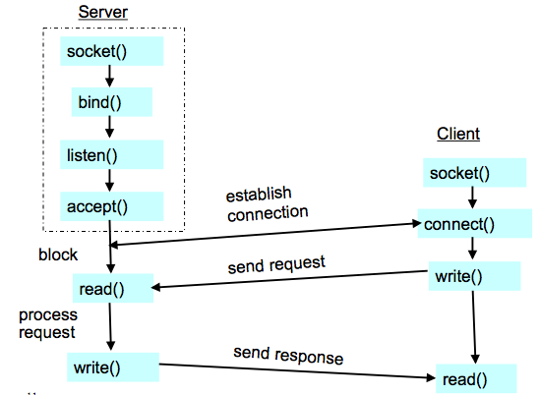
Discussion: How do you set sockets up in a P2P application?
DIKU
peer-peer
How many sockets in each peer?
What if many peers connect to one peer?
Notes:
Server-side: One server socket in listening state and potentially many sockets servicing clients (established).
Client-side: Potentially many client sockets.
TCP → sockets identified by socket pair, i.e., 4-tuple of client-server IPs and ports.

Slide 18
HTTP Basics
HTTP layered over bidirectional byte stream
Interaction
  Client sends request to server, followed by response from server to client
  Requests/responses are encoded in text
Targets access to web objects
  GET, POST, HEAD → HTTP/1.0
  GET, POST, HEAD, PUT, DELETE → HTTP/1.1
Stateless
  Server maintains no info about past client requests
    What about personalization? Data stored in back-end database; client sends “web cookie” used to lookup data
Source: Freedman (partial)

Slide 19
Layer Encapsulation in HTTP
DIKU
TCP
sockets
Source: Freedman (partial)

Slide 20
HTTP Request Example
DIKU
GET / HTTP/1.1
Host: sns.cs.princeton.edu
Accept: */*
Accept-Language: en-us
Accept-Encoding: gzip, deflate
User-Agent: Mozilla/5.0 (Macintosh; U; Intel Mac OS X 10.5; en-US; rv:1.9.2.13) Gecko/20101203 Firefox/3.6.13
Connection: Keep-Alive
Source: Freedman

Slide 21
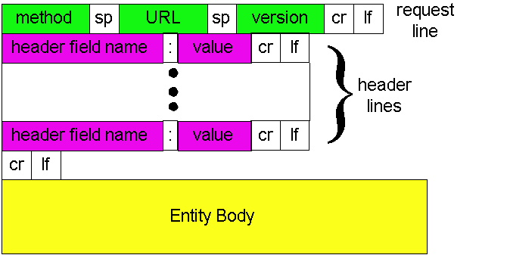
HTTP Request
DIKU
Source: Freedman

Slide 22
HTTP Response Example
DIKU
HTTP/1.1 200 OK
Date: Wed, 02 Feb 2011 04:01:21 GMT
Server: Apache/2.2.3 (CentOS)
X-Pingback: http://sns.cs.princeton.edu/xmlrpc.php
Last-Modified: Wed, 01 Feb 2011 12:41:51 GMT
ETag: "7a11f-10ed-3a75ae4a"
Accept-Ranges: bytes
Content-Length: 4333
Keep-Alive: timeout=15, max=100
Connection: Keep-Alive
<!DOCTYPE html PUBLIC "-//W3C//DTD XHTML 1.0 Transitional//EN" "http://www.w3.org/TR/xhtml1/DTD/xhtml1-transitional.dtd">
<html xmlns="http://www.w3.org/1999/xhtml" dir="ltr" lang="en-US">
Source: Freedman

Slide 23
Single Transfer Example
DIKU
Source: Freedman
Client
Server
Client sends HTTP request for HTML
DAT
ACK
Server reads from disk
DAT
ACK
Client parses HTML

Slide 24
Single Transfer Example
DIKU
Source: Freedman
Client
Server
0 RTT
SYN
Client opens TCP connection
SYN
1 RTT
ACK
Client sends HTTP request for HTML
DAT
ACK
Server reads from disk
DAT
2 RTT
FIN
ACK
Client parses HTML
FIN
ACK

Slide 25
Single Transfer Example
DIKU
Source: Freedman
Client
Server
0 RTT
SYN
Client opens TCP connection
SYN
1 RTT
ACK
Client sends HTTP request for HTML
DAT
ACK
Server reads from disk
DAT
2 RTT
FIN
ACK
Client parses HTML
Client opens TCP connection
FIN
ACK
SYN
SYN
3 RTT
ACK
Client sends HTTP request for image
DAT
Server reads from disk
ACK
4 RTT
DAT
Image begins to arrive

Slide 26
Problems with simple model
DIKU
Multiple connection setups
  Three-way handshake each time (TCP “synchronizing” stream)
Lots of extra connections
  Increases server state/processing
  Server forced to keep connection state
Later we will see also that
  Short transfers are hard on stream protocol (TCP)
    How much data should it send at once?
    Congestion avoidance: Takes a while to “ramp up” to high sending rate (TCP “slow start”)
    Loss recovery is poor when not “ramped up”
Source: Freedman (partial)

Slide 27
Persistent Connection Example
DIKU
Source: Freedman
Client
Server
0 RTT
DAT
Client sends HTTP request for HTML
ACK
Server reads from disk
DAT
1 RTT
ACK
Client parses HTML
Client sends HTTP request for image
DAT
Server reads from disk
ACK
DAT
2 RTT
Image begins to arrive

Slide 28
Persistent HTTP
DIKU
Non-persistent HTTP issues:
Requires 2 RTTs per object
OS must allocate resources for each TCP connection
But browsers often open parallel TCP connections to fetch referenced objects
Persistent HTTP:
Server leaves connection open after sending response
Subsequent HTTP messages between same client/server are sent over connection
Source: Freedman

Slide 29
Persistent HTTP
DIKU
Persistent without pipelining:
Client issues new request only when previous response has been received
One RTT for each object
Persistent with pipelining:
Default in HTTP/1.1 spec
Client sends requests as soon as it encounters referenced object
As little as one RTT for all the referenced objects
Server must handle responses in same order as requests
Persistent without pipelining most common: When does pipelining work best?
Multiple parallel requests or pipelined requests?
Source: Freedman (partial)
Notes:
Q1
Small objects, equal time to serve each object
Small because pipelining simply removes additional 1 RTT delay to request new content
Q2
Multiple parallel connections (~2-4). Easier server parallelism
No “head-of-line blocking” problem like pipelining
Dynamic content makes HOL blocking possibility worse

Slide 30
HTTP Caching
DIKU
Clients often cache documents
  When should origin be checked for changes?
  Every time? Every session? Date?
HTTP includes caching information in headers
  HTTP 0.9/1.0 used: “Expires: <date>”; “Pragma: no-cache”
  HTTP/1.1 has “Cache-Control”
    “No-Cache”, “Private”, “Max-age: <seconds>”
    “E-tag: <opaque value>”
If not expired, use cached copy
If expired, use condition GET request to origin
  “If-Modified-Since: <date>”, “If-None-Match: <etag>”
  304 (“Not Modified”) or 200 (“OK”) response
Source: Freedman

Slide 31
HTTP Conditional Request
DIKU
GET / HTTP/1.1
Host: sns.cs.princeton.edu
User-Agent: Mozilla/5.0 (Macintosh; U; Intel Mac OS X 10.5; en-US; rv:1.9.2.13)
Connection: Keep-Alive
If-Modified-Since: Tue, 1 Feb 2011 17:54:18 GMT
If-None-Match: "7a11f-10ed-3a75ae4a"
HTTP/1.1 304 Not Modified
Date: Wed, 02 Feb 2011 04:01:21 GMT
Server: Apache/2.2.3 (CentOS)
ETag: "7a11f-10ed-3a75ae4a"
Accept-Ranges: bytes
Keep-Alive: timeout=15, max=100
Connection: Keep-Alive
Source: Freedman

Slide 32

Web Proxy Caches
DIKU
User configures browser: Web accesses via cache
Browser sends all HTTP requests to cache
  Object in cache: cache returns object
  Else: cache requests object from origin, then returns to client
origin
server
Proxy
server
HTTP request
HTTP request
client
HTTP response
HTTP response
HTTP request
HTTP response
client
origin
server
Source: Freedman

Slide 33
When a single cache isn’t enough
DIKU
What if the working set is > proxy disk?
  Cooperation!
A static hierarchy
  Check local
  If miss, check siblings
  If miss, fetch through parent
Internet Cache Protocol (ICP)
  ICPv2 in RFC 2186 (& 2187)
  UDP-based, short timeout
public
Internet
Parent
web cache
Source: Freedman

Slide 34
Streaming multimedia: DASH
DIKU
DASH: Dynamic, Adaptive Streaming over HTTP
server:
  divides video file into multiple chunks
  each chunk stored, encoded at different rates
  manifest file: provides URLs for different chunks
client:
  periodically measures server-to-client bandwidth
  consulting manifest, requests one chunk at a time
    chooses maximum coding rate sustainable given current bandwidth
    can choose different coding rates at different points in time (depending on available bandwidth at time)
Source: Kurose & Ross

Slide 35
Streaming multimedia: DASH
DIKU
DASH: Dynamic, Adaptive Streaming over HTTP
“intelligence” at client: client determines
  when to request chunk (so that buffer starvation, or overflow does not occur)
  what encoding rate to request (higher quality when more bandwidth available)
  where to request chunk (can request from URL server that is “close” to client or has high available bandwidth)
Source: Kurose & Ross

Slide 36
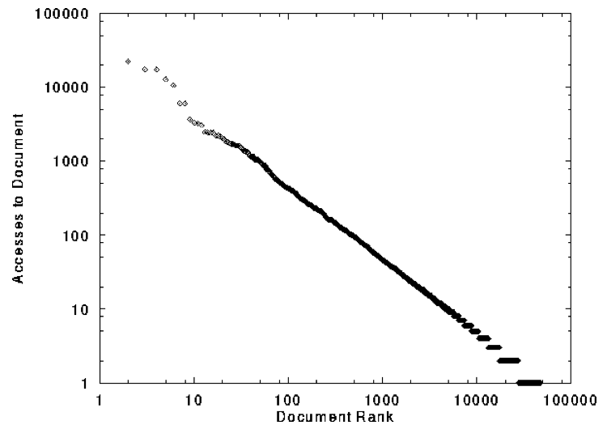
Web traffic has cacheable workload
DIKU
“Zipf” or “power-law” distribution
Source: Freedman

Slide 37
Content Distribution Networks (CDNs)
DIKU
origin server
in North America
Content providers are CDN customers
Content replication
CDN company installs thousands of servers throughout Internet
  In large datacenters
  Or, close to users
CDN replicates customers’ content
When provider updates content, CDN updates servers
CDN distribution node
CDN server
in S. America
CDN server
in Asia
CDN server
in Europe
Source: Freedman

Slide 38
Content Distribution Networks &
Server Selection
DIKU
Replicate content on many servers
Challenges
  How to replicate content
  Where to replicate content
  How to find replicated content
  How to choose among known replicas
  How to direct clients towards replica
Source: Freedman

Slide 39
Server Selection
DIKU
Which server?
  Lowest load: to balance load on servers
  Best performance: to improve client performance
    Based on Geography? RTT? Throughput? Load?
  Any alive node: to provide fault tolerance
How to direct clients to a particular server?
  As part of routing: anycast, cluster load balancing
  As part of application: HTTP redirect
  As part of naming: DNS
  We will explain some of these techniques better later in the course!
Source: Freedman (partial)

Slide 40

How Akamai Works
DIKU
Source: Freedman
cnn.com (content provider)
DNS root server
GET index.html
Akamai
cluster
http://cache.cnn.com/cnn.com/foo.jpg
Akamai global
DNS server
1
2
HTTP
Akamai regional
DNS server
Nearby
Akamai
cluster
End-user

Slide 41
How Akamai Works
DIKU
Source: Freedman
cnn.com (content provider)
DNS root server
DNS lookup
cache.cnn.com
Akamai
cluster
Akamai global
DNS server
1
2
3
4
ALIAS:
g.akamai.net
Akamai regional
DNS server
Nearby
Akamai
cluster
End-user

Slide 42
How Akamai Works
DIKU
Source: Freedman
cnn.com (content provider)
DNS root server
Akamai
cluster
Akamai global
DNS server
5
1
2
3
4
6
Akamai regional
DNS server
ALIAS
a73.g.akamai.net
Nearby
Akamai
cluster
End-user

Slide 43
How Akamai Works
DIKU
Source: Freedman
cnn.com (content provider)
DNS root server
Akamai
cluster
Akamai global
DNS server
5
1
2
3
4
6
Akamai regional
DNS server
7
DNS a73.g.akamai.net
8
Address
1.2.3.4
Nearby
Akamai
cluster
End-user

Slide 44
How Akamai Works
DIKU
Source: Freedman
cnn.com (content provider)
DNS root server
Akamai
cluster
Akamai global
DNS server
5
1
2
3
4
6
Akamai regional
DNS server
7
8
9
Nearby
Akamai
cluster
End-user
GET /foo.jpg
Host: cache.cnn.com

Slide 45

How Akamai Works
DIKU
Source: Freedman
cnn.com (content provider)
DNS root server
GET foo.jpg
11
12
Akamai
cluster
Akamai global
DNS server
5
1
2
3
4
6
Akamai regional
DNS server
7
8
9
Nearby
Akamai
cluster
End-user
GET /foo.jpg
Host: cache.cnn.com

Slide 46
How Akamai Works
DIKU
Source: Freedman
cnn.com (content provider)
DNS root server
11
12
Akamai
cluster
Akamai global
DNS server
5
1
2
3
4
6
Akamai regional
DNS server
7
8
9
Nearby
Akamai
cluster
End-user
10

Slide 47
Summary
DIKU
Network applications
  Email, Web → more in textbook, Chapter 2!
Socket abstraction
  Communication between processes
  Client / Server, Peer-to-Peer
HTTP concepts
  Web objects, request / response (pull)
  Persistent connections, web proxies
  Caching, content delivery

