Slide 1
DIKU
Computer Systems (Computer Networks)
David Marchant
Based on slides compiled by Marcos Vaz Salles, with adaptions by Vivek Shah and Michael Kirkedel Thomsen

Slide 2
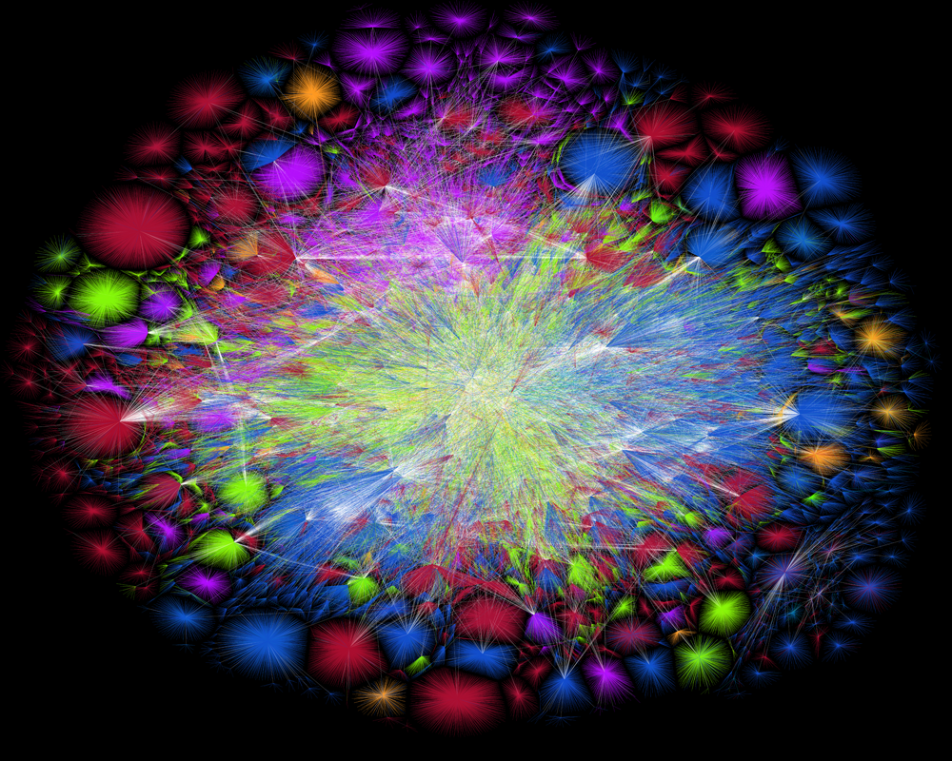
DIKU
Why study Computer Networks?
How can we build networked applications?
What are the protocols that power the Internet?
How can we secure data transmission?
Map of the internet (2015), The Opte Project, www.opte.org
Notes:
In this course, we will study the system design of the Internet!

Slide 3

DIKU
What should we learn in this portion of
the course?
Describe the design of application-layer protocols such as HTTP and DNS.
Implement networked applications making use of sockets.
Explain the mechanisms used by transport-layer protocols to achieve multiplexing, reliability, flow control, and congestion control.
Describe network setups involving subnets, NAT, and LAN segments as well as related interconnection hardware such as routers, switches, and hubs.
Explain the use of cryptography and operational measures to secure network protocols and applications.
Build for performance by using all the hardware we have, both locally and remotely.
Utilise events as basis for applications.
De-mystify cloud computing and its impacts on data center networking

Slide 4

DIKU
Computer Networks: What will we study?
How can we build networked applications?
  Application-level protocols, e.g., HTTP and content delivery
  Programming with sockets
  Resolving names with DNS

Slide 5
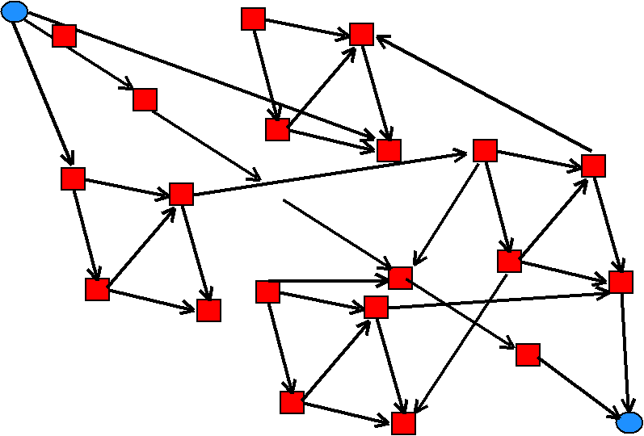
DIKU
Computer Networks: What will we study?
What are the protocols that power the Internet?
  UDP: Basic transport
  TCP: Reliable and ordered transport with flow and congestion control
  IP: Addressing, forwarding, routing
  Ethernet et al: Physical transmission
Largest portion of the course

Slide 6
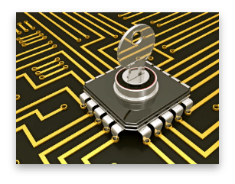
DIKU
Computer Networks: What will we study?
How can we secure data transmission?
  Cryptography
  Authentication
  HTTPS, IPSec: Securing protocols

Slide 7

DIKU
Computer Networks: What will we study?
Not only theoretical knowledge, but also skills
  Programming with sockets
  Implementing protocols
  Using network tools
  Building distributed applications

Slide 8
DIKU
References & Course Materials
Book
  Computer Networking, 8th ed., James F. Kurose and Keith W. Ross, Pearson, ISBN 13: 978-0-135-92873-8
Ex-book
  Computer Systems: A Programmers Perspective, 3rd ed., Randal Bryant and David O’Hallaron, ISBN 13: 978-0-134-09266-9
Other references
  Vast majority listed in the course schedule
  Will keep updating them as we go

Slide 9
DIKU
Acknowledgements
Many of the slides in this course are based on or reproduce material kindly made available by Michael Freedman (Princeton), James Kurose & Keith Ross (RPI & NYU-Poly, textbook), Jerome Saltzer & M. Frans Kaashoek & Robert Morris (MIT), Randal E. Bryant & David R. Halloran (Computer Systems, textbook)
Marcos Vaz Salles (Associate Professor, DIKU) for creating and compiling these slide sets

Slide 10
DIKU
Questions so far?

Slide 11
DIKU
What should we learn today?
Identify the key concepts in networking of protocols, layering, resource allocation, and naming.
Describe what a protocol is and the main issues in protocol design.
Explain the goal of layering in networked systems and the multiple layers in the Internet protocol suite.
Explain how circuit switching and packet switching address the resource allocation problem in networks.
Explain Time-Division Multiplexing (TDM) and Frequency-Division Multiplexing (FDM) and predict transmission time in circuit switched networks.
Explain the advantages and challenges of packet switching and store-and-forward, and identify the components of transfer time, including processing, queueing, transmission, and propagation.
Predict transfer time in such store-and-forward networks.
Explain the notion of throughput in store-and-forward networks and predict throughput in specific scenarios.

Slide 12
Networking is Relevant
Source: Freedman

Slide 13

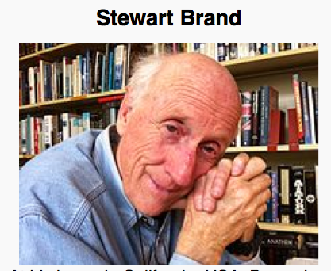




Information wants to be free because it has become so cheap to distribute, copy, and recombine... It wants to be expensive because it can be immeasurably valuable to the recipient. (1985)
Source: Freedman

Slide 14





What’s the Internet: “nuts and bolts” view
PC
A network of networks
Millions of connected computing devices: hosts = end systems
  running network apps
communication links
  fiber, copper, radio, satellite
  transmission rate = bandwidth
routers: forward packets (chunks of data)
Mobile network
server
Global ISP
wireless
laptop
cellular
handheld
Home network
Regional ISP
access
points
Institutional network
wired
links
router
Source: Kurose & Ross (partial)

Slide 15
DIKU
Key Concepts in Networking
Protocols
  Speaking the same language
  Syntax and semantics
Layering
  Standing on the shoulders of giants
  A key to managing complexity
Resource allocation
  Dividing scarce resources among competing parties
  Memory, link bandwidth, wireless spectrum, paths
Naming
  What to call computers, services, protocols, …
Source: Freedman

Slide 16
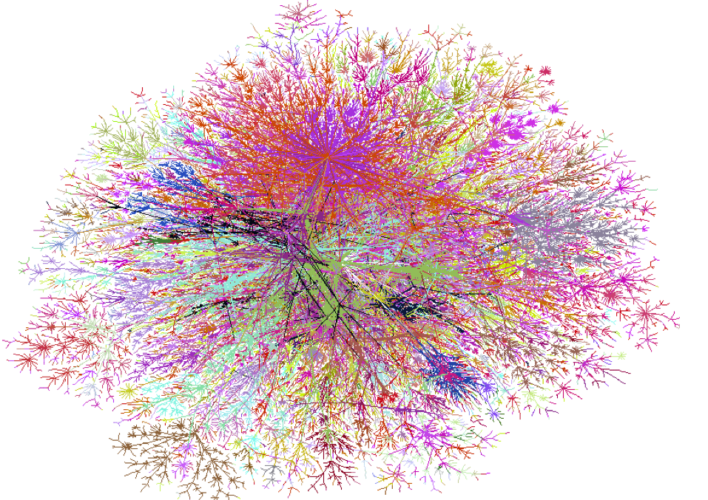
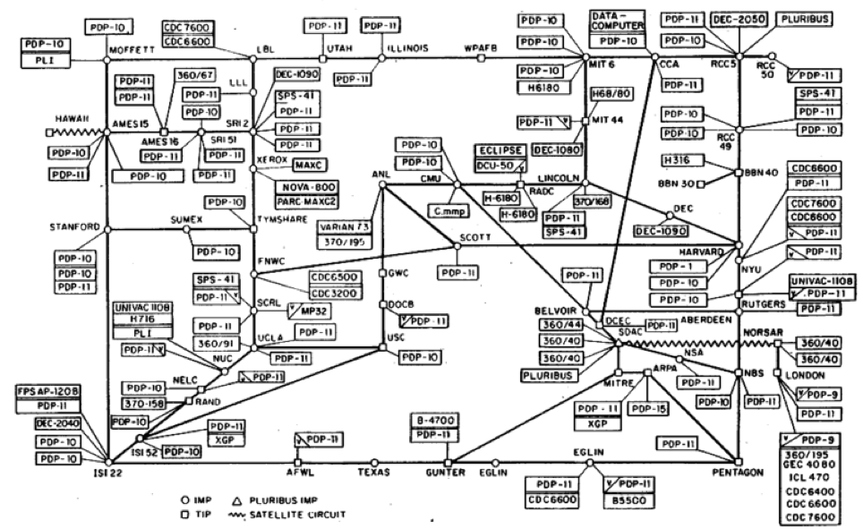
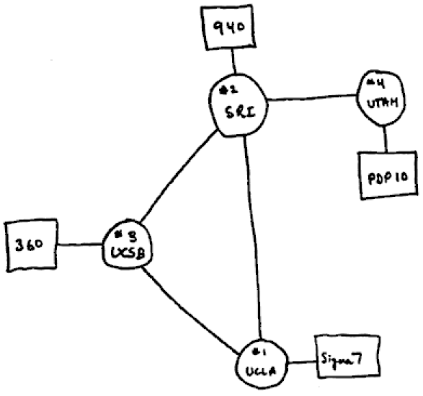

DIKU
Key Concepts in Networking
Protocols
  Speaking the same language
  Syntax and semantics
1969
1977
1998
All speak IPv4
“Internet Protocol version 4”
Source: Freedman
Notes:
IPv5 (Internet Protocol, version 5) was assigned to an experimental protocol called ST (Internet Stream Protocol). ST was first defined in 1979 in IEN 119 (Internet Engineering Note), and was later revised in RFC 1190 (ST2) and RFC 1819 (ST2+). ST was envisioned to be the connection oriented complement to IPv4, but it has never been introduced for public usage. Many of the concepts available in ST can be found today in MPLS.

Slide 17
DIKU
Protocol design is about tradeoffs
How should hosts and routers communicate?
  Standard protocol
  Fast: Machine readable in hardware at line rates
Browsers, web servers, and proxies?
  Can be slower: software readable
  Human readable
  Extensible and forward-compatible
  Not everybody might be familiar with extensions
Source: Freedman

Slide 18

DIKU
IPv4 Packet
4-bit
Version
4-bit
Header
Length
8-bit Type of
Service (TOS)
16-bit Total Length (Bytes)
16-bit Identification
3-bit
Flags
13-bit Fragment Offset
8-bit Time to
Live (TTL)
8-bit Protocol
16-bit Header Checksum
20-byte
header
32-bit Source IP Address
32-bit Destination IP Address
Options (if any)
Payload
Source: Freedman

Slide 19
DIKU
Example: HyperText Transfer Protocol
GET /courses/archive/spr09/cos461/ HTTP/1.1
Host: www.cs.princeton.edu
User-Agent: Mozilla/4.03
CRLF
Request
HTTP/1.1 200 OK
Date: Mon, 2 Feb 2009 13:09:03 GMT
Server: Netscape-Enterprise/3.5.1
Last-Modified: Mon, 21 Feb 2009 11:12:23 GMT
Content-Length: 42
CRLF
Site under construction
Response
Source: Freedman (partial)

Slide 20
DIKU
Key Concepts in Networking
Protocols
  Speaking the same language
  Syntax and semantics
Layering
  Standing on the shoulders of giants
  A key to managing complexity
Source: Freedman

Slide 21
DIKU
Layering = Functional Abstraction
Sub-divide the problem
  Each layer relies on services from layer below
  Each layer exports services to layer above
Interface between layers defines interaction
  Hides implementation details
  Layers can change without disturbing other layers
Application
Application-to-application channels
Host-to-host connectivity
Link hardware
Source: Freedman

Slide 22
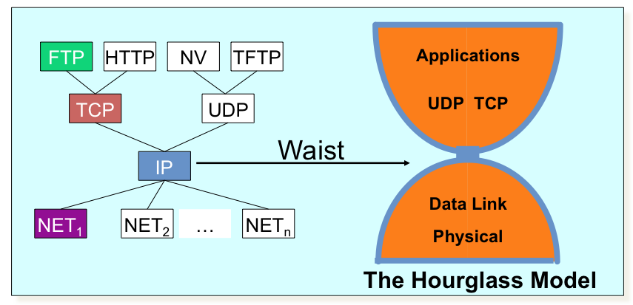
DIKU
The Internet Protocol Suite
The waist facilitates interoperability
Source: Freedman
Notes:
IP ON EVERYTHING!!! :-)

Slide 23

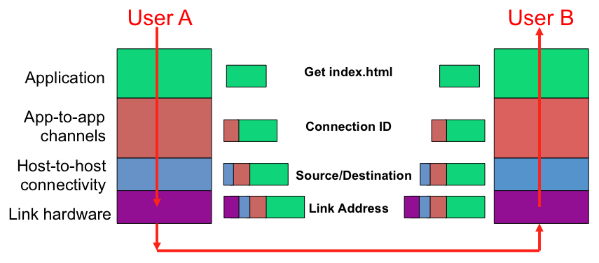
DIKU
Layer Encapsulation in HTTP
Source: Freedman

Slide 24
DIKU
Layer Encapsulation in HTTP
Application
Transport
Network
Link
Physical
Source: Freedman

Slide 25
DIKU
IP Suite: End Hosts vs. Routers
host
host
HTTP message
HTTP
HTTP
TCP segment
TCP
TCP
router
router
IP packet
IP packet
IP packet
IP
IP
IP
IP
Ethernet
interface
Ethernet
interface
SONET
interface
SONET
interface
Ethernet
interface
Ethernet
interface
Source: Freedman

Slide 26
DIKU
Key Concepts in Networking
Protocols
  Speaking the same language
  Syntax and semantics
Layering
  Standing on the shoulders of giants
  A key to managing complexity
Resource allocation
  Dividing scarce resources among competing parties
  Memory, link bandwidth, wireless spectrum, paths
First Example: circuit vs. packet switching
Source: Freedman (partial)

Slide 27
DIKU
Network Core: Circuit Switching
end-end resources reserved for “call”
link bandwidth, switch capacity
dedicated resources: no sharing
circuit-like (guaranteed) performance
call setup required
Source: Kurose & Ross

Slide 28
DIKU
Circuit Switching: FDM and TDM
Example:
FDM
4 users
frequency
time
TDM
frequency
time
Source: Kurose & Ross
Notes:
1536/24 = 64!
100msec + 500msec

Slide 29
DIKU
Numerical example
How long does it take to send a file of 640,000 bits from host A to host B over a circuit-switched network?
  all link speeds: 1536 Mbps
  each link uses TDM with 24 slots/sec
  500 msec to establish end-to-end circuit
  Note: 1 Mbps = 10⁶ bps
Let’s work it out!
Possible answers
(a) 500 msec
(b) 500.4 msec
(c) 510 msec
(d) 1 sec
Source: Kurose & Ross
Notes:
REVISE: give multiple choice answers for students next time.
1536 / 24 = 64 Mbps -> note 1Mbps = 10^6 bps
Transfer = 0.01 s = 10ms
Connect = 500ms
Total 510ms

Slide 30
DIKU
Numerical example
How long does it take to send a file of 640,000 bits from host A to host B over a circuit-switched network?
  all link speeds: 1536 Mbps
  each link uses TDM with 24 slots/sec
  500 msec to establish end-to-end circuit
  Note: 1 Mbps = 10⁶ bps
Let’s work it out!
Possible answers
(a) 500 msec
(b) 500.4 msec
(c) 510 msec (Assuming only 1 link)
(d) 1 sec
d = N(L/R)
Source: Kurose & Ross
Notes:
REVISE: give multiple choice answers for students next time.
1536 / 24 = 64 Mbps -> note 1Mbps = 10^6 bps
Transfer = 0.01 s = 10ms
Connect = 500ms
Total 510ms

Slide 31
DIKU
Network Core: Packet Switching
each end-end data stream divided into packets
user A, B packets share network resources
each packet uses full link bandwidth
resources used as needed
resource contention:
aggregate resource demand can exceed amount available
congestion: packets queue, wait for link use
store and forward: packets move one hop at a time
  node receives complete packet before forwarding
Bandwidth division into “pieces”
Dedicated allocation
Resource reservation
Source: Kurose & Ross

Slide 32

DIKU
Packet Switching: Statistical Multiplexing
100 Mb/s
Ethernet
A
C
statistical multiplexing
1.5 Mb/s
B
queue of packets
waiting for output
link
D
E
sequence of A & B packets has no fixed timing pattern
  bandwidth shared on demand: statistical multiplexing.
TDM: each host gets same slot in revolving TDM frame.
Source: Kurose & Ross

Slide 33
DIKU
Packet switching versus circuit switching
Packet switching allows more users to use network!
Example:
1 Mb/s link
each user:
  100 kb/s when “active”
  active 10% of time
circuit-switching:
  10 users, utilization?
packet switching:
  with 35 users, probability > 10 active at same time is less than .0004
N
users
…..
1 Mbps link
Q: How did we get value 0.0004?
A: P(N=10) =
C(35,10)*P(A)¹⁰*(1-P(A))⁽³⁵⁻¹⁰⁾
P(N>10) → sum the above for N=10..35
Q: what happens if > 35 users ?
Source: Kurose & Ross (partial)
Notes:
Circuit switching, 1/10 of link for each user, each user uses only 1/10 of her share.
Probability of Exactly 10 users active = C(35,10) * P(Active)^10 * ( 1 – P(Active))^(35 - 10)
Probability of More than 10 users active = sum the above formulate for users = 10 .. 35.

Slide 34
DIKU
Packet-switching: store-and-forward
L
R
R
R
takes L/R seconds to transmit (push out) packet of L bits on to link at R bps
store and forward: entire packet must arrive at router before it can be transmitted on next link
delay = 3L/R (assuming zero propagation delay)
Example:
  L = 7.5 Mbits
  R = 1.5 Mbps
  transmission delay =
  (a) 5 sec
  (b) 10 sec
  (c) 15 sec
  (d) 20 sec
more on delay shortly …
Source: Kurose & Ross
Notes:
Answer is 15 sec. L/R = 5 sec; 3L/R = 15 sec

Slide 35
DIKU
How do loss and delay occur?
packets queue in router buffers
packet arrival rate to link exceeds output link capacity
packets queue, wait for turn
packet being transmitted (delay)
A
B
packets queueing (delay)
free (available) buffers: arriving packets
dropped (loss) if no free buffers
Source: Kurose & Ross

Slide 36
DIKU
Four sources of packet delay
transmission
A
propagation
B
nodal
processing
queueing
d_{nodal} = d_{proc} + d_{queue} + d_{trans} + d_{prop}
d_{proc}: nodal processing
  check bit errors
  determine output link
  typically < msec
d_{queue}: queueing delay
  time waiting at output link for transmission
  depends on congestion level of router
Source: Kurose & Ross

Slide 37
DIKU
Four sources of packet delay
transmission
A
propagation
B
nodal
processing
queueing
d_{nodal} = d_{proc} + d_{queue} + d_{trans} + d_{prop}
d_{trans}: transmission delay
  L: packet length (bits)
  R: link bandwidth (bps)
  d_{trans} = L/R
d_{prop}: propagation delay
  d: length of physical link
  s: propagation speed in medium (~2x10⁸ m/sec)
  d_{prop}= d/s
d_{trans} and d_{prop}
very different
Source: Kurose & Ross

Slide 38
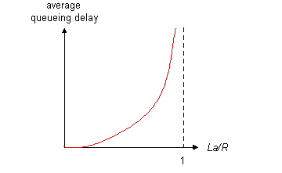

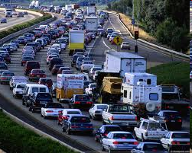
DIKU
Queuing delay
R: link bandwidth (bps)
L: packet length (bits)
a: average packet arrival rate
  La/R ~ 0: avg. queuing delay small
  La/R → 1: avg. queuing delay large
  La/R > 1: more “work” arriving than can be serviced, average delay infinite!
average queueing delay
traffic intensity
= La/R
La/R ~ 0
La/R → 1
Source: Kurose & Ross

Slide 39
DIKU
Packet Loss
queue (aka buffer) preceding link in buffer has finite capacity
packet arriving to full queue dropped (aka lost)
lost packet may be re-transmitted by previous node, by source end system, or not at all
buffer
(waiting area)
packet being transmitted
A
B
packet arriving to
full buffer is lost
Source: Kurose & Ross

Slide 40
DIKU
Throughput
throughput: rate (bits/time unit) at which bits transferred between sender/receiver
  instantaneous: rate at given point in time
  average: rate over longer period of time
link capacity
R_{s} bits/sec
link capacity
R_{c} bits/sec
server, with
file of F bits
to send to client
pipe that can carry
fluid at rate
R_{s} bits/sec)
pipe that can carry
fluid at rate
R_{c} bits/sec)
server sends bits
(fluid) into pipe
Source: Kurose & Ross

Slide 41
DIKU
Throughput: Internet scenario
per-connection end-end throughput: min(R_{c}, R_{s}, R/10)
in practice: R_{c} or R_{s} is often bottleneck
R_{s}
R_{s}
R_{s}
R
R_{c}
R_{c}
R_{c}
10 connections (fairly) share backbone bottleneck link R bits/sec
Source: Kurose & Ross

Slide 42
DIKU
Summary
Internet is a network of networks
  Inter-operability, power to the edges
Key concepts in networking
  Protocols, layers, resource allocation, and naming
Circuit switching
  FDM
  TDM
Packet switching
  Store-and-forward
  Delay, loss, throughput

Slide 43



What’s next ? What to program on the network ?

Slide 44
What’s next ? How to program the network ?
register file
ALU
system bus
memory bus
main
memory
MI
I/O
bridge
Expansion slots
I/O bus
USB
controller
graphics
adapter
disk
controller
network
adapter
mouse
keyboard
monitor
disk
network
Source: Bryant & Halloran

