Slide 1
Concept Maps

Slide 2
Concept Maps
Take all the concepts and idea of a subject
Link them together
Should act as a ‘map’ of the subject
We’re going to make one for CompSys (so far)

Slide 3
How to Create a Concept Map
List all the core terms/topics
List any general concepts
Link between them
Use something were you can draw and move shapes easily, such as powerpoint

Slide 4
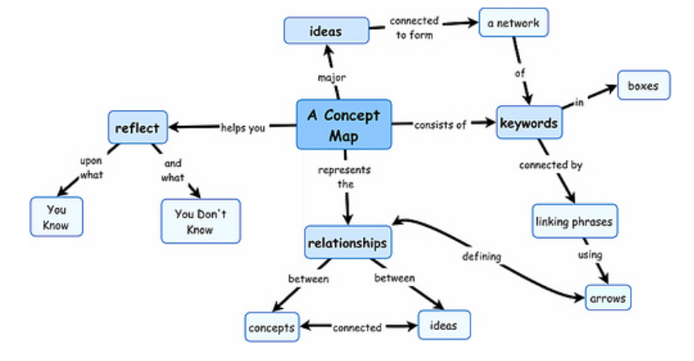
Taken from: https://www.morgan.edu/academic-affairs/resources/instructional-technology/teaching-with-technology/concept-maps

