Slide 1
DIKU
Computer Networking I
David Marchant
Based on slides compiled by Marcos Vaz Salles, with adaptions by Vivek Shah and Michael Kirkedel Thomsen

Slide 2
A quick note about me
PhD student from Scotland
Jeg taler ikke dansk :(
‘David’ on the Discord
Office: HCØ, Building B, room 772-01-0-S06

Slide 3
Christmas makes everything awkward
Week | Mon | Tue | Wed | Thu | Fri | Sat | Sun
50 |  |  |  | Lecture Exercises | Cafe
51 |  | Lecture A4 out |  | Xmas
52
1 |  | Lecture |  | Lecture Exercises A5 out | Cafe A4 in
2 |  | Lecture |  | Lecture Exercises | Cafe A5 in
3
4 | Exam week

Slide 4
Networking is Relevant
Source: Freedman

Slide 5

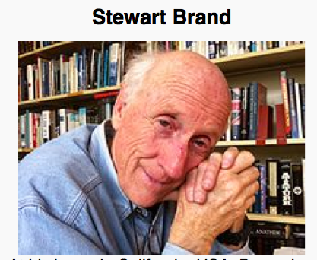




Information wants to be free because it has become so cheap to distribute, copy, and recombine... It wants to be expensive because it can be immeasurably valuable to the recipient. (1985)
Source: Freedman

Slide 6





What’s the Internet: “nuts and bolts” view
PC
A network of networks
Millions of connected computing devices: hosts = end systems
  running network apps
communication links
  fiber, copper, radio, satellite
  transmission rate = bandwidth
routers: forward packets (chunks of data)
Mobile network
server
Global ISP
wireless
laptop
cellular
handheld
Home network
Regional ISP
access
points
Institutional network
wired
links
router
Source: Kurose & Ross (partial)

Slide 7
DIKU
Key Concepts in Networking
Protocols
  Speaking the same language
  Syntax and semantics
Layering
  Standing on the shoulders of giants
  A key to managing complexity
Resource allocation
  Dividing scarce resources among competing parties
  Memory, link bandwidth, wireless spectrum, paths
Naming
  What to call computers, services, protocols, …
Source: Freedman

Slide 8
DIKU
Key Concepts in Networking
Protocols
  Speaking the same language
  Syntax and semantics
Layering
  Standing on the shoulders of giants
  A key to managing complexity
Resource allocation
  Dividing scarce resources among competing parties
  Memory, link bandwidth, wireless spectrum, paths
Naming
  What to call computers, services, protocols, …
Source: Freedman

Slide 9
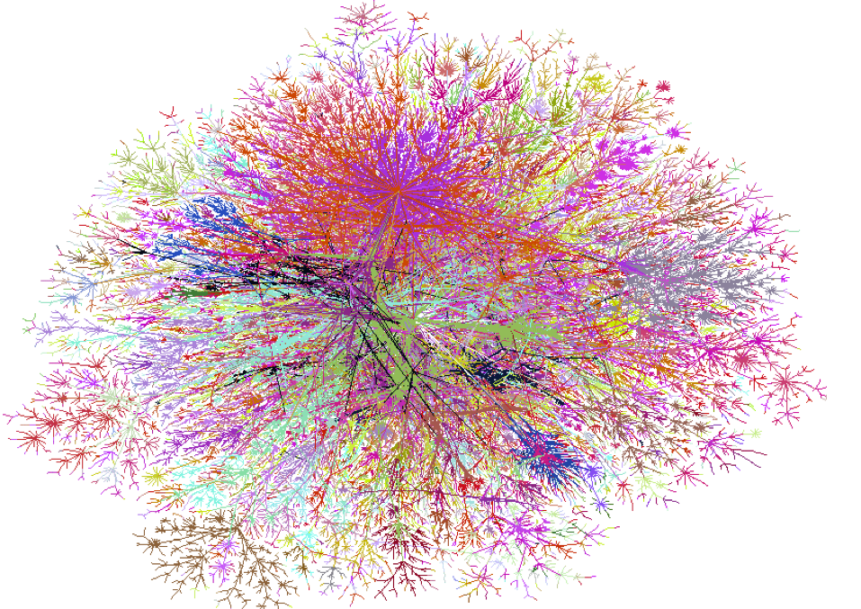
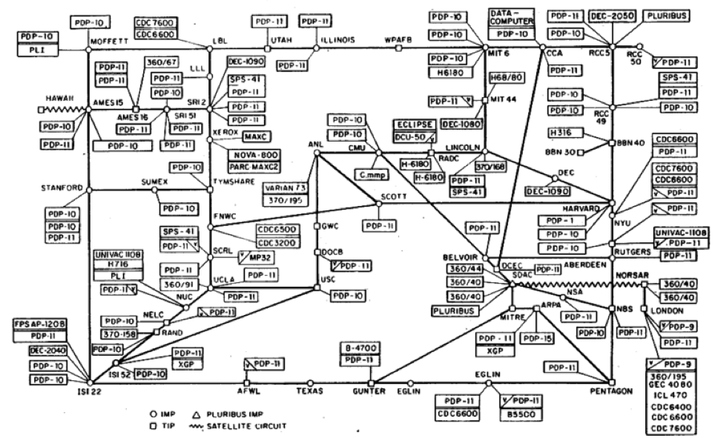
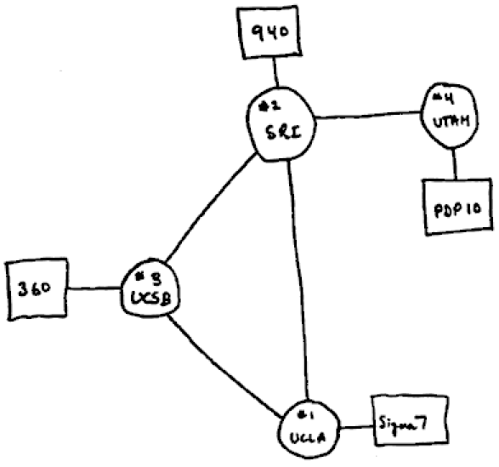

DIKU
Key Concepts in Networking
Protocols
  Speaking the same language
  Syntax and semantics
1969
1977
1998
All speak IPv4
“Internet Protocol version 4”
Source: Freedman
Notes:
IPv5 (Internet Protocol, version 5) was assigned to an experimental protocol called ST (Internet Stream Protocol). ST was first defined in 1979 in IEN 119 (Internet Engineering Note), and was later revised in RFC 1190 (ST2) and RFC 1819 (ST2+). ST was envisioned to be the connection oriented complement to IPv4, but it has never been introduced for public usage. Many of the concepts available in ST can be found today in MPLS.

Slide 10
DIKU
Protocol design is about tradeoffs
How should hosts and routers communicate?
  Standard protocol
  Fast: Machine readable in hardware at line rates
Browsers, web servers, and proxies?
  Can be slower: software readable
  Human readable
  Extensible and forward-compatible
  Not everybody might be familiar with extensions
Source: Freedman

Slide 11

DIKU
IPv4 Packet
4-bit
Version
4-bit
Header
Length
8-bit Type of
Service (TOS)
16-bit Total Length (Bytes)
16-bit Identification
3-bit
Flags
13-bit Fragment Offset
8-bit Time to
Live (TTL)
8-bit Protocol
16-bit Header Checksum
20-byte
header
32-bit Source IP Address
32-bit Destination IP Address
Options (if any)
Payload
Source: Freedman

Slide 12
DIKU
Example: HyperText Transfer Protocol
GET /courses/archive/spr09/cos461/ HTTP/1.1
Host: www.cs.princeton.edu
User-Agent: Mozilla/4.03
CRLF
Request
HTTP/1.1 200 OK
Date: Mon, 2 Feb 2009 13:09:03 GMT
Server: Netscape-Enterprise/3.5.1
Last-Modified: Mon, 21 Feb 2009 11:12:23 GMT
Content-Length: 42
CRLF
Site under construction
Response
Source: Freedman (partial)

Slide 13
DIKU
Key Concepts in Networking
Protocols
  Speaking the same language
  Syntax and semantics
Layering
  Standing on the shoulders of giants
  A key to managing complexity
Resource allocation
  Dividing scarce resources among competing parties
  Memory, link bandwidth, wireless spectrum, paths
Naming
  What to call computers, services, protocols, …
Source: Freedman

Slide 14
DIKU
Layering = Functional Abstraction
Sub-divide the problem
  Each layer relies on services from layer below
  Each layer exports services to layer above
Interface between layers defines interaction
  Hides implementation details
  Layers can change without disturbing other layers
Application
Application-to-application channels
Host-to-host connectivity
Link hardware
Source: Freedman

Slide 15
DIKU
Key Concepts in Networking
Application Layer
Transport Layer
Network Layer
Link Layer
Physical Layer

Slide 16
DIKU
IP Suite: End Hosts vs. Routers
host
host
HTTP message
HTTP
HTTP
TCP segment
TCP
TCP
router
router
IP packet
IP packet
IP packet
IP
IP
IP
IP
Ethernet
interface
Ethernet
interface
SONET
interface
SONET
interface
Ethernet
interface
Ethernet
interface
Source: Freedman

Slide 17


DIKU
Layer Encapsulation in HTTP
Source: Freedman

Slide 18
DIKU
Layer Encapsulation in HTTP
Application
Transport
Network
Link
Physical
Source: Freedman

Slide 19
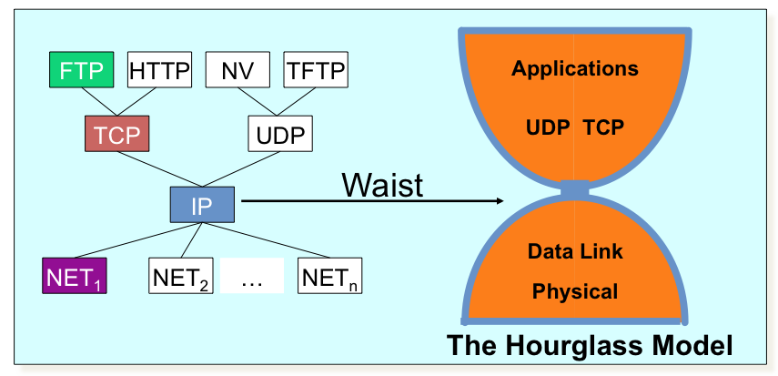
DIKU
The Internet Protocol Suite
The waist facilitates interoperability
Source: Freedman
Notes:
IP ON EVERYTHING!!! :-)

Slide 20
DIKU
Key Concepts in Networking
Protocols
  Speaking the same language
  Syntax and semantics
Layering
  Standing on the shoulders of giants
  A key to managing complexity
Resource allocation
  Dividing scarce resources among competing parties
  Memory, link bandwidth, wireless spectrum, paths
Naming
  What to call computers, services, protocols, …
Source: Freedman

Slide 21

DIKU
Network Core: Packet Switching
Data broken up into smaller ‘packets’
Can be sent seperately, each using full bandwidth
Full bandwidth used on a single packet
Packets from different sources are interspersed
Resources only used when needed
Unreliable transfer
A
B
C

Slide 22
DIKU
Key Concepts in Networking
Protocols
  Speaking the same language
  Syntax and semantics
Layering
  Standing on the shoulders of giants
  A key to managing complexity
Resource allocation
  Dividing scarce resources among competing parties
  Memory, link bandwidth, wireless spectrum, paths
Naming
  What to call computers, services, protocols, …
Source: Freedman

Slide 23
DIKU
A Programmers View of the Internet
1. Hosts are mapped to a set of 32-bit IP addresses
  128.2.203.179
2. The set of IP addresses is mapped to a set of identifiers called Internet domain names
  128.2.217.3 is mapped to www.cs.cmu.edu
3. A process on one Internet host can communicate with a process on another Internet host over a connection
Source: Freedman

Slide 24
DIKU
IPv4 and IPv6
The original Internet Protocol, with its 32-bit addresses, is known as Internet Protocol Version 4 (IPv4)
1996: Internet Engineering Task Force (IETF) introduced Internet Protocol Version 6 (IPv6) with 128-bit addresses
  Intended as the successor to IPv4
As of 2021, majority of Internet traffic still carried by IPv4
  Only 30-35% of users access Google services using IPv6.
We will focus on IPv4, but will show you how to write networking code that is protocol-independent.
Source: Freedman

Slide 25
DIKU
IPv4, IPv6 and beyond
IPv0
Reserved
IPv1-3
Initial attempts, became IPv4 and TCP(‘73-’79)
IPv4
First actually deployed protocol (‘81)
5
Experiment (‘90 -’95) into video streaming protocol
IPv6
Improvement on IPv4 (‘95)
IPv7
Incorrectly assigned when IPv6 was assumed to already be in use(‘88)
8
PIP, obsolete replacement for IPv4 (‘94)
9
TUBA, obsolete replacement for IPv4 (’92),
IPv9
April Fools Joke by IETF (‘94),
IPv9
Chinese research project, seemingly abandoned (‘04)
IPv11-14
Unassigned
IPv15
Reserved
Source: Freedman

Slide 26
Using the network
Source: Freedman

Slide 27
DIKU
Network Core: Circuit Switching
To send a message we can use libaries at the application layer
Underlying layers will take care of most of the work
Can be done in (almost) any lanaguage. C is difficult though, so we’ll use Python
Source: Kurose & Ross

Slide 28
A Client-Server Transaction
Most network applications are based on the client-server model:
  A server process and one or more client processes
  Server manages some resource
  Server provides service by manipulating resource for clients
  Server activated by request from client (vending machine analogy)
1. Client sends request
Client
process
Server
process
Resource
4. Client
handles
response
3. Server sends response
2. Server
handles
request
Note: clients and servers are processes running on hosts
(can be the same or different hosts)

Slide 29
A Client-Server Transaction
Most network applications are based on the client-server model:
  There can be multiple clients connected to a single server
  Individual hosts can act as both clients and servers at the same time
process
C
process
C
S
process
C
process
S
S
S
process
C
Note: clients and servers are processes running on hosts
(can be the same or different hosts)

Slide 30
Hardware Organization of a Network Host
CPU chip
register file
ALU
system bus
memory bus
main
memory
MI
I/O
bridge
Expansion slots
I/O bus
USB
controller
graphics
adapter
disk
controller
network
adapter
mouse
keyboard
monitor
disk
network

Slide 31
Internet Connections
Clients and servers communicate by sending streams of bytes over connections. Each connection is:
  Point-to-point: connects a pair of processes.
  Full-duplex: data can flow in both directions at the same time,
  Reliable: stream of bytes sent by the source is eventually received by the destination in the same order it was sent.
A socket is an endpoint of a connection
  Socket address is an IPaddress:port pair
A port is a 16-bit integer that identifies a process:
  Ephemeral port: Assigned automatically by client kernel when client makes a connection request.
  Well-known port: Associated with some service provided by a server (e.g., port 80 is associated with Web servers)

Slide 32
Well-known Ports and Service Names
Popular services have permanently assigned well-known ports and corresponding well-known service names:
  echo server: 7/echo
  ssh servers: 22/ssh
  email server: 25/smtp
  Web servers: 80/http
Mappings between well-known ports and service names is contained in the file /etc/services on each Linux machine.

Slide 33
Sockets Interface
Set of system-level functions used in conjunction with Unix I/O to build network applications.
Created in the early 80’s as part of the original Berkeley distribution of Unix that contained an early version of the Internet protocols.
Available on all modern systems
  Unix variants, Windows, OS X, IOS, Android, ARM

Slide 34
Sockets
What is a socket?
  To the kernel, a socket is an endpoint of communication
  To an application, a socket is a file descriptor that lets the application read/write from/to the network
    Remember: All Unix I/O devices, including networks, are modeled as files
Clients and servers communicate with each other by reading from and writing to socket descriptors
The main distinction between regular file I/O and socket I/O is how the application “opens” the socket descriptors
Client
Server
clientfd
serverfd

Slide 35
Sockets Interface
Client
Server
socket
socket
bind
listen
Connection
request
connect
accept
write
read
Client / Server
Session
Await connection
request from
next client
read
write
close
EOF
read
close

Slide 36
Sockets Interface: socket
Clients and servers use the socket function to create a socket descriptor:
Example:
int socket(int domain, int type, int protocol)
C:
#include <sys/socket.h>
int socket_fd = socket(AF_INET, SOCK_STREAM, 0);
Indicates that we are using 32-bit IPV4 addresses
Indicates that the socket will be the end point of a connection
from socket import *
with socket(AF_INET, SOCK_STREAM) as sock:
...
Python:

Slide 37
Sockets Interface: listen
By default, kernel assumes that descriptor from socket function is an active socket that will be on the client end of a connection.
A server calls the listen function to tell the kernel that a descriptor will be used by a server rather than a client:
Converts sockfd from an active socket to a listening socket that can accept connection requests from clients.
int listen(int sockfd, int backlog);
C:
listen(socket_fd, 10);
Python:
sock.listen(10)

Slide 38
Sockets Interface: accept
Servers wait for connection requests from clients by calling accept:
Waits for connection request to arrive on the connection bound to listenfd, then fills in client’s socket address in addr and size of the socket address in addrlen.
Returns a connected descriptor that can be used to communicate with the client via Unix I/O routines.
int accept(int listenfd, SA *addr, int *addrlen);
socklen_t clientlen;
struct sockaddr_storage clientaddr;
conn_fd = accept(socket_fd, (SA *) &clientaddr, &clientlen);
C:
Python:
Conn, conn_addr = sock.accept()

Slide 39
Sockets Interface: connect
A client establishes a connection with a server by calling connect:
Attempts to establish a connection with server at socket address addr
  If successful, then clientfd is now ready for reading and writing.
  Resulting connection is characterized by socket pair
(x:y, addr.sin_addr:addr.sin_port)
    x is client address
    y is ephemeral port that uniquely identifies client process on client host
int connect(int clientfd, SA *addr, socklen_t addrlen);
C:
struct sockaddr s_addr;
connect(socket_fd, (struct sockaddr *)&s_addr, sizeof(s_addr));
Python:
client_sock.connect(“130.226.237.173”, 56)

Slide 40
Sockets Interface
Client
Server
socket
socket
bind
listen
Connection
request
connect
accept
write
read
Client / Server
Session
Await connection
request from
next client
read
write
close
EOF
read
close

Slide 41
Python Example
Client:
import socket
with socket.socket(socket.AF_INET, socket.SOCK_STREAM) as client_socket:
client_socket.connect((“127.0.0.1”, 5678))
request = bytearray(“This is a message”.encode())
client_socket.sendall(request)
response = client_socket.recv(1024)
print(response)
Note that these lines are where our processes synchronise
Server:
import socket
with socket.socket(socket.AF_INET, socket.SOCK_STREAM) as server_socket:
server_socket.bind((“127.0.0.1”, 5678))
server_socket.listen()
while True:
connection, connection_address = server_socket.accept()
with connection:
message = connection.recv(1024)
connection.sendall(response)

Slide 42
accept Illustrated
listenfd(3)
Client
Server
1. Server blocks in accept, waiting for connection request on listening descriptor listenfd
clientfd
Connection
request
listenfd(3)
Client
Server
2. Client makes connection request by calling and blocking in connect
clientfd
listenfd(3)
Client
Server
3. Server returns connfd from accept. Client returns from connect. Connection is now established between clientfd and connfd
clientfd
connfd(4)

Slide 43
Connected vs. Listening Descriptors
Listening descriptor
  End point for client connection requests
  Created once and exists for lifetime of the server
Connected descriptor
  End point of the connection between client and server
  A new descriptor is created each time the server accepts a connection request from a client
  Exists only as long as it takes to service client
Why the distinction?
  Allows for concurrent servers that can communicate over many client connections simultaneously
    E.g., Each time we receive a new request, we fork a child to handle the request

Slide 44
Iterative Servers
Iterative servers process one request at a time
Client 1
Server
Client 2
connect
accept
connect
write
read
write
call read
call read
ret read
write
read
close
close
Wait for server to finish with Client 1
accept
read
write
ret read

Slide 45
Fundamental Flaw of Iterative Servers
Client 1
Server
Client 2
connect
accept
connect
write
call read
write
call read
call read
ret read
write
call read
Client 2 blocks
waiting to read
from server
User goes
out to lunch
Client 1 blocks
waiting for user
to type in data
Server blocks
waiting for
data from
Client 1
Solution: use concurrent servers instead
  Concurrent servers use multiple concurrent flows to serve multiple clients at the same time

Slide 46
Thread-based Server Execution Model
Connection requests
Listening
server
main thread
Client 1
server
peer
thread
Client 2
server
peer
thread
Client 1 data
Client 2 data
  Each client handled by individual peer thread
  Threads share all process state except TID
  Each thread has a separate stack for local variable
  We’ll get into what this actually means after Christmas . . .

Slide 47
Concurrent servers
  Use socketserve library
  Two parts: Server class, and Handler class
  Server is a class to run continuously, handle errors, and spawn new threads to respond to each new request
  Handler is what actually reads in new messages and processes them

Slide 48
Concurrent servers
Iterative Server:
import socket
with socket.socket(socket.AF_INET, socket.SOCK_STREAM) as server_socket:
server_socket.bind((“127.0.0.1”, 5678))
server_socket.listen()
while True:
connection, connection_address = server_socket.accept()
with connection:
message = connection.recv(1024)
connection.sendall(response)
Concurrent Server:
from socketserver import ThreadingTCPServer, StreamRequestHandler
class MyHandler(StreamRequestHandler):
def handle(self) -> None:
message = self.request.recv(1024)
self.request.sendall(message)
with ThreadingTCPServer((“127.0.0.1”, 5678), MyHandler) as my_server:
my_server.serve_forever()

Slide 49
Sockets Interface
Client
Server
socket
socket
bind
listen
Connection
request
connect
accept
write
read
Client / Server
Session
Await connection
request from
next client
read
write
close
EOF
read
close

Slide 50
Concurrent servers
client 1
server
client 2
call accept
call connect
ret accept
call connect
call fgets
child 1
fork
User goes out to lunch
Client 1 blocks
waiting for user to type in data
call read
call accept
ret accept
Child blocks waiting for data from Client 1
call fgets
fork
child 2
write
call
read
call read
...
write
close
ret read
close

Slide 51
Concurrent servers
  Demonstrated in exercises for this week
  This allows for Non-blocking servers. Very good for performance as all clients can get respodned too without a huge queue.
  We have not really talked about threading yet (and might not till after you’ve finished the networking assignment), so don’t get too concerned with the details just yet.

