Slide 1
word2vec for Russian text
By Olha Kaminska
Project for “Scientific Data Computing” course

Slide 2
introduction

Slide 3
Tasks
Collect Russian text data.
Implement Word2Vec algorithm for Russian text.
Test obtained results.

Slide 4
Some theory
Word embedding is the collective name for a set of language modeling and feature learning techniques in natural language processing (NLP) where words or phrases from the vocabulary are mapped to vectors of real numbers.
Word2vec is a group of related models that are used to produce word embedding.
Word2vec takes as its input a large corpus of text and produces a vector space, typically of several hundred dimensions, with each unique word in the corpus being assigned a corresponding vector in the space.
Word vectors are positioned in the vector space such that words that share common contexts in the corpus are located in close proximity to one another in the space.

Slide 5
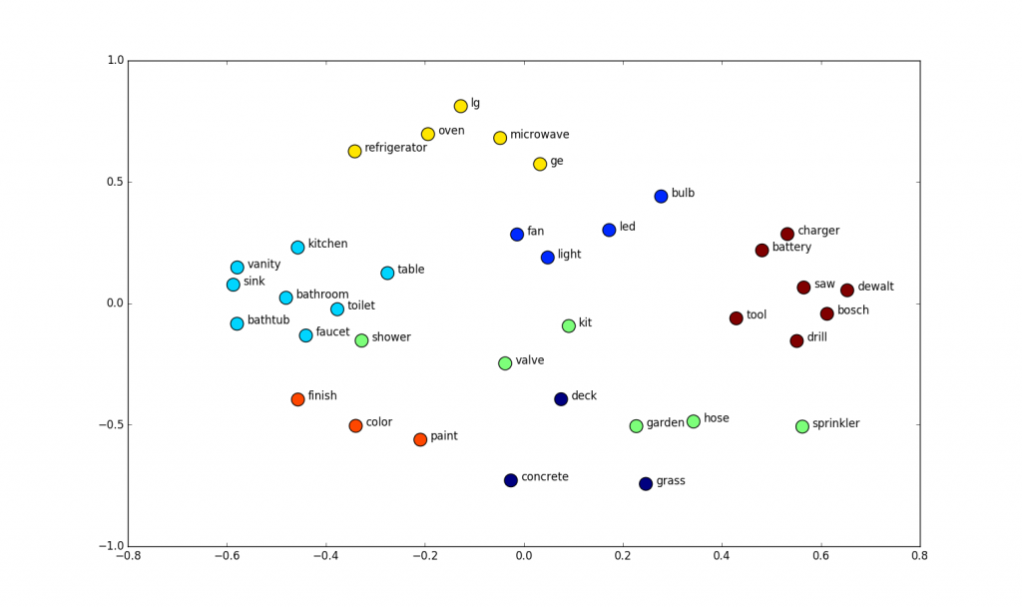
Examples
2D word embedding space
Software for word embedding
Word2vec (by Google);
GloVe (by Stanford University);
fastText (by Facebook);
Gensim.
Sourse: suriyadeepan.github.io/

Slide 6

Data
“KinoPoisk.ru” webpage;
From reviews to top-250 movies – collected 100 positive reviews.
From reviews to bottom-250 movies – collected 100 negative reviews.
Saved as text files.

Slide 7
algorithm

Slide 8

Steps
Create corpora for Russian text;
Lemmatize words (process of determining the lemma of a word based on its intended meaning);
Encode each lemma as one-hot vector;
Train Neural Network to predict words from the context;
From NN take the transition weights from the input layer to the hidden layer, this will be embedding.

Slide 9

1. Corpora
Take Russian reviews data.
Preprocess data:
Delete punctuation;
Delete numbers;
Delete special symbols;
Lowercase letters.

Slide 10

2. Lemmatization
Lemmatization is the algorithmic process of determining the lemma of a word based on its intended meaning. Lemmatization depends on correctly identifying the intended part of speech and meaning of a word in a sentence, as well as within the larger context surrounding that sentence, such as neighboring sentences or even an entire document.
Take lemmas from preprocessed data.
For Russian text use library “pymorphy2”.

Slide 11
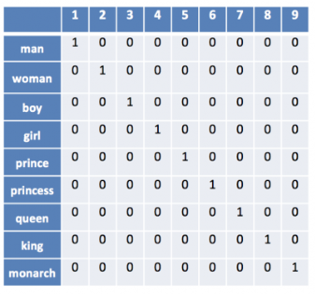
3. Encoding
Encode each lemma as one-hot vector.
Obtain quadratic matrix, size near 17,000 rows and columns.
Sourse: https://www.shanelynn.ie/get-busy-with-word-embeddings-introduction/

Slide 12
4. Neural Network
Train the Neural Network to predict words from the context, considering only the previous word.
There are as many input neurons as there are different lemmas.
One-hot vector is fed to input.
In the hidden layer there are so many neurons, what dimension want to have embedding.
Spoiler: 300 dimensional vectors.

Slide 13
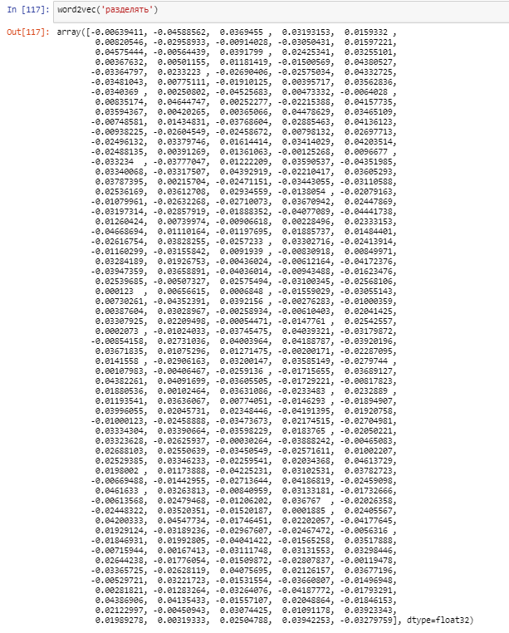
5. Weights
From NN take the transition weights from the input layer to the hidden layer.
This is embedding of input words.

Slide 14
results

Slide 15
Using in classification task
Task: classify review as positive or negative.
Train data: 90% of positive reviews + 90% of negative reviews.
Test data: 10% of positive reviews + 10% of negative reviews.
Model: Logistic Regression.
Test set accuracy: 70%*
* Logistic Regression with Google Word2Vec for the same amount of English review gave 76% test set accuracy.

Slide 16
Thank you for attention!

