Slide 1
Automating tedious tasks with Expect
Steve Wainstead
spawlowski@diligent.com
Sept 19, 2019

Slide 2
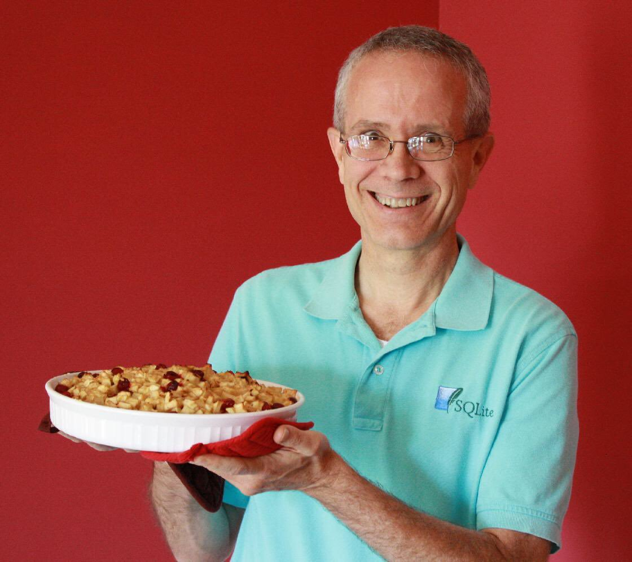

Slide 3
How can I automate more tasks during my work?

Slide 4
How can I automate more tasks during my work?
kubectl
docker
docker-compose
mysql
bash
git
curl
code

Slide 5
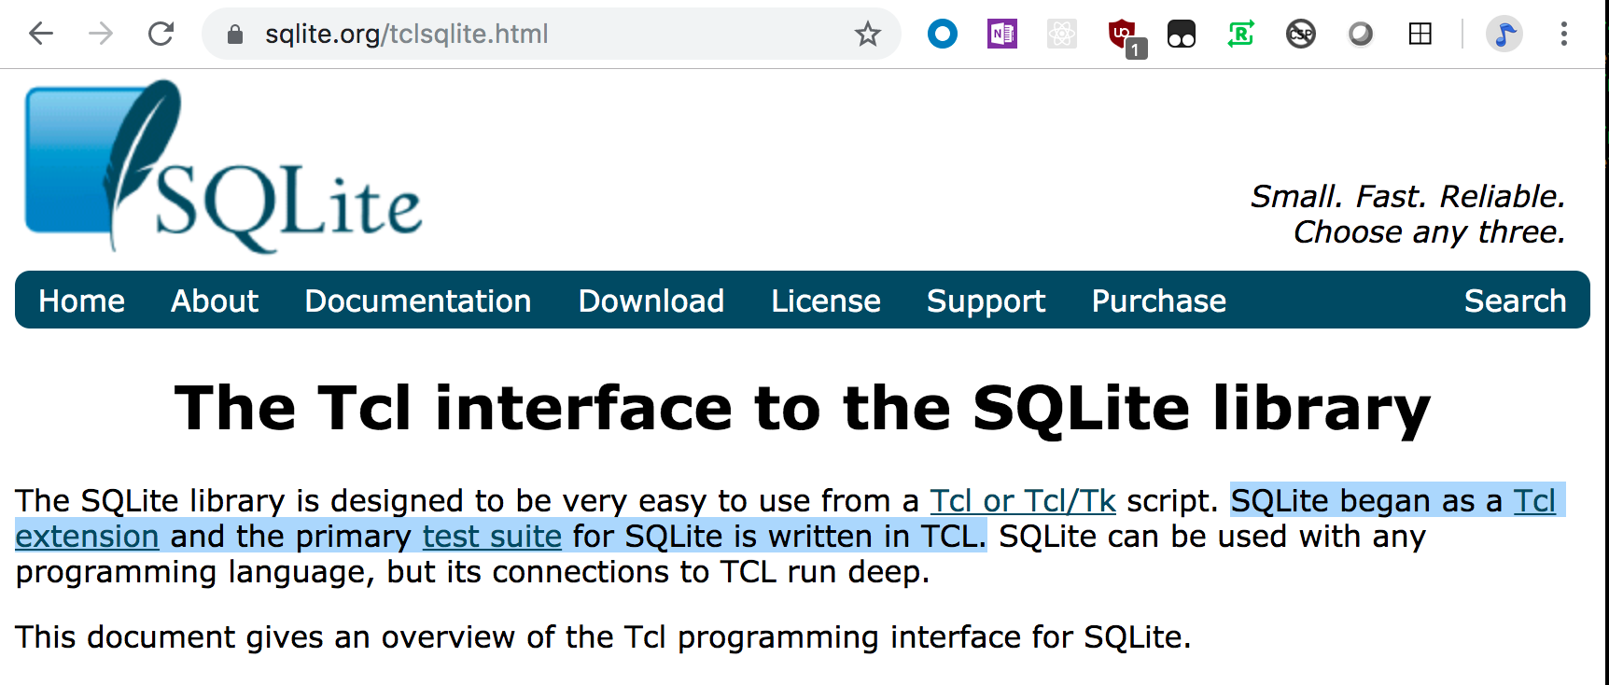

Slide 6
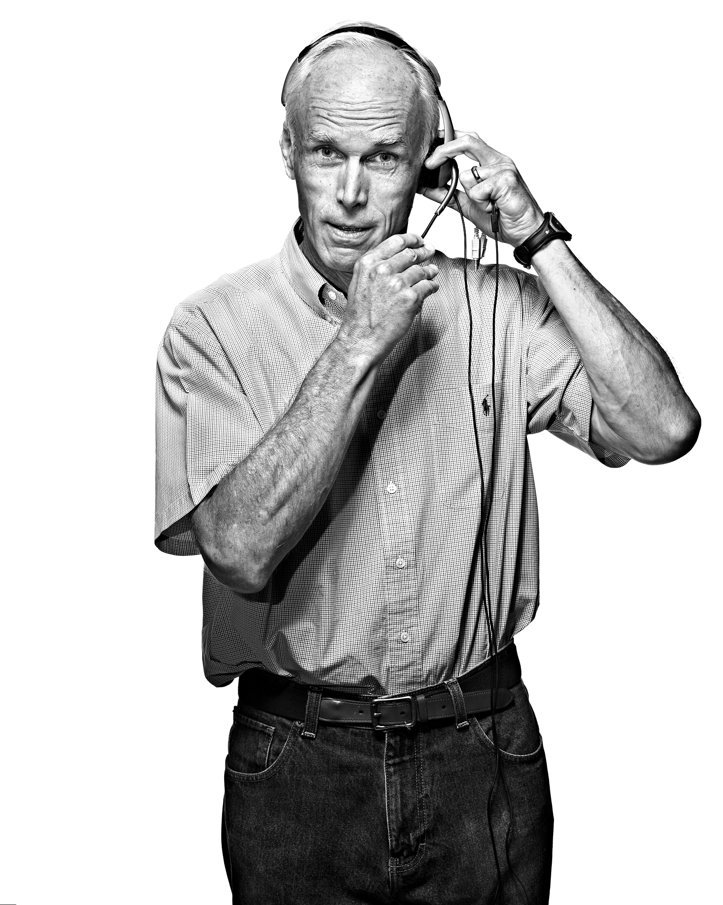

Slide 7
Everything in Tcl is a command.

Slide 8
Tcl has only one data type: the string

Slide 9
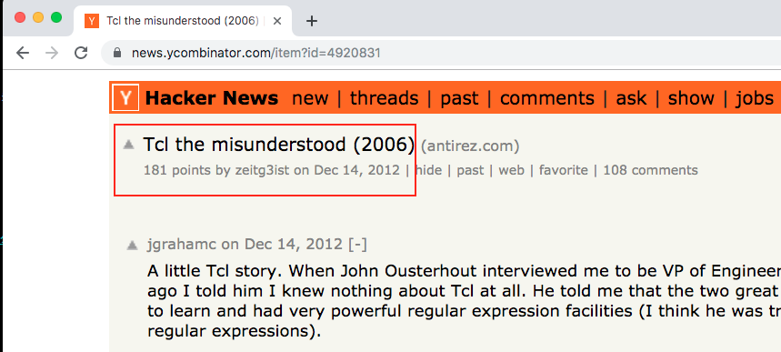
Tcl the Misunderstood

