Slide 1
Module I
Melvin C Jose
ECE Department
VJCET

Slide 2
SYLLABUS
Module 1: Computer Arithmetic and Processor Basics Algorithms for binary multiplication and division. Fixed and floating-point number representation. Functional units of a computer, Von Neumann and Harvard computer architectures, CISC and RISC architectures. Processor Architecture – General internal architecture, Address bus, Data bus, control bus. Register set – status register, accumulator, program counter, stack pointer, general purpose registers. Processor operation – instruction cycle, instruction fetch, instruction decode, instruction execute, timing response, instruction sequencing and execution (basic concepts, data path).
Ref.Book: Subrata Ghoshal, Computer Architecture and Organization: From 8085 to Core2Duo and beyond, Pearson, 2011.

Slide 3
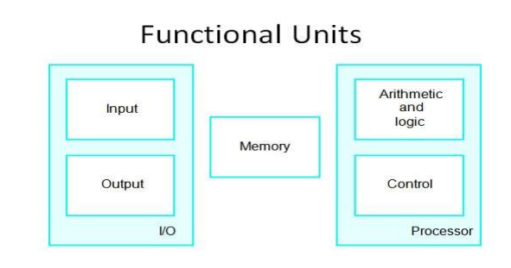
Functional Units of a Computer

Slide 4
Functional Units of a Computer
Computer consists of five main parts namely,
Input unit
Central Processing Unit
Memory unit
Arithmetic & logical unit
Control unit
Output unit

Slide 5
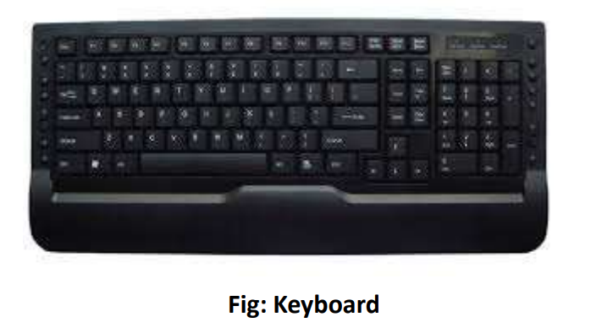
Functional Units of a Computer
Input Unit: Input units are used by a computer,
The most commonly used input devices are, which read the data.

Slide 6
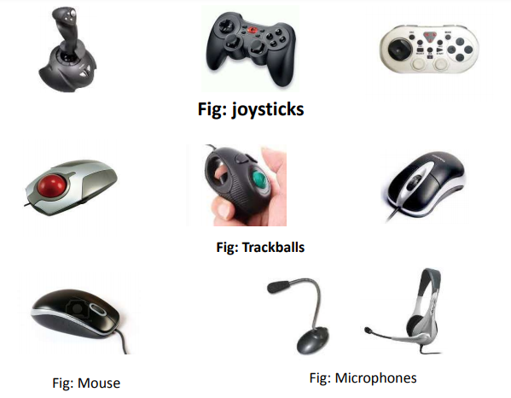
Some of the Input Units

Slide 7
Memory unit
Memory unit is used to store programs and data.
Two types of memory exist. they are,
Primary storage,
and Secondary storage
Primary storage
Primary memory contains a large number of semiconductor storage cells, capable of storing a bit of information.
The bits of information are grouped into fixed size words.
The word length of a computer is between 16-64 bits.
Addresses are used to access the words from memory.
Addresses are numbers that identifies locations.

Slide 8
Memory unit
The memory is know as main memory in which program must resides.
Cache is also a kind of memory which is used to access the data very soon. they are highly coupled with the processor.
Example: RAM,ROM.
Advantages: Small, and Fast
Disadvantages:
less storage capacity
and costly

Slide 9
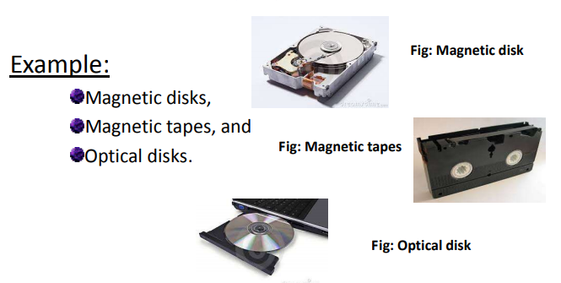
Memory Unit
Secondary storage: Secondary memory are used when large amount of data and programs have to be stored.

Slide 10
Arithmetic and logic unit
Most of all the operations of a computer are executed in the ALU of the processor.
It perform arithmetic operations like addition, subtraction, multiplication, division
Also the logical operations like AND, OR, NOT operations.

Slide 11
Output unit
Output units are used to send the processed results to the user.
Output devices display information in a way that you can understand. The most common output device is a monitor.
Output devices are pieces of equipment that are used to get information or any other response out from computer. These devices display information that has been held or generated within a computer.

Slide 12
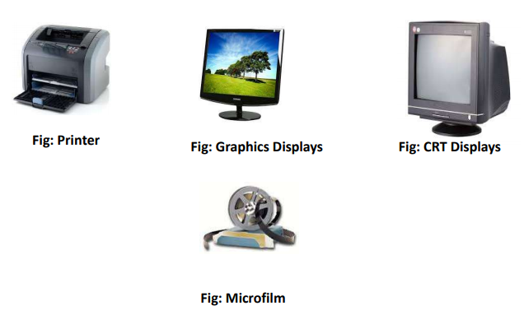
Some of the output units are

Slide 13
Control unit
Control unit is used to coordinate the operations of the input, output, memory, ALU in some way. It coordinates the operation of all the units using control signals like timing signals.
Timing signals are the signals determining the time when a given action must take place. A large set of control lines carriers the signals used for timing and synchronization of events in all units.

Slide 14
Von Neumaan and Harvard Computer
The embedded hardware primarily includes
The processor
memory
bus
peripheral devices
I/O ports
and various controllers
The embedded software usually contains ,
The embedded operating system
Various applications.

Slide 15
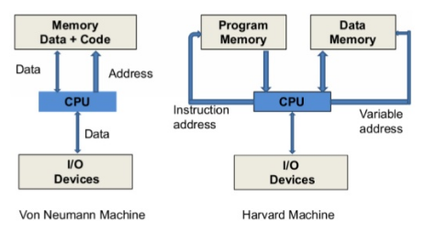
Von Neumaan and Harvard Computer
There are basically two types of architecture that apply to embedded systems : Von Neumann architecture and Harvard architecture.

Slide 16
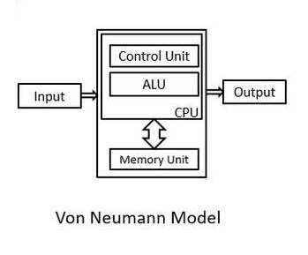
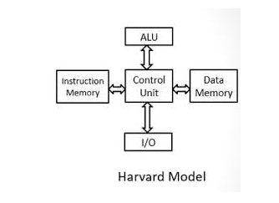
Von Neumaan and Harvard Computer

Slide 17
Von Neumaan and Harvard Computer
Von Neumann Architecture: In a Von-Neumann architecture, the same memory and bus are used to store both data and instructions that run the program. Since you cannot access program memory and data memory simultaneously, the Von Neumann architecture is susceptible to bottlenecks and system performance is affected.

Slide 18
Von Neumaan and Harvard Computer
Harvard Architecture: Compared with the Von Neumann architecture, a Harvard architecture processor has two outstanding features.
First, instructions and data are stored in two separate memory modules; instructions and data do not coexist in the same module.
Second, two independent buses are used as dedicated communication paths between the CPU and memory; there is no connection between the two buses.

Slide 19
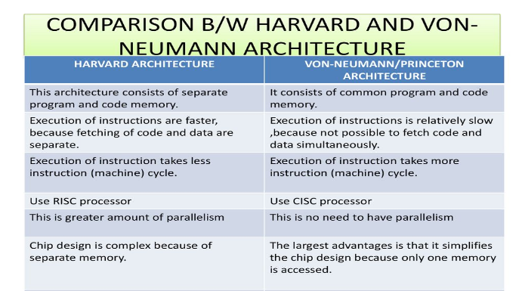
Comparison between Von neumann and Harvard Architecture:

Slide 20
RISC AND CISC
The term RISC stands for ‘’Reduced Instruction Set Computer’’.
It is a CPU design plan based on simple orders and acts fast. This is small or reduced set of instructions.
Here, every instruction is expected to attain very small jobs.
In this machine, the instruction sets are modest and simple, which help in comprising more complex commands.
Each instruction is about the similar length; these are wound together to get compound tasks done in a single operation.
Most commands are completed in one machine cycle. This pipelining is a crucial technique used to speed up RISC machines.

Slide 21
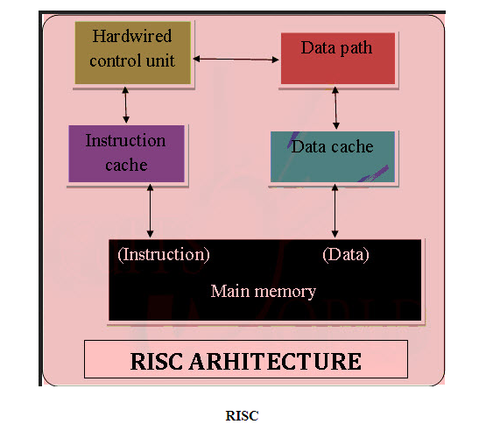
RISC

Slide 22
CISC
The term CISC stands for ‘’Complex Instruction Set Computer’’.
It is a CPU design plan based on single commands, which are skilled in executing multi-step operations.
CISC computers have small programs
.It has a huge number of compound instructions, which takes a long time to perform.
Here, a single set of instruction is protected in several steps; each instruction set has additional than 300 separate instructions.
Maximum instructions are finished in two to ten machine cycles.

Slide 23
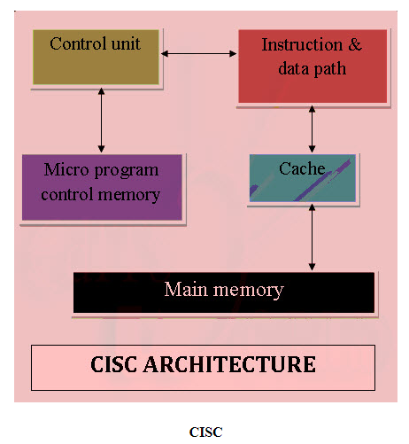
CISC

Slide 24
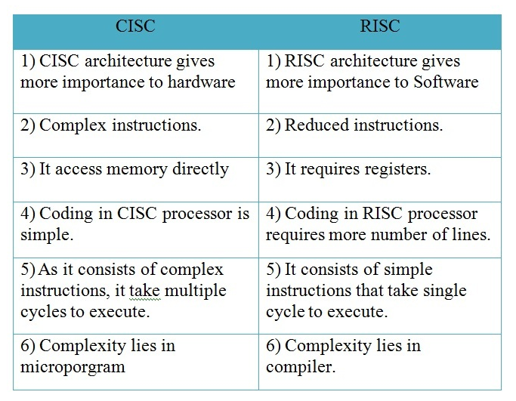
Comparison between RISC and CISC:

Slide 25
Microprocessor and Microcontroller
Microprocessor: Microprocessor is a silicon-based integrated chip with only a central processing unit. It’s the heart of a computer system which is designed to perform loads of tasks that involve data. Microprocessors don’t have RAM, ROM, IO pins, Timers, and other peripherals on the chip. They are to be added externally to make them functional. It consists of the ALU which handles all the arithmetic and logical operations; the Control Unit which manages and handles the flow of instructions throughout the system; and Register Array which stores the data from memory for fast access.
Microcontroller: Microcontroller is like a mini computer with a CPU along with RAM, ROM, serial ports, timers, and IO peripherals all embedded on a single chip. t’s designed to perform application specific tasks that require a certain degree of control such as a TV remote, LED display panel, smart watches, vehicles, traffic light control, temperature control, etc. It’s a high-end device with a microprocessor, memory, and input/output ports all on a single chip. It’s the brains of a computer system which contains enough circuitry to perform specific functions without external memory.

Slide 26
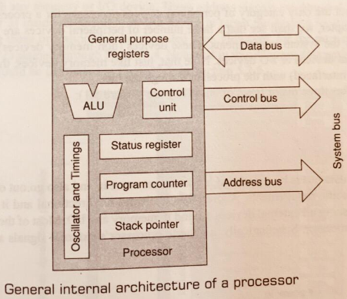
Processor Architecture

Slide 27
Processor Architecture
The Arithmetic/Logic Unit (ALU) : Performs all the arithmetic and logical operations
Set of general purpose register: for various storage and operations while it is being manipulated.
Status Register : Accommodates the status of the different arithmetic and logical operation, Normally used for conditional branching (flags)
Program Counter (Sequencing):
This is a register that is used to control the sequencing of the execution of instructions. This register always holds the address of the instruction to be executed next.

Slide 28
Processor Architecture
The Stack pointer
The stack pointer is used to point into memory. The memory this register points to is a special area called the stack. The stack is an area of memory used to hold data that will be retrieved soon. The stack is usually accessed in a Last in First out (LIFO) fashion.
The Control Unit: Generating all the control signals for general working of the processor
Oscillator and timing module (internal clock),Reset

Slide 29
System Bus
Wires connecting memory & I/O peripherals to microprocessor
Address Bus( uni-directional)
Data Bus( Bi-directional)
Control Bus( most of the signals moves out of the processor)

Slide 30
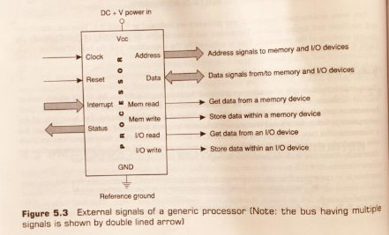
External Signals for Generic Processors
The purpose of these signals are to execute any program

Slide 31
Address Bus and Addressing
Identifying peripheral(I/O) or memory location
Number of address lines indicates its maximum memory Size handling capability
If n is address lines then 2^{n} Address is possible

Slide 32
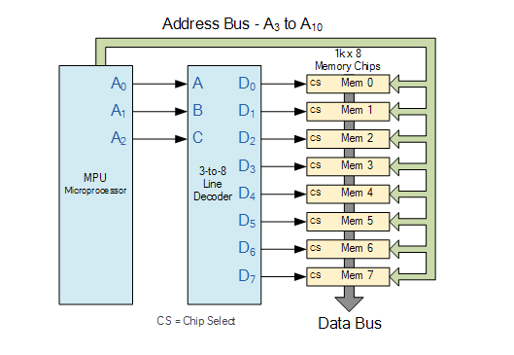
Address Bus and Addressing

Slide 33
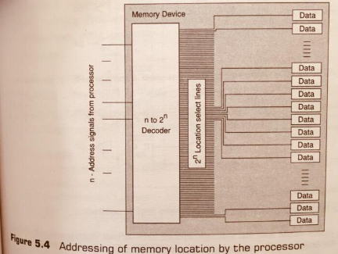
Address Bus and Addressing

Slide 34
Data Bus and Data Flow Control
Width of data bus indicates simultaneous handling capability of the maximum number of bits
Reading from or writing into the device (memory or I/O),it is done with the help of control signals (read or write)

Slide 35
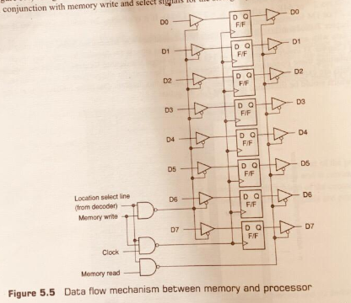
Data Bus and Data Flow Control

Slide 36
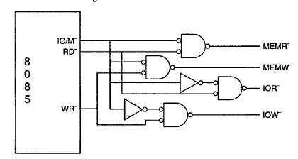
Generation of Control Signals

Slide 37
External Signals
Status Signals
External and Internal Interrupts
Power Supply and Clock Frequency
V_{CC}: +5 V power supply
V_{ss}: Ground Reference
X₁, X2: A crystal (or RC, LC network) is connected at these two pins. The frequency is internally divided by two; therefore, to operate a system at 3 MHz, the crystal should have a frequency of 6 MHz
CLK (OUT) - Clock output: This signal can be used as the system clock for other devices.

Slide 38
The register in the processor perform two roles
User-visible register: Enable the machine- or assembly language programmer to minimize main memory references by optimizing use of registers.
Control and status registers: Used by the control unit to control the operation of the processor and by privileged, operating system programs to control the execution of programs.

Slide 39
User-visible Registers
CATEGORIES
General Purpose
Data
Address
PSW

Slide 40
Register Set
Internal Operation- need internal registers-to store some temporary information or operands
All registers are combination of flip-flops
Registers are accessible and some are not accessible by programmer
Accessing memory is too time consuming
More registers-complexity in instruction decoding.
Separate instruction set required for separate register

Slide 41
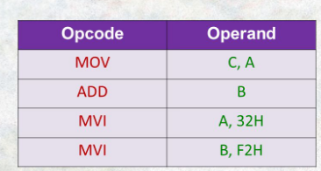
General Purpose Registers
General Purpose Registers can be assigned to a variety of functions by the programmer
Mostly these registers contain the operand for any opcode.
In some cases these are used for addressing purpose.

Slide 42
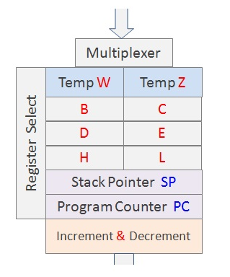
General Purpose Registers

Slide 43
Commonly used Registers
Accumulator or result register
Status register
Stack pointer
Program counter
Some of these registers are temporary registers

Slide 44
Data Registers
Data Register to hold data (result) and cannot be employed in the calculation of an operand address
Eg. Accumulator.

Slide 45
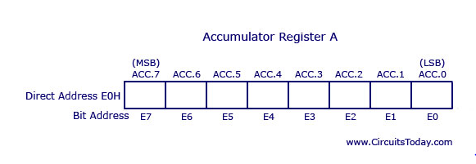
Accumulator or result register

Slide 46
Status registers/Program Status Word
Program status word (PSW) contain status information.
The PSW typically contains condition codes plus other status information.
Sign: Contains the sign bit of the result of the last arithmetic operation.
Zero: Set when the result is 0.
Carry: Set if an operation resulted in a carry (addition) into or borrow (subtraction)out of a high-order bit. Used for multiword arithmetic operations.
Equal: Set if a logical compare result is equality.
Overflow: Used to indicate arithmetic overflow.
Interrupt Enable/Disable: Used to enable or disable interrupts.

Slide 47
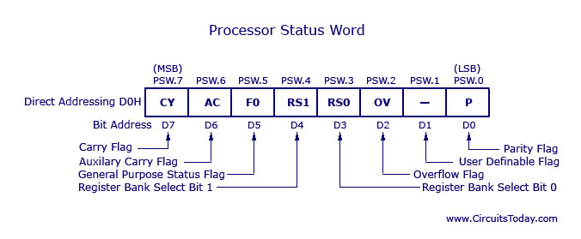
Status register

Slide 48
Program Counter
This register always holds the address of the instruction to be fetched next.
After fetching it is automatically incremented by one to point to the next.
In program branching it is reloaded with address of branch

Slide 49
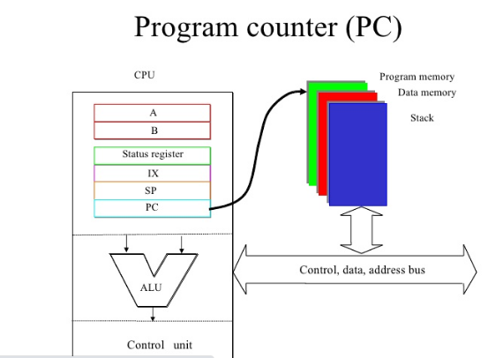

Slide 50
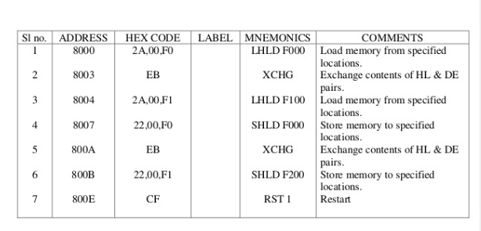
Program Counter

Slide 51
Stack pointer
System stack is a dedicated register in RAM area
It is always point to the top of the stack area.
The stack is an area of memory used to hold data that will be retrieved soon.
The stack is usually accessed in a Last in First out (LIFO) fashion.

Slide 52
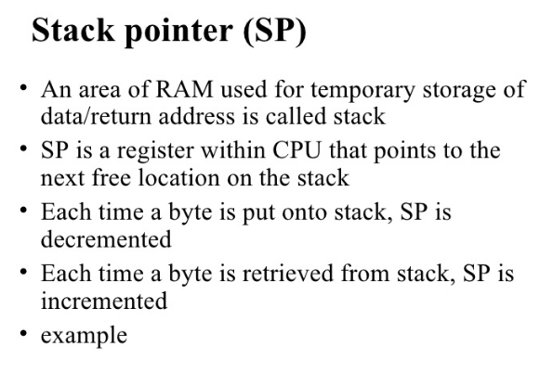

Slide 53
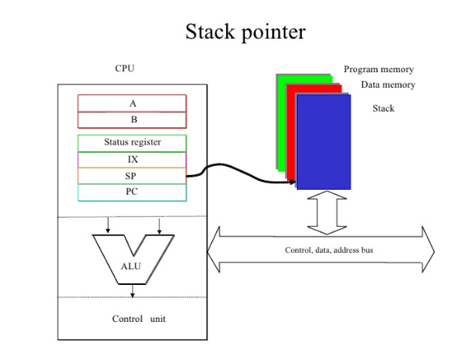
Stack pointer

Slide 54
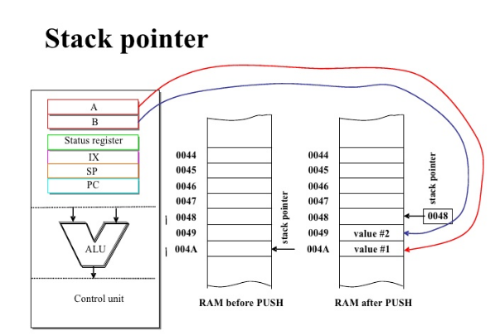

Slide 55
Processor Operation
To execute the programs, it is always in machine code
Instruction Cycle: Combination of Three steps given below to execute the program
Fetch
Decode
Execute

Slide 56
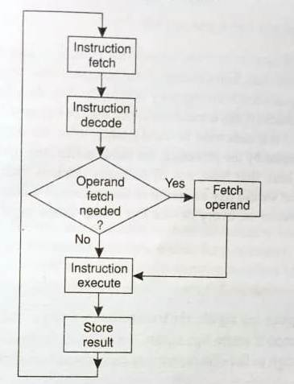
Flowchart for simplified Instruction Cycles

Slide 57
Flowchart for simplified Instruction Cycle
Fetch the opcode (machine code) from program memory
Decoding it using decoder logic
If necessary fetch Operands from memory
Then instruction is execute
Result of the instruction is stored
Whole cycle is repeated

Slide 58
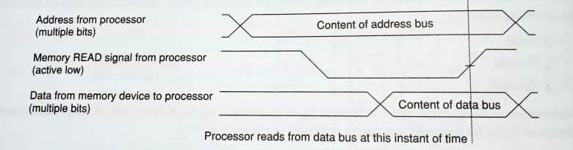
Timing Diagram for Instruction Fetch

Slide 59
Instruction Fetch
Fetch the instruction Bytes from External Memory
Point the correct location(Unique binary address) of the target Bytes
Decode the address (Memory decoding)
Read signals (RD) from control unit
Low to high RD signal place the data(Stable at that time) in data bus
So, the content of that address are available for the Processor

Slide 60
Instruction Decode
The fetched instruction code (machine code) decoding (hardware/ software) is happening next
The processor will understand the action to be done
If action required operands its fetched from memory or register
Note: Instruction Decoding through software is known as micro programming

Slide 61
Instruction Execute
Here the identified action got executed with the support of operands
The processor is looks for next instruction and continue the process

Slide 62
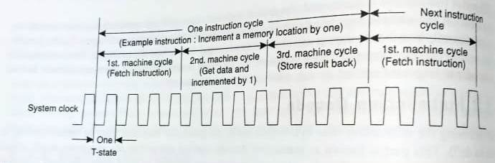
Instruction Cycle ,Machine Cycle, T-State

Slide 63
Machine cycle and T-states
Several T-states One machine cycle
Several Machine cycle Instruction Cycle
T-state = Clock of the processor
E.g.: For 8085 4 to6 T-states for one machine
cycle

Slide 64
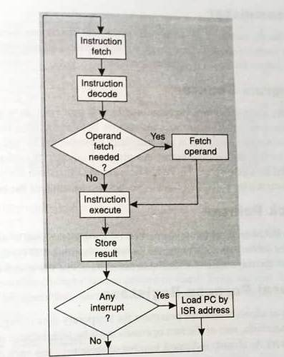
Modified Flowchart for simplified Instruction Cycles

