Slide 1

Data Transposition of the Kasumi Block Cipher on the IXP Processor
09/22/2004
Presented at Intel Corp., Hudson, MA.
IXA University Summit
Berk Sunar
CRIS Laboratory
http://crypto.wpi.edu/
Worcester Polytechnic Institute

Slide 2

Our Collaboration with Intel
Crypto support for IXP 2400/2800 architecture (IPSec, SSL)
Efficiency of crypto algorithms is critical for packet processing
3 year research/development plan
  Secret key (Block Ciphers, Hash functions)
  Public key (RSA, D-H, ECC)
Preliminary work on Kasumi block cipher

Slide 3
Kasumi
Developed by Mitsubishi Corp. for 3G GSM networks ‘99
Based on Matsui’s Misty-1 block cipher ‘97
64-bit Block cipher 128-bit key
8 round Feistel network (cf. DES)
Design criteria
  provable robustness against linear and differential cryptanalysis
  ‘Optimized’ for low-complexity hardware implementation
Well studied overall design

Slide 4
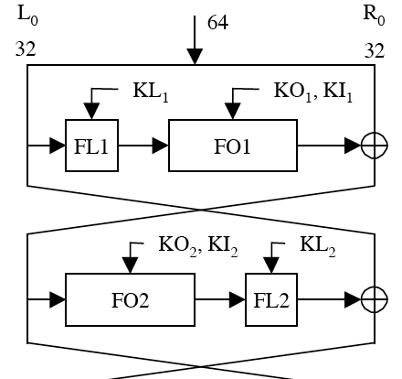
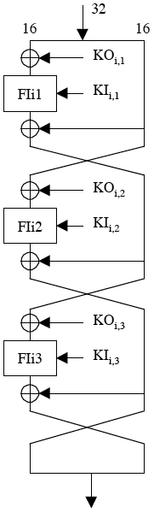
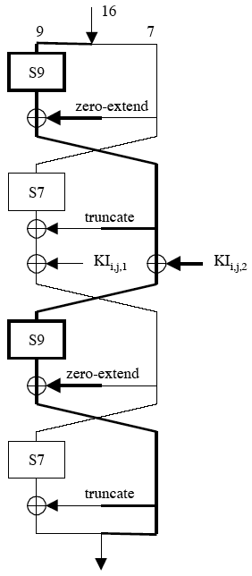
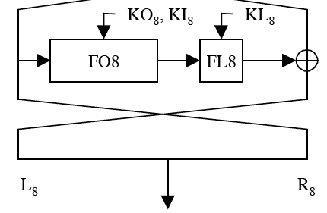
The Kasumi Block Cipher
.
.
.
.
.
.
8-round Kasumi network FO function Fli function

Slide 5
S7-Gate Logic
y0=x1x3+x4+x0x1x4+x5+x2x5+x3x4x5+x6+x0x6+x1x6+x3x6+x2x4x6+x1x5x6+x4x5x6
y1=x0x1+x0x4+x2x4+x5+x1x2x5+x0x3x5+x6+x0x2x6+x3x6+x4x5x6+1
y2=x0+x0x3+x2x3+x1x2x4+x0x3x4+x1x5+x0x2x5+x0x6+x0x1x6+x2x6+x4x6+1
y3=x1+x0x1x2+x1x4+x3x4+x0x5+x0x1x5+x2x3x5+x1x4x5+x2x6+x1x3x6
y4=x0x2+x3+x1x3+x1x4+x0x1x4+x2x3x4+x0x5+x1x3x5+x0x4x5+x1x6+x3x6+x0x3x6+x5x6+1
y5=x2+x0x2+x0x3+x1x2x3+x0x2x4+x0x5+x2x5+x4x5+x1x6+x1x2x6+x0x3x6+x3x4x6+x2x5x6+1
y6=x1x2+x0x1x3+x0x4+x1x5+x3x5+x6+x0x1x6+x2x3x6+x1x4x6+x0x5x6

Slide 6
The Key Schedule
First derive two arrays of 16-bit subkeys
Generate round keys using rotations shown below
K = K1 || K2 || K3 ||…|| K8. Divide the 128-bit key into 8 16-bit keys
Kj’=Kj XOR Cj , for j=0 to 8
round 1 2 3 4 5 6 7 8
KL_{i,1} K1<<<1 K2<<<1 K3<<<1 K4<<<1 K5<<<1 K6<<<1 K7<<<1 K8<<<1
KL_{i,2} K3 K4 K5 K6 K7 K8 K1 K2
KO_{i,1} K2<<<5 K3<<<5 K4<<<5 K5<<<5 K6<<<5 K7<<<5 K8<<<5 K1<<<5
KO_{i,2} K6<<<8 K7<<<8 K8<<<8 K1<<<8 K2<<<8 K3<<<8 K4<<<8 K5<<<8
KO_{i,3} K7<<<13 K8<<<13 K1<<<13 K2<<<13 K3<<<13 K4<<<13 K5<<<13 K6<<<13
KI_{i,1} K5’ K6’ K7’ K8’ K1’ K2’ K3’ K4’
KI_{i,2} K4 ‘ K5’ K6’ K7’ K8’ K1’ K2’ K3’
KI_{i,3} K8 ‘ K1’ K2’ K3’ K4’ K5’ K6’ K7’

Slide 7
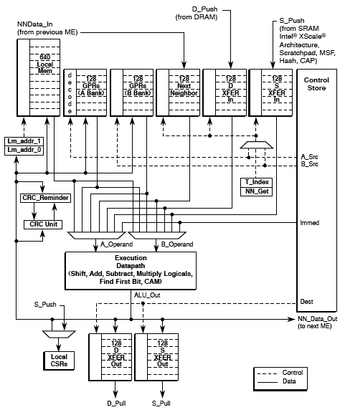
IXP µEngine
Source: Intel Corp.
See reference 4.

Slide 8
Implementation on IXP
Goal: Run efficiently (high throughput) on one µEngine
Optimization of S-box ops is critical, use lookup tables.
Memory accesses to SRAM and DRAM are expensive (high latency)
The IXP architecture provides up to 256 General Purpose Registers
Local memory helps to avoid latency
Need memory optimization

Slide 9
Memory Optimization
Optimized to hint compiler to use registers and local memory
  Lookup tables -> local memory
  Variables -> GPRs
Original code: 3.5 Mbits/sec.
Optimized code: 31 Mbits/sec.
Further optimization still possible!
  Assembly optimization of critical sections
  Marginal speedup expected

Slide 10
A Completely Different Approach
Some observations:
  Kasumi S-box’s are bit-oriented
  Usually table-lookup is used to speed up operations
  Still costly; need storage and possibly memory accesses
  Low throughput: only one 64-bit block is encrypted every 8 rounds

Slide 11
Parallelization
Idea:
  Modify algorithm to process bits of (up to) 32 input blocks in parallel.
New Approach:
  Transpose 32 input blocks (64-bits) into words that contain one bit of each block, all with same significance.
  Modify algorithm to process words instead of bits. Eliminates need for table lookup!
  Modify key schedule.

Slide 12
Data Transposition
Needed at the very beginning and end of the encryption
Easy to visualize:
31 … 2 1 0
Data 0
Data 1
Data 2
.
.
.
.
.
.
Data 31
Slice 2
Slice 0

Slide 13
Implementing Transposition
Efficient recursive algorithm
  Divide the data block into 4 quadrants
  Swap the diagonal (masking & shifting)
  Repeat recursively on the quadrants
Step 1
Step 2
31 … 2 1 0
31 … 2 1 0
Data 0
Data 0
2
1
3
4
Data 31
Data 31

Slide 14
S-box’es & Key Schedule
S-box’s are implemented as word operations acting on 32-input bits in parallel
  No table lookup!
Zero extensions and truncations are no longer needed (zero words, discarded words)
Shifts and rotates in Fl and the key schedule are now simple word reassignments
  In practice no need for moving data around
  simply read from the correct word

Slide 15
S7-Gate Logic
y0=x1x3+x4+x0x1x4+x5+x2x5+x3x4x5+x6+x0x6+x1x6+x3x6+x2x4x6+x1x5x6+x4x5x6
y1=x0x1+x0x4+x2x4+x5+x1x2x5+x0x3x5+x6+x0x2x6+x3x6+x4x5x6+1
y2=x0+x0x3+x2x3+x1x2x4+x0x3x4+x1x5+x0x2x5+x0x6+x0x1x6+x2x6+x4x6+1
y3=x1+x0x1x2+x1x4+x3x4+x0x5+x0x1x5+x2x3x5+x1x4x5+x2x6+x1x3x6
y4=x0x2+x3+x1x3+x1x4+x0x1x4+x2x3x4+x0x5+x1x3x5+x0x4x5+x1x6+x3x6+x0x3x6+x5x6+1
y5=x2+x0x2+x0x3+x1x2x3+x0x2x4+x0x5+x2x5+x4x5+x1x6+x1x2x6+x0x3x6+x3x4x6+x2x5x6+1
y6=x1x2+x0x1x3+x0x4+x1x5+x3x5+x6+x0x1x6+x2x3x6+x1x4x6+x0x5x6

Slide 16
The Kasumi Block Cipher
.
.
.
.
.
.
8-round Kasumi network FO function Fl function

Slide 17
Advantages
Costly bit manipulations are now simple permutations of the operands.
Up to 32-fold parallelization of operations.
We can avoid costly pre-computation of the key schedule.
Truncations, zero extensions, rotations are avoided.

Slide 18
Disadvantages
Performance penalty
  through initial and final transformation of input data and key schedules.
S-box substitution tables need to be implemented rather than lookup tables
  Eliminates lookup tables
  But requires more code to implement the logic operations
More memory needed for 32-times data!

Slide 19
Implementation
Proof of concept Pentium implementation on 1.7 Ghz P4.
Regular Kasumi:
  15,400 cycles , 7 Mbits/sec
Transposed Kasumi:
  75,000 cycles, 46.4 Mbits/sec (32 times more data)
Speedup > 6.5 times (incl. transformations)
“Sweet spot” : ≥ 6 sessions.

Slide 20
IXP Implementation
Optimized temporary memory use by rewriting S-box equations.
After many hours of code review and conflict resolution …
Throughput = 128 Mbits/sec
Speedup = 3.2 compared to original Kasumi code.

Slide 21
A Final Note
When feedback mode is employed it becomes impossible to use transposition on single stream
  3GPP integrity and authentication functions (f8 & f9)
We can however encrypt multiple sessions (different data streams),
  a likely scenario on a network processor.
  the sessions do not have to start/end at the same time to make transposition work.

Slide 22
Ongoing Research
Memory optimized IXP implementation of data transposition technique.
Fitting everything into registers and local memory
Compiling the transpose module turned out to be a challenge for the compiler (exp. time algorithm to resolve A/B bank conflicts).
Need to determine the minimum number of sessions for the transposition to be more efficient than the regular technique.

Slide 23
Future Research
Elliptic Curve Schemes.
  Polynomial arithmetic
  NAF, sliding windows, pre-computation based .
Montgomery multiplication.
  Highly serial, use hybrid version.
  Parallelize multiple multiplications
Exponentiation techniques.
  Sliding windows, pre-computation based.
Block Ciphers (Kasumi, AES, DES).
  Unified lookup tables, parallelization.
Hash algorithms (SHA-1, MD5).

Slide 24
References
ETSI/SAGE Specification. Specification of the 3GPP confidentiality and integrity algorithms; part 2: KASUMI specification , number 35.202, European Telecommunications Standards Institute, Sophia-Antipolis Cedex, France, November, 1999.
Mitsuru Matsui. New block encryption algorithm MISTY Fast Software Encryption, 4th International Workshop, FSE '97, Haifa, Israel, January 20-22, 1997, Proceedings In Eli Biham, editors, Lecture Notes in Computer Science, volume 1267, Springer-Verlag, Berlin, pages 54--68, January, 1997.
Junko Nakajima and Mitsuru Matsui. Fast software implementations of MISTY1 on alpha processors , IEICE Transactions on Fundamentals of Electronics, Communications and Computer Sciences, volume E82-A, number 1, pages 107--116, January, 1999.
Intel® IXP 2400/IXP 2800 Network Processors, Microengine C Language Support Reference Manual, November 2003.

