Slide 1
GSM Security

Slide 2
GSM Security Provisions
Anonymity
Authentication
Signaling protection
User data protection

Slide 3
Anonymity
Use of temporary Ids
Use IMSI for initial authentication
VLR generates a TMSI for the user
Use the K_{c} to encrypt TMSI

Slide 4
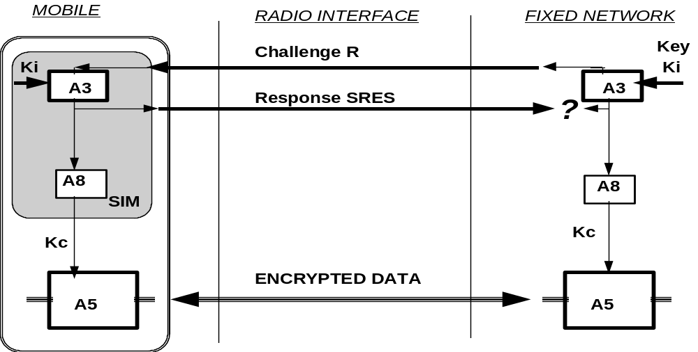
Authentication

Slide 5
GSM Triplets
Authentication while roaming
  Without passing the Ki
AuC generates (Rand, XRES, Kc) triplets
Passes to VLR

Slide 6
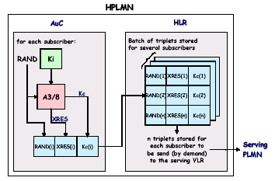
Triplets (cont’d)

Slide 7
Attacks on GSM Security
Microwave links
SIM/ME interface
Attacks on A3/8, A5/1
  Through air interface
  With possession of ME
Attacks on SIM card
  Optical fault induction
  Partitioning attacks (IBM)
    Ki can be extracted with <1000 tries

Slide 8
Attacks (cont’d)
False base station
  GSM does unilateral authentication
DoS
  Jamming the signal
  Preventing the MS from communicating

Slide 9
3GPP
Built on GSM
Two way authentication
Better algorithms
  KASUMI
Protection of network signaling

Slide 10
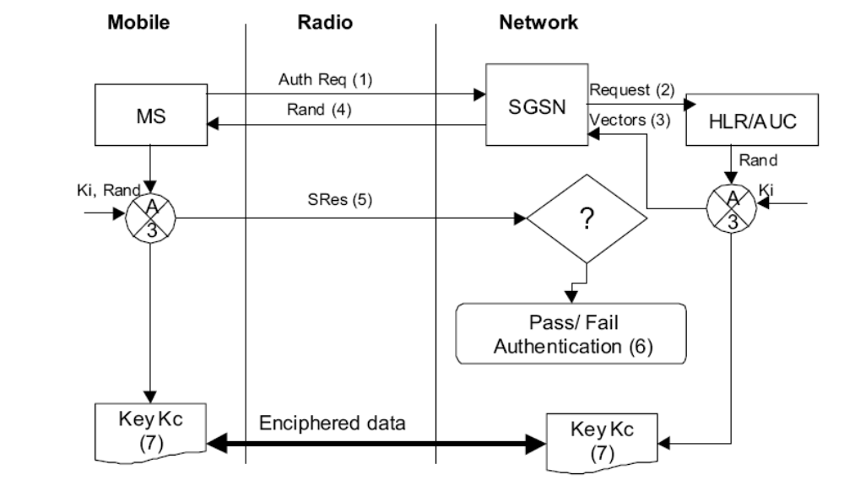
GRPS Security

