Slide 1
V-IRAM Register File
Iakovos Mavroidis
iakovos@cs.berkeley.edu
January 9, 2001

Slide 2
Block Diagram
eight select signals
8x3
Bank0
eight external
read addresses
external
to
internal
mapping
four read addresses
64-bit word
4x7
64-bit word
8x7
four read addresses
128
four data-out
buses
4x7
internal
to
external
mapping
eight external
data-out buses
4x64
8x64
three external
write addresses
Bank1
3x7
four data-out
buses
64-bit word
64-bit word
4x64
128
three data-in buses
4-bit mask
3x64
  256 64-bit words with 8-read, 3-write ports
  Area constraints => Split RF to two 128 64-bit words banks.
  clock at 200MHz

Slide 3
Write operation
D
E
C
MEM
ARRAY
address
write
WL
7
enable
128
1
16
16
16
16
data-in
64
mask
4
phi
enable/address
decoder
prech
eval
prech
eval
prech
eval
prech
eval
prech
eval
prech
mask/datain
write
RF
write
RF
write
RF
write
RF
write
RF
mem
write
RF
write
RF
write
RF
Two cycle pipelined write

Slide 4
Read operation
select
3
D
E
C
MEM
ARRAY
address
external
to
internal
mapping
read
WL
7
enable
128
1
64
read BL
decoded select
internal to
external mapping
Data-out
8
64
phi
enable/address/sel
ext2int map and decode
map
dec
prech
map
dec
prech
map
dec
prech
map
dec
prech
map
dec
prech
map
dec
data-out and
int2ext map
prech
rd
map
prech
rd
map
prech
rd
map
prech
rd
map
prech
rd
map
prech
Throughput = 1 cycle, Latency = 1 cycle

Slide 5
Write through
phi
WRITE
en/address
decoder
prech
eval
prech
eval
prech
eval
prech
eval
prech
eval
prech
mask/datain
write
RF
write
RF
write
RF
write
RF
write
RF
RF
write
RF
write
RF
write
RF
READ
enable/address/map
mapping and decode
map
dec
prech
map
dec
prech
map
dec
prech
map
dec
prech
map
dec
prech
map
dec
data-out and mapping
prech
rd
map
prech
rd
map
prech
rd
map
prech
rd
map
prech
rd
map
prech

Slide 6
Floorplan
output regs
input regs
0.05m
MEM
ARRAY 0
8-bit
input
decoders
regs
clock
drivers
0.78m
ext
2int
map
regs
prech read bit lines
routing
regs
int2ext mapping
0.26m
1.92m
prech read bit lines
MEM
ARRAY 1
8-bit
input
decoders
regs
0.78m
input regs
0.05m
output regs
0.11m
0.19m
0.1m
0.61m
1.02m

Slide 7
Mapping of external to internal read ports
0
3
Eight 3-bit decoders
1
3
2
3
read port
mapping
3
3
4
3
5
3
6
3
7
3
8
8
8
8
8
8
8
8
decoded select
signals
0
8
external read
addresses
1
8
2
8
3
8
4
8
5
8
6
8
7
8
0
1
2
3
4
5
6
7
internal read addresses

Slide 8
Dynamic NAND decoder
VDD
VDD
read WL 127
VDD
VDD
rwline126
...
...
...
rwline2
VDD
VDD
rwline1
VDD
VDD
rwline0
gnd
phi
phi
CMOS
2-bit
decoder
CMOS
2-bit
decoder
CMOS
3-bit
decoder
}
Predecoders
enable(prech to gnd)
addr[6:5]
addr[4:3]
addr[2:0]

Slide 9
Decoder Interleaving
precharge to VDD
PMOS
PMOS
NMOS
NMOS
G
F
E
D
C
B
A
G
F
E
D
C
B
A
G
F
E
D
C
B
A
4bit
dec
4bit
dec
8bit
dec
4bit
dec
4bit
dec
8bit
dec
4bit
dec
4bit
dec
8bit
dec
4bit
dec
4bit
dec
8bit
dec
4bit
dec
4bit
dec
8bit
dec
4bit
dec
4bit
dec
8bit
dec
4bit
dec
4bit
dec
8bit
dec

Slide 10
Cell : 4 read/3 write ports
wwl0
wwl1
wwl2
rwl0
rwl1
rwl2
rwl3
rbl2
rbl3
wbl1
wbl0
wbl2
wbl1_
wbl2_
wbl0_
rbl1
rbl0

Slide 11
Precharging of read bit lines
precharge to VM1 (inverter thershold) + s
BL0
BL1
VM2 < VM1
data-out
VM1
phi
vdd

Slide 12
Mapping of internal data-outs to external data-outs
BANK0
port 0
port 1
port 2
port 3
64
64
64
64
read BL’s
64
8
data-out 0
decoded select signals
from external to
internal mapping
64
8
data-out 1
64
8
data-out 2
64
8
data-out 3
64
data-out 4
8
64
data-out 5
8
64
data-out 6
8
64
data-out 7
8
64
64
64
64
read BL’s
port 0
port 1
port 2
port 3
BANK1

Slide 13
Backup slides

Slide 14
Registers
Posedge trigger FF with
output prech to gnd
Posedge trigger FF with
output prech to vdd
phi
phi
phi
out
in
phi
out
in
phi
phi
Negedge trigger FF with
output prech to gnd
Negedge trigger FF with
output prech to vdd
phi
phi
phi
out
in
phi
out
in
phi
phi

Slide 15
Buffers
regs
regs
128bit
decoders
regs
BANK0
ext
2int
map
regs
prech rblines
routing
regs
int2ext mapping
prech rblines
128bit
decoders
regs
BANK1
regs
regs

Slide 16
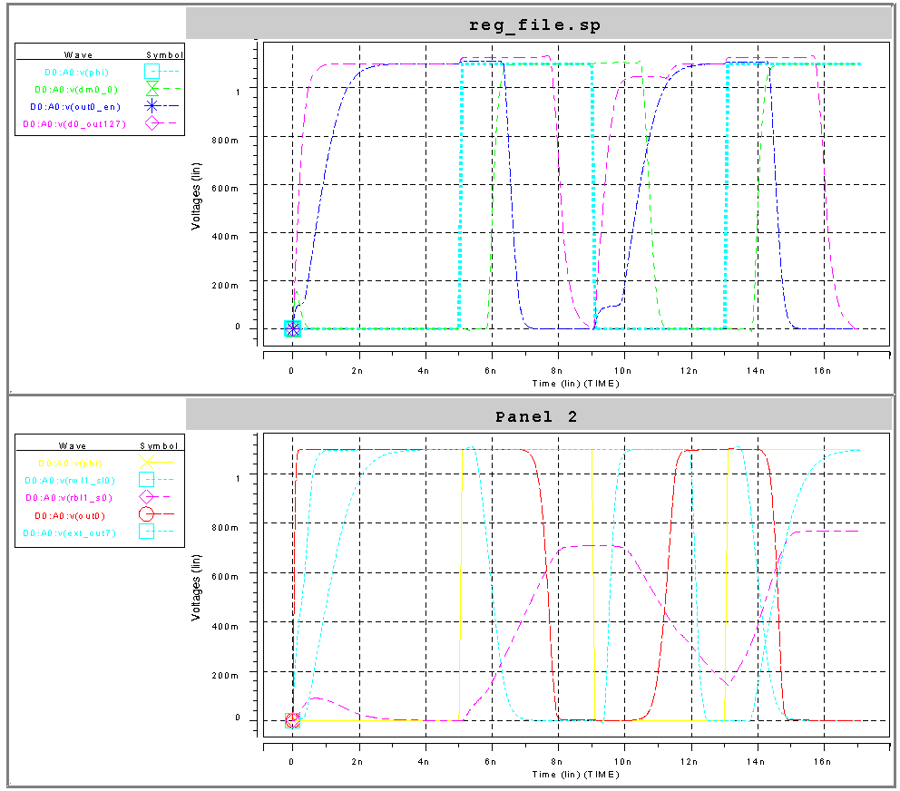
Spice Simulations - read at 1.1 volts

Slide 17
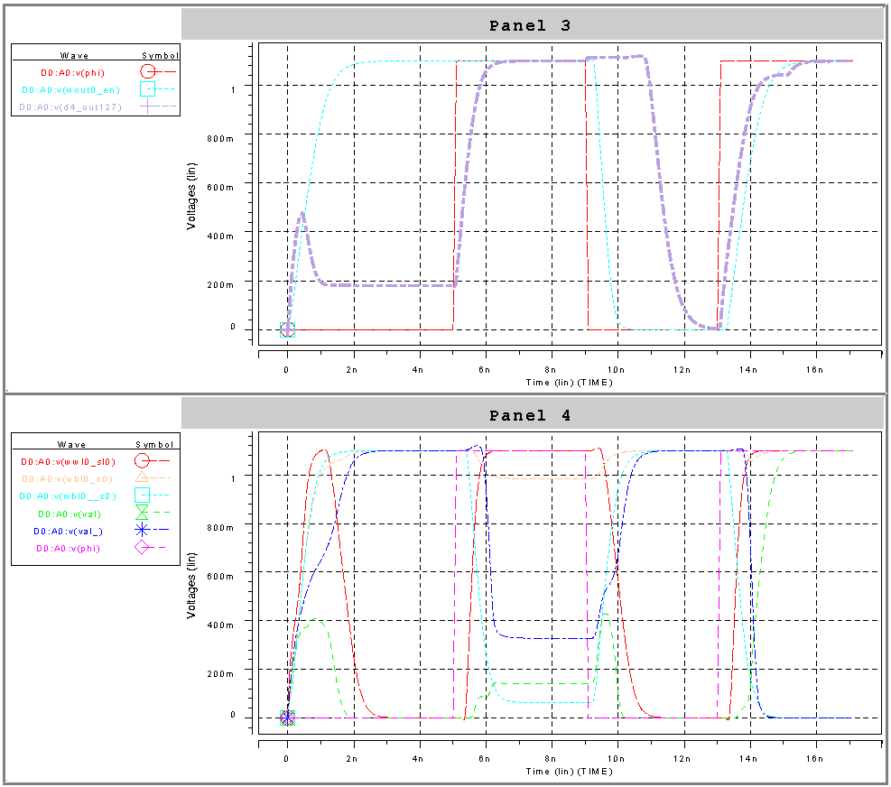
Spice Simulations - write at 1.1 volts

Slide 18
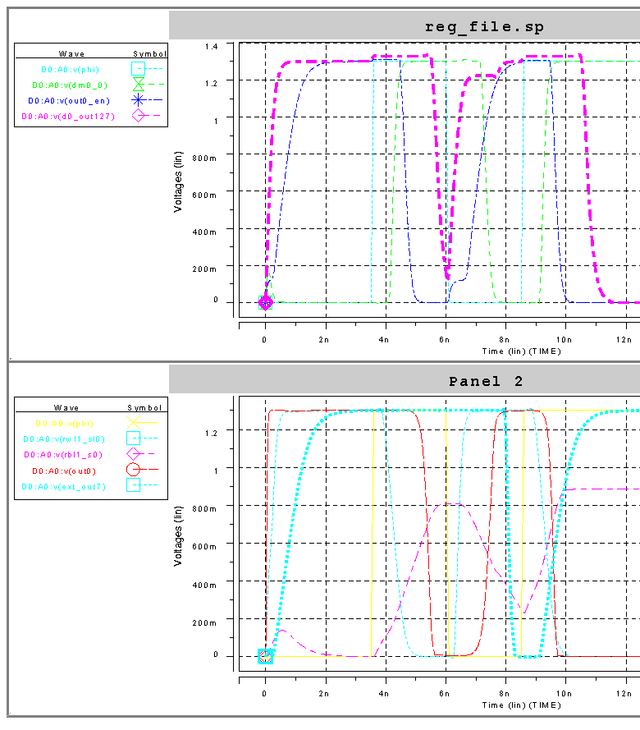
Spice Simulations - read at 1.3 volts

Slide 19
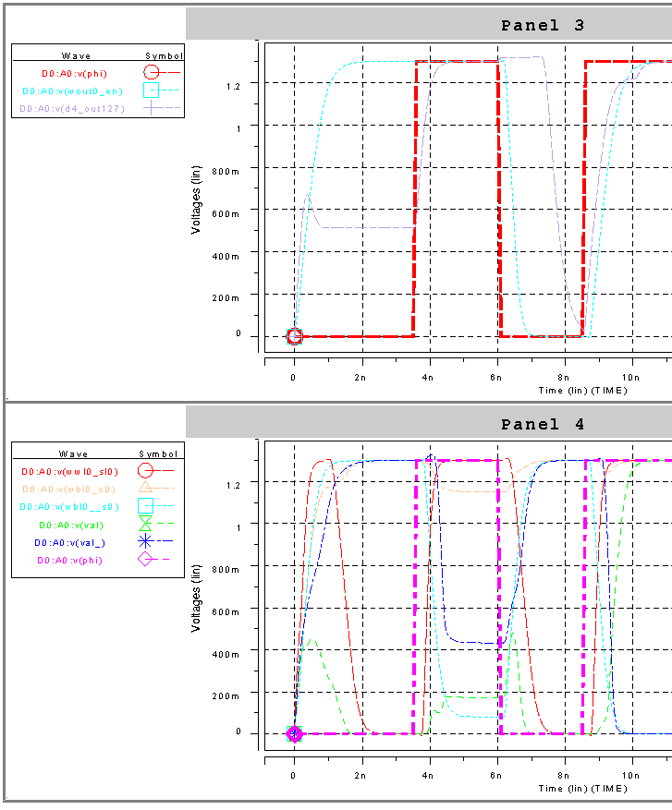
Spice Simulations - write at 1.3 volts

