Slide 1
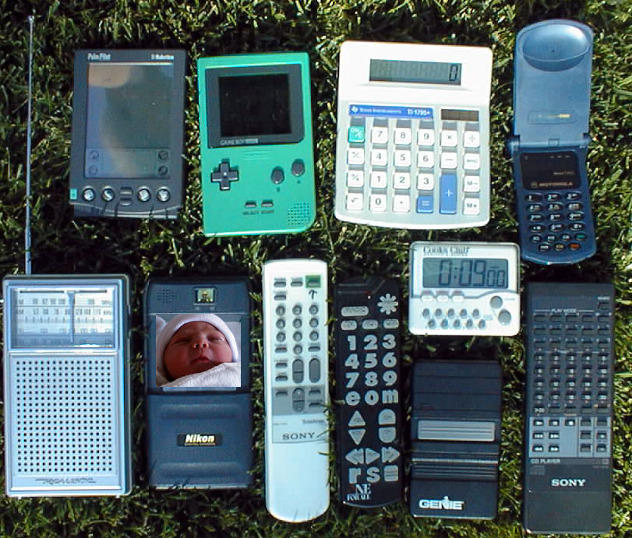
Perspective on Post-PC Era
PostPC Era will be driven
by 2 technologies:
1) Mobile Consumer Devices
  e.g., successor to PDA,
  cell phone,
  wearable computers
2) Infrastructure to Support such Devices
  e.g., successor to Big Fat Web Servers, Database Servers (Yahoo+, Amazon+, …)

Slide 2
PostPC processor applications
Multimedia processing; (“90% of cycles on desktop”)
  image/video processing, voice/pattern recognition, 3D graphics, animation, digital music, encryption
  narrow data types, streaming data, real-time response
Embedded and portable systems
  notebooks, PDAs, digital cameras, cellular phones, pagers, game consoles, set-top boxes
  limited chip count, limited power/energy budget
Significantly different environment from that of workstations and servers
And larger: ‘99 32-bit microprocessor market:
386 million for Embedded, 160 million for PCs

Slide 3
IRAM Overview
A processor architecture for embedded/portable systems running media applications
  Based on media processing and embedded DRAM
  Simple, scalable, and efficient
  Good compiler target
Microprocessor prototype with
  256-bit media processor, 16 MBytes DRAM
  150 million transistors, 290 mm²
  3.2 Gops, 2W at 200 MHz
  Industrial strength compiler
  Implemented by 6 graduate students
Notes:
I will start with what is interesting about Vector IRAM.
This is a prototype microprocessor that integrates a vector unit with 256 bit datapaths with a 16 MByte embedded DRAM memory system. The design uses 150 million transistors and occupies nearly 300 square mm. While operating at just 200 MHz, Vector IRAM achieves 3.2 giga ops and consumes 2 Watts. Vector IRAM also comes with an industrial strength vectorizing compiler for software development.
Vector IRAM is being implemented by a group of only 6 graduate students, responsible for architecture, design, simulation and testing. So, if Patterson and Hennessy decide to introduce performance/watt/man year as major processor metric in the new version of their book, this processor will likely be one of the best in this class.

Slide 4
Architecture Details (1)
MIPS64™ 5Kc core (200 MHz)
  Single-issue core with 6 stage pipeline
  8 KByte, direct-map instruction and data caches
  Single-precision scalar FPU
Vector unit (200 MHz)
  8 KByte register file (32 64b elements per register)
  4 functional units:
    2 arithmetic (1 FP), 2 flag processing
    256b datapaths per functional unit
  Memory unit
    4 address generators for strided/indexed accesses
    2-level TLB structure: 4-ported, 4-entry microTLB and single-ported, 32-entry main TLB
    Pipelined to sustain up to 64 pending memory accesses
Notes:
The vector unit is also connected to the coprocessor interface of the MIPS processor and works at 200 MHz. It includes a multiported 8 Kbyte register file. This allows each of the 32 registers to hold 32 64bit elements or 64 32b elements and so on. The flag register file has capacity of half a Kbyte. There are two functional units for arithmetic operations. Both can executed integer and logical operations, but only one can executed floating-point. There are also 2 flag processing units which provide support for predicated execution and exception handling. Each of the functional units has a 256 bit pipelined datapath. One each cycle, 4 64b operations or 8 32b operations or 16 16b operations can execute in parallel. To simplify the design and reduce area requirements, our prototype does not implement 8b integer operations and double precision arithmetic. All operations excluding divides are fully pipelined.
The vector coprocessor also includes one memory or load/store unit. The LSU can exchange up to 265b per cycle with the memory system and has four address generators for strided and indexed accesses. Address translation is performed in a two level TLB structure. The hardware managed, first level, microTLB has four entries and four ports, while the main TLB has 32 double-page entries and a single access port. The main TLB is managed by software. The memory unit is pipelined and up to 64 independent accesses may be pending at any time.

Slide 5
VIRAM Prototype Architecture
Flag Unit 0
Flag Unit 1
Instr. Cache (8KB)
FPU
Flag Register File (512B)
MIPS64™
5Kc Core
CP IF
Arithmetic
Unit 0
Arithmetic
Unit 1
256b
256b
Vector Register File (8KB)
Data Cache (8KB)
SysAD IF
64b
64b
Memory Unit
TLB
256b
DMA
Memory Crossbar
JTAG IF
JTAG
…
DRAM0
(2MB)
DRAM1
(2MB)
DRAM7
(2MB)
Notes:
We now move to the microarchitecture of our prototype microprocessor. This slide presents the block diagram for Vector IRAM. It consists of three basic blocks: the scalar core, the vector unit and the memory system. The slides in your handout include all the details of the system. I will just highlight some of the most interesting components.
The scalar core of VIRAM is the 5Kc MIPS processor. This is a single issue, 64-bit processor with a six stage pipeline. It includes first level instruction and data caches and a coprocessor interface to which a single precision FPU has been attached. The scalar core operates at 200 MHz and its design has been provided by MIPS Technologies in the form of a sythesizable core.
The vector unit is also connected to the coprocessor interface of the MIPS processor and works at 200 MHz. It includes a multiported 8 Kbyte register file. This allows each vector to hold 32 64bit elements or 64 32b elements and so on. There are two functional units for arithmetic operations. Both can executed integer and logical operations, but only one can executed floating-point. There are also 2 flag processing units which provide support for predicated execution and exception handling. Each of the functional units has a 256 bit pipelined datapath. One each cycle, 4 64b operations or 8 32b operations or 16 16b operations can execute in parallel. To simplify the design and reduce area requirements, our prototype does not implement 8b integer operations and double precision arithmetic. All operations excluding divides are fully pipelined. The vector coprocessor also includes one memory or load/store unit. The LSU can exchange up to 256b per cycle with the memory system and has four address generators for strided and indexed accesses. Address translation is performed in a two level TLB structure. The memory unit is pipelined and up to 64 independent accesses may be pending at any time.
Embedded DRAM is used in Vector IRAM as the main memory for both scalar and vector units. There is not SRAM cache for the vector unit which accesses DRAM directly.The memory system consists of 8 DRAM macro. Each bank has capacity of 2 Mbytes and a 256-bit synchronous interface. Random and page access time for each macro are 25 and 7.5 nsec respectively. Embedded DRAM macros are designed and provided by IBM Microelectronics. The DRAM is connected to the scalar and vector units with a crossbar interconnect. The crossbar has peak bandwidth of 12.8 Gbytes per direction, load or store, and is able to transmit up to 5 independent addresses per cycle.

Slide 6
Architecture Details (2)
Main memory system
  No SRAM cache for the vector unit
  8 2-MByte DRAM macros
    Single bank per macro, 2Kb page size
    256b synchronous, non-multiplexed I/O interface
    25ns random access time, 7.5ns page access time
  Crossbar interconnect
    12.8 GBytes/s peak bandwidth per direction (load/store)
    Up to 5 independent addresses transmitted per cycle
Off-chip interface
  64b SysAD bus to external chip-set (100 MHz)
  2 channel DMA engine
Notes:
Embedded DRAM is used in Vector IRAM as the main memory for both scalar and vector units. There is not SRAM cache for the vector unit which accesses DRAM directly.
The memory system consists of 8 DRAM macro. Each bank has capacity of 2 Mbytes with 2 Kbit pages, and a monolithic bank organization. They interface is synchronous at 200MHz and 256 bits wide. Random and page access time for each macro are 25 and 7.5 nsec respectively. Embedded DRAM macros are designed and provided by IBM Microelectronics. The macros are connected to the scalar and vector units with a crossbar interconnect. The crossbar has peak bandwidth of 12.8 Gbytes per direction, load or store, and is able to transmit up to 5 independent addresses per cycle.
The external interface of vector IRAM is 64b SysAD, the standard bus for MIPS based processors. It operates at 100MHz. A simple 2 channel DMA engine is also included for transferring data between external devices and the on-chip DRAM.

Slide 7
Modular Vector Unit Design
256b
Integer Datapath 0
Integer Datapath 0
Integer Datapath 0
Integer Datapath 0
FP Datapath
FP Datapath
FP Datapath
FP Datapath
Control
Vector Reg.
Elements
Vector Reg.
Elements
Vector Reg.
Elements
Vector Reg.
Elements
Flag Reg. Elements
& Datapaths
Flag Reg. Elements
& Datapaths
Flag Reg. Elements
& Datapaths
Flag Reg. Elements
& Datapaths
Integer Datapath 1
Integer Datapath 1
Integer Datapath 1
Integer Datapath 1
Xbar IF
Xbar IF
Xbar IF
Xbar IF
64b
64b
64b
64b
Single 64b “lane” design replicated 4 times
  Reduces design and testing time
  Provides a simple scaling model (up or down) without major control or datapath redesign
Most instructions require only intra-lane interconnect
  Tolerance to interconnect delay scaling
Notes:
I will now talk about the implementation of Vector IRAM and discuss why it is scalable and modular.
For the heart of the vector unit we have designed a single 64b component we call a “lane”, which we replicated 4 times. A lane includes one 64b datapath from every functional unit and a partition of the vector register file. This partition stores the vector elements to be processed by local datapaths during the execution of a vector instruction. This modular approach significantly simplifies design and testing, as a single simpler component must be implemented. It also provides a simple scaling path for our architecture. Future implementations can provide higher or low performance, power, and area by scaling the number of lanes in the system, without requiring significant datapath or control redesign. One can generate multiple high-end or low-end implementations from a single design database this way.
In addition, Most instructions require only local interconnect within a lane for their execution, a fact that reduces the effect of interconnect delay scaling on this design.
This makes the architecture appropriate for deep submicron processes.

Slide 8
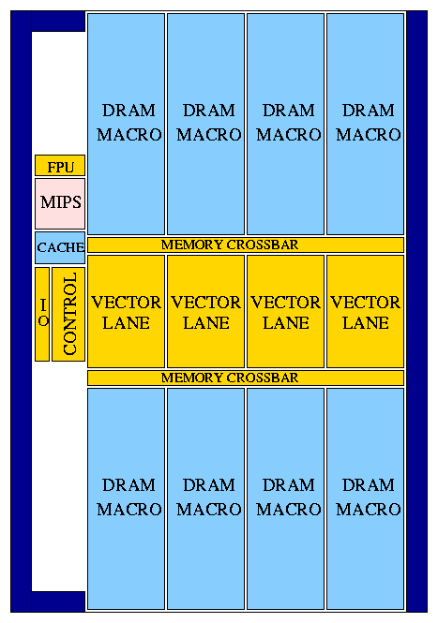
Floorplan
Technology: IBM SA-27E
  0.18μm CMOS
  6 metal layers (copper)
290 mm² die area
  225 mm² for memory/logic
  DRAM: 161 mm²
  Vector lanes: 51 mm²
Transistor count: ~150M
Power supply
  1.2V for logic, 1.8V for DRAM
Peak vector performance
  1.6/3.2/6.4 Gops wo. multiply-add (64b/32b/16b operations)
  3.2/6.4 /12.8 Gops w. multiply-add
  1.6 Gflops (single-precision)
14.5 mm
20.0 mm
Notes:
This figure presents the floorplan of Vector IRAM. It occupies nearly 300 square mm and 150 million transistors in a 0.18um CMOS process by IBM. Blue blocks on the floorplan indicate DRAM macros or compiled SRAM blocks. Golden blocks are those designed at Berkeley. They included synthesized logic for control and the FP datapaths, and full custom logic for register files, integer datapaths and DRAM.
Vector IRAM operates at 200MHz. The power supply is 1.2V for logic and 1.8V for DRAM. The peak performance for the vector unit is 1.6 giga ops for 64bit integer operations. Performance doubles or quadruples for 32 and 16b operations respectively. Peak floating point performance is 1.6 Gflops.
There are several interesting things to notice on the floorplan. First the overall design modularity and scalability. It mostly consists of replicated DRAM macros and vector lanes connected through a crossbar. Another very interesting feature is the percentage of this design directly visible to software. Compilers can control any part of the design that is registers, datapaths or main memory. They do that by scheduling proper arithmetic or load store instructions. The majority of our design is used for main memory, vector registers and datapaths. On the other hand, if you take a look at a processor like Pentium 3, you will see that less than 20% of its are is used for datapaths and registers. The rest is caches and dynamic issue logic. While this usually work for the benefit of applications, they cannot be controlled by compiler and they cannot be turned off when not necessary.

Slide 9
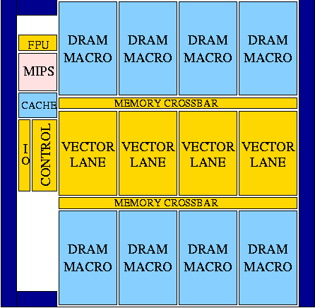
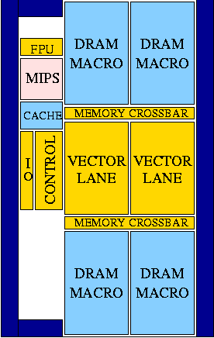
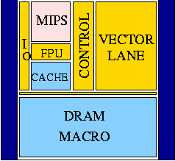
Alternative Floorplans (1)
“VIRAM-8MB”
4 lanes, 8 Mbytes
190 mm²
3.2 Gops at 200 MHz
(32-bit ops)
“VIRAM-2Lanes”
2 lanes, 4 Mbytes
120 mm²
1.6 Gops at 200 MHz
“VIRAM-Lite”
1 lane, 2 Mbytes
60 mm²
0.8 Gops at 200 MHz

Slide 10
Power Consumption
Power saving techniques
  Low power supply for logic (1.2 V)
    Possible because of the low clock rate (200 MHz)
    Wide vector datapaths provide high performance
  Extensive clock gating and datapath disabling
    Utilizing the explicit parallelism information of vector instructions and conditional execution
  Simple, single-issue, in-order pipeline
Typical power consumption: 2.0 W
  MIPS core: 0.5 W
  Vector unit: 1.0 W (min ~0 W)
  DRAM: 0.2 W (min ~0 W)
  Misc.: 0.3 W (min ~0 W)
Notes:
A number of architectural techniques were used to reduce the power consumption of Vector IRAM.
First using the low clock frequency of 200 MHz allowed to use 1.2V for logic power supply and that was the major contribution to power saving. Performance on this chip does not come from high frequency operation but from the use of wide datapaths on which we executed multiple vector element operations in parallel. We also made extensive clock gating and datapath disabling. For that we utilize the explicit parallelism information provided by vector instructions. Each instruction describes the resources it will use for the next few cycles. We also used predicated execution for disabling additional resources and clocks. Finally the simple, in-order nature of the vector unit leads to low power overhead for issue and control logic.
We have estimated the typical power consumption of Vector IRAM to be 2 Watts. About half of that is for the vector unit where the major contributor is the large register file. One quarter goes to the scalar core and another quarter to the DRAM and I/O logic. Note that when not used, most of the components in our design dissipate almost 0 power as they are dynamically turned off.

Slide 11
VIRAM Compiler
Frontends
Optimizer
Code Generators
C
T3D/T3E
Cray’s
PDGCS
C++
C90/T90/SV1
Fortran95
SV2/VIRAM
Based on the Cray’s PDGCS production environment for vector supercomputers
Extensive vectorization and optimization capabilities including outer loop vectorization
No need to use special libraries or variable types for vectorization
Notes:
Apart from the hardware, we have also worked on software development tools. We have a vectorizing compiler with C, C++, and Fortran front-ends. It is based on the production compiler by Cray for its vector supercomputers, which we ported to our architecture. Its has extensive vectorization capabilities including outer-loop vectorization. Using this compiler, vectorize applications written in high level languages without necessarily using optimized libraries or “special” (non-standard) variable types in his application.

Slide 12
The IRAM Team
Hardware:
  Joe Gebis, Christoforos Kozyrakis, Ioannis Mavroidis, Iakovos Mavroidis, Steve Pope, Sam Williams
Software:
  Alan Janin, David Judd, David Martin, Randi Thomas
Advisors:
  David Patterson, Katherine Yelick
Help from:
  IBM Microelectronics, MIPS Technologies, Cray, Avanti

Slide 13
Jim Gray: Trouble-Free Systems
Manager
  Sets goals
  Sets policy
  Sets budget
  System does the rest.
Everyone is a CIO
(Chief Information Officer)
Build a system
  used by millions of people each day
  Administered and managed by a ½ time person.
    On hardware fault, order replacement part
    On overload, order additional equipment
    Upgrade hardware and software automatically.
“What Next?
A dozen remaining IT problems”
Turing Award Lecture,
FCRC,
May 1999
Jim Gray
Microsoft
Notes:
Server systems are more complex. They have some semi-custom applications, they have much heavier load, and often they provide the very services the PDAs, appliances, and desktops depend on. To some extent, the complexity has not disappeared, it has just moved.
But people who own servers are going to own many of them. They do not mind managing the server content, that is their business. But, they do not want to be systems management experts.
So, server systems should be self managing. The human systems manager should set goals, polices and budget. The system should do the rest. It should distribute work among the servers, when new ones arrive, they should just add to the cluster when they are plugged in. When a server fails, its storage will have been replicated somewhere else, so the storage and computation can move to those new locations.
The operational test for this systems is that it serves millions of people each day, and yet it is managed by a fraction of a person who does all the administrative tasks. Currently, such a system would need 24-hour a day coverage by a substantial staff. With special expertise required for upgrades, maintenance, system growth, database administration, backups, network management, and the like.

Slide 14
The real scalability problems: AME
Availability
  systems should continue to meet quality of service goals despite hardware and software failures
Maintainability
  systems should require only minimal ongoing human administration, regardless of scale or complexity: Today, cost of maintenance = 10-100 cost of purchase
Evolutionary Growth
  systems should evolve gracefully in terms of performance, maintainability, and availability as they are grown/upgraded/expanded
These are problems at today’s scales, and will only get worse as systems grow

Slide 15
Principles for achieving AME
No single points of failure, lots of redundancy
Performance robustness is more important than peak performance
Performance can be sacrificed for improvements in AME
  resources should be dedicated to AME
    biological systems > 50% of resources on maintenance
  can make up performance by scaling system
Introspection
  reactive techniques to detect and adapt to failures, workload variations, and system evolution
  proactive techniques to anticipate and avert problems before they happen

Slide 16
ISTORE-1 Brick
Webster’s Dictionary:
“brick: a handy-sized unit of building or paving material typically being rectangular and about 2 1/4 x 3 3/4 x 8 inches”
ISTORE-1 Brick: 2 x 4 x 11 inches (1.3x)
  Single physical form factor, fixed cooling required, compatible network interface to simplify physical maintenance, scaling over time
  Contents should evolve over time: contains most cost effective MPU, DRAM, disk, compatible NI
  If useful, could have special bricks (e.g., DRAM rich)
  Suggests network that will last, evolve: Ethernet

Slide 17
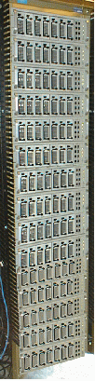
ISTORE-1 hardware platform
80-node x86-based cluster, 1.4TB storage
  cluster nodes are plug-and-play, intelligent, network-attached storage “bricks”
    a single field-replaceable unit to simplify maintenance
  each node is a full x86 PC w/256MB DRAM, 18GB disk
  more CPU than NAS; fewer disks/node than cluster
Intelligent Disk “Brick”
Portable PC CPU: Pentium II/266 + DRAM
Redundant NICs (4 100 Mb/s links)
Diagnostic Processor
ISTORE Chassis
80 nodes, 8 per tray
2 levels of switches
20 100 Mbit/s
2 1 Gbit/s
Environment Monitoring:
UPS, redundant PS,
fans, heat and vibration sensors...
Disk
Half-height canister

Slide 18
ISTORE as
Storage System of the Future
Availability, Maintainability, and Evolutionary growth key challenges for storage systems
  Maintenance Cost ~ >10X Purchase Cost per year,
  Even 2X purchase cost for 1/2 maintenance cost wins
  AME improvement enables even larger systems
ISTORE also cost-performance advantages
  Better space, power/cooling costs ($@colocation site)
  More MIPS, cheaper MIPS, no bus bottlenecks
  Compression reduces network $, encryption protects
  Single interconnect, supports evolution of technology, single network technology to maintain/understand
Match to future software storage services
  Future storage service software target clusters

Slide 19
ISTORE Issues
From last retreat: ISTORE 2 postponed, on the shelf
From last retreat: ISTORE 1 designer, implementer left Berkeley for a startup
Working “a day a week” on ISTORE 1
As a result, much slower progress than we had hoped
Your advice requested

