Slide 1
VIRAM-1 Architecture Update and Status
Christoforos E. Kozyrakis
kozyraki@cs.berkeley.edu
IRAM Retreat
January 2000

Slide 2
Outline
VIRAM-1 architecture overview
Design update
  scalar core
  fixed-point multiply-add model
  floating-point datapath
  FP exceptions model
  vector memory unit
Implementation status

Slide 3
Vector IRAM
Vector processing
  high-performance for media processing
  low power/energy for processor control
  modularity, low complexity
  scalability
  well understood software development
Embedded DRAM
  high bandwidth for vector processing
  low power/energy for memory accesses
  modularity, scalability
  small system size

Slide 4
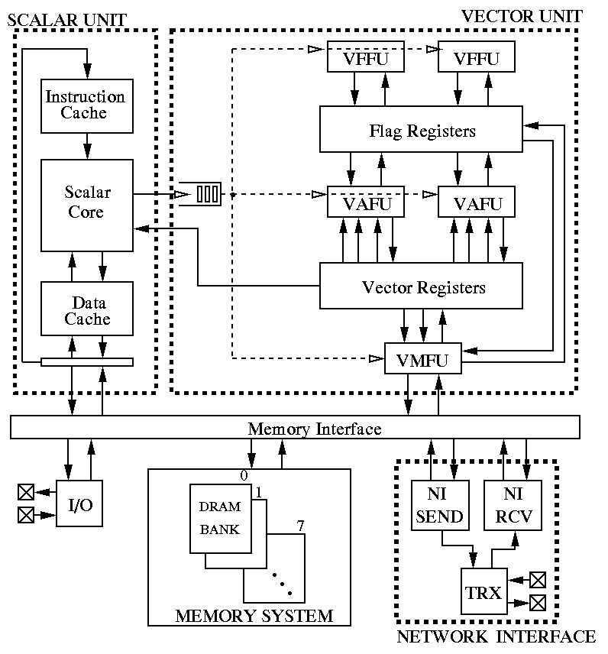
Block Diagram

Slide 5
Design Overview
64b MIPS scalar core
  coprocessor interface
  16KB I/D caches
Vector unit
  8KByte vector register file
  support for 64b, 32b, and 16b data-types
  2 arithmetic (1 FP), 2 flag processing, 1 load-store units
  4 64-bit datapaths per unit
  DRAM latency included in vector pipeline
  4 addresses/cycle for strided/indexed accesses
  2-level TLB
Memory system
  8 2MByte eDRAM banks
  single sub-bank per bank
  256-bit synchronous interface, separate I/O signals
  20ns cycle time, 6.6ns column access
  crossbar interconnect for 12.8 GB/sec per direction
  no caches
Network interface
  user-level message passing
  dedicated DMA engines
  4 100MByte/s links

Slide 6
VIRAM-1 Floorplan
DRAM
Bank
0
DRAM
Bank
2
DRAM
Bank
4
DRAM
Bank
6
N
I
M
I
P
S
Vector
Lane 0
Vector
Lane 1
C
T
L
Vector
Lane 2
Vector
Lane 3
I
O
DRAM
Bank
1
DRAM
Bank
3
DRAM
Bank
5
DRAM
Bank
7

Slide 7
Vector Lanes
64b
Xbar I/F
Xbar I/F
Xbar I/F
Xbar I/F
Integer
Datapath 0
Integer
Datapath 0
Integer
Datapath 0
Integer
Datapath 0
Vector
Registers
Vector
Registers
Vector
Registers
Vector
Registers
Flag Regs.
& Datapath
Flag Regs.
& Datapath
Flag Regs.
& Datapath
Flag Regs.
& Datapath
Control
FP
Datapaths
FP
Datapaths
FP
Datapaths
FP
Datapaths
Integer
Datapath 1
Integer
Datapath 1
Integer
Datapath 1
Integer
Datapath 1
Xbar I/F
Xbar I/F
Xbar I/F
Xbar I/F
256b

Slide 8
Prototype Summary
Technology:
  0.18um eDRAM CMOS process (IBM)
  6 layers of copper interconnect
  1.2V and 1.8V power supply
Memory: 16 MBytes
Clock frequency: 200MHz
Power: 2 W for vector unit and memory
Transistor count: ~140 millions
Peak performance:
  GOPS: 3.2 (64b), 6.4 (32b), 12.8 (16b)
  GFLOPS: 1.6 (32b)

Slide 9
Scalar Core
64b MIPS core
  implements MIPS64 ISA
  6 stage pipeline
  single instruction issue
  16KByte direct-map I/D caches
  coprocessor interfaces for scalar FPU and vector unit
  non-multiplexed memory interface
Synthesizable design provided by MIPS Inc.

Slide 10
Fixed-point Multiply-add
Mul & Shift Right & Round
Add & Sat
z
x
n
n/2
+
sat
w
*
n
n
Shift
y
Round
n
n/2
a
Multiply halves & shift instruction provides support for any fixed-point format
Precision is equal to the datatype width; multiplier’s inputs have half the width
Uniform, simple support for all datatypes

Slide 11
Fixed-point Instructions
Multiply
  multiply lower or upper halves, shift right and round
Add/subtract
  add and saturate
  subtract and saturate
Shift (scale)
  shift right and round
  shift left and saturate
Multiply-add
  all combinations of multiply and add/subtract instructions
Saturate to narrower width
  32b, 16b, 8b

Slide 12
Floating-point Datapath
Support for single-precision FP only
  2 32b datapaths per vector lane
Simple instructions set
  add, sub, mul, div, compare, convert and truncate
  no multiply-add, sqrt, etc.
IEEE compliance
  only one rounding mode supported (NRE)
  imprecise exception for division is rather conservative
Fully pipelined instructions
  3 cycles latency for add/sub/mul/compare/convert
  10 cycles latency for divide, 8 cycles repeat rate
Synthesizable code provided by the RAW group at MIT

Slide 13
FP Exceptions Model
2 execution modes for FP instructions
  set in control register by user
Normal mode
  exceptions for each vector element are noted in flag registers
  an exception is raised at the end of instruction execution
  allows exception detection without performance drop
Precise mode
  following FP instructions are stalled early in the pipeline until execution completes and exceptions are raised
  Performance of precise mode is half (0.8 GFLOPS) but architecture state is precise

Slide 14
Vector Memory Unit
Single load-store unit
  complexity of 2nd LSU not justified by initial benchmarking
Focus on the major memory performance problems:
  4 addresses/cycle for indexed/strided accesses for 16b/32b datatypes
  single sub-bank per eDRAM bank
Memory unit enhancements
  optimized stride 2 accesses with single address per cycle
  address decoupling for strided/indexed accesses

Slide 15
Address decoupling
The problem for indexed/strided accesses
  memory conflicts stall the arithmetic units as well
  lack of sub-banks increases the number of conflicts
Address decoupling buffer
  buffer space for the addresses of one load/store instruction (128 physical addresses)
  stalled indexed/strided accesses are placed in the buffer until they can be served (in order)
  memory conflicts do not affect the arithmetic pipelines
No data buffer is used
  vector registers hold store data or are reserved for load data
  checks for register hazards are necessary

Slide 16
Implementation Status
Verilog RTL model
  consists of synthesizable and behavioral models of various components
  most individual components developed
  missing: TLB, interface and I/O blocks
  next step: integration and testing
Datapath development
  full-custom integer multiplier has been designed
  full-custom shifter and adder to follow
  FP datapath to be synthesized
Tape-out: early summer…

