Slide 1
Scalable Vector Coprocessor for Media Processing
Christoforos Kozyrakis
(kozyraki@cs.berkeley.edu)
IRAM Project Retreat,
July 12th, 2000

Slide 2
This Presentation
A direction for future work on vector coprocessors
  Motivated by work on VIRAM-1
  My approach to scalable vector architectures
    Krste’s thesis was not the end of it ☺
Looking to motivate heated discussions and get some early feedback
This is a short presentation
  Several details omitted or still unknown
  Qualitative arguments available for now; Quantitative data will follow in the future
Familiarity with the VIRAM-1 (or some other vector) architecture is not necessary but it is useful…

Slide 3
Outline
Key assumptions
The goal
  An architecture platform for scalable vector coprocessors
Inefficiencies of the VIRAM architecture
Scalable architecture overview
Discussion of few important architecture issues
  Register discovery
  Cluster assignment
  Memory latency
  Vector chaining
Other architecture issues

Slide 4
Assumptions
Media processing is important
Vector processing is a good much for media processing
There is no single optimal chip
  Media applications have a wide range of performance, power, and cost requirements
  Have to address scaling and customization issues
Software is the “king”
  HLL/compiler based software development
  Software compatibility among chips is important
Useful guidelines
  Locality (to avoid interconnect scaling issues)
  Modularity (to decrease design time)
  Simplicity

Slide 5
The Goal
An architecture platform for vector coprocessors that:
  Is efficient for media processing (performance, power, area, complexity)
  Is scalable and customizable: processing power, area, cost, and complexity can be adapted to a specific application domain
  Binary compatibility between the various implementations
  Works well with variety of main processor architectures targeting different types of parallelism
  Works well with a variety of memory systems
Parallelism Levels
Efficient Solution
Multi-programming
MPP? NOW?
Thread
MT? SMT? CMP?
Irregular ILP
VLIW? Superscalar?
Data
VECTOR

Slide 6
Inefficiencies of the VIRAM Architecture
Scaling by allocating more vector lanes
  Large scaling steps
  Requires long vectors for efficiency and/or puts pressure on instruction issue bandwidth
  Fixed number of functional units, non optimal datapath use
Scaling by adding functional units to the lanes
  Lane must be redesigned
  Register file complexity (2-3R/1W ports per FU)
  The area, delay, and power of a register file for N functional units grow by N³, N^{3/2}, and N³ respectively
Dependence to memory system details
  Control and lanes are designed around the specific memory system
Not well suited for a multi-issue or multi-threaded scalar core

Slide 7
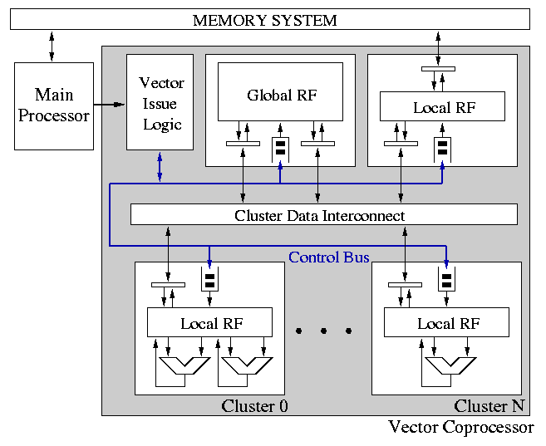
Scalable Vector Architecture

Slide 8
The Microarchicture
Execution clusters (N)
  A small, simple vector processor without a memory system that implements some subset of the ISA
  1 or 2 functional units (64b datapaths?)
  An instruction queue
  A few local vector registers for temporary results (4 to 8?)
The architecture state cluster (1)
  Global vector register file (32+ registers)
The memory cluster (1)
  Interface to the memory system; Memory system details exposed here
  A few local vector registers for decoupling or software speculation support (4 to 8?)

Slide 9
The Microarchicture
Vector issue logic (1)
  Issues instructions to clusters
  It does not handle chaining or scheduling
  The number/mix of clusters and the details of the main processor are exposed here
Cluster data interconnect (1)
  Moves data between the various clusters
  Anything from a simple bus to full crossbar
Control bus (1)
  For issuing instructions and transfers to the clusters

Slide 10
Why Clusters?
Benefits
  Performance/area/power = f(# of clusters, mix of clusters, type and BW of cluster interconnect)
  Reduced complexity within each cluster (small register file, simple datapaths, simple control, all local interconnect)
  Reduced complexity for global register file (few ports)
  Modularity by cluster design reuse
  Instruction classes with different characteristics can be separated
  No need for single synchronous clock across clusters
Potential disadvantage: inter-cluster communication
  Cycles used moving data between clusters
  Cost of required cluster data interconnect

Slide 11
Inter-cluster Communication
Should be infrequent:
  Streaming nature of multimedia applications
    Most temporary results used once
  Clusters can be assigned independent instructions
    Instructions from different iterations of the outer-loop, from different loops, or from different threads
  Clusters of different types rarely communicate (e.G. Integer and floating-point clusters)
Critical issues to work on
  Assignment of instructions to clusters
  Code scheduling for such an architecture

Slide 12
Issue 1: Register Discovery
Within a cluster
  Source registers may be local or coming from the interconnect
  The result is written in a local register
At issue time in VIL
  Keep track of architectural register’s true location with register renaming hardware
  If a source register not local to the cluster to execute the instruction, initiate an inter-cluster transfer
  If there is no available local register for the result in the cluster, initiate a transfer from a local to a global register to make up space
  Note: single issue is enough if each vector instruction occupies a functional unit for multiple cycles
    Keep cluster datapaths narrow

Slide 13
Issue 2: Cluster assignment
Simple if only one cluster can handle this instruction
If multiple clusters available, decide based:
  Location of source operands
  Availability of local register for result
  How busy the candidate clusters are
  Software hints (e.g. thread of execution)
Need experimental work to determine which policies work best

Slide 14
Issue 3: Memory Latency
Use local registers in memory cluster for decoupling
Each load is decomposed to
  A load into a local register in the memory cluster
  A (later) move from the memory cluster to a global/local register
Each store is decomposed to
  A move from some cluster to register in the memory cluster
  A store from the local register to the memory system
  “Store & deallocate” should be a useful instruction

Slide 15
Issue 4: Vector Chaining
If all sources are local within a cluster
  Just like in a non-clustered vector architecture
If some sources are non-local
  Chaining rate is dictated by non-local data arrival
  If data for the next element operation have arrived, execute the corresponding operation (simple control)
Due to simplicity of each cluster and independence from memory latency, density-time implementations of conditional operations are easy to combine with full chaining

Slide 16
Other Issues (1)
Optimal configurations for various application domains
Clusters organization
  Number, type, and mix of clusters (integer/FP/mixed)
  Number and width of functional units
  Number of local registers per cluster
  Instruction queue size, need of queues in CDI inputs/outputs etc
Memory cluster
  Number of local registers
  Organization (number of address generators, number of pending accesses etc)
Architecture state cluster
  Number of register file ports

Slide 17
Other issues (2)
Data cluster interconnect
  Type (bus, other), bandwidth, protocol (packet-based?)
  Synchronization of plesio-synchronous clusters
Code scheduling for a clustered vector architecture
  Effect on inter-cluster communication frequency
  Handling run-time or loop constants (replication in hardware or software)
Support for speculation in software
Coprocessor interface enhancements
Memory system optimizations for vector coprocessors
  Several options available as well
  A very large issue to include in this presentation
Pick a good name (preferably from Greek mythology)

Slide 18
Backup slides

Slide 19
VIRAM Prototype Architecture
Flag Unit 0
Flag Unit 1
Inst. Cache
FPU
Flag Register File (512B)
MIPS64™
5Kc Core
CP IF
Arithmetic
Unit 0
Arithmetic
Unit 1
32B
32B
Vector Register File (8KB)
Data Cache
SysAD IF
8B
8B
Memory Unit
TLB
32B
DMA
Memory Crossbar
JTAG IF
JTAG
…
DRAM0
(2MB)
DRAM1
(2MB)
DRAM7
(2MB)

Slide 20
Delayed Vector Pipeline
F
D
R
E
M
W
.
.
.
DRAM latency: >25ns
VLD
vld
A
T
VW
vadd
Load → Add RAW hazard
vst
VADD
vld
DELAY
VR
VX
VW
vadd
VST
vst
A
T
VR
.
.
.
Random access latency included in the vector unit pipeline
Arithmetic operations and stores are delayed to shorten RAW hazards
Long hazards eliminated for the common loop cases
Vector pipeline length: 15 stages

Slide 21
Modular Vector Unit Design
32B
Integer Datapath 0
Integer Datapath 0
Integer Datapath 0
Integer Datapath 0
FP Datapath
FP Datapath
FP Datapath
FP Datapath
Control
Vector Reg.
Elements
Vector Reg.
Elements
Vector Reg.
Elements
Vector Reg.
Elements
Flag Reg. Elements
& Datapaths
Flag Reg. Elements
& Datapaths
Flag Reg. Elements
& Datapaths
Flag Reg. Elements
& Datapaths
Integer Datapath 1
Integer Datapath 1
Integer Datapath 1
Integer Datapath 1
Xbar IF
Xbar IF
Xbar IF
Xbar IF
8B
8B
8B
8B
Single 64b “lane” design replicated 4 times
  Reduces design and testing time
  Provides a simple scaling model (up or down) without major control or datapath redesign
Most instructions require only intra-lane interconnect
  Tolerance to interconnect delay scaling

Slide 22
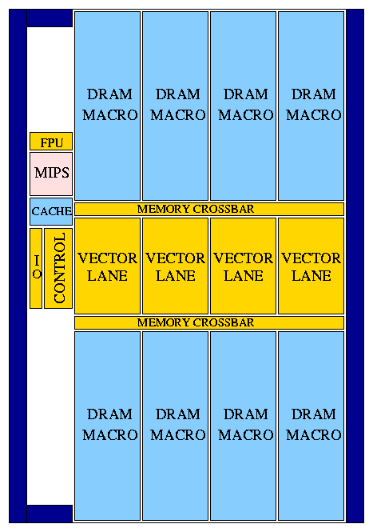
VIRAM-1 Floorplan

Slide 23
Short Vectors
Very common in media applications
  Block based algorithms (e.g. Mpeg), short filters etc
Outer-loop vectorization
  Not always available (loop-carried dependencies, irregular outer-loop, short outer-loops)
  Requires more sophisticated compiler technology
  May turn sequential accesses into strided/indexed

