Slide 1
Hamming Transcoders for Power Reduction on Internal Buses
Victor Wen
Jan. 13, 2000
University of California, Berkeley

Slide 2
Outline
Motivations
Related Work
Initial Approaches
Transition Code Technique
Preliminary Results
Future Work/Conclusion
Notes:
start with motivation
show related work
show some of the initial approach we thought
describe the transcoding technique
present preliminary result from simulator
conclude with future research direction and what we have learned so far

Slide 3
Power reduction through coding
Encoded Version
Input
Encoder
Output
Decode
Can we encode information in a way that takes less power?
Do this on chip?!

Slide 4
Reasoning
Increasing importance of wires relative to transistors
  Spend transistors to drive wires more efficiently?
  Try to reduce transitions over wires
Orthogonal to other power-saving techniques
  I.e. voltage reduction, low-swing drive
  clock gating
  Parallelism (like vectors!)
Portable devices more important
Notes:
Focus on internal buses. External I/O low power techniques have been investigated.
Increase chip complexity coupled with reduced transistor size makes wires dominant power consumer in modern processor.
Buying less wire transitions (which are more expensive b/c of higher capacitance) with higher transistor transitions.
Portable devices are becoming more and more ubiquitous. It is important to keep the power dissipation of chips low, both to increase battery life and to combat heat dissipation problem.
This technique is also orthogonal to other power-saving technique such as low-swing driver/receiver. Ideally, the transcoder should be a macro block that can be throw into any circuits with little modification.

Slide 5
Related Work
Bus Invert Coding, by M. R. Stan and W. P. Burleson
  Reduce peak power by 50%, avg by up to 25%
Work-zone Encoding, by E. Musoll et al.
  Compare favorably with other techniques
Test Vector Ordering, by P. Girard et al.
  Result: 8.2% to 54.1% less activities
Minimizing Power consumption, by A. Chandrakasan and R. Broderson
Notes:
The bus invert coding technique computes the Hamming distance between the present bus value and the next bus value. If the Hamming distance is greater than n/2 (where n is the width of the bus), then the the inverted bit is set to 1 and the next bus value is inverted before transmitting. Otherwise the inverted bit is set to 0 and the next bus value is sent as it is. This technique requires n+1 bits to transmit n bits. This technique can reduce peak power consumption by 50% and average power dissipation by up to 25%.
Work-zone Encoding technique recognizes locality of memory references.
Once a work zone is recognized, only the zone identifier and offset is sent across the wire
Incurs large encoder and decoder logic overhead
Used mainly for external address bus
Test Vector Ordering
Problem: chips experience higher circuit activities during test than normal usage mode. Thus testing may not reflect proper operating environment.
Goal: re-order test vectors to reduce power consumption and with no loss of fault coverage.
Uses Hamming distance between test vectors.
Alg: a complete graphs with vertex=test vector and edge with weight equals to Hamming distance. Then find the Hamiltonian path of minimum weight (NP-Hard problem). An heuristic based on Greedy algr. is used to reduce computational time
Results: reduction in circuit activity ranges from 8.2 to 54.1%.
Minimizing Power consumption on CMOS circuits
shed light on different techniques at different level to reduce power of CMOS circuits.
Circuit level: low swing logic, logic-level powering down, gated clock
Architectural level: pipelining, superscalar, minimize resource sharing, number representation
Algorithmic level: Loop unrolling, reduce number of operation (I.e. tree-structured table lookup requires less operation than full-table lookup in vector quantization)
The technique proposed in this presentation is orthogonal to these techniques. It can be applied in conjunction to these techniques
Note: BI and WZE primarily focus on extern I/O pins.

Slide 6
Huffman-based Compression
Input
Encoder
Output
Decode
…
Variable bit length – problem!
Possible soln: macro clock
Less bits != less transitions
Notes:
Variable output bit length is hard to deal with in an simple and elegant way in hardware.
The compression is in time (latency) but not necessary in power.
One solution is a macro clock where the code word is transmitted within that period
Reduces the number of bits transmitted on the wire but not necessary the number of transitions
Power burned by the faster clock might be significant

Slide 7
Hamming Weight
Input
Encoder
Output
Decode
0
0
Find a map function to minimize transition
Search space is large – 256! (For 8-bit bus)
Leads to transition code idea
1
1
2
2
3
3
4
4
5
…
6
7
Map
Function
…
254
254
255
255
Notes:
Represent the 8-bit value as 0 to 255. Map this input into another 8-bit value such that the next input value will have less bits flipped than the original value.
Find the map code from input to output to guarantee low transition.
The search space is 256! Too large to be done practically – in hardware!
Heuristics such as Greedy or Go with the Winner may help, but they still difficult to implement in hardware. Unless the mapping is static.
Then a mapping works well for some particular input may not work well for some other inputs.
But the idea of Hamming weight between successive inputs helps to lead to the transition code idea.

Slide 8
Hamming Transcoder
State Transition Diagram
Code: 0xFF
Freq: 10
256x256 table
for 8 bit bus
5
2
6
Code: 0x00
Freq: 2620
1
Most frequent arc assigned low-weight codes
Use output codes to XOR transmission line
  Every 1 in coded version causes transistion
  Most frequent arcs cause least number of transitions
Notes:
Closer look at the finite state machine in the encoder side.
As mentioned, the states are actually input values and arcs has transition code and frequency information. Thus a state transition will produce the correct transition code.
This can be done in random logic or RAM. We were thinking about RAM b/c we can then dynamically change the codes and rank.
Basically, we keep a pattern history depth of 1. If we keep more history, the results might more accurate but hardware require is much more. For example, a history depth of 2 will require a 256³ size table for 8-bit bus.
Even with history depth of 1, the hardware require is formidable. (the transistor is cheap but not that cheap). Thus we have the idea of the ranking system where higher ranked transitions gets transcoded and lower ranked transitions does not.

Slide 9
Hamming Transcoder (con’t)
Only transitions matter, not absolute value
Recognize more frequent transitions & assign low-weight code to them
Guarantees more frequent transitions have less bits changes on the wire
5
5
2
6
2
6
1
1
Notes:
Key idea: recognize more frequent transition in the bit stream and assign low Hamming weight code to them (basically, a low weight code means there are less 1s in the bit pattern). Not sending the code directly on wire. Instead sending the XOR of this value and the current value on the bus.
State represents actual input/output values. The arcs between the states has: transition codes and frequency.
This guarantees that more frequent transitions will cause less bits flipped on the bus. Thus power saving can be achieved.
Of course, the logic itself will burn more power. However, we are banking on the fact that power burned by transistors are a lot less than long buses.

Slide 10
Transition Code – Setup
8
9
8
Coder
Decoder
Coder
Cur bus value
Transition
Table
Prev input
Transcode
8
9
To Bus
XOR
Cur input
Coded?
Notes:
This is what we envision how to use our trans-coder and decoder. The two registers at each end are to hold previous input and bus value.
In steady state, the bottom register hold the previous input and when the current input comes, the appropriate transition code can be produced. This used to XOR with the current value on the bus from the top register and this new value is sent to the other end.
In the decoding end, similar action can be taken to produce the desired output. Basically, previous bus value and current bus value can be used to produce (via xoring) to produce transition code. This transition code and the previous output can be used to determine what the current output should be.
A asymmetry between the coder and the decoder.
Talk about the 9th bit. If the certain transition does not have high enough frequency, then we will use the input as the transcode to xor with the bus value and set the 9th bit to 1. Thus on the bus, if the 9th bit flips, then we know the transition code itself is the input value.

Slide 11
Simulation Setup
Verilog XL Sim
Monitor
Post-process
Transcode Sim
Verilog simulation
on picoJava core
RTL
Custom monitoring
component outputs
the bits on selected
buses
Post process the
output files into
format suitable for
transcoder simulator
Reads the file, setup
transition table and
perform simulation
Sun offering processor descriptions in Verilog
  picoJava (for now)
  UltraSparc (soon)
Notes:
Describe how we simulate the idea
First gather trace file using picoJava’s RTL.
We pick particularly long wires to monitor and output the bit to trace files.
The test program is very simple. Basically, operands are pushed onto stack and we perform a floating point add on them.
After the trace files are produced, they post-processed to a format suitable for the transcoder simulator.
The transcoder simulator sets up the transition table by reads a particular file.
If we again simulate using the same file as trace input, then we have a oracle encoder. This is useful to see the maximum potential of this approach.
The results are shown in the next two slides. They are quite promising.

Slide 12
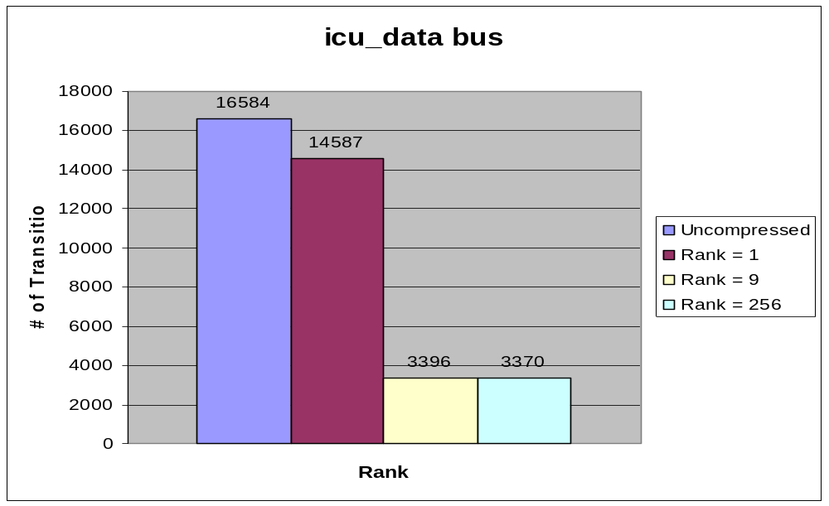
Simulation Results (1)
Savings
  Rank 9 saves 79.52%
  Rank 256 saves 79.68%
9th bit overhead
  Rank 1: 23%
  Rank 9: 0.29%

Slide 13
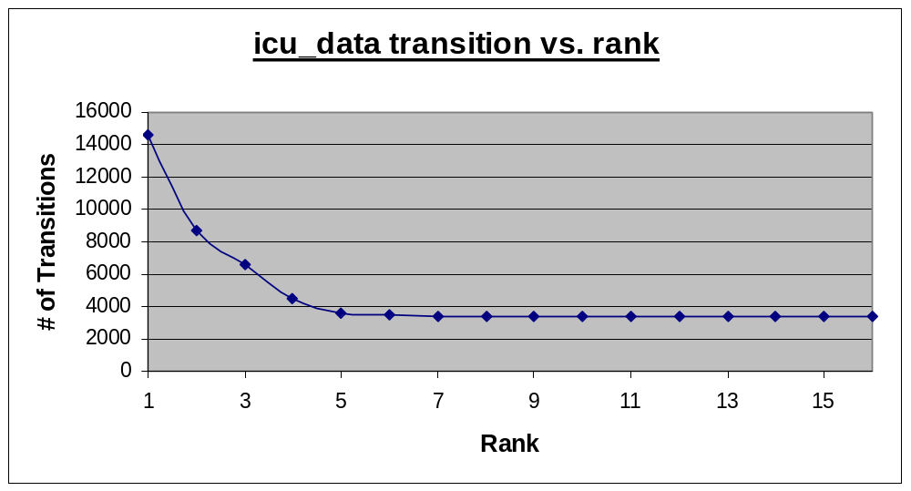
Simulation Results (2)
Number of transitions
drops quickly as
ranks increases
256x256 table might
not be necessary
Other trace files show
similar trends
Note: icu_data connects between instruction cache unit and integer unit. A fairly long bus according to picoJava’s floorplan

Slide 14
Conclusion & Future Work
Conclusion
  Transition coding attacks the root of the problem
  Minimal change to existing circuits
  Orthogonal to other low power techniques
Future work
  Simulate SPEC on Sparc & UltraSparc RTL
  Build adaptability into coder/decoder
  Use of more history
  Implement actual hardware
Notes:
Future work:
More rigorous testing using SPEC benchmarks on Sparc v8 or UltraSparc RTL.
It seems adaptability is necessary to handle wide variety of data streams.
Implement actual hardware or at least have a design so we can really see if there is power savings. Right now, we’ve only demonstrated that activity on buses is reduced.
Conclusion:
Transition coding attacks the root of the problem at reducing activity on the bus. It doesn’t necessary minimize the information sent but it minimize the amount of different information.
By keeping hardware small and simple and design it as a macro cell, it can be inserted to the circuits with very little change. At most we need to increase 1 wire for every 8 (if we so choose).
This technique is orthogonal to other power saving techniques. We can use this in conjunction with low swing driver/receiver, low voltage transistor, power down logic, and other architectural techniques such as superscalar and pipelining.
In the portable device domain, power is very important that we need to use every trick in our bag.

