Slide 1

INS TRUCTIONS
KruSHI-CONNECT
FROM FARMERS’ HANDS TO YOURS
FINAL VIVA PROJECT PRESENTATION
DILAN SACHINTHA MANAGE

Slide 2

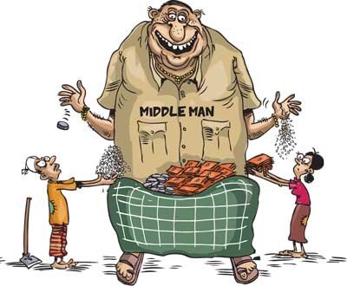
Problem Statement
75% of Sri Lankan farmers are small-scale and rely on middlemen. (FAO)
Middlemen take 30%-50% of the profit, reducing farmer earnings. (CBSL)
Post-harvest losses due to inefficient supply chains range from 30%-40%. (MoA)
Limited digital adoption – only ~20% of farmers use online selling due to lack of awareness and accessibility. (ICTA)
Consumers face higher prices and limited access to fresh farm produce. (SLCAA)

Slide 3
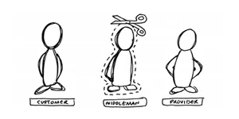
Motivation
Eliminate middlemen → Ensure fair pricing for farmers.
Direct-to-Consumer (D2C) model → More profits for farmers, fresher produce for consumers.
User-friendly digital platform → Supports the needs of all user types involved.
Reduce waste → Optimize farm-to-market logistics.

Slide 4

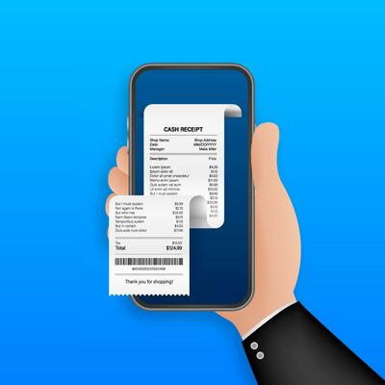
Key Objectives
Facilitate Direct Farmer-to-Consumer Sales: Eliminate middlemen to increase farmer earnings.
Enable Location-Based Services: Utilize Google Maps externally for product location tracking and customer access on pickup orders.
Provide Secure Authentication & Role-Based Access: Implement Firebase authentication for farmers, customers, and admins (with Email link authorization and fingerprint integration for admin related access).
Order Management & Transactions: Enhanced order processing, and payments integration.
Telephony Services: Allow customers to directly call farmers for inquiries.
Receipt Downloading: Provide an option to download order receipts for record-keeping.
Implement Product Filtering & Search: Allow users to filter by category, price, and location for better product discovery.

Slide 5
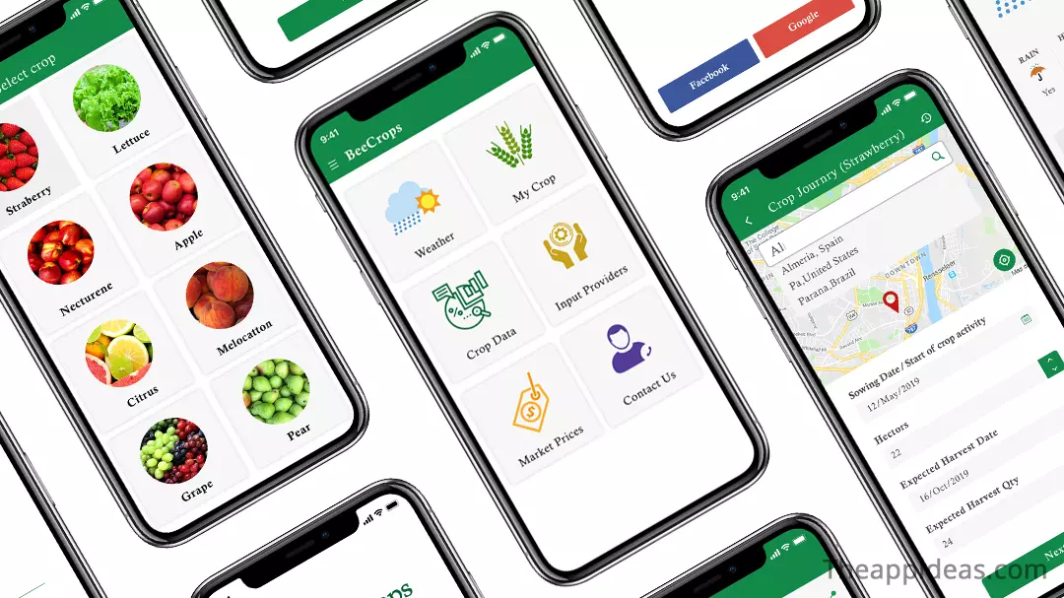
Technologies & Architecture
Frontend (Android - Java & XML) :
Technologies Used:
XML: UI Layouts.
Android Design Palette: Manual UI structuring.
Java: Manages UI logic (Activities, Fragments, Adapters, ViewModel).
Architecture Used:
MVVM (Model-View-ViewModel)
Model (M): Handles data-related operations (Firestore models, authentication models).
View (V):
XML Layouts: UI design for activities & fragments.
Android Design Palette: Drag-and-drop UI structuring.
ViewModel (VM): Manages UI logic and API interactions.

Slide 6

Technologies & Architecture
Backend (Firebase Services & APIs)
Technologies Used:
Java: Handles backend logic and Firestore interactions.
Firestore (NoSQL Database): Stores application related data.
Firebase Authentication: Role-based login/signup management.
Firebase Storage: Stores product images.Firestore Security.
Network & API Handling:
Java (Firestore Queries & Data Processing): Manages Firestore CRUD operations.
Java (FirebaseAuth & Firebase Storage SDK): Handles authentication and image uploads.
APIs & External Integrations:
Google Maps & Places APIs: Fetches and displays locations Telephony: Allows direct calls.
PayHere: Processes payments securely.

Slide 7

Key Features : Farmers
Farmer Sign-Up & Authentication:
Only farmers (role) can register and login using farmer signup & sign-in pages.
Product Management:
Farmers can add products (only farmers) and update stocks of their products.
Uploads support three images per product via Firebase storage.
Admin approval required for farmer products to be listed on the app.
Order Management:
Farmers can view only their own ordered products and gets to update the status on pickup orders of customers.
Location Services:
Product location fetched dynamically from the farmer’s stored address.
Direct Customer Interaction:
Customers can call farmers directly via the Telephony API from order details.

Slide 8

Key Features : Customers
Product Browsing & Ordering:
Customers can browse, search and filter on conditions through admin-approved products.
Location-Based Product Filtering with customers being able to view nearby farmers’ products on Google Maps externally.
Customers can add products to the cart and place orders with secure payments through PayHere.
Customers are able to download a receipt related to their order.
After Ordering:
Customers can check order status directly in the app as they are updated by farmers and admin.
UI updates dynamically.
Account Management: Customer can update their information they entered when registering (password also – if needed).

Slide 9
Key Features : Admin
Admin Dashboard:
Centralized product and order management.
Product Approval System:
Admins review products marked as "Pending Approval“ as products can be approved (made visible to customers) or rejected.
Order Monitoring: Admins have full control over order status updates.
Security Features for Admins:
Password less Email Authentication for Login
When accessing critical application process data fingerprint authorization is needed (biometric access control).

Slide 10

Conclusion & Takeaways
What was achieved?
A fully functional agricultural marketplace connecting farmers & customers.
Benefits of Krushi-Connect:
For Farmers → Easy product listing, direct customer interaction, increased sales visibility.
For Customers → Seamless access to fresh, farm-direct products, real-time farmer contact.
For Admins → Efficient platform management with secure control over products, and orders.
Scalability:
The platform is designed for growth, with the upcoming enhancements such as AI-based pricing suggestions for farmers, Real-time chat support, Real-time delivery support, Multi-Language Support and more payment methods integrated.

Slide 11

THANK-YOU

