Slide 1
Modeling: Chemistry
Reaction-diffusion system
G
α
βγ
EGFR
A + B C
PLC
Grb
DAG
SoS
Ca
Ca
PKC
AC
PDE
CaM
CaMKII
AA
Ras
cAMP
CaN
PLA₂
MAPK
PKA
PP1
cascade
Diffusion represented as flux of molecules between compartments
G
α
βγ
EGFR
PLC
Grb
DAG
SoS
Ca
Differential equation representation
Ca
PKC
Ras
AC
PDE
CaM
CaMKII
AA
cAMP
CaN
PLA₂
MAPK
PKA
PP1
cascade
dA/dt = -kf[A][B] + kb[C] + flux

Slide 2
Modeling: Electricity
Cable equation + HH equations
∂²V
[
(V – E_{leak})‏
∂V
]
= r_{a}
+ C_{m}
∂x²
r_{m}
∂t
Compartmental representation
Ra/2
Ra/2
Cm
Rm
Gchan
Em
Echan

Slide 3

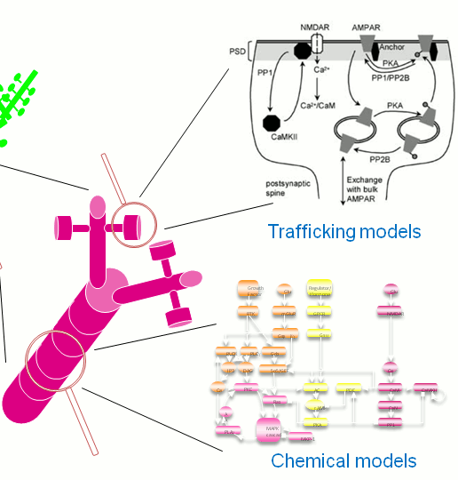

Detailed cell+chemical pathways in abstract network

Slide 4
Modular solvers for multiscaling
Ca
CaMKII
CaM
G
α
βγ
EGFR
PLC
Grb
DAG
SoS
Ca
Ca
PKC
Ras
AC
PDE
CaM
CaMKII
AA
cAMP
CaN
PLA₂
MAPK
PKA
PP1
cascade
Electrical:
HSolve
ODE + Diffusion:
Ksolve + Dsolve
Stochastic (GSSA)
Gsolve

Slide 5
Solver communication
Adaptors +
Messaging
What the user sees
Ksolve/
Gsolve
Ksolve/
Gsolve
Cross-reactions
HSolve
Dsolve

Slide 6
The Multiscale Object-Oriented Simulation Environment
http://moose.ncbs.res.in, http://sourceforge.net/projects/moose/
LGPL but uses GPL modules
C++/Python/Qt/GSL/OpenGL and many many more…

Slide 7
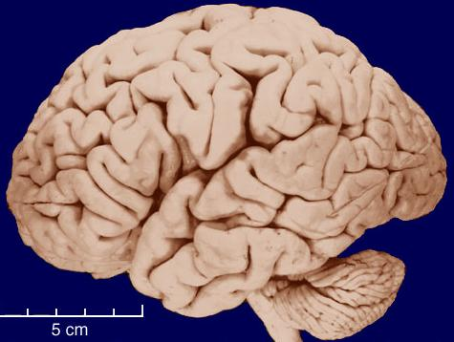
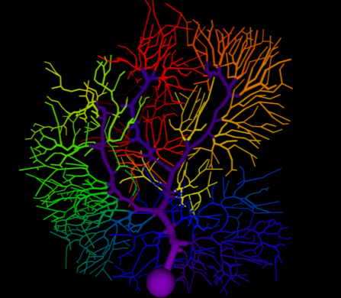
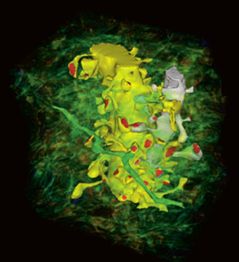
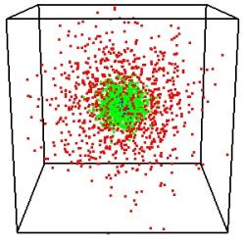
Typical numbers: Brain
1e11 cells
1e15 synapses
10000? reactions per synapse
Electrical events: < 1 ms
Chemical events: 1s -> 1000 s
Structural events: 100s -> months
Lifetime of a protein: days
Lifetime of a neuron: 100 years
Lifetime of a memory: 100 years.

Slide 8
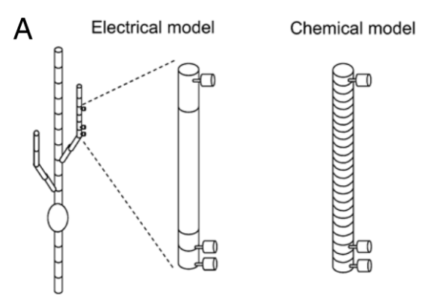
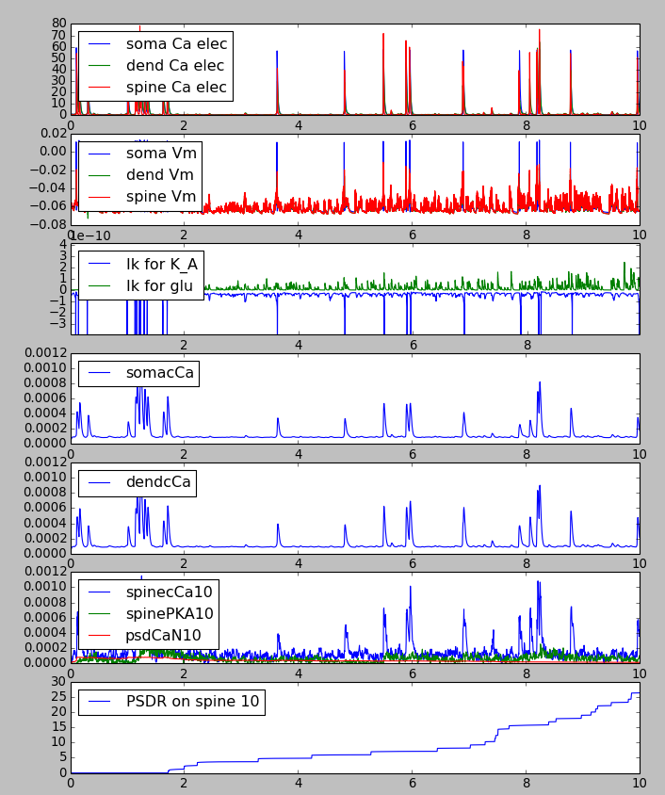

All together
Multiscale neuron embedded in LIF network

