Slide 1
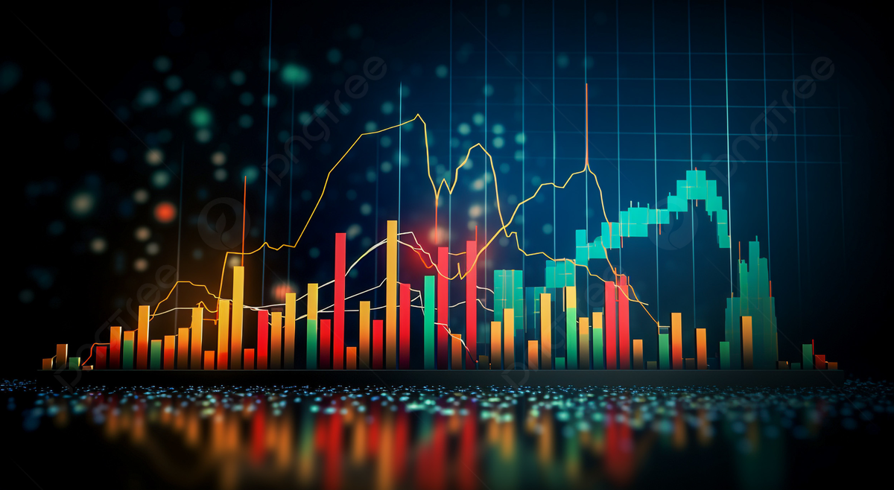
Glimpse AI POWERED TREND AND DEMAND ANALYZER
Team codebinders

Slide 2

The solution
Goal: Forecast future product demand and recommend items most aligned with those trends.
Solution:
Predict top trending keywords using historical search, sales, and sentiment data.
Match those keywords to catalog products using combined textual metadata.
Rank and output the most relevant, in-demand products for the upcoming week.
Business Use Case: Helps fashion retailers with trend-based inventory planning, targeted marketing, and merchandising decisions.

Slide 3

Key features
Multi-source data fusion strategy: Combines search trends, sales data, customer feedback, and product catalog information for a holistic view.
Natural Language Processing (NLP): Cleans, tokenizes, and matches search queries to catalog items using text analysis.
Sentiment analysis: Extracts consumer sentiment from feedback to enhance trend scoring.
Time series forecasting: Uses Facebook Prophet to predict demand for each keyword over upcoming days.
Composite scoring: Blends search frequency, sales volume, and sentiment with weighted importance to rank keywords.
Data-driven recommendations: Generates a prioritized list of products aligned with upcoming trends.

Slide 4

Findings
Upcoming demand signals: Identifies which fashion-related keywords are likely to trend in the next week.
Product trend alignment: Maps trending keywords directly to relevant catalog items.
Sentiment-driven enhancement: Uses positive or negative consumer feedback to influence keyword ranking.
Search–sales–sentiment correlation: Captures how consumer behavior in search, buying, and feedback intersects.

Slide 5
Thank you

