Slide 1
Introduction to project ipl score prediction flask app
Slide 1

Slide 2
Flask is microweb framework; it is written in python
Slide 2

Slide 3
It is a microweb framework because it does not need any tools or liberary to work
Slide 3

Slide 4
We can make web application and it is easy to use and also it has simple syntax
Slide 4

Slide 5
There is no need of data abst.layer form validaton or complex orm to make it easy to use and minimal
Slide 5

Slide 6
Being minimal does not mean it has limited usage we can extend it by using extensions for more usability e.g adding data to database and form validation
Slide 6

Slide 7


Companies like pinterest and linkeldn use flask to create internal tools

Slide 8
Project overview
Slide 8

Slide 9
liberaries we have used 1-import pandas as pd 2-import pickle 3-from sklearn.linear_model import LinearRegression 4-from sklearn.linear_model import Ridge 5-from sklearn.model_selection import GridSearchCV 6-import seaborn as sns 7-from sklearn import metrics 8-import numpy as np
Slide 9

Slide 10
get_dummies
Slide 10

Slide 11
We have taken dataset from kaggle featursare : wickets team name previous wickets bowling team bating team the algorithm we have used that is : linear regression
Slide 11

Slide 12
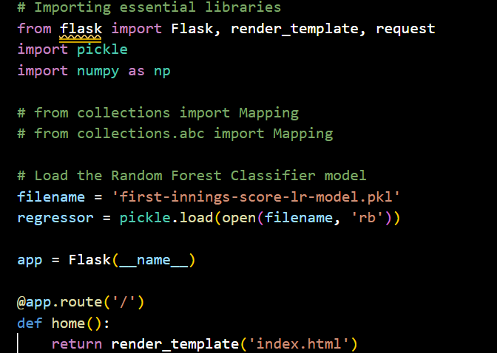

Slide 13
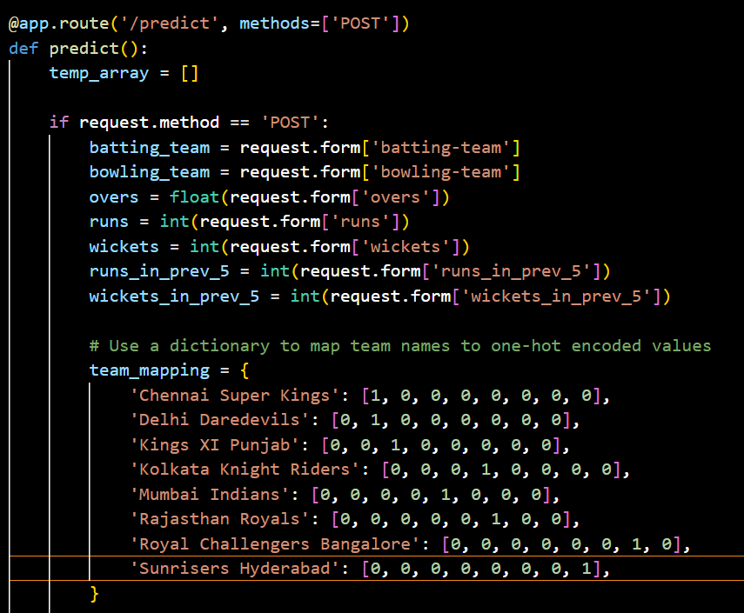

Slide 14
