Slide 1
Default Prediction
Presented by
ASHOK SUTHAR (17MCMT17)
DHILBER M (17MCMI15)
Students of
M.TECH IN COMPUTER SCIENCE & M.TECH IN ARTIFICIAL INTELLIGENCE
SCHOOL OF COMPUTER & INFORMATION SCIENCE
UNIVERSITY OF HYDERABAD
2017-2019
Notes:
1

Slide 2
Abstract
Here, a loan default prediction model is constructed using different Classification algorithms such as MLP, Decision Trees, SVM, Logistic Regression among others, to train and test the prediction model.
Notes:
1

Slide 3
Problem Statement
The aim of this project is to find the best possible classifying technique for the particular data set and predicting with most accuracy if a user will default or not.
Notes:
1

Slide 4
Data Set
Data is taken from UCI machine Learning Repository.
The original dataset contains 23 attributes + one class attribute and 30000 instances.
Attributes are either numeric or nominal in nature.
Attribute descriptions are as follows:
Notes:
1

Slide 5
VARIABLE DESCRIPTION
X1: Amount of the given credit (NT dollar): it includes both the individual consumer credit and his/her family (supplementary) credit.
X2: Gender
X3: Education
X4: Marital status
X5: Age
X6 - X11: History of past payment.
X12-X17: Amount of bill statement (NT dollar).
X18-X23: Amount of previous payment (NT dollar).
Notes:
1

Slide 6
Algorithms Used
Support Vector Machine (SMO)
Decision Tree (J48)
Logistic Regression
Multilayer Perceptron
K-Nearest Neighbour (IBk)
Random Forest
Stochastic gradient descent
Notes:
1

Slide 7
Results
*Percentage-Split (90-10)
Model | Accuracy | Specificity | Sensitivity
SVM | 81 | 66.12 | 82.68
Logistic Regression | 81.2 | 65.29 | 83.23
MLP | 80.7 | 59.25 | 83.67
IBk | 74.3667 | 41.54 | 82.52
J48 | 79.9667 | 59.54 | 82.67
SGD | 81.0333 | 66.23 | 83.33
Random Forest | 81.451 | 63.80 | 84.15
Notes:
1

Slide 8
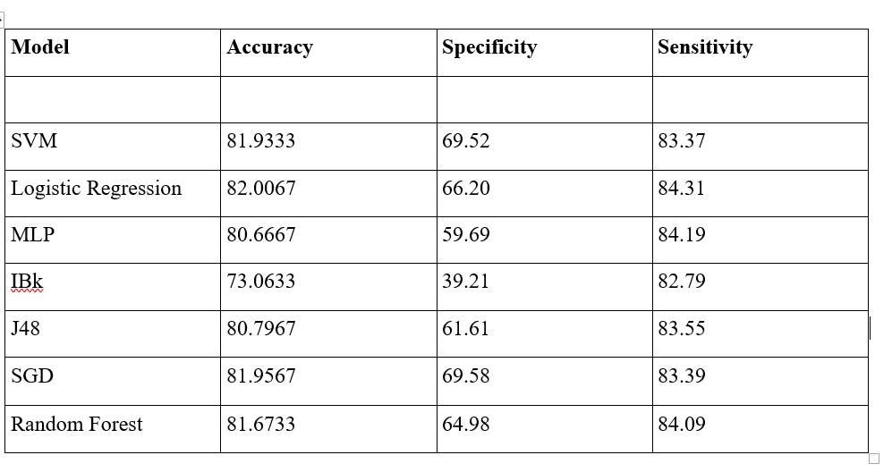
Cont..
With 10-fold cross Validation
Notes:
1

Slide 9
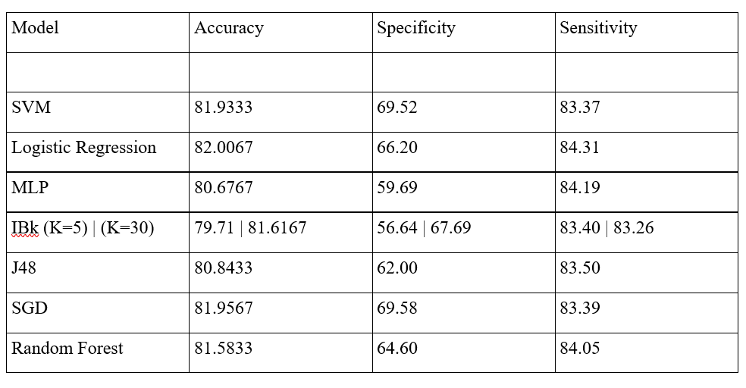
10-Fold Cross-Validation
Normalised data
Notes:
1

Slide 10
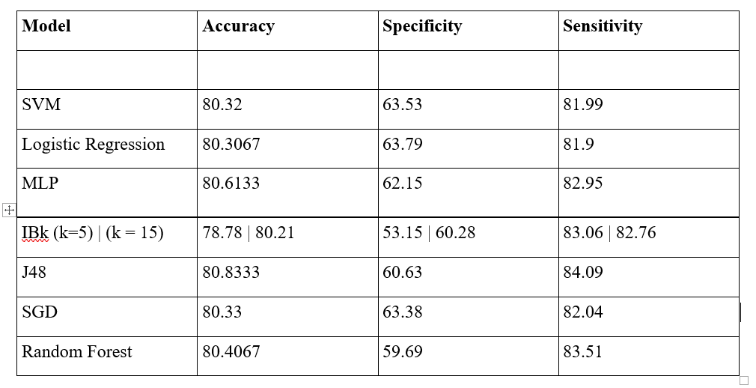
After applying Pricipal Component Analysis
*Principal Components=12
*10 Fold Cross-Validation
*Non-normalised data
Notes:
1

Slide 11
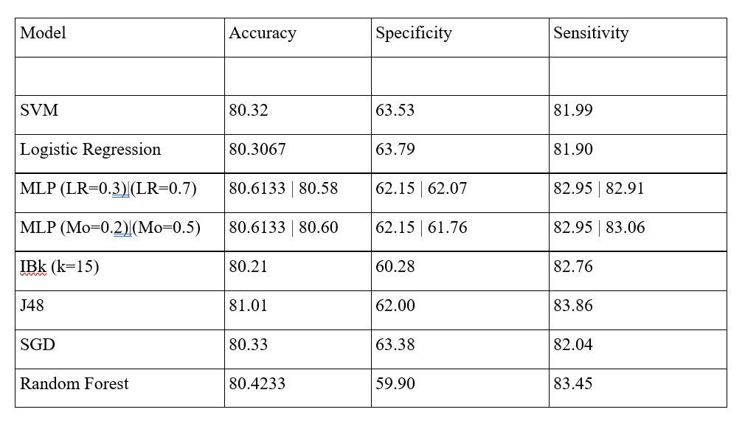
After applying Pricipal Component Analysis
*Principal Components=12
*With Feature Selection
*10 Fold Cross-Validation
*Normalised data
Notes:
1

Slide 12
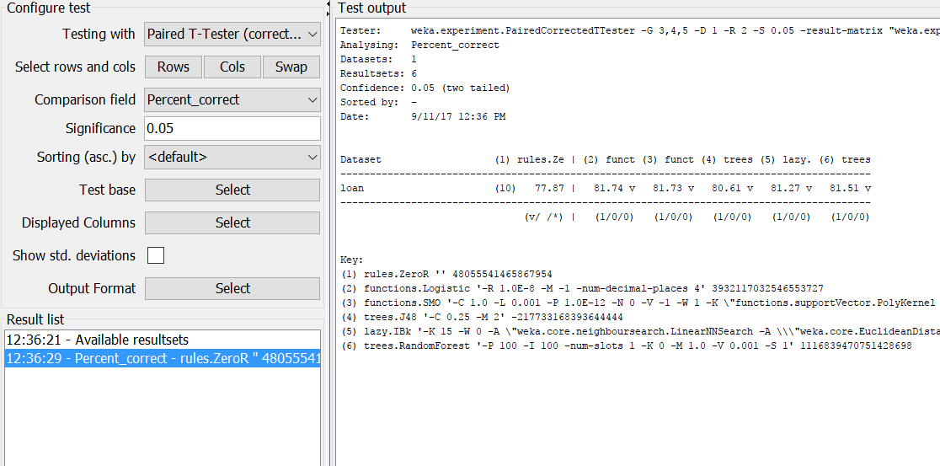

Slide 13
Conclusion
By comparing the interestingness measure of both the algorithms we can conclude that for this dataset Logistic Regression performs best with 10-fold Cross validation.
Notes:
1

Slide 14
Thank You
Notes:
1

