Slide 1
What does the script do?
Given a loan amount, repayment frequency, loan term range and interest rate range declared by the user, the script will output how much the repayments would be for the given ranges.
Once printed it will ask if the user would also like a csv version of the output and export this to the users desktop.

Slide 2

How the script structure is built
The script is broken into 5 files which will individually be covered.
There is a 6th script (validation.py) which exists for testing purposes in the 2 test scenarios
The final 2 scripts are the tests:
test_calculations.py which asserts the mathematical formula is working based off the file calculation.py
test_input.py which assers the input validation is working based where incorrect inputs are declared.

Slide 3
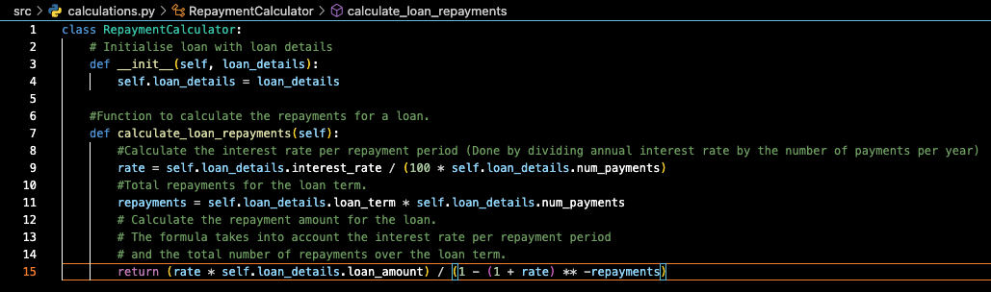
Calculations.py
First part of script developed, as it was necessary to first confirm that the calculation for loan repayments was correct
We define 2 functions:
Init – to initialize the loan details to be used (the loan_details are ‘stored’ in a separate class and are not used directly in this script, but are imported into the main)
Calculate_loan_repayments – to perform the actual calculation by parsing the information in laon_details

Slide 4
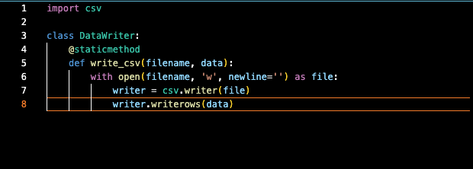
Data_writer.py
This was a ‘stetch’ goal, where it wasn’t necessary for the code to run, however if time allowed was an added feature
This code imports the standard library csv for python and uses the @staticmethod to call a class without creating an instance of it.
The code the defines how to write a csv file (for later use)

Slide 5

Input.py
The largest code block, however in some ways the most simple.
This stores all of the user inputs as varibales.
After building the basic necessity of the code I added some additional features:
Applying the DRY principal I defined a function to clear the terminal, that can then be used in each other function with a single line ```self.clear_terminal()```
A confirm input step to display back what the user had declared and allowed for the user to start over if information was wrong – this came about when testing and being irritated that I had to go through the entire code or close the terminal if something went wrong.

Slide 6

Input.py
Cont
An exit (and confirmation) function that allows a user to type exit at any input to leave the program early
Error handling to ensure that correct inputs are being delared, and if not providing feedback to the user, and allow them to try again.
This part of the code took the shortest time to build the ‘basics’ (inputs and variables) but also the longest in refinement to handle the added features that make it more user friendly

Slide 7
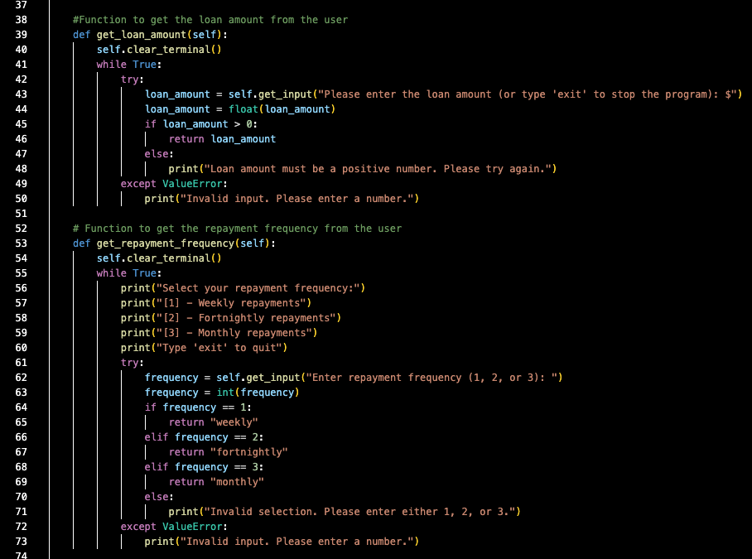
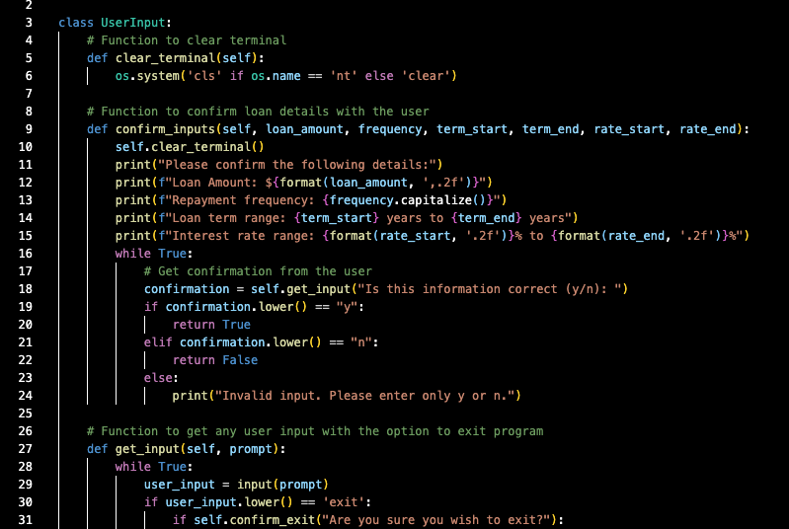
Input.py

Slide 8
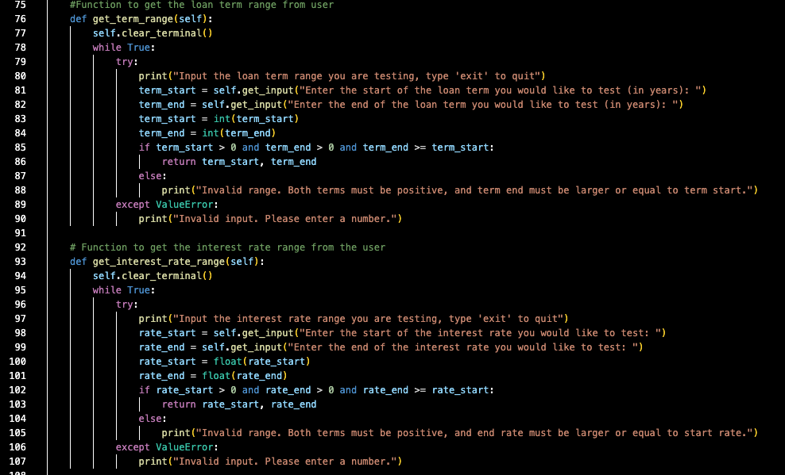
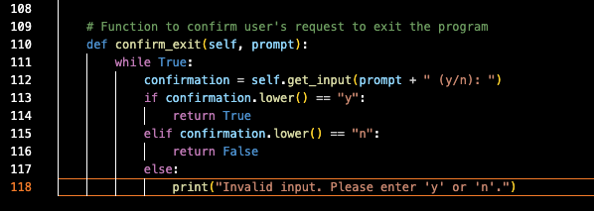
Input.py

Slide 9
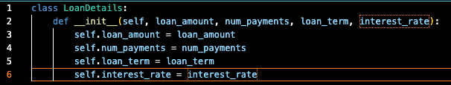
Loan_details.py
The Class creates an object that represents the loan and all the details.
Originally I had not had a class for this function and housed it directly in ‘main.py’ however for Organisation, reuse and potential future extention I separated this into its own file and class.

Slide 10
Main.py
‘Where the magic happens’
Imports all of the classes from the other scripts, and some python standard libraries (pathlib and os)
This is the builder and brings everything together.
It first creates an instance or the UserInput to get all the user inputs.
It maps the repayment frequencies to numbers (to be used to calculate the number of repayments)
It also prepares the data for csv export creating an overall header and then column headers (separated by commas)
Then it performs the main function:

Slide 11

Main.py
The script then loops all of the interest rates in the range declared by the user (stepping by 0.25% each time) inside a loop of each of the loan term years (stepping 1 year at a time)
The loop performs the repayment calculator function then appends the csv row with the data decalred and prints the result to terminal.
This uses f string to make the text visually appealing and understandable by the user instead of simply providing the output with no context.
After the loop completes the script will ask if the user wishes to export the results. If yes it will then export a csv to the desktop and if no will close the program.

Slide 12
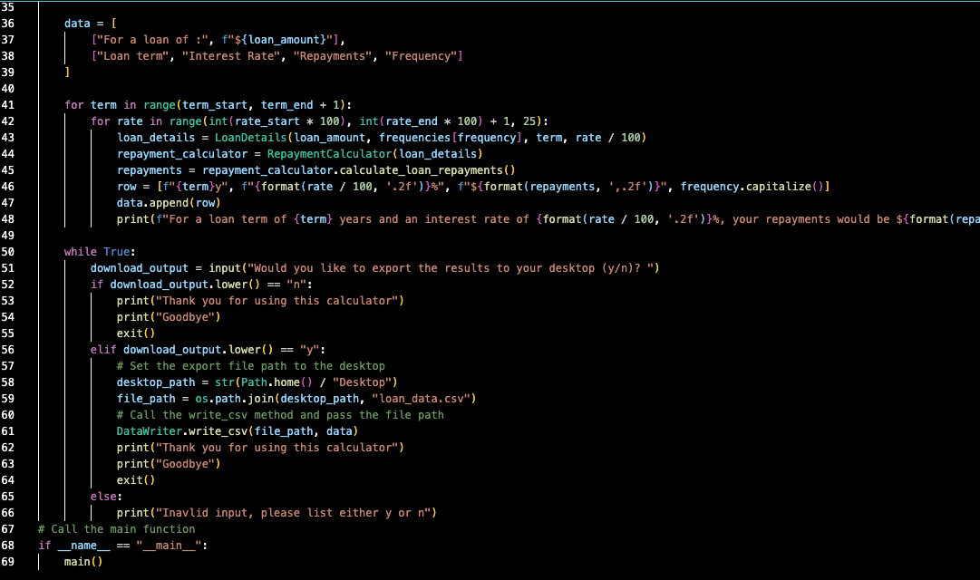
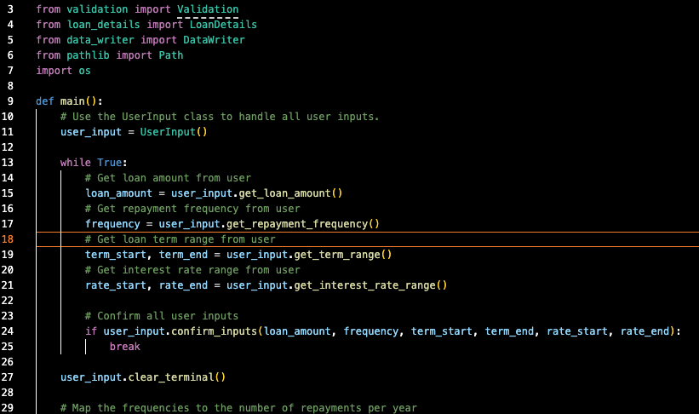
Main.py

Slide 13
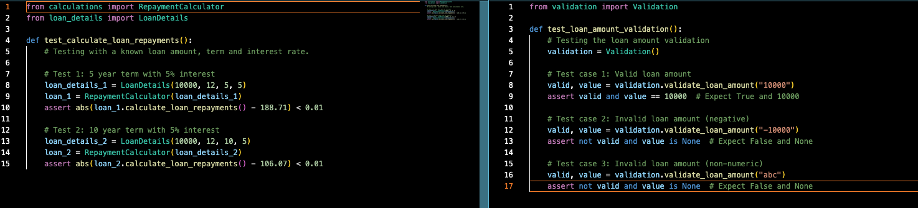
Tests
There are 2 test scripts and an additional validation script that is used in conjunction.
These are tested using pytest
Test_calculations works on the ‘calculations’ function to ensure the mathematic operation works as intended by parsing known loan details and repayments.
Had to investigate the ‘abs’ function, as the output was not always 100% due to loan term, interest rates and rounding.
Test_input uses the validation script to make sure that errors are handled correctly.

