Slide 1
ALPHA COMMUNITY
Smart Intelligence for Every Community
- World citizen safety mobile app
- AI, IoT, Firebase, offline database, and role-based response
- Elephant, flood, landslide, garbage, reports, map, and assistant
Alpha Community final project | 1
Notes:
[Sources]
Project source: local Alpha Community Flutter project in C:/Users/sa/Desktop/Alfa community.
Image source: user-provided camera hardware photo from Codex temp attachment.

Slide 2
ALPHA COMMUNITY
Communities need faster local risk response
The app focuses on practical safety problems that citizens and officers can act on.
Citizen pain
Officer pain
System gap
Late alerts, difficult public reporting, unclear emergency contacts, and weak internet in field areas.
Reports need GPS, photo, date/time, description, and contact number before action can begin.
Disaster, waste, wildlife, and public issue data are usually separated instead of connected.
Alpha Community final project | 2
Notes:
[Sources]
Requirement source: D:/requirement gathering/REQUIREMENT_DATASET_DECISION_REPORT.md.

Slide 3
ALPHA COMMUNITY
Survey data shaped the first useful version
127 records were analyzed across citizen and officer respondents.
Dataset coverage
100 citizen records, 26 officer records, and 1 database check record across six Sri Lankan locations.
Product decision
Prioritize safety map, issue reporting, emergency contacts, location-based alerts, and officer dashboard.
Alpha Community final project | 3
Notes:
[Sources]
Requirement source: D:/requirement gathering/REQUIREMENT_DATASET_DECISION_REPORT.md; feature counts and respondent totals.

Slide 4
ALPHA COMMUNITY
The project is explained by 5W + H
A clear technical and general explanation for presentation defense.
What
Why
Who
Smart citizen safety and monitoring app
Reduce late alerts and improve public response
Citizens, officers, admins, local authorities
Where
When
How
Villages, towns, hazard areas, smart bins
Daily reporting, emergencies, field monitoring
Flutter, IoT, Firebase, offline DB, AI models
Alpha Community final project | 4
Notes:
[Sources]
Project source: local Flutter implementation and requirement decision report.

Slide 5
SYSTEM DESIGN
One app connects people, sensors, AI, and officers
- The app is not only a dashboard; it is a response workflow.
- Each module uses location relevance and operational role access.
- Online and offline data paths keep the system usable in field areas.
Section 1
Notes:
[Sources]
Project source: Alpha Community app architecture in lib/src and iot folders.

Slide 6
ALPHA COMMUNITY
Architecture connects field data to action
The system converts reports and sensor readings into role-specific decisions.
Citizens
IoT devices
Firebase
Mobile app
->
->
->
NIC login, reports, GPS, photos
Camera, bin, water, soil, beam readings
Cloud sync, users, reports, alerts, sensor data
AI modules, dashboards, offline cache
response loop
Officers/Admin
Review, assign, clear bins, control users
Alpha Community final project | 6
Notes:
[Sources]
Project source: lib/src/services, lib/src/screens, lib/src/plugins, and iot folders.

Slide 7
ALPHA COMMUNITY
Location decides which modules matter first
The app avoids showing every risk equally to every citizen.
Ampara
Elephant alerts, rural road safety
Mahiyanganaya
Elephant alerts, rural road safety
Badulla
Landslide and mountain road warnings
Nuwara Eliya
Landslide and mountain road warnings
Rathnapura
Flood and river overflow alerts
Colombo
Garbage overflow, urban flooding, traffic, safety
Alpha Community final project | 7
Notes:
[Sources]
Requirement source: D:/requirement gathering/REQUIREMENT_DATASET_DECISION_REPORT.md location-specific alerts.
Implementation source: lib/src/services/module_registry.dart.

Slide 8
ALPHA COMMUNITY
Roles separate public use from authority control
The login model protects admin/officer functions while keeping citizen reporting simple.
Citizen
Officer
Admin
Registers and logs in by NIC. Reports issues, checks modules, uses assistant, and sees location-relevant cards.
Logs in by employee ID. Reviews citizen reports, updates status, and handles assigned work.
Default admin can see all cards, create officers, and monitor the system.
Alpha Community final project | 8
Notes:
[Sources]
Implementation source: lib/src/services/auth_service.dart, lib/src/models/app_user.dart, and role-specific screens.

Slide 9
ALPHA COMMUNITY
Citizen reports become officer work items
A structured report gives officers the minimum evidence needed for action.
- Citizen selects report type: flood, landslide, elephant movement, garbage overflow, road damage, water issue, or other.
- Report captures description, photo, GPS location, date/time, and contact number.
- Report is saved locally and synced online when possible.
- Officer reviews, assigns, resolves, or marks garbage bin as free.
- Admin can monitor the whole workflow.
Officer requirement match
The survey showed every officer required contact number, date/time, description, GPS location, and photo.
Alpha Community final project | 9
Notes:
[Sources]
Requirement source: officer required fields in D:/requirement gathering/REQUIREMENT_DATASET_DECISION_REPORT.md.
Implementation source: lib/src/screens/citizen_work_screen.dart and lib/src/services/community_report_store.dart.

Slide 10
DATA AND DATABASE
Cloud sync and offline storage make the app field-ready
- Firebase stores shared online data.
- Local storage keeps the app useful during weak internet.
- The sync design supports citizens, officers, admin, IoT, and alerts.
Section 2
Notes:
[Sources]
Implementation source: Firebase and local database services in lib/src/services.

Slide 11
ALPHA COMMUNITY
Firebase is the shared online database
Firestore connects users, reports, alerts, and IoT readings across devices.
users
community_reports
Citizen and officer accounts
Issue reports and workflow status
alpha_iot_elephant
alpha_iot_environment
Perimeter beam readings
Flood and landslide readings
garbage_bins
alerts
Bin fill, weight, and capacity
Safety alert history
Alpha Community final project | 11
Notes:
[Sources]
Implementation source: lib/src/services/firebase_bootstrap.dart, auth_service.dart, community_report_store.dart, iot_sensor_service.dart, and garbage_bin_sensor_service.dart.

Slide 12
ALPHA COMMUNITY
Offline support protects rural usability
The app is designed to continue useful work when internet is weak.
- Local database stores user records and offline-friendly app data.
- Prediction history remains on device for comparison.
- Reports can be cached locally and synced when online.
- Assistant has offline safety answers for flood, landslide, elephant, and garbage.
- This matches the survey finding that smartphone and network access are mixed.
OFFLINE
FIRST
Alpha Community final project | 12
Notes:
[Sources]
Requirement source: offline/low-data recommendation in D:/requirement gathering/REQUIREMENT_DATASET_DECISION_REPORT.md.
Implementation source: pubspec.yaml dependencies sqflite/shared_preferences and lib/src/services.

Slide 13
IOT AND FIELD INTELLIGENCE
Sensors turn real-world conditions into simple decisions
- The app hides raw engineering details from citizens.
- It shows meaningful status, levels, and guidance instead.
- Field readings support faster alerts and officer response.
Section 3
Notes:
[Sources]
Implementation source: iot folder and updated module screens.

Slide 14
ALPHA COMMUNITY
IoT data is separated by safety domain
Each physical signal is mapped to the app module that can use it.
Elephant safety
Flood risk
Landslide risk
Live camera frame analysis plus perimeter crossing signal for early warning.
Rainfall, water level, and drainage values produce a flood risk score.
Rainfall, slope, soil moisture, vibration, and tilt support hillside stability assessment.
Garbage bin
Firebase sync
Fill percentage, weight, free capacity, and bin location guide citizens and officers.
Readings are uploaded online so the mobile app can display live dashboards.
Alpha Community final project | 14
Notes:
[Sources]
Implementation source: iot/README.md and lib/src/services/iot_sensor_service.dart.

Slide 15
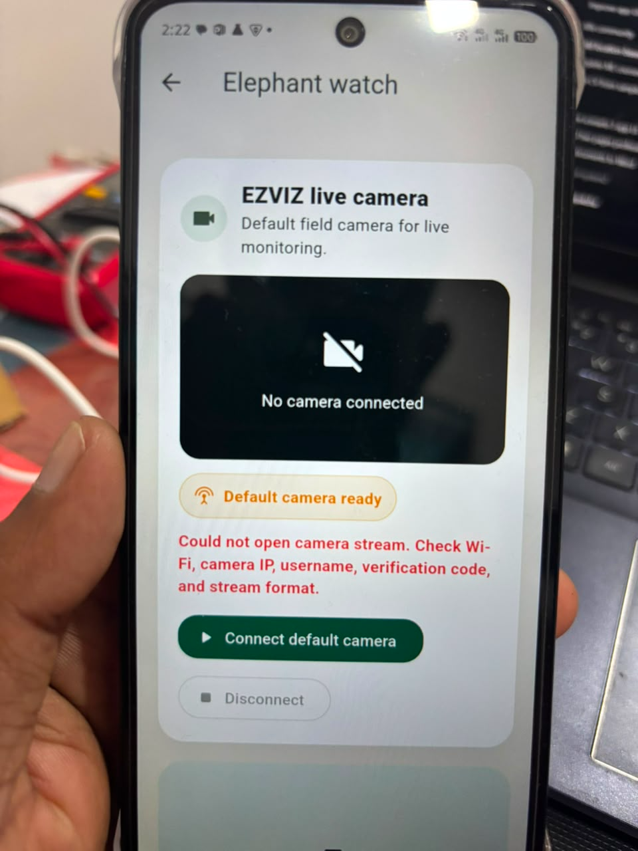
ALPHA COMMUNITY
Elephant Safety combines camera AI and perimeter alerts
The module is designed for rural field monitoring and fast citizen warning.
- Live field camera connects to the app.
- AI analyzes frames for elephant presence.
- Perimeter beam reading adds a second risk signal.
- Medium/high risk creates a safety alert.
- Citizens receive simple guidance: keep distance and contact officers.
Alpha Community final project | 15
Notes:
[Sources]
Implementation source: lib/src/screens/detection_screen.dart, lib/src/services/elephant_detector.dart, and ezviz_camera_service.dart.
Image source: user-provided app screenshot from Codex temp attachment.

Slide 16
ALPHA COMMUNITY
Flood Intelligence shows automatic water risk
Citizens see usable decisions instead of technical sensor controls.
Flood Intelligence
- Inputs: rainfall in 24 hours, river or drain water level, drainage capacity.
- Output: low, medium, or high flood risk.
- Dashboard displays live metrics with progress meters.
- Refresh action saves assessment history.
- Guidance helps citizens prepare or move away from danger.
Automatic risk level
Live field intelligence
Rainfall 24h
80 mm
Water level
1.5 m
Drainage
55%
Refresh live assessment
Alpha Community final project | 16
Notes:
[Sources]
Implementation source: lib/src/plugins/flood/flood_screen.dart and lib/src/services/risk_engine.dart.
Visual source: final-style dashboard mockup based on updated Flutter screen.

Slide 17
ALPHA COMMUNITY
Landslide Intelligence reads terrain risk
The screen is built for hill-country monitoring and officer field decisions.
- Inputs: 72-hour rainfall, terrain slope, soil moisture, movement or tilt.
- Output: hillside stability risk level.
- Dashboard hides raw sensor labels and presents field intelligence.
- History helps compare recent assessments.
- Guidance supports evacuation awareness and officer escalation.
Landslide Intelligence
Automatic risk level
Live field intelligence
Rainfall 72h
120 mm
Terrain slope
25 deg
Refresh live assessment
Alpha Community final project | 17
Notes:
[Sources]
Implementation source: lib/src/plugins/landslide/landslide_screen.dart and lib/src/services/iot_sensor_service.dart.
Visual source: final-style dashboard mockup based on updated Flutter screen.

Slide 18
ALPHA COMMUNITY
Smart garbage management supports both citizens and officers
The module changes garbage reporting from complaint-only to capacity-aware service.
Citizen value
Officer value
AI value
Find a bin with free space, see fill percentage, and get directions.
See full-bin reports, assign collection work, and mark bins free after clearing.
Classify waste photos to support plastic, glass, metal, paper, and mixed waste reporting.
- Fill level: 0-60% safe, 61-79% medium, 80-100% full.
- The app displays used weight, free percentage, and remaining capacity.
Alpha Community final project | 18
Notes:
[Sources]
Implementation source: lib/src/plugins/garbage/garbage_screen.dart, garbage_bin_sensor_service.dart, garbage_classifier.dart, and iot garbage firmware.

Slide 19
AI AND ML
Models make the app smarter without making citizens handle complexity
- On-device AI supports offline prediction.
- Online GenAI improves assistant answers when internet is available.
- The user interface presents risk and guidance, not model internals.
Section 4
Notes:
[Sources]
Implementation source: AI services and model asset paths in lib/src/services and lib/src/plugins.

Slide 20
ALPHA COMMUNITY
ML training has four separate problem types
Each model is trained differently because each input type is different.
Elephant detection
Garbage classification
Image/object detection from camera frames and labeled elephant images.
Image classification for plastic, glass, metal, paper, mixed waste, and similar categories.
Flood prediction
Landslide prediction
Tabular model using rainfall, water level, and drainage effectiveness.
Tabular model using rainfall, slope, soil moisture, vibration, and tilt signals.
Alpha Community final project | 20
Notes:
[Sources]
Implementation source: assets/models references in Flutter plugins and risk_engine.dart fallback.

Slide 21
ALPHA COMMUNITY
Training pipeline turns field data into mobile models
The model plan is practical: collect, clean, train, test, convert, deploy.
1
Gather
2
Clean
3
Train
Images, sensor readings, labels, locations
Remove duplicates, normalize values, resize images
CNN/detection models and tabular risk models
4
Validate
5
Convert
6
Deploy
Accuracy, confusion matrix, field test cases
Export to TensorFlow Lite format
Add .tflite files to Flutter assets
Alpha Community final project | 21
Notes:
[Sources]
Project source: ML design based on app model asset paths and dataset decision report.

Slide 22
ALPHA COMMUNITY
TFLite and GenAI serve different jobs
The app combines fast offline intelligence with richer online assistance.
TFLite on device
Online GenAI assistant
Fast, private, and usable with weak internet. Used for image classification and risk prediction modules.
Provides richer safety answers when internet is available. Citizens do not need to configure API settings.
Alpha Community final project | 22
Notes:
[Sources]
Implementation source: pubspec.yaml tflite_flutter dependency and lib/src/services/citizen_assistant_service.dart.

Slide 23
ALPHA COMMUNITY
Security protects authority actions
The app separates identity, role, and workflow permissions.
- Citizen registration uses NIC for uniqueness.
- Officer login uses employee ID.
- Admin creates officer accounts; officers cannot self-register.
- Admin can see every module; citizens see location-relevant modules.
- Privileged role login is not automatically preserved after app restart.
- Firebase security rules should enforce role-based collection access in production.
Alpha Community final project | 23
Notes:
[Sources]
Implementation source: auth_service.dart, app_user.dart, auth_gate.dart, login and admin screens.

Slide 24
ALPHA COMMUNITY
The mobile app is built as a complete product
Core app parts work together instead of remaining separate demos.
Landing
Home
Video hero, app purpose, global citizen positioning
Location-aware safety cards and live IoT summaries
Modules
Workflows
Elephant, flood, landslide, garbage intelligence screens
Citizen report, officer review, admin control
Assistant
Map/Contacts
Offline guidance and online GenAI answers
Safety hotspots and emergency contact access
Alpha Community final project | 24
Notes:
[Sources]
Implementation source: lib/src/screens and lib/src/plugins.

Slide 25
ALPHA COMMUNITY
Testing confirms the main behavior
The app has automated checks for login, roles, reports, risk scoring, and assistant behavior.
- flutter analyze: no issues found.
- flutter test: 12 tests passed.
- flutter build apk --debug: APK built successfully.
- Debug APK path: build/app/outputs/flutter-apk/app-debug.apk
Alpha Community final project | 25
Notes:
[Sources]
Verification source: latest local command outputs in this Codex task.
Implementation source: test/widget_test.dart.

Slide 26
ALPHA COMMUNITY
Deployment path is clear for Android and iOS
The current build is Android-ready; iOS needs Apple tooling.
Android
iOS
Build debug or release APK from Flutter and install with ADB or distribute through Play Store.
Requires macOS, Xcode, Apple Developer account, iOS Firebase config, and App Store/TestFlight setup.
Production readiness
Finalize Firebase rules, real trained models, sensor calibration, push notifications, and release signing.
Alpha Community final project | 26
Notes:
[Sources]
Project source: Flutter build configuration, Firebase config, and app deployment requirements.

Slide 27
ALPHA COMMUNITY
Limitations define the next engineering work
The current app is strong for alpha/final project demonstration, with clear production upgrades.
- AI accuracy depends on real field datasets and balanced labels.
- Sensor calibration must be completed before real public safety use.
- Camera stream reliability depends on network and camera configuration.
- Offline sync needs conflict handling for full production scale.
- Official authority alerts must always override app AI guidance.
Future roadmap
Live map markers, SMS fallback, Sinhala/Tamil/English support, analytics dashboard, push alerts, and model confidence monitoring.
Alpha Community final project | 27
Notes:
[Sources]
Requirement source: D:/requirement gathering/REQUIREMENT_DATASET_DECISION_REPORT.md roadmap and offline recommendations.

Slide 28
Alpha Community is a complete community safety ecosystem.
Alpha Control
Automatic risk level
Live field intelligence
Mobile app + IoT + AI + Firebase + offline database + role-based response
Risk cards
Live
Reports
Synced
- Useful for rural and urban communities
- Designed for citizens, officers, and admins
- Ready for stronger datasets, real sensors, and production release
Refresh live assessment
Alpha Community final project | 28
Notes:
[Sources]
Project source: final Alpha Community app features implemented in local workspace.
Visual source: final-style app mockup based on implemented modules.

