Slide 1
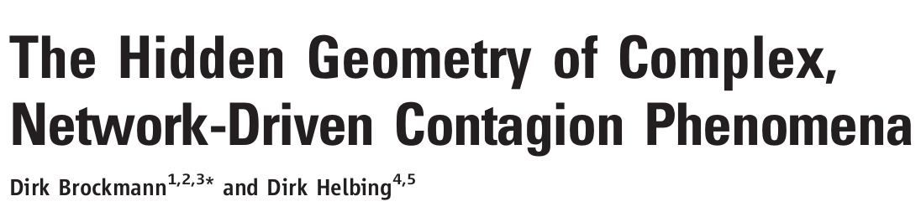
Modeling epidemics using most probable paths
Dileep, Akanksha, Daniel, Lingyu

Slide 2
The spread of a contagion
Background
The global spread of epidemics affects the lives of millions of people.
The key questions that influence the course of action taken during an epidemic are:
Where did the pathogen emerge?
Where are the new cases to be expected?
When is the epidemic going to arrive at distant locations?
How many cases are to be expected?

Slide 3
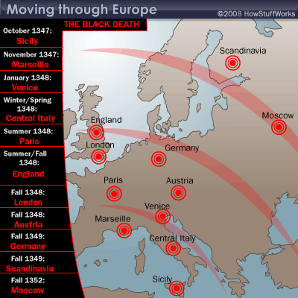
Approaches
Background
Reaction diffusion model
Spread of an epidemic correlates strongly with geometric distance.
e.g. Black Death
Metapopulation model, agent-based computer simulation.
Complex
Require knowledge of epidemiological and structural parameters

Slide 4
A revised model corrected with effective distance
Background
The Global Mobility Network (GMN)
Air traffic network, mobilizing 7 billion of passengers globally each year
Effective distance vs geographic distance.
Simple and powerful
Predict epidemic propagation speed, arrival time, and origin location.

Slide 5
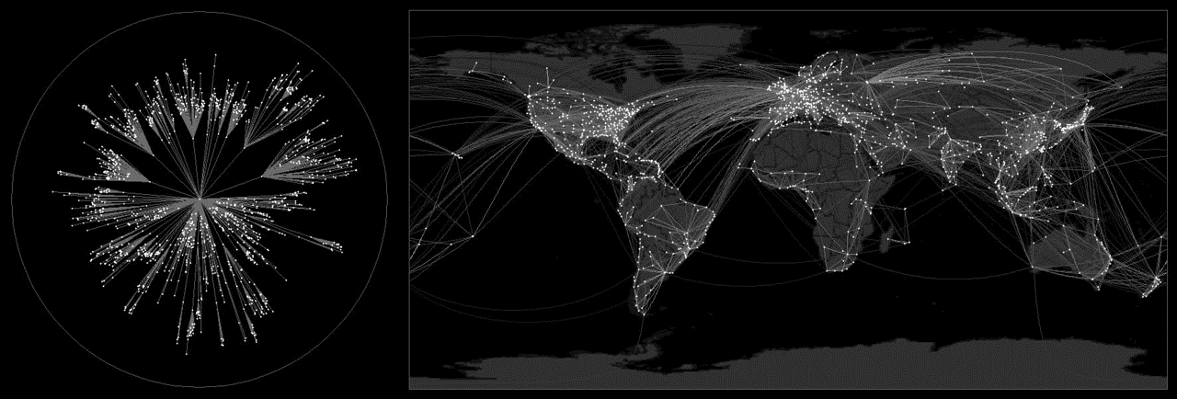

Slide 6
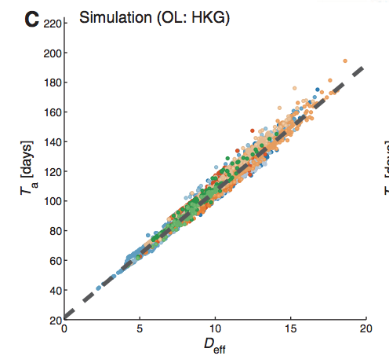
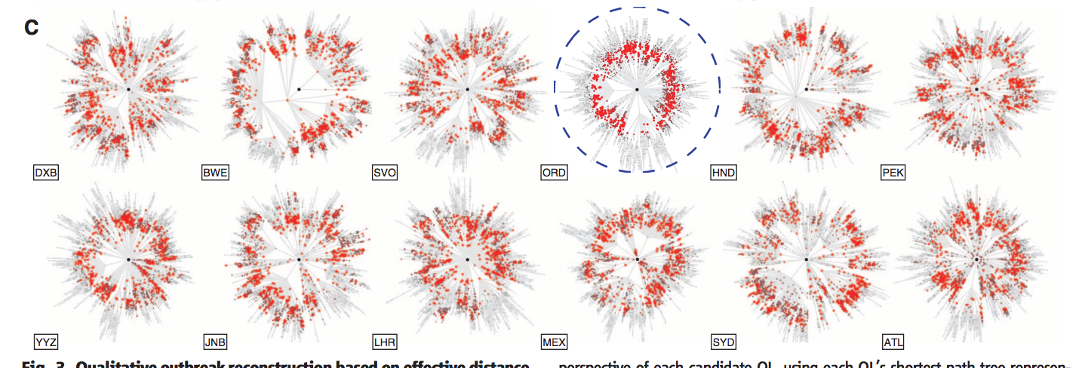
Project goals - Basic aim
Project Goals
Recreating the relationship between Epidemic arrival time (y-axis) and effective distance (x-axis)
Simulation of epidemic outbreaks and identification of origin of outbreak.

Slide 7
Project goals - Extensions
Project Goals
Addition of quarantine zones in airports
Relationship between number of quarantines and epidemic spread
Identifying the key nodes (airports) involved in the spread of the epidemic
Find minimum number of quarantines to curtail an epidemic outbreak
Potential extension
Simulate the Ebola outbreak of 2014 - involves incorporation of land transport and local air transport networks

Slide 8
What approaches
Project Approaches
Network dynamics using ODE simulations
MATLAB
Python
SPaTo network visualization tool (www.spato.net) - reduces a network to the shortest-path tree of a selected root node
GLEAM (www.gleamviz.org) - Model validity and comparison
Notes:
converts the geographic mapping to the eff dist mapping that you can see in the video

Slide 9
Who will do what?
Division of Labor
Dileep:
Akanksha:
Daniel:
Lingyu:

