Slide 1

Music Store Data Analysis
Name : Dileep Somanapalli
Batch No: ISP2501
Domain : SQL

Slide 2
About Me
Background :
My name is Dileep Somanapalli. Currently I am pursuing my BTech in TKR College of Engineering and Technology with specialization in Data Science.
Why you want to learn Data Science:
Because I have strong interest in Data-driven Decision making and passion to extract insights from real world data. I want to build my career in Analytics and data science where data can be used to solve business problems effectively.
work experience:
Data Science Intern – Cognifyz Technologies
Hands-on experience in EDA, data preprocessing, and visualization
Profiles:
LinkedIn: https://www.linkedin.com/in/dileep-somanapalli
Git Hub: https://github.com/dileep272004

Slide 3
Objective of the Project
Analyze customer purchasing behavior.
Identify top revenue generating customers and locations.
Discover most popular music genres across countries.
Understand sales and music trends.
Support business decision-making using data analysis.

Slide 4
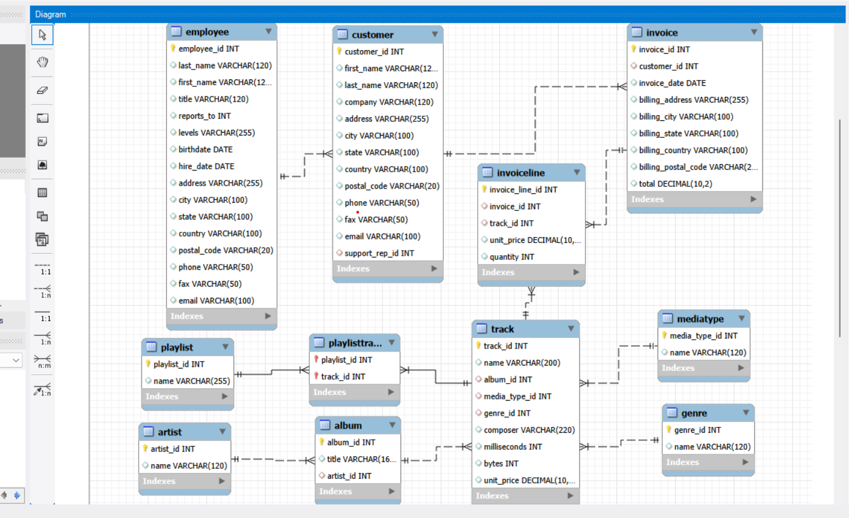
ER Diagram and Schema Explanation
Entity Relationship (ER) Diagram
The ER Diagram represents the structure of the Music Store database.
It shows how different entities are connected using relationships.
Each table represents a real-world entity such as customers, invoices, tracks, artists, and playlists in the music store system.
Database Design Overview
The Music Store database follows a Relational Database Model where multiple tables are connected using Primary Keys and Foreign Keys.
The system stores information related to customers, employees, music tracks, artists, albums, invoices, and playlists.

Slide 5
ER Diagram and Schema Explanation
Main Entities in Music Store Database
Customer → Stores customer details.
Invoice → Stores purchase transactions.
Invoice Line → Stores purchased tracks information.
Track → Contains song details.
Album & Artist → Represent music creators.
Genre & MediaType → Classify music categories.
Playlist & Playlist Track → Manage music collections.
Employee → Handles customer support.
Key Relationships
A Customer can generate multiple Invoices
Each Invoice contains multiple purchased Tracks
Tracks belong to specific Albums and Artists
Each track is categorized under a Genre
Playlists contain multiple tracks through Playlist Track table

Slide 6
Key analysis questions (use cases)
Who is the senior most employee based on job title?
Which countries generate the highest number of invoices?
What are the top 3 highest invoice values?
Which city generates the highest revenue?
Who is the best customer based on total spending?
Who are the Rock music listeners?
Which artists have produced the most Rock music tracks?
Which tracks are longer than the average song length?
How much amount is spent by each customer on artists?
What is the most popular music genre in each country?
Which customer spends the most on music in each country?

Slide 7

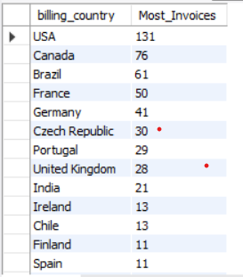
Who is the senior most employee based on job title?
Key Insight
Andrew Adams is the senior-most employee, holding the position of General Manager
The role represents the highest level of management and decision-making authority in the organization.
This helps understand the organizational hierarchy and leadership structure of the music store.
Which countries generate the highest number of invoices?
Key Insight
USA generates the highest number of invoices (131), indicating the largest customer activity.
Countries like Canada and Brazil also show strong purchasing participation.
Higher invoice count suggests strong market demand and customer engagement in these regions.

Slide 8
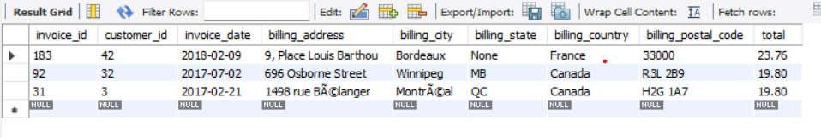

What are the top 3 highest invoice values?
Key Insight
The highest invoice value is 23.76, generated from a customer in France.
The next highest purchases (19.80) are recorded from Canada, showing strong spending behavior.
High-value invoices indicate premium or bulk music purchases by customers.
Which city generates the highest revenue?
Key Insight
Prague generates the highest total revenue (273.24) among all cities.
Customers in Prague contribute the maximum sales for the music store.
Prague is the best location to conduct promotional events or music festivals to maximize business revenue.

Slide 9

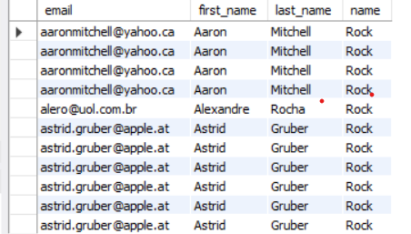
Who is the best customer based on total spending?
Key Insight
František Wichterlová is identified as the best customer of the music store.
The customer has spent a total of 144.54,which is the highest among all customers.
High-value customers like this contribute significantly to overall business revenue and should be targeted for loyalty programs.
Who are the Rock music listeners?
Key Insight
Customers from multiple countries actively listen to Rock music, showing its global popularity.
Some customers appear multiple times because they purchased multiple Rock tracks
Rock music is one of the most preferred genres among music store customers.

Slide 10
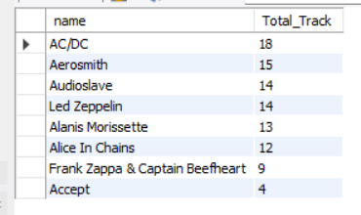
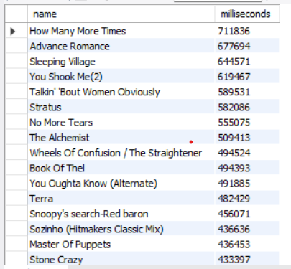
Which artists have produced the most Rock music tracks?
Key Insight
AC/DC has produced the highest number of Rock tracks in the dataset.
Artists like Aerosmith, Led Zeppelin, and Audioslave are also major contributors to Rock music.
These artists represent the most influential Rock performers, making them ideal candidates for promotions or music events.
Which tracks are longer than the average song length?
Key Insight
Several tracks such as “How Many More Times” and “Advance Romance” have durations significantly higher than the average song length.
These longer tracks indicate the presence of extended or live musical compositions in the music store.
Long-duration songs may appeal to dedicated music listeners, making them suitable for premium playlists or special collections.

Slide 11
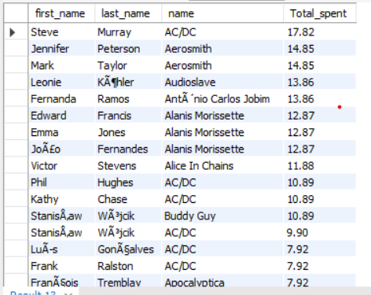
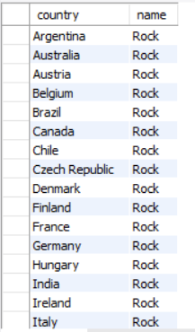
How much amount is spent by each customer on artists?
Key Insight
Customers show higher spending on popular artists such as AC/DC, Aerosmith, and Alanis Morissette.
Some customers repeatedly purchase tracks from the same artist, indicating artist loyalty and preference.
Understanding customer–artist spending patterns helps in personalized recommendations and targeted promotions.
What is the most popular music genre in each country?
Key Insight
Rock music is the most popular genre across almost all countries.
This indicates a global dominance of Rock music among customers.
The company can prioritize Rock playlists, promotions, and artist collaborations internationally.

Slide 12
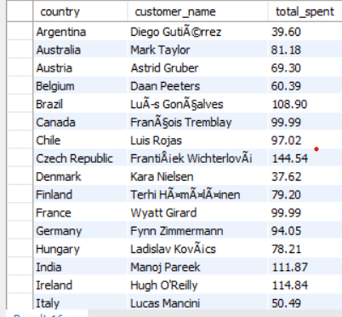
Which customer spends the most on music in each country?
Key Insight
Each country has a distinct top-spending customer, showing localized purchasing behavior.
Customers from countries like Czech Republic, Brazil, and India show comparatively higher music spending.
Identifying these premium customers helps the business design loyalty programs and personalized offers.

Slide 13
Final business insights and recommendations
Final Business Insights
Rock music is the most popular genre across multiple countries.
A small group of high-value customers contributes major revenue.
Certain cities like Prague generate the highest sales, making them ideal for promotional events.
Popular artists and long-duration tracks show strong customer engagement patterns.
Recommendations
Organize music festivals and promotions in high-revenue cities.
Provide exclusive offers and loyalty rewards for top customers.
Promote Rock genre playlists and artists to maximize sales.
Focus marketing campaigns on countries with higher invoice activity.

Slide 14
Conclusion (Key finding overall)
The Music Store data analysis helped identify customer purchasing patterns and revenue trends.
Analysis revealed top customers, high-performing cities, and popular music genres contributing to business growth.
Rock music dominates customer preferences across most countries.
SQL-based analysis enables data-driven decision making for marketing and sales strategies.
The project demonstrates how structured databases can transform raw data into meaningful business insights.

Slide 15
Experience & Challenges – SQL Data Analysis Project
Experience
Gained hands-on experience in advanced SQL querying techniques.
Strengthened skills in joins, subqueries, and window functions.
Analyzed real-world datasets to extract meaningful insights.
Improved analytical thinking and problem-solving abilities.
Challenges Faced
Managing complex multi-table relationships and joins.
Debugging complex queries and window functions.
Handling large datasets during analysis and summarizing results.
Ensuring accurate aggregations and interpretations.

Slide 16
Any Questions
You are Welcome!

Slide 17

THANK YOU

