Slide 1

Data engineering project
By-
Ramesh
Dileep
Lokesh
charan

Slide 2
Problem Statement
We need to do is the transformations on the given information of patients and update the data in MySQL table.
PySpark Transformations :
1. What type of work has more cases of stroke.
2. Who participated in this clinic measurement. How many Female/Male have a stroke.
3. Dataset has missing values for smoking_status and bmi parameters, fill out smoking_status with a value of ‘No info’ and bmi parameter with mean value.
4. Calculate the number of stroke cases for people for age between 40-50 yrs,50-60 yrs, 60-70 yrs and above 70 yrs.
5. Move data to Kafka topic .

Slide 3
Proposed Methods
Apache Spark
Apache Kafka
MySQL database

Slide 4

Spark
Apache Spark is a data processing framework that can quickly perform processing tasks on large data sets
Apache Spark is written in Scala programming language. To support Python with Spark.
developed at the University of California.

Slide 5
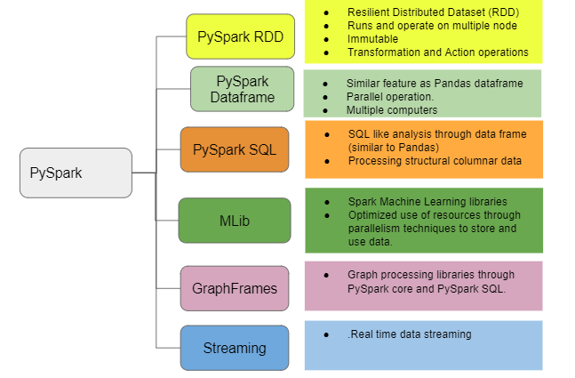

Slide 6
Advantages of Pyspark
Swift Processing.
Natural Dynamics.
Fault-tolerant.

Slide 7
Apache Kafka
Apache Kafka is a distributed event store and stream-processing platform. It is an open-source system developed by the Apache Software Foundation written in Java and Scala.
Kafka is primarily used to build real-time streaming data pipelines and applications that adapt to the data streams. It combines messaging, storage, and stream processing to allow storage and analysis of both historical and real-time data.
Producers sending compressed messages will compress the batch together and send it as the payload of a wrapped message. And as before, the data on disk is exactly the same as what the broker receives from the producer over the network and sends to its consumers.

Slide 8
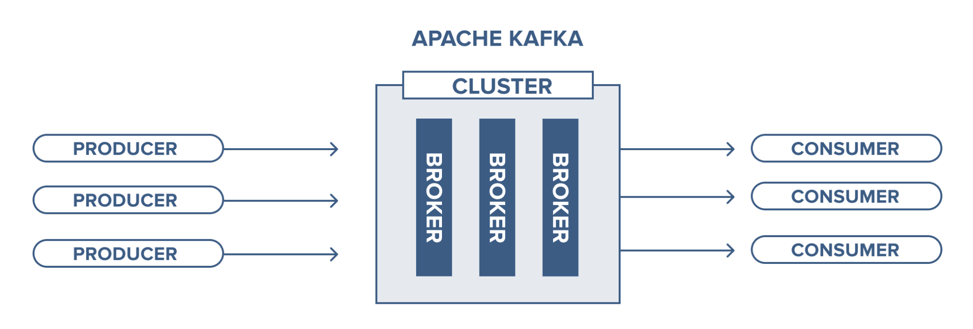
ARCHITECTURE OF APACHE KAFKA

Slide 9
MySQL database
MySQL, the most popular Open Source SQL database management system, is developed, distributed, and supported by Oracle Corporation.
MySQL creates a database for storing and manipulating data, defining the relationship of each table. Clients can make requests by typing specific SQL statements on MySQL. The server application will respond with the requested information and it will appear on the clients' side.

Slide 10
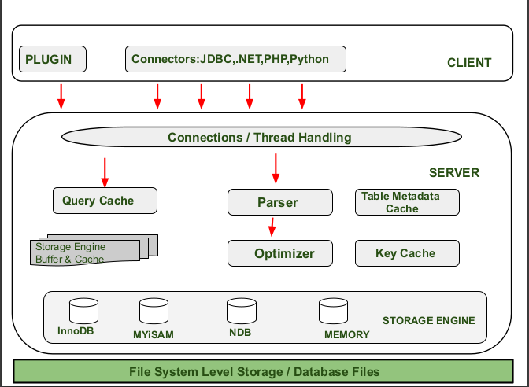
ARCHITECTURE OF MYSQL

Slide 11
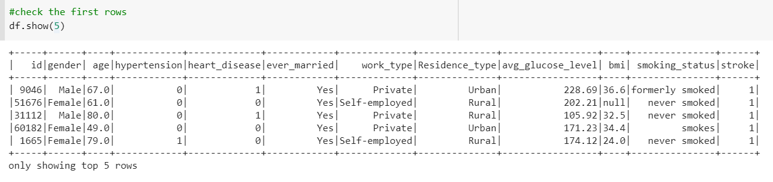
dataset

Slide 12
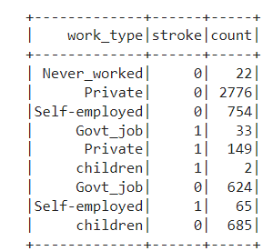
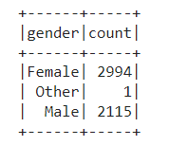
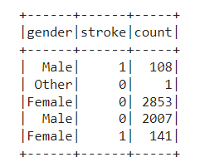
Results

Slide 13
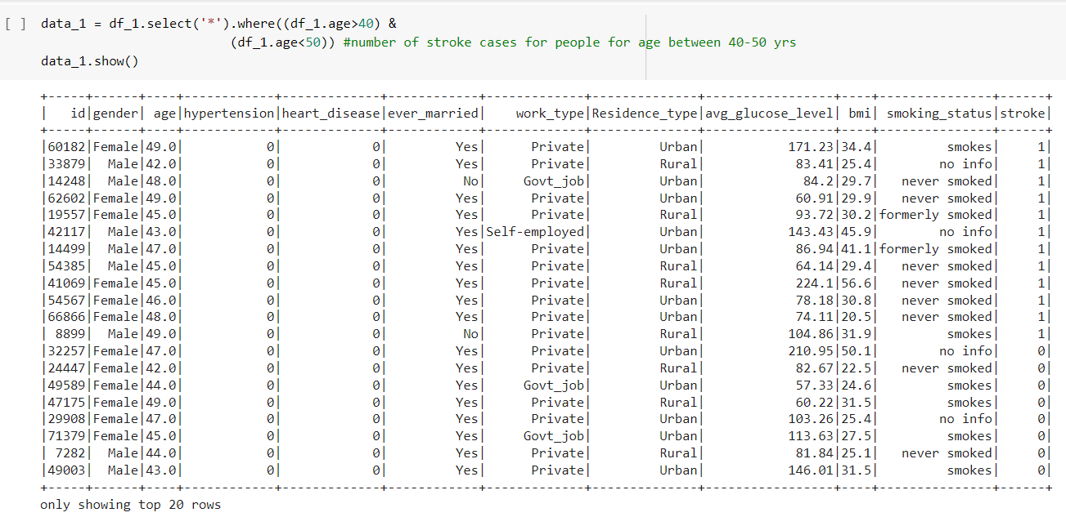
Results

Slide 14



