Slide 1


Leveraging Machine Learning for Depression Screening A Step Towards Proactive Intervention
PGPDSE – Hyd, Mar’24
TeamONE
Dileep, Praneeth, Sreekar, Ghouse, Sreehitha, Kalyani
Mentored by - Ankush Bansal

Slide 2
Leveraging Machine Learning for Depression Screening A Step Towards Proactive Intervention
PGPDSE – Hyd, Mar’24
TeamONE
Dileep, Praneeth, Sreekar, Ghouse, Sreehitha, Kalyani
Mentored by - Ankush Bansal

Slide 3
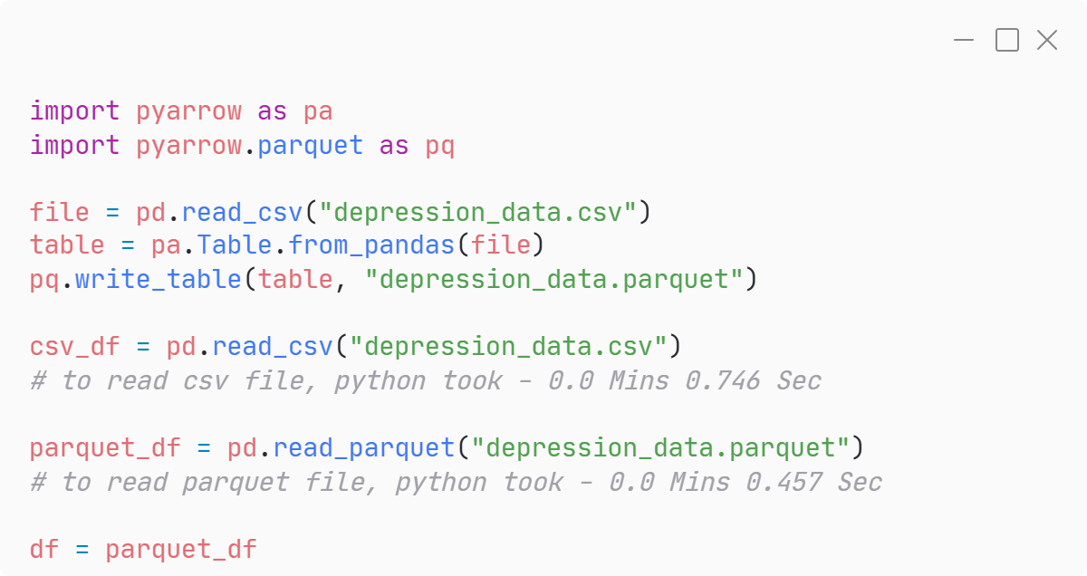
Dataset
Team
One
Converting from *.csv to *.parquet
Parquet is an open-source columnar storage file format designed for efficient data processing. Unlike CSV, which stores data row-by-row, Parquet stores data column-by-column. This columnar organization offers several key advantages
Faster data loading
Reduced storage space
Improved data integrity
Enhanced performance for machine learning tasks
<.py code>
40%
*.parquet
file took
less time to load
that *.csv file

Slide 4
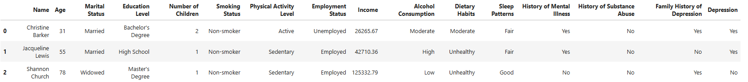
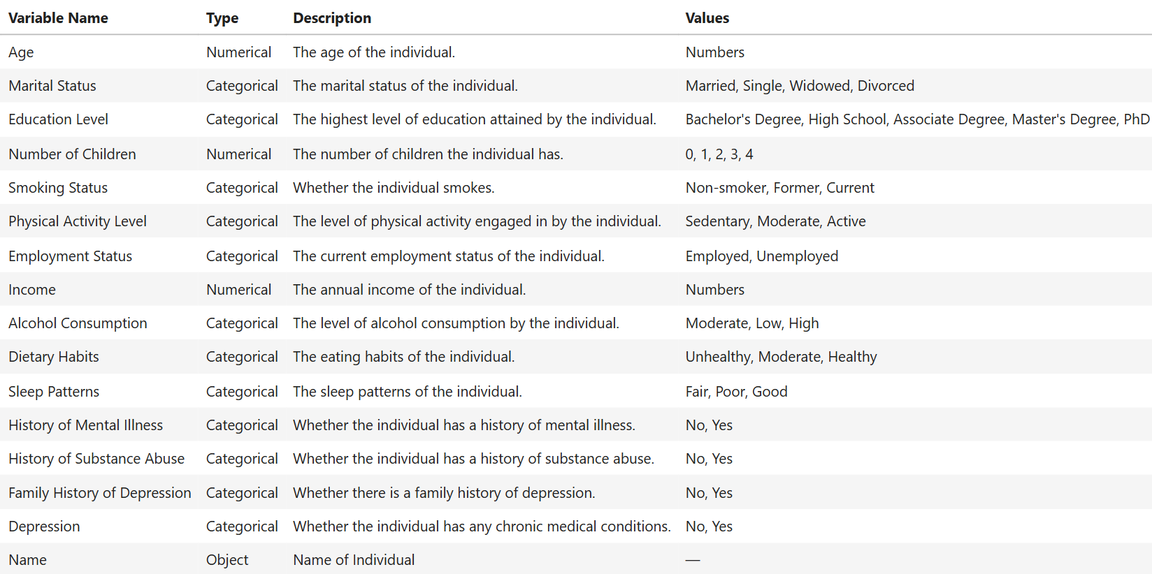
Dataset
Team
One
Shape
Rows : 4,13,768
Columns : 16
Dtypes Columns
Categorical : 13
Numerical : 2
Object : 1

Slide 5
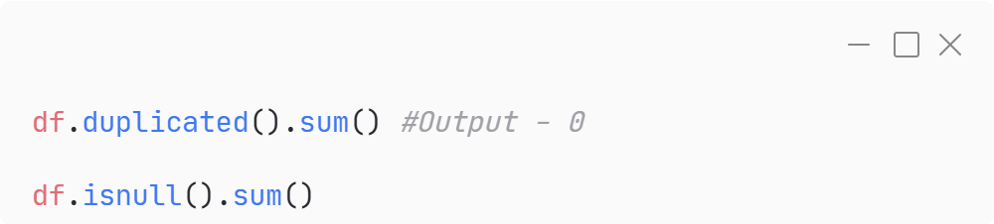
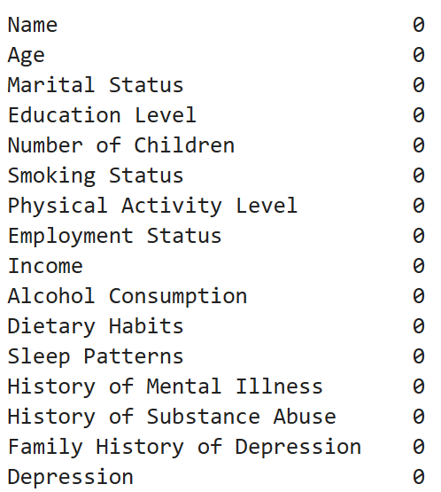
Nulls & Duplicates
Team
One
<.py code>
Why..?
Algorithm Compatibility
Biased Analysis
Reduced Statistical Power
There are no Null Values in this Dataset
There are no Duplicate Values in this Dataset

Slide 6
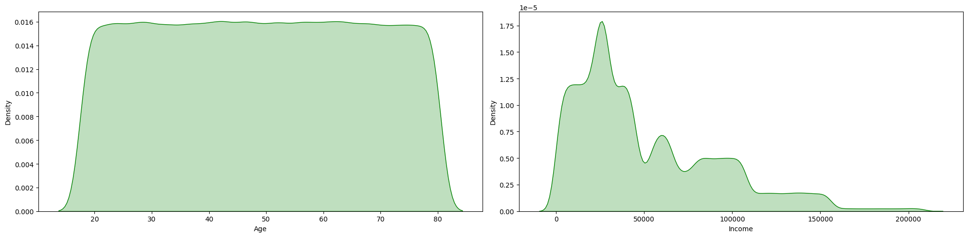
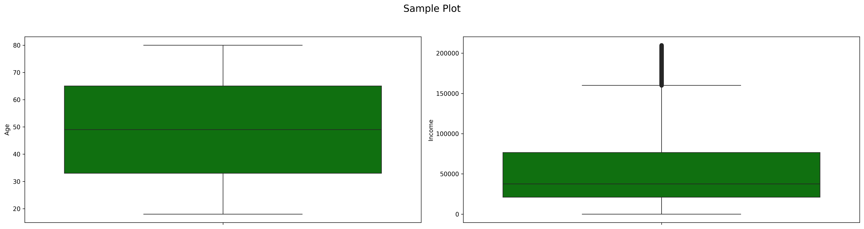
Univariant Analysis
Team
One
AGE INCOME

Slide 7
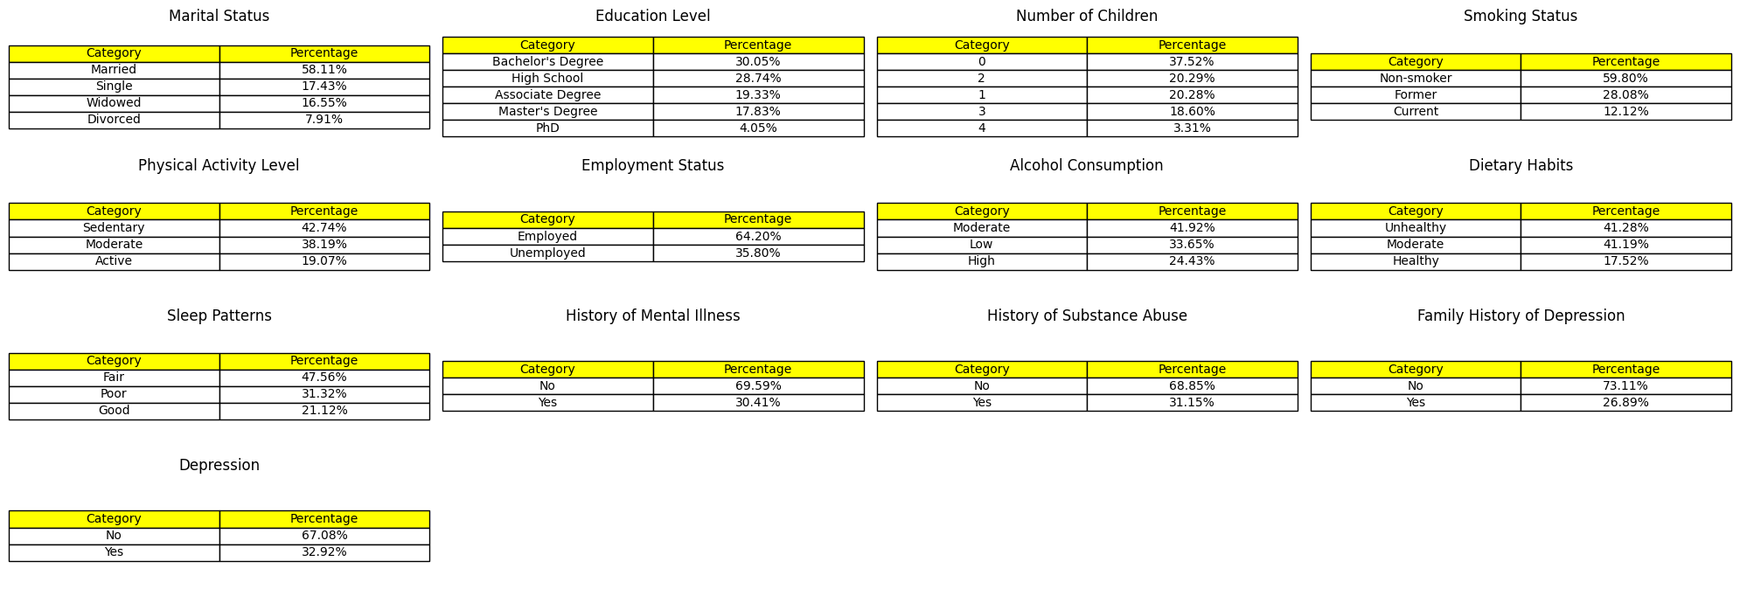
Univariant Analysis
Team
One

Slide 8
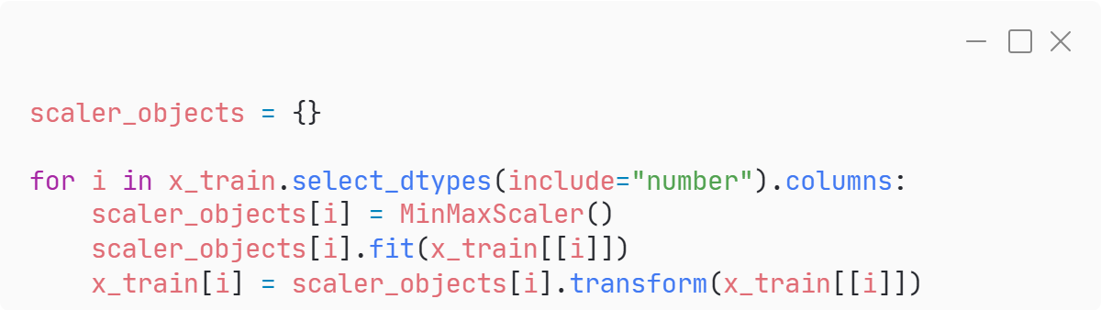
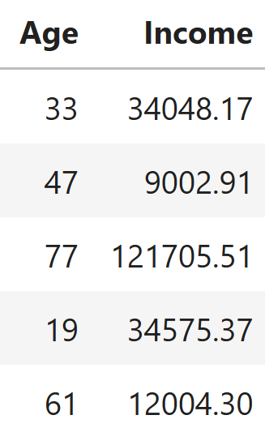
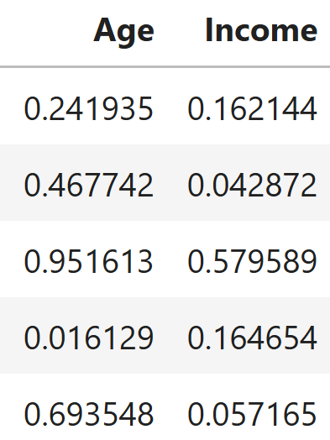
Scaling
Team
One
Why..?
Equalizing Feature Influence
Improving Algorithm Performance
Preventing Domination by Large Values
We used “MinMax Scaler”, because of the outliers in “income” variable.
We have done “fit_transform” on training data, and just “transform” on testing data to prevent data leakage. Because the test data should be hidden from the model so that overfitting will not happen.
<.py code>
Before Scaling
After Scaling

Slide 9
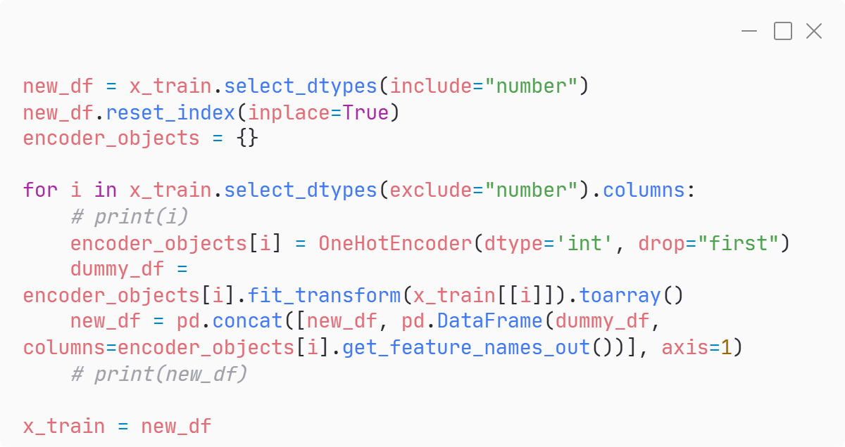
Encoding
Team
One
Why..?
Algorithm Compatibility
We used “One Hot Encoding” to make 14 categorical variables as numerical.
We have done “fit_transform” on training data, and just “transform” on testing data to prevent data leakage. Because the test data should be hidden from the model so that overfitting will not happen.
<.py code>

Slide 10
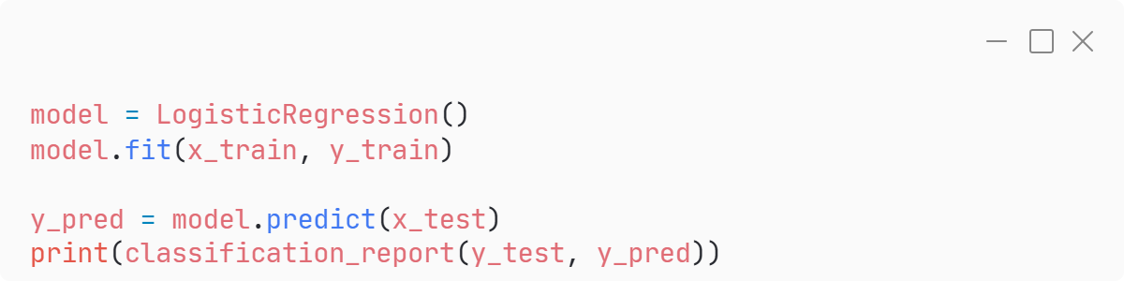
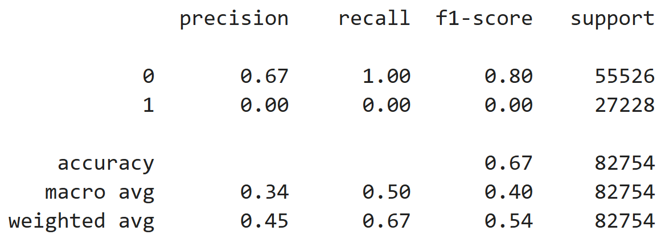
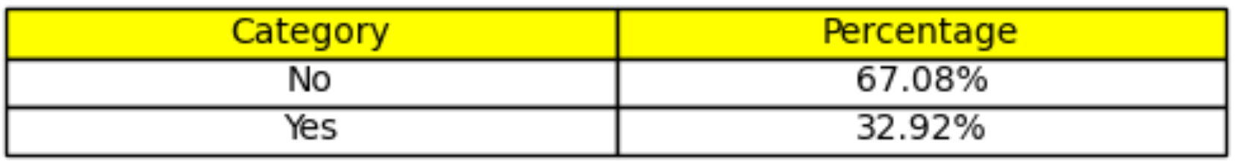
Base Model
Team
One
<.py code>
We have use “Logistic Regression” is a base model. It gave 67% accuracy, but the model failed to detect class 1 datapoints in test data.
Possible Reasons for failing of algorithm:
Class Imbalance
Insufficient Features
Model Limitations
Classification Report

Slide 11
Works to be done:
Team
One
Will check if this data is satisfying the assumption of Linear Regression?
Linearity
Independence of Residuals
Homoscedasticity
Normality of Residuals
No Multicollinearity
Will do statistical tests to know which feature is important to predict target
Will do PCA to make sure there is no Multicollinearity.
Will do transformation on Numerical features
Will do hyperparameter tunning
Will check is this data performs better in clustering rather that classification
Will try various other classification algorithms
Will to feature engineering
Will make this whole algorithm dynamic using OOPs – (Pipeline)

Slide 12
THANK YOU
Please ask your question
PGPDSE – Hyd, Mar’24
TeamONE
Dileep, Praneeth, Sreekar, Ghouse, Sreehitha, Kalyani
Mentored by - Ankush Bansal

