Slide 1
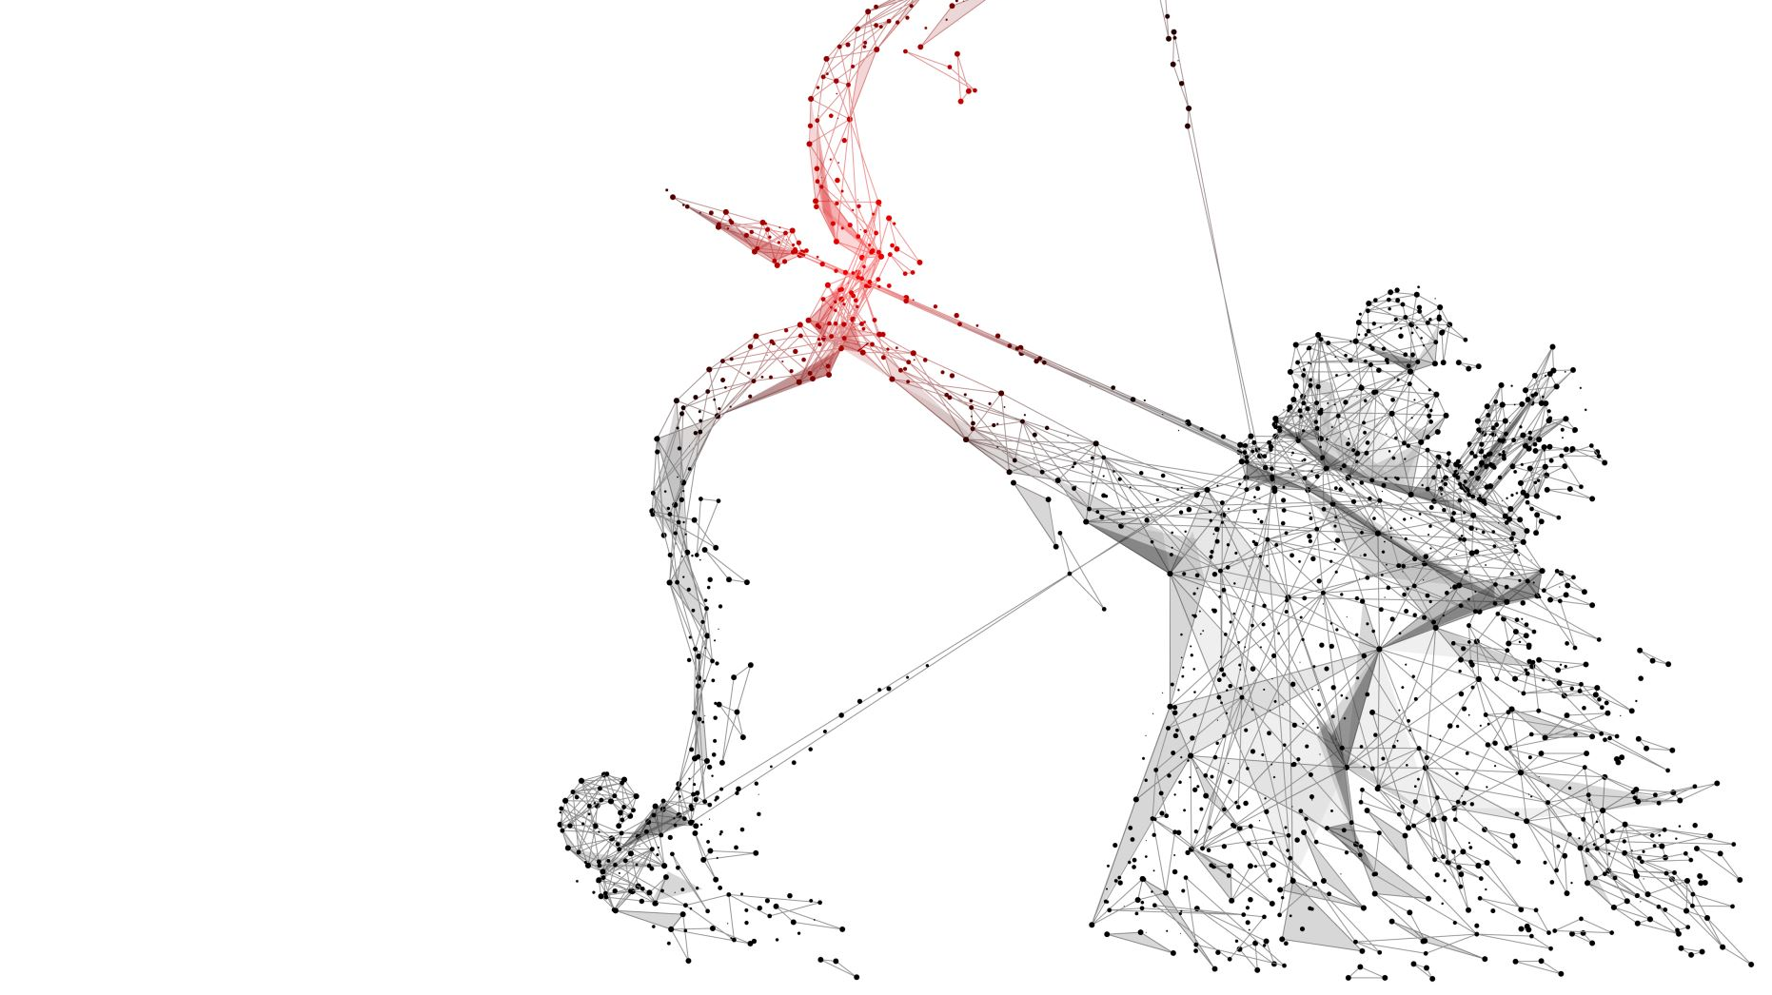
Chinmaya News
By Class IX D

Slide 2
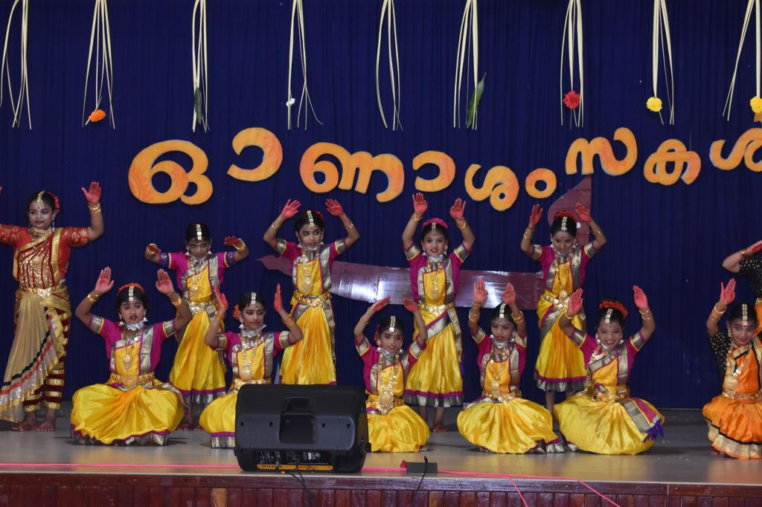
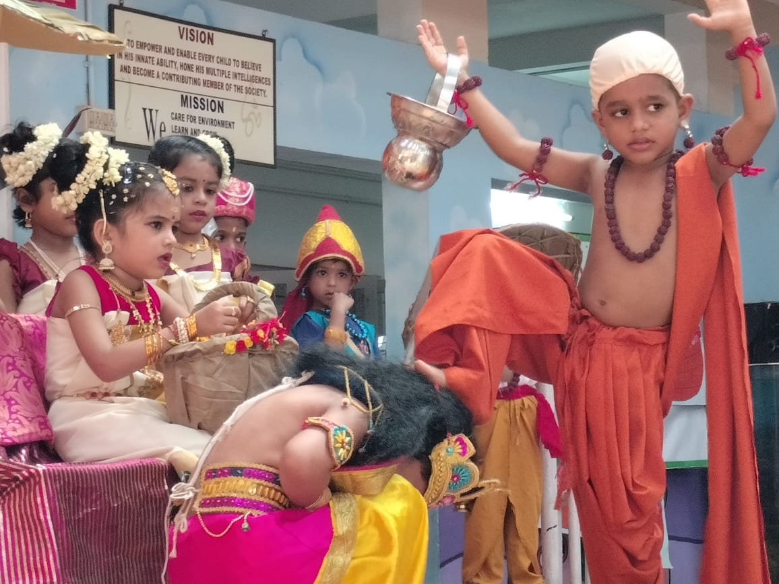
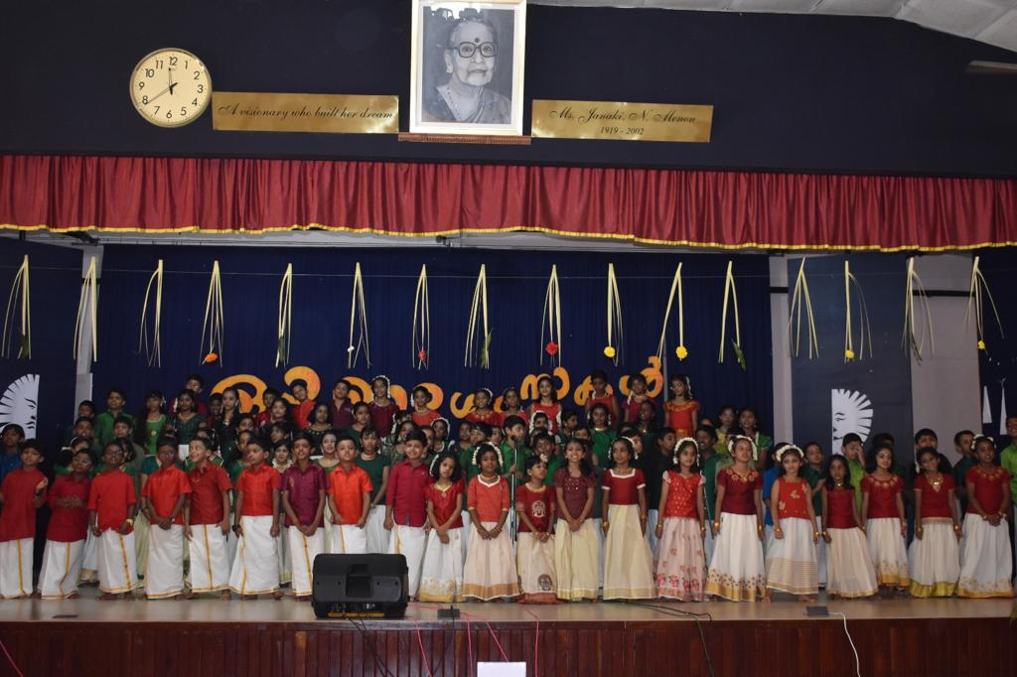
Onam celebration
Chinmaya Vidyalaya celebrated Onam on 25.08.2023.
Shri. A Gopalakrishnan, Chief Sevak, CMECT-GC, Shri K S Vijayakumar, President, Board of Management, Shri M Unnikrishnan, Secretary, Board of Management and Shri Venugopal C Govind, Senior Trustee, CMECT - GC were the dignitaries. Principal, Ms. Prathiba V welcomed the gathering.

Slide 3
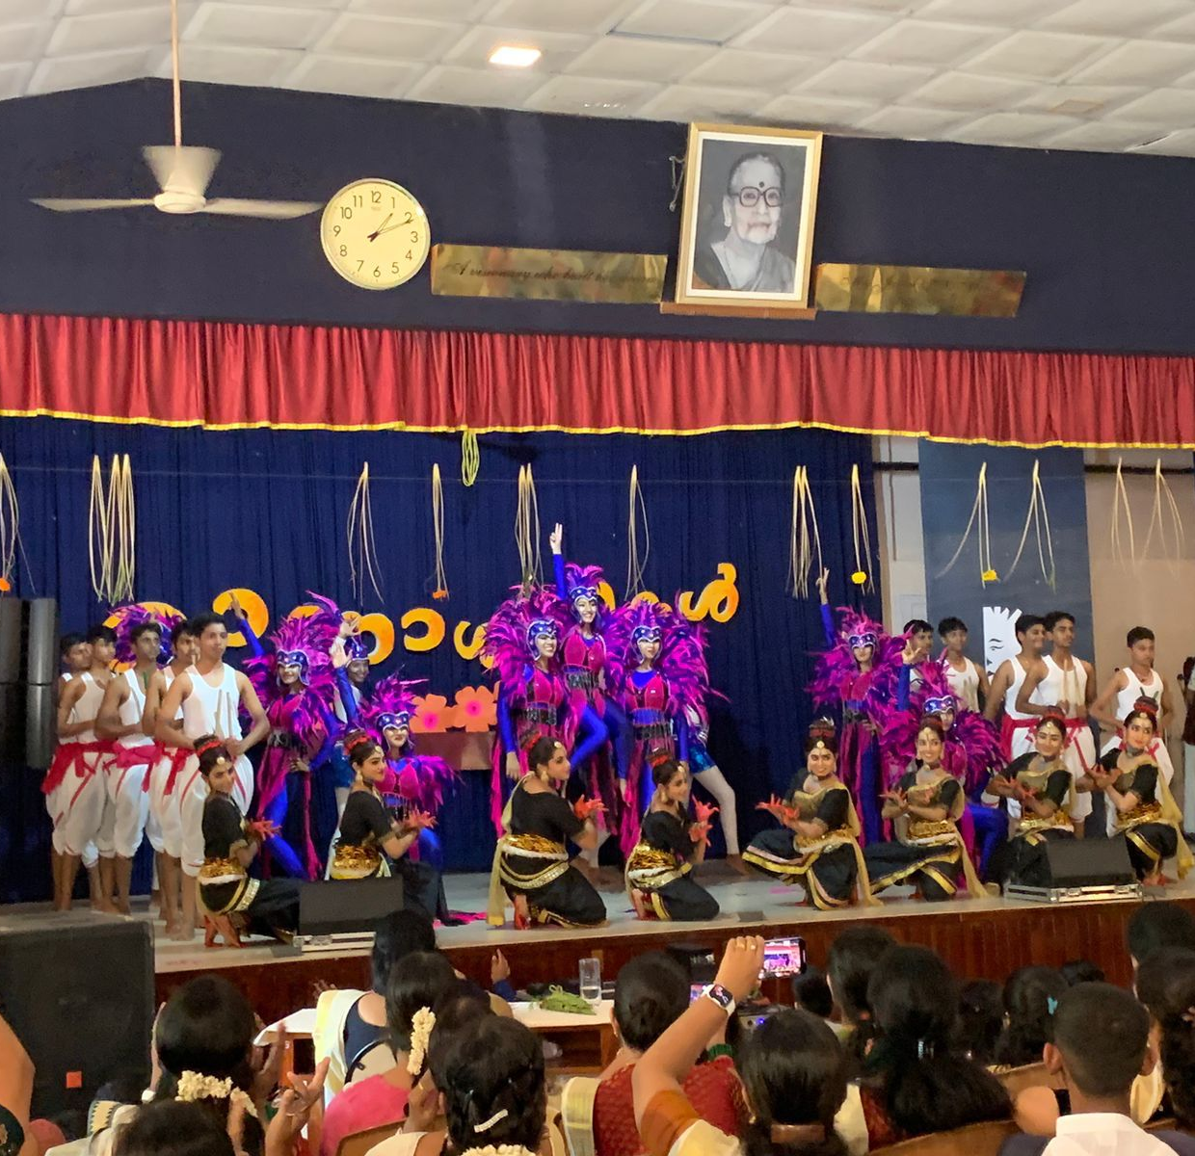
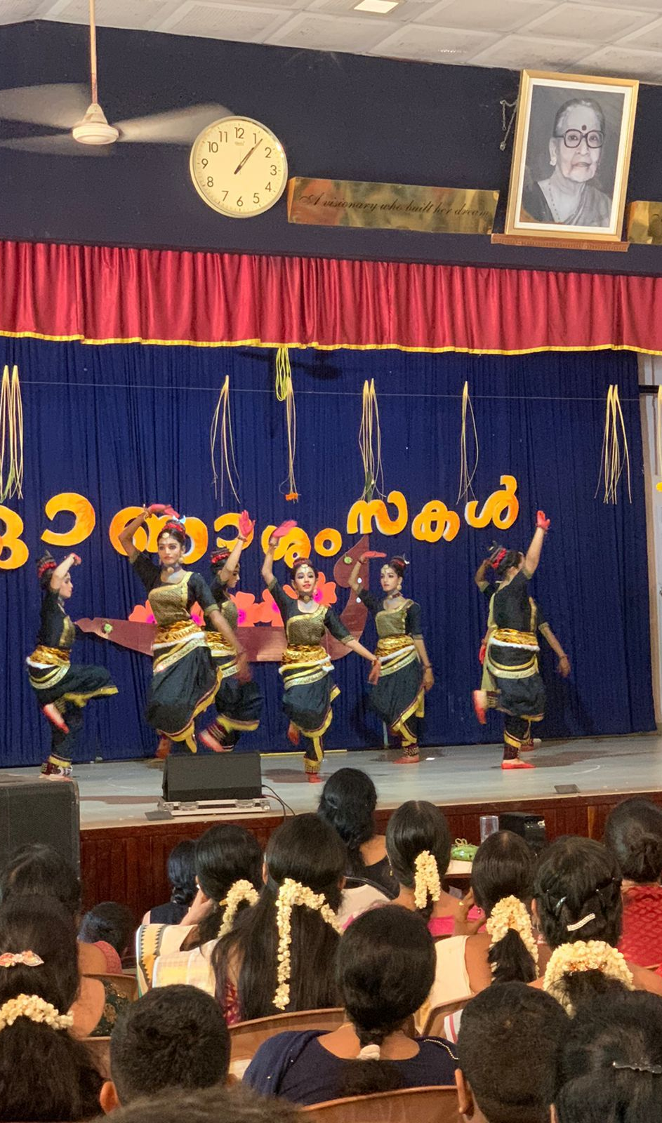
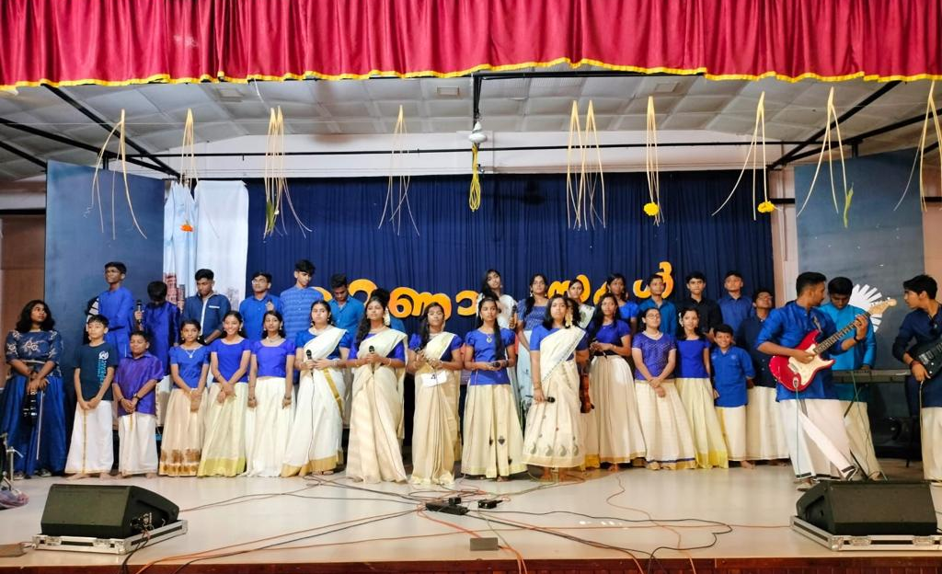
inter house competition
The three events of the Inter-house competitions were Gana Tharangini (Music Fusion), Aanandotsavam (Festival Saga) and Nrityathi Nrityathi (Dance Fusion).
The senior students of the school presented a fabulous display of dance and music.
The highlight of the day was 'Aanandotsavam' - Potpourri of Temple Festivals. The spectacular performance of students turned out to be an enjoyable day for the whole school.

Slide 4
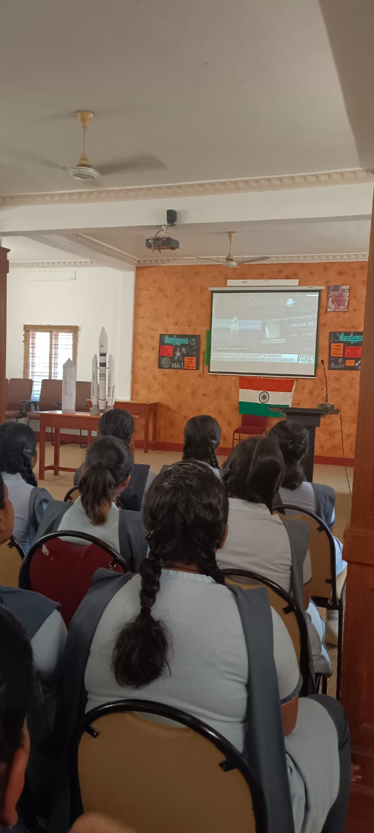
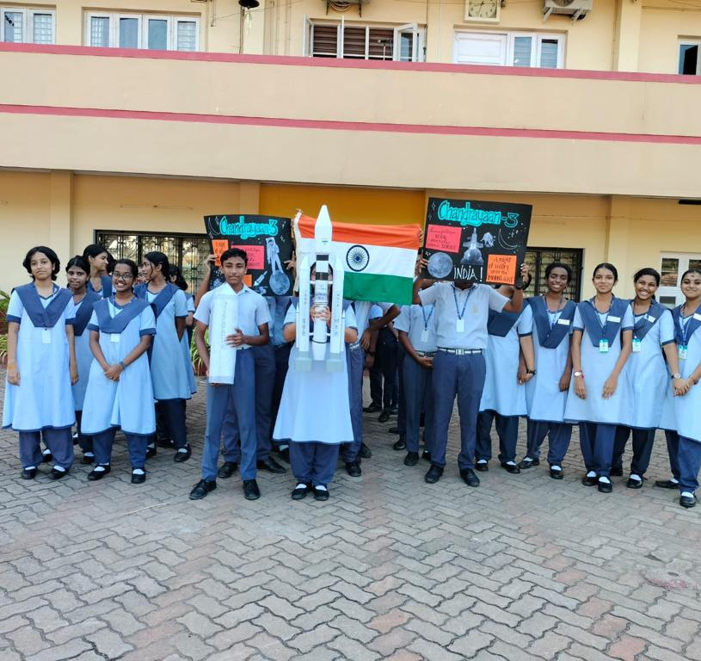
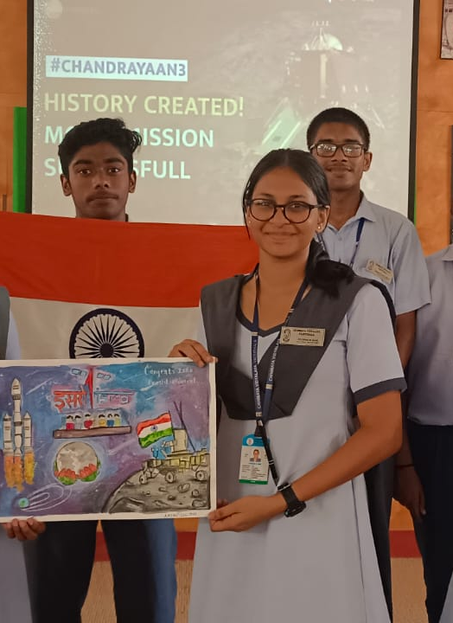
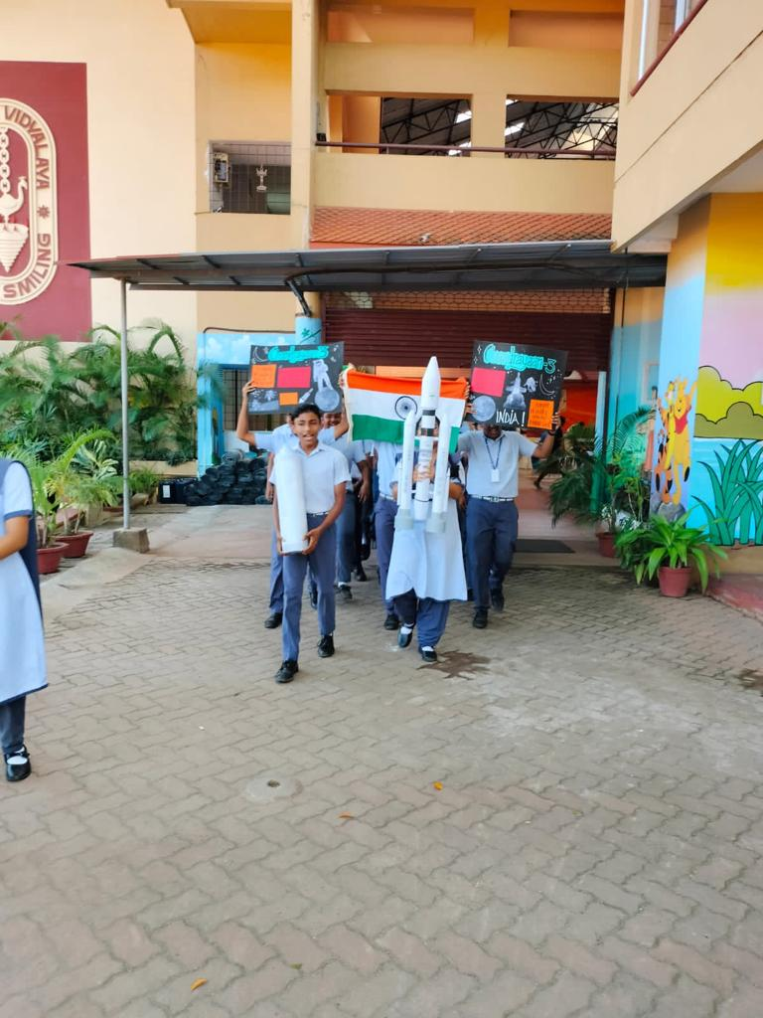
Chandrayaan celebration
Information to be added in school

Slide 5
Teacher’s Day celebration
Information and proper pictures to be added in school

Slide 6
Kg Sree Krishna Jayanthi celebration
Information and proper pictures to be added in school

Slide 7

Thank You!

