Slide 1



credit_defaults
View in Power BI
Last data refresh:
11/2/2021 4:46:11 AM UTC
Downloaded at:
12/21/2021 12:47:20 AM UTC

Slide 2
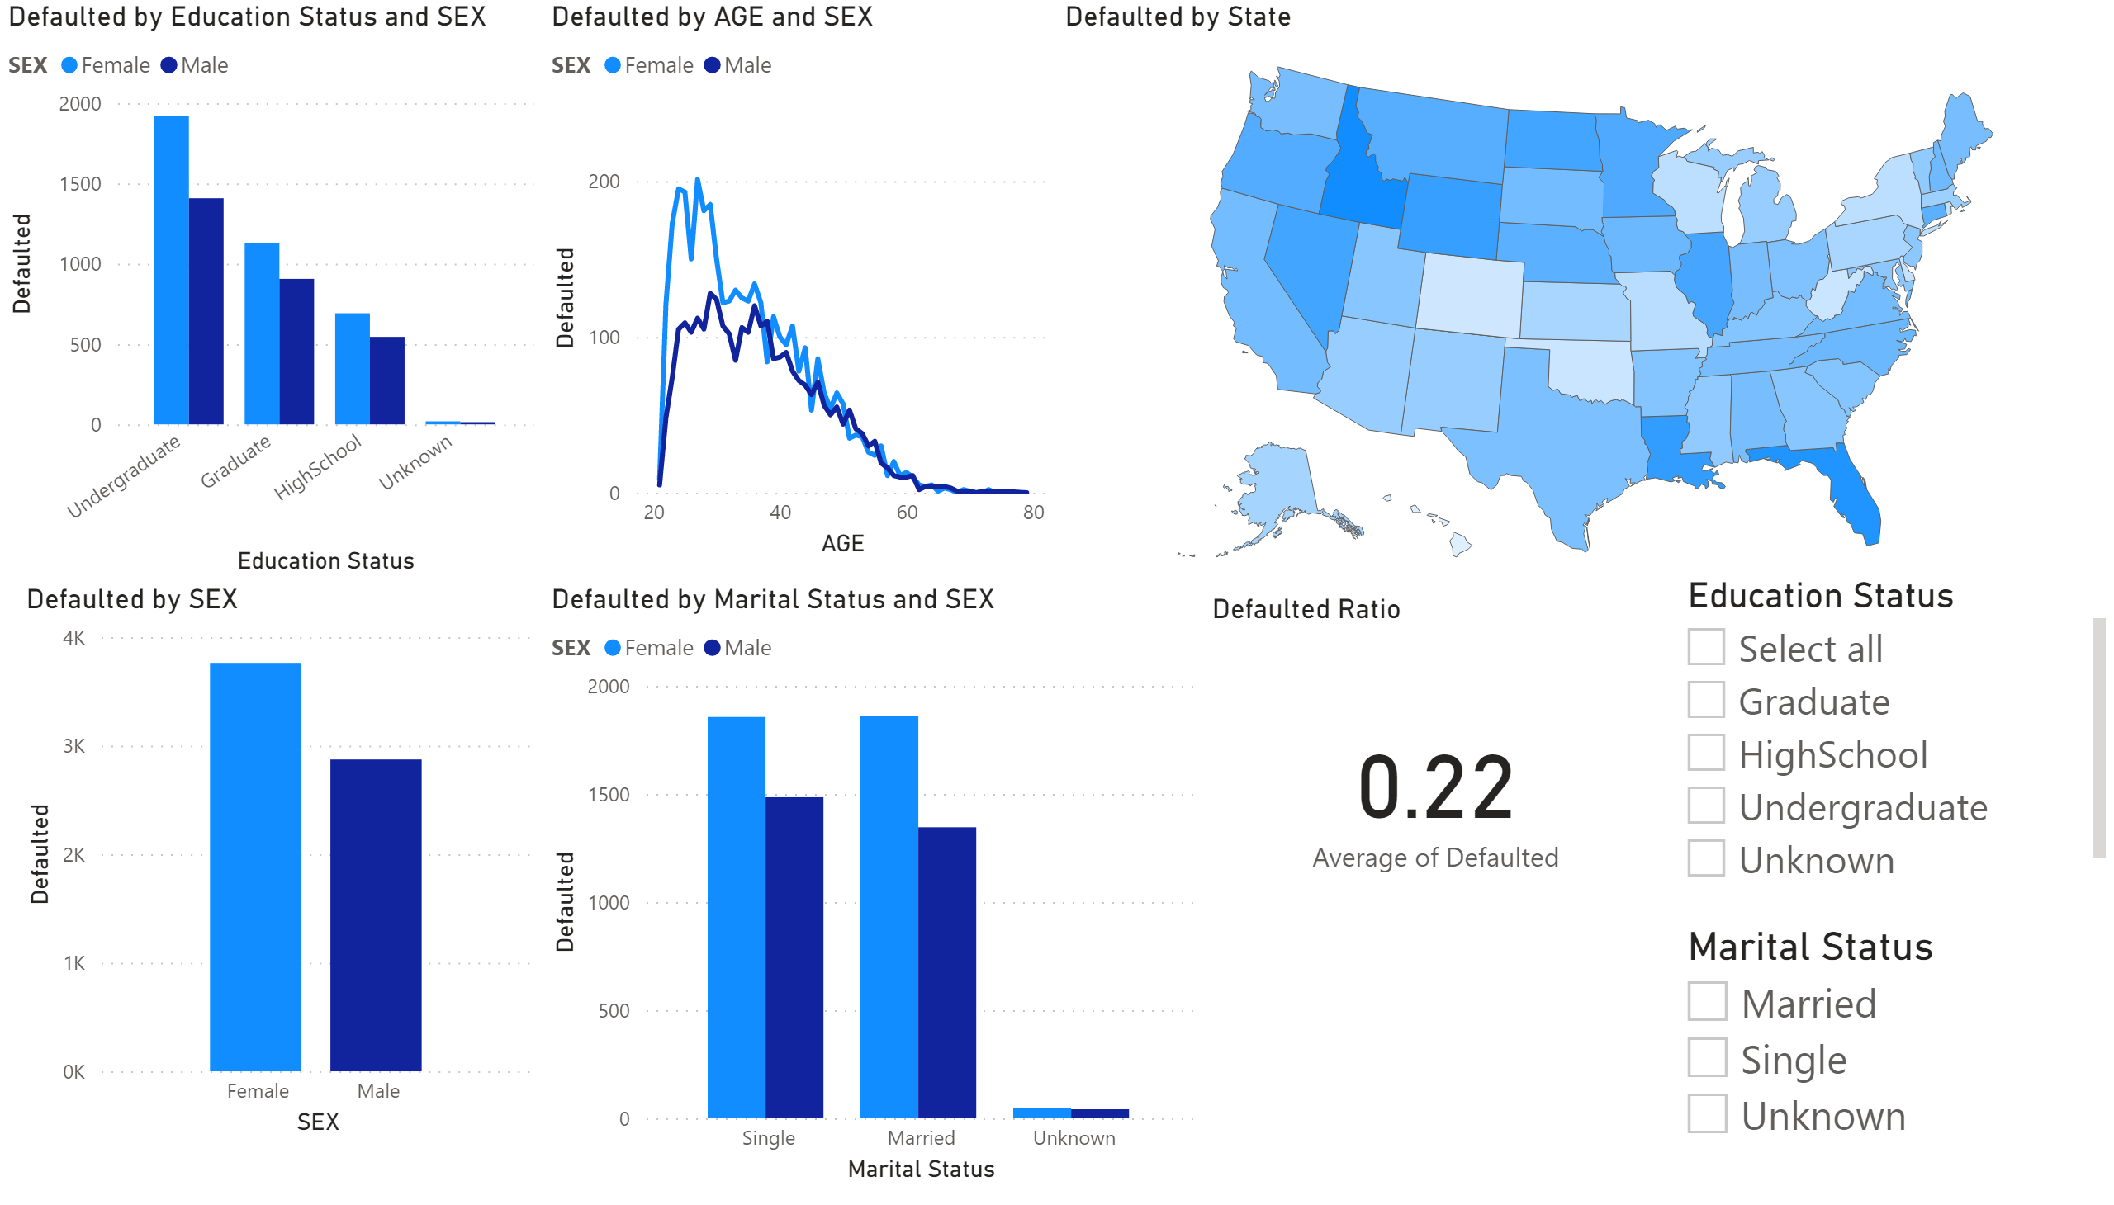
Page 1
Notes:
shapeMap
No alt text provided
clusteredColumnChart
No alt text provided
Defaulted Ratio
No alt text provided
clusteredColumnChart
No alt text provided
lineChart
No alt text provided
clusteredColumnChart
No alt text provided
slicer
No alt text provided
slicer
No alt text provided

