Slide 1



HR_Data_Dashboard
View in Power BI
Last data refresh:
11/5/2021 12:56:05 AM UTC
Downloaded at:
12/21/2021 1:27:35 AM UTC

Slide 2
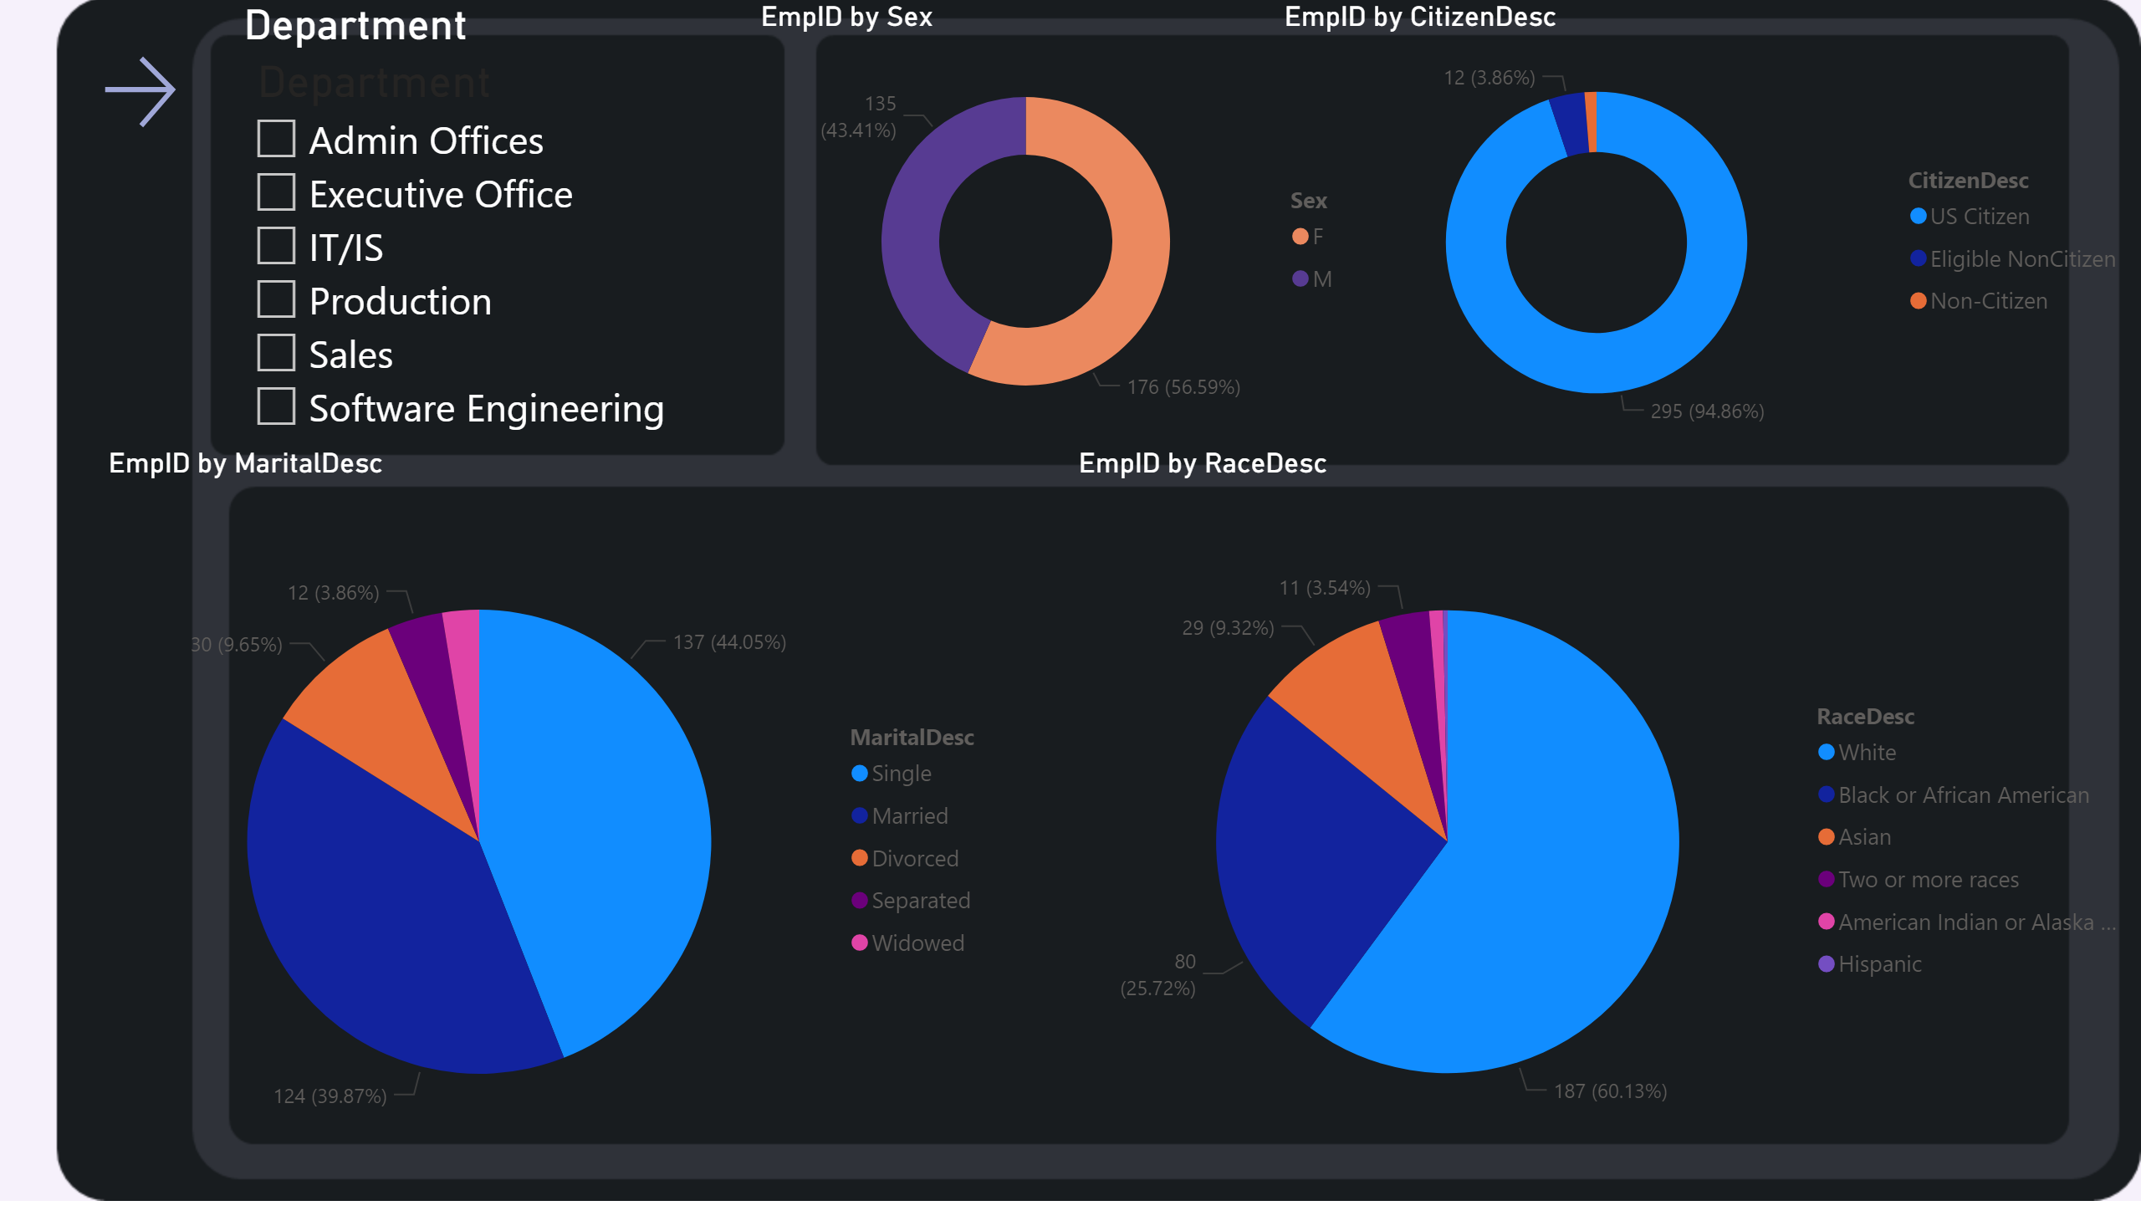
Page 1
Notes:
pieChart
No alt text provided
donutChart
No alt text provided
actionButton
No alt text provided
pieChart
No alt text provided
donutChart
No alt text provided
Department
No alt text provided

Slide 3
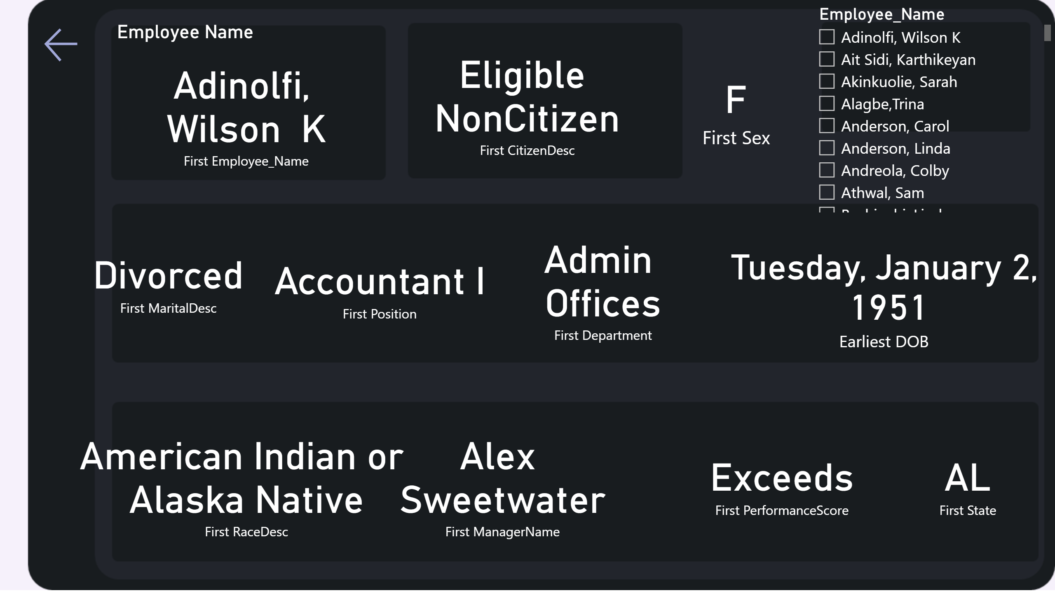
Page 2
Notes:
Employee Name
No alt text provided
card
No alt text provided
card
No alt text provided
card
No alt text provided
card
No alt text provided
card
No alt text provided
card
No alt text provided
card
No alt text provided
card
No alt text provided
card
No alt text provided
card
No alt text provided
slicer
No alt text provided
actionButton
No alt text provided

