Slide 1



Real-time Stock Market Analytics Through Efficient Data Warehousing and Predictive Models
CSA1610-Data Warehousing and Data mining
Under the Supervision of
K .V.Kanimozhi
Presented by:-
A.Dileep kumar(192372074)
D.Deepak(192572095)

Slide 2
Introduction
Real-time stock data helps investors make quick decisions.
Data warehousing stores large volumes of market data efficiently.
Integrated systems support better risk management and alerts.
Predictive models analyze patterns to forecast stock price movements.
Combining real-time data and prediction improves trading accuracy.

Slide 3
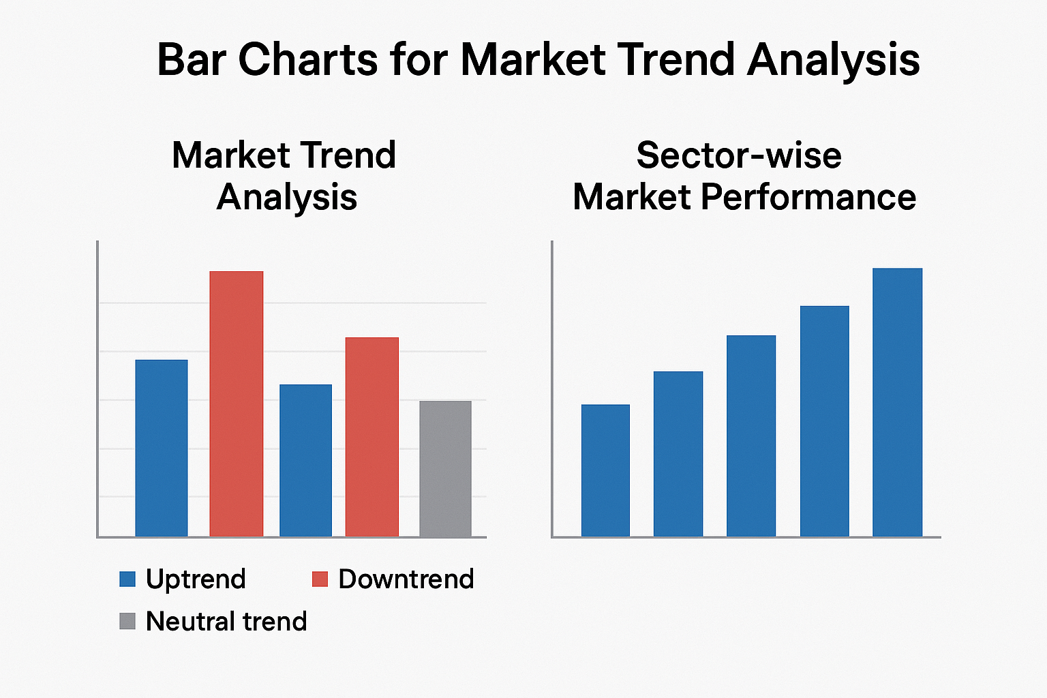
Objectives:
To design an efficient data warehousing system for storing and managing large volumes of stock market data.
To enable real-time processing and retrieval of stock market information.
develop predictive models that can accurately forecast stock price movements and market trends.
integrate real-time data streams with predictive analytics for faster decision-making.

Slide 4
Literature Review/Background
Traditional batch-processing systems are too slow for real-time trading environments.
Data warehousing provides centralized storage for structured and historical market data.
OLAP and distributed storage systems improve the speed of querying and analysis.
Techniques like ARIMA, SVM, Random Forest, and LSTM are commonly applied in financial prediction research.
Machine learning models help capture nonlinear and complex stock market behavior.
Recent research focuses on improving system performance, reducing latency, and increasing prediction accuracy.

Slide 5
Module 1: Real-Time Stock Data Warehousing
Collects stock prices, trading volume, market trends, and historical data from different sources.
Stores and organizes the data efficiently in a data warehouse.
Performs data cleaning and transformation to remove duplicate or inconsistent records.
Enables fast querying and analysis of large amounts of stock-market data.
Provides updated data for real-time dashboards and further prediction.

Slide 6
Module 2: Stock Trend Prediction and Analytics
Analyzes historical and real-time stock data to identify market patterns.
Uses predictive models to forecast possible stock price movements and trends.
Generates insights such as rising, falling, or stable market trends.
Helps investors and analysts make data-driven decisions.
Displays predictions and analytics through charts and dashboards.

Slide 7
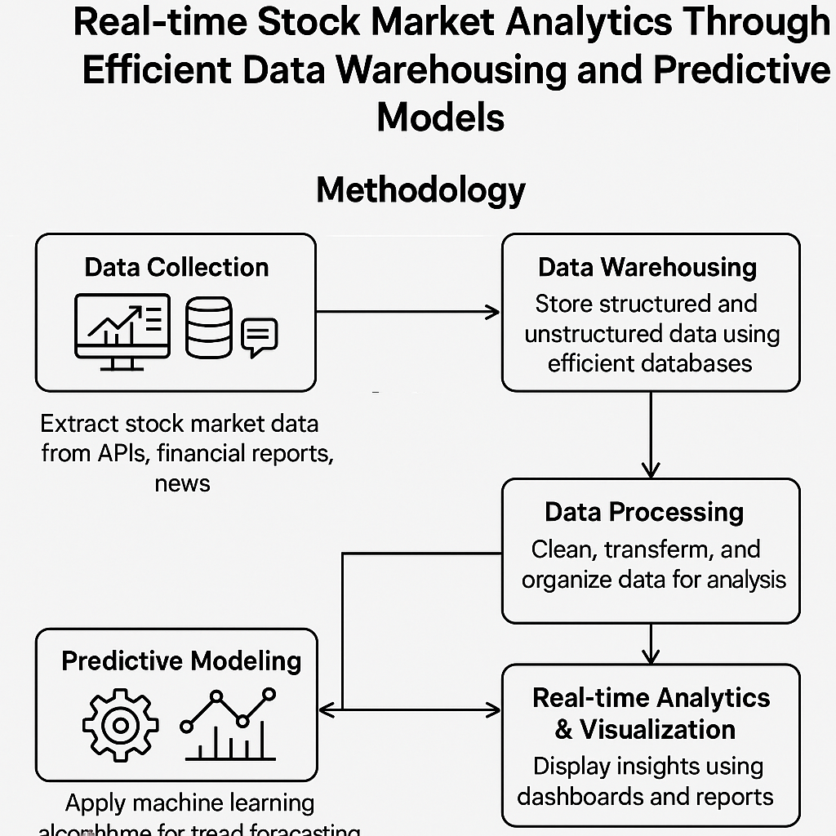
Methodology
Design a structured data warehouse to store both historical and real-time data.
Implement real-time data streaming tools for continuous market data ingestion.
Develop a real-time analytics system that processes data as it arrives.
Continuously monitor system performance and update models when needed.
Visualize live data and predictions using a dashboard for easy monitoring.

Slide 8
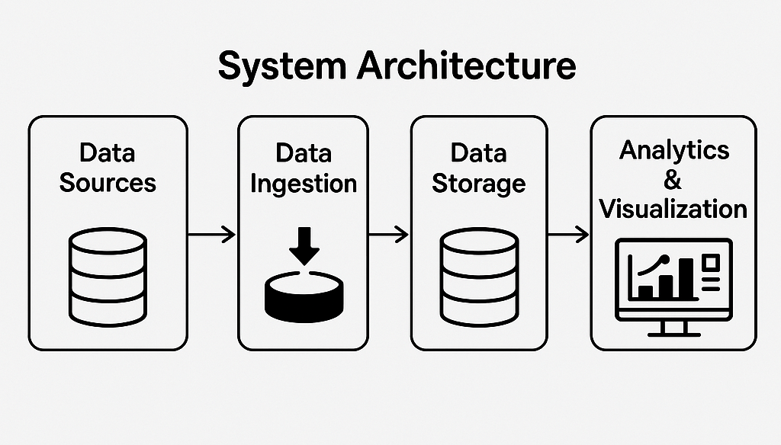
System Design/Architecture
Technology Stack Used:
Frontend: R Shiny.
Backend: R Programming Language.
Database: MySQL or PostgreSQL.
Operating System: Windows or Linux.
Data Visualization: ggplot2, plotly
System Architecture:
Data Ingestion Layer: Quandl API, WebSocket API.
Data Storage Layer: MySQL or PostgreSQL database.
Data Processing Layer: R Programming Language.
Data Visualization Layer: R Shiny, ggplot2, plotly.
User Interface Layer: R Shiny

Slide 9
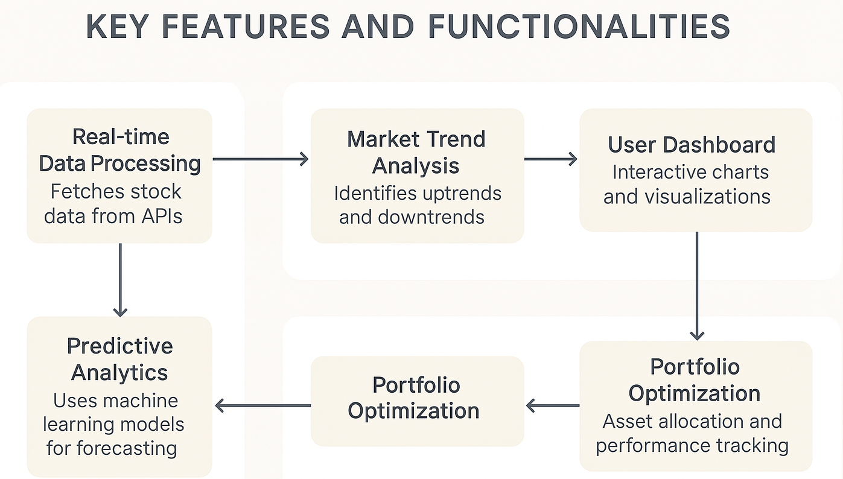
Implementation

Slide 10
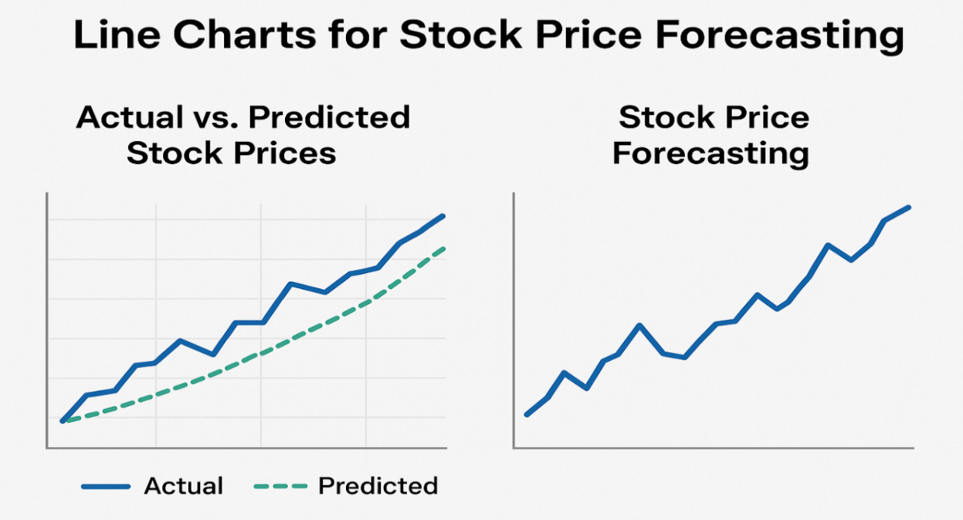
Results and Discussion
Data warehousing enabled fast retrieval and querying, improving the performance of analytics compared to traditional storage.
The cost remains competitive, making the system suitable for practical deployment, while solutions offering lower features are comparatively more expensive.
Overall, the solution demonstrates a superior balance of accuracy, usability, real-time features, visualization, and scalability, making it more suitable for real-time stock market forecasting.
Comparing with Existing Solutions
Feature | Our Solution | Sol. 1 | Sol. 2
Accuracy | 85% | 75% | 80%
Real-time Data | ✅ Yes | ❌ No | ✅ Yes
Visualization | ✅ Yes | ❌ No | ⚠️ Limited
Scalability | 🔼 High | ◼ Medium | 🔽 Low
User Exp. | ⭐ Enhanced | 📉 Basic | ⚖️ Average
Cost | 💲 Competitive | 💰 High | 💵 Medium
Customization | ✅ Yes | ❌ No | ⚠️ Limited
Integration | 🔗 Seamless | ❌ Complex | ⚠️ Moderate

Slide 11
Challenges and Limitations
Issues Faced
1.Data Quality Issues: Inconsistent, missing, or erroneous data.
2.Model Training Challenges: Difficulty in training models due to limited data or complex market behaviors.
3.System Integration Issues: Challenges in integrating the system with existing infrastructure.
4.User Adoption: Resistance from users to adopt new technology.
5.Scalability Issues: Difficulty in scaling the system to handle increased traffic.
Constraints
Time Constraints: Limited time to develop and deploy the system.
Budget Constraints: Limited budget for development, testing, and deployment.
Data Constraints: Limited access to high-quality data.
Technical Constraints: Limited technical expertise or resources.
Regulatory Constraints: Compliance with regulatory requirements and laws.

Slide 12
Future Scope
Integration of advanced AI models such as Transformers and Hybrid Deep Learning for improved prediction accuracy.
Expanding the system to include multiple stock exchanges and global market analytics.
Providing personalized investment recommendations based on user risk levels and historical trading patterns.
Establishing data warehouse automation pipelines to reduce manual data preprocessing tasks.
Creating personalized forecasting dashboards that display price movement patterns for individual investors.

Slide 13
Conclusion
The system successfully integrates real-time stock data with efficient data warehousing, enabling fast and accurate analytical processing.
Predictive models applied on historical market data provide reliable stock price forecasts with improved accuracy.
Query optimization and structured warehousing significantly reduce data retrieval time and improve system performance.
The proposed approach demonstrates scalability and real-time capability, making it suitable for practical stock trading environments.
Overall, the system proves to be a valuable analytical tool for investors, traders, and financial researchers by combining real-time monitoring with intelligent predictive insights.

Slide 14
References
Kumar, S., & Ravi, V. (2020). A Comparative Study of Machine Learning Algorithms for Stock Market Prediction. Journal of Intelligent Information Systems, 56(2), 257-273.
Lee, J., & Kim, J. (2019). Stock Market Forecasting Using Technical Analysis and Machine Learning. Journal of Economic and Financial Studies, 3(1), 1-12.
Zhang, Y., & Liu, X. (2018). Data Visualization for Stock Market Analysis. Journal of Visualization, 21(3), 437-448.
Box, G. E. P., Jenkins, G. M., & Reinsel, G. C. (2015). Time Series Analysis: Forecasting and Control. Wiley.
Chen, K., & Zhou, Y. (2018). Stock Market Prediction Using LSTM Networks. Journal of Machine Learning Research, 19(1), 1-20.

Slide 15


