Slide 1

Exploratory Data Analysis of Job Candidate Attributes

Slide 2
About me
As a B.Tech student majoring in Electronics and Communication Engineering (ECE) at Rajiv Gandhi University of Knowledge Technologies, I've honed my mathematics, programming, and analytical skills. Despite my ECE focus, I'm captivated by data science's potential to extract insights from vast datasets, fueling innovation and informed decision-making. I've pursued supplementary coursework and self-study in data science, completing online courses, participating in hackathons, and undertaking personal projects.
While lacking formal work experience in data science, I've independently completed projects and collaborated on academic endeavors involving data analysis and machine learning. These experiences have bridged theoretical knowledge with practical application, enhancing my problem-solving abilities. My LinkedIn profile (https://www.linkedin.com/in/dileepmanelli/) and GitHub profile (https://github.com/dileepmanelli) provide further insight into my academic background, projects, and skills.

Slide 3
Objective of the project
The objective of the project is to analyze a dataset containing information about graduates, aiming to uncover insights related to career trajectories, earnings potential, and factors influencing employment outcomes. Through comprehensive data exploration, statistical analysis, and hypothesis testing, the project seeks to provide valuable insights for educational institutions and career planning initiatives.

Slide 4
Summary of the Data
The dataset comprises information about graduates, including demographics, educational backgrounds, and career-related attributes. It encompasses numerical data such as salary, academic scores, and personality test scores, as well as categorical variables like gender, specialization, and job designation. The dataset offers a comprehensive view of graduates' profiles, enabling analysis of employment trends, salary distributions, and potential correlations between various factors influencing career outcomes.

Slide 5
Exploratory Data Analysis:
Data Cleaning and Manipulation Steps
Handling date columns
Converting to datetime
Handling missing values
Filling missing values
Removing outliers
Interquartile Range
Renaming columns
Merging dataframes
Selecting columns
Concatenating dataframes
Filtering rows based on conditions

Slide 6
Exploratory Data Analysis: Univariate Analysis Steps
In our exploratory data analysis (EDA), we conducted a comprehensive univariate analysis encompassing Probability Density Functions (PDFs), histograms, boxplots, and countplots to understand numerical and categorical variables. Additionally, we identified outliers within each numerical column, crucial for data integrity. By scrutinizing probability and frequency distributions of numerical data, we gained insights into their statistical characteristics and potential anomalies. Similarly, examining the frequency distribution of categorical variables allowed us to grasp the prevalence of each category, providing context for further analysis. This multifaceted approach to EDA equipped us with a deeper understanding of the dataset's structure, paving the way for informed decision-making and subsequent analytical endeavors.

Slide 7
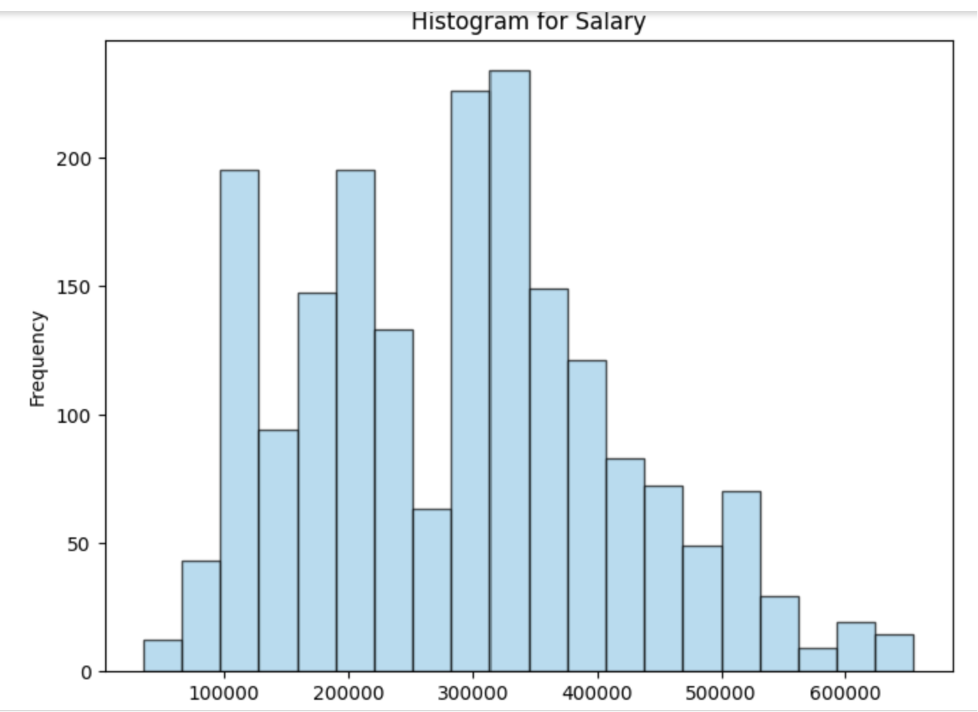
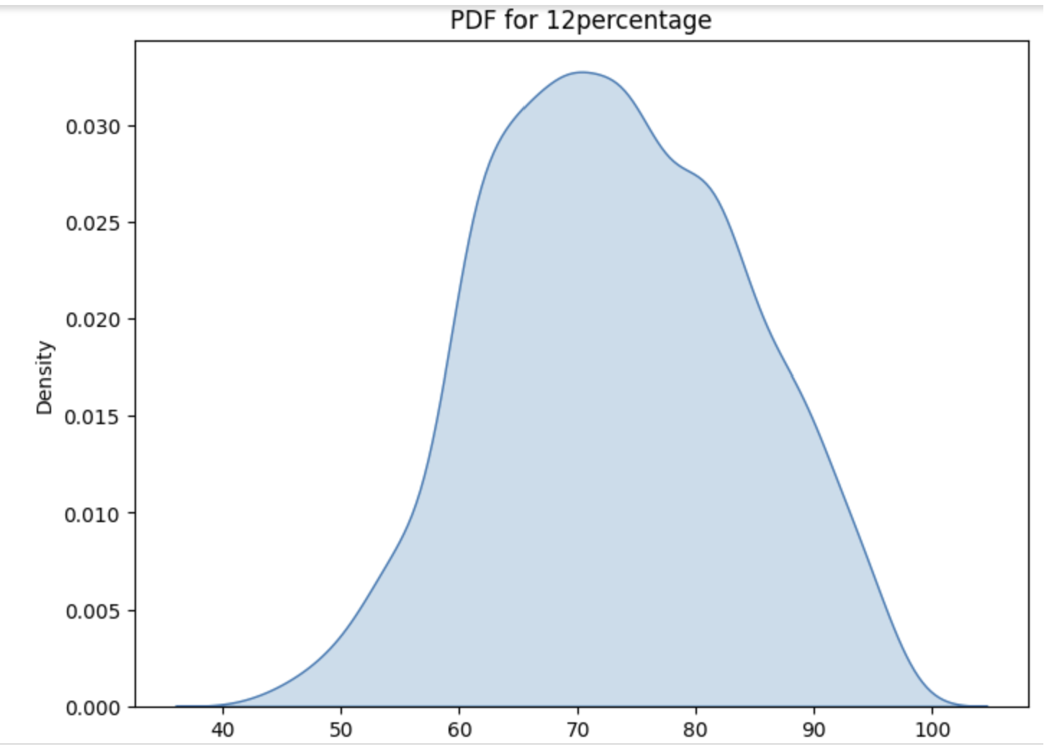
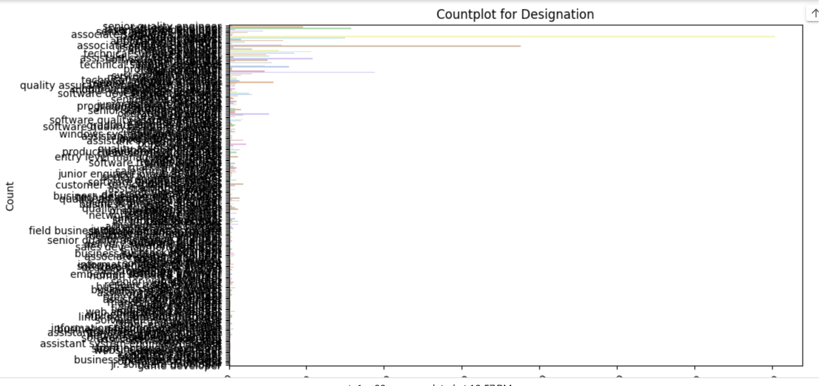
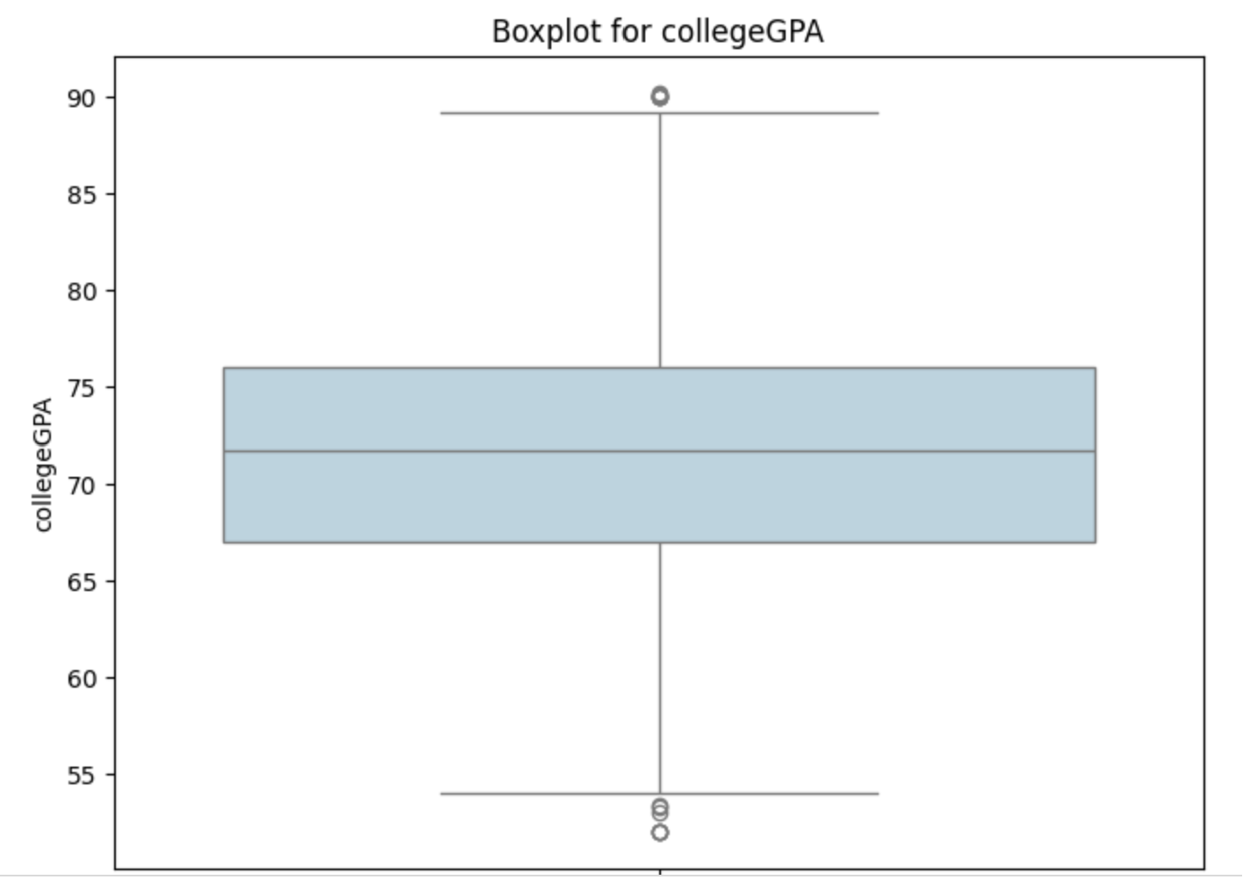
Exploratory Data Analysis: Univariate Analysis Steps

Slide 8
Exploratory Data Analysis: Bivariate Analysis Steps
In our exploratory data analysis (EDA), we engaged in bivariate analysis to uncover relationships between numerical columns using scatter plots, hexbin plots, and pair plots, facilitating insights into correlations and dependencies. Furthermore, we elucidated patterns between categorical and numerical columns through swarm plots, box plots, and bar plots, revealing variations and trends across different categories. Additionally, we explored relationships between categorical variables using stacked bar plots, discerning associations and dependencies among various categorical factors.

Slide 9
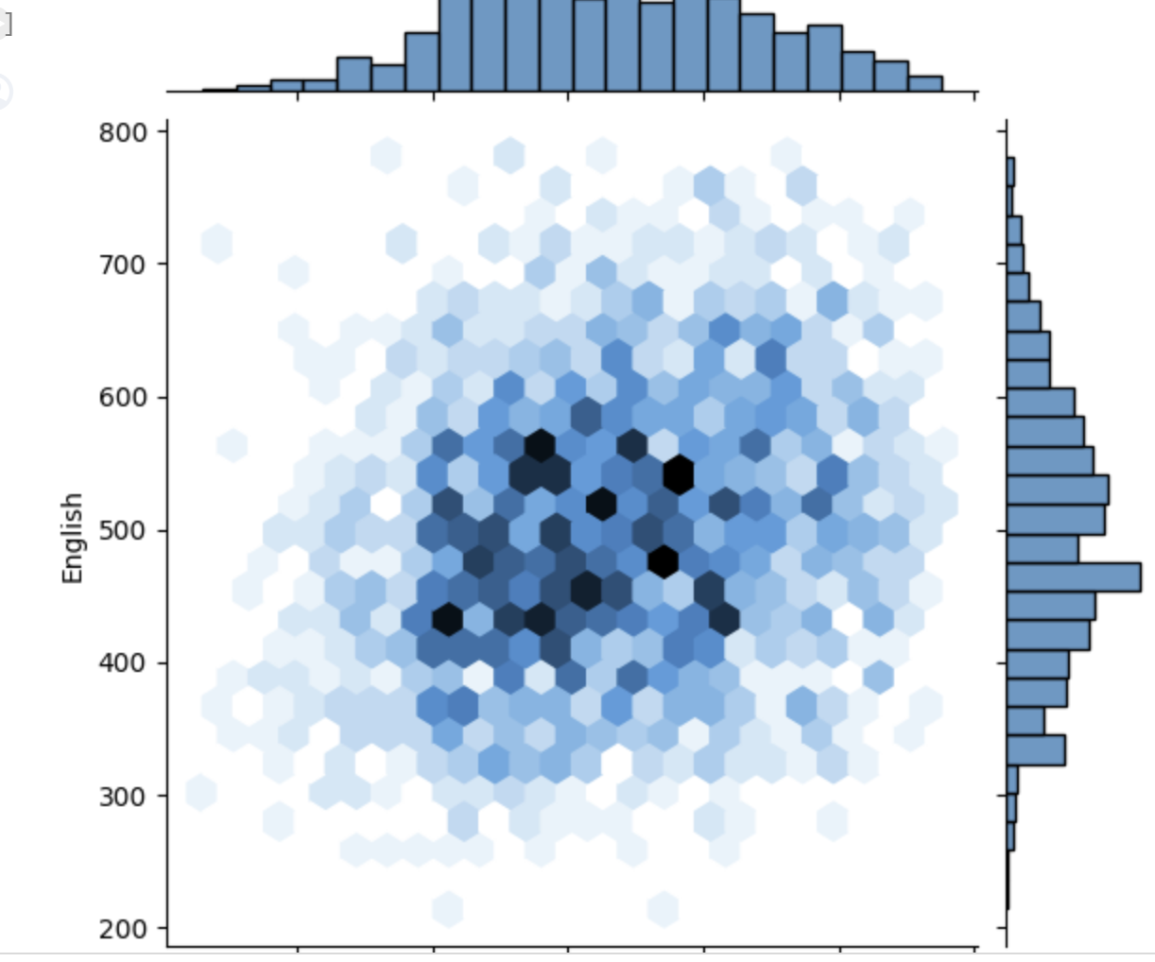
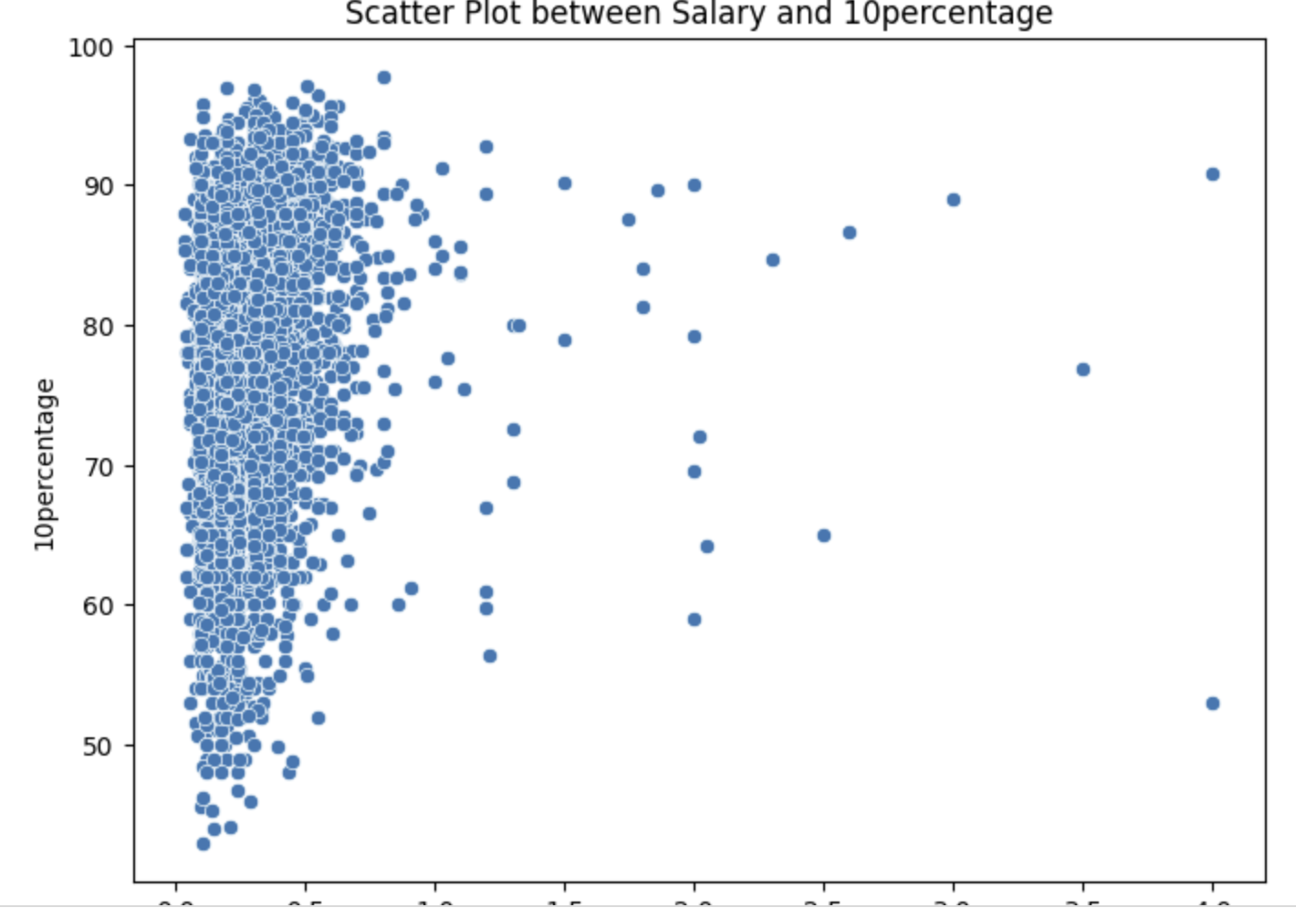
Exploratory Data Analysis: Bivariate Analysis Steps
This holistic approach to EDA provided a comprehensive understanding of inter-variable dynamics, enabling us to derive meaningful insights and inform subsequent analytical decisions with a nuanced understanding of the dataset.

Slide 10
Exploratory Data Analysis: Research Questions
To validate the claim, we scrutinized salary data of Computer Science Engineering graduates in roles such as Programming Analyst, Software Engineer, Hardware Engineer, and Associate Engineer. Additionally, we conducted a statistical test to ascertain if there exists a significant variation in specialization preferences based on gender. Through rigorous analysis, we aimed to corroborate the claim's accuracy regarding potential salary ranges and uncover any disparities or patterns in gender-specific preferences for particular specializations. This approach allowed us to provide robust insights into both salary expectations and gender-related trends within the realm of specialization choices among Computer Science Engineering graduates.

Slide 11
Conclusion
In this exploratory data analysis (EDA) project, we thoroughly examined a dataset to gain insights into various aspects such as salary distributions, educational backgrounds, and job preferences of individuals. Through univariate and bivariate analyses, we explored the probability distributions of numerical variables, identified outliers, and investigated relationships between different variables. Additionally, we assessed patterns between categorical and numerical columns and examined potential dependencies between gender and specialization choices. Overall, our findings provide valuable insights into the dataset's characteristics, aiding in better understanding societal trends and informing decision-making processes in relevant domains.

Slide 12

THANK YOU

